Slide 1
The Mughal Dynasty: A Legacy Begins
• The Mughal Empire arose in the Indian subcontinent during the 16th century.

Slide 2
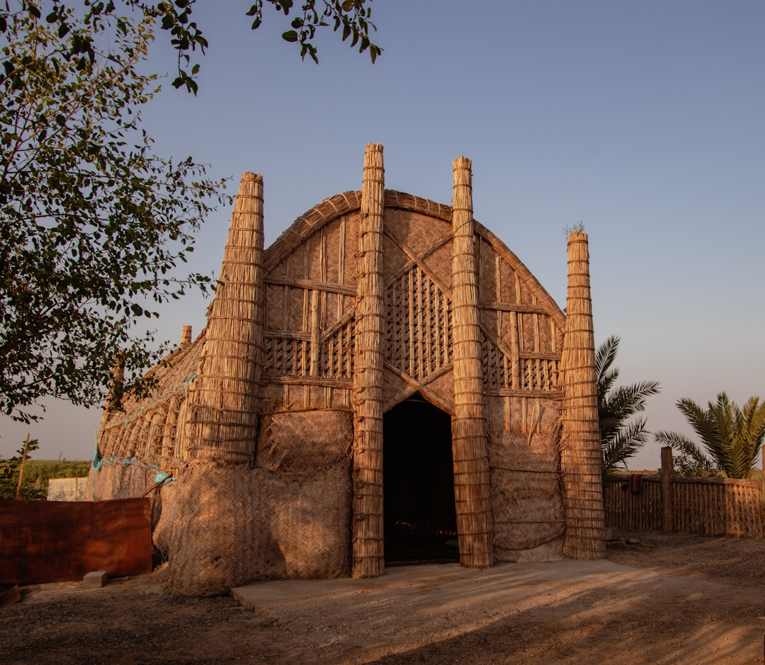
Humayun's Struggles and Sher Shah Suri's Interlude
• Humayun, Babur's son, inherited a fragile empire and faced numerous revolts.
• Sher Shah Suri, an Afghan ruler, defeated Humayun and temporarily established the Sur Empire.
• Humayun spent fifteen years in exile in Persia, gaining support and military knowledge.
• Sher Shah Suri implemented administrative reforms, including land revenue systems.
• Humayun eventually returned and regained control of the Mughal throne before his death.
• Sher Shah Suri's rule, though brief, significantly impacted future Mughal administration.
Generated by AI Slide Generator

Slide 3
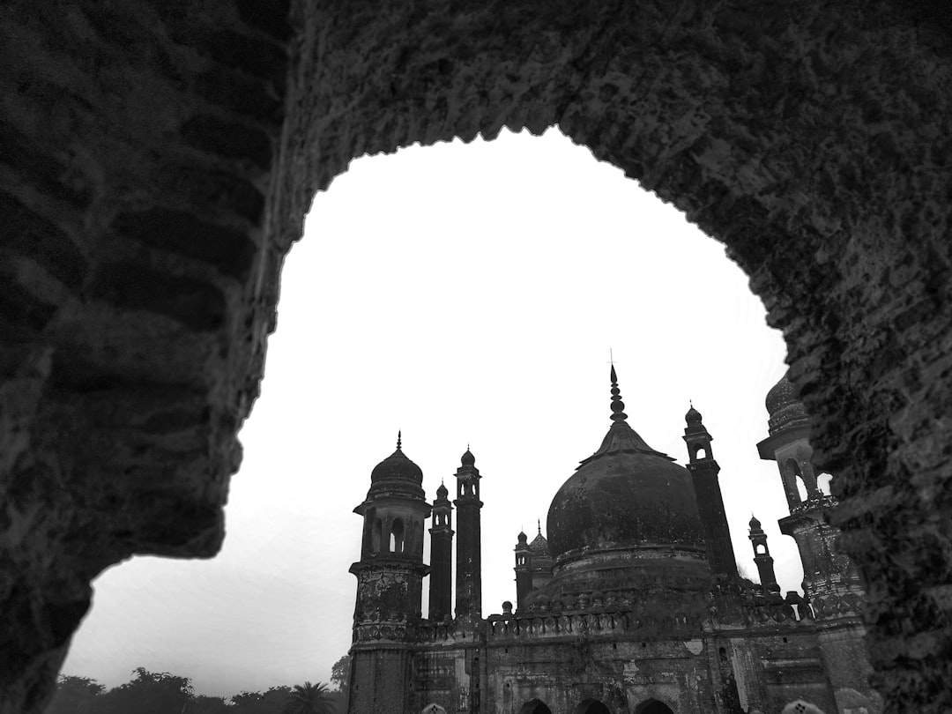
Akbar the Great: Consolidation and Innovation
• Akbar, Humayun's son, is considered one of the greatest Mughal emperors.
• He expanded the empire through military conquests and strategic alliances, including Rajput kingdoms.
• Akbar implemented a policy of religious tolerance known as *Sulh-i-Kul* (universal peace).
• He abolished the *jizya* tax on non-Muslims, promoting religious harmony.
• The *Mansabdari* system, a unique administrative and military structure, was established by Akbar.
• Fatehpur Sikri, a new capital city, was built by Akbar, showcasing Mughal architecture.
Generated by AI Slide Generator

Slide 4
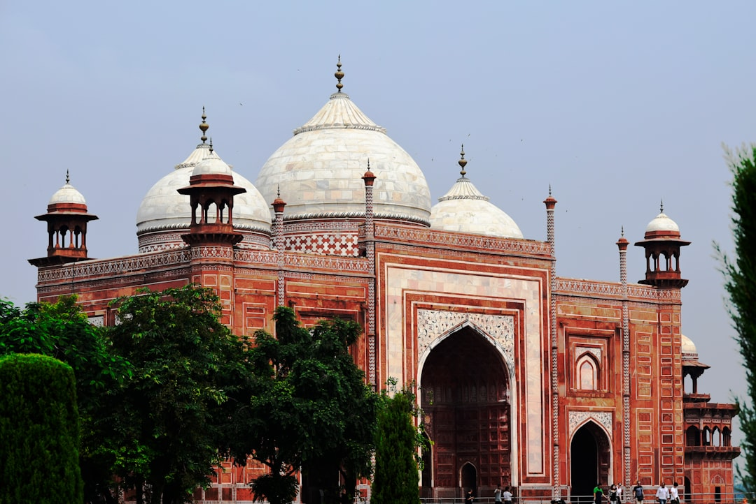
Shah Jahan: Architecture and Artistic Flourishing
• Shah Jahan's reign is known for its architectural achievements and cultural refinement.
• The Taj Mahal, a magnificent mausoleum, was built in memory of his wife, Mumtaz Mahal.
• He commissioned the construction of the Red Fort (Lal Qila) in Delhi, a symbol of Mughal power.
• Mughal painting reached its zenith during Shah Jahan's rule, with intricate miniature art.
• The Peacock Throne, an opulent symbol of Mughal royalty, was a highlight of his court.
• Shah Jahan's reign witnessed a period of peace and economic prosperity, with focus on arts and culture.
Generated by AI Slide Generator

Slide 5
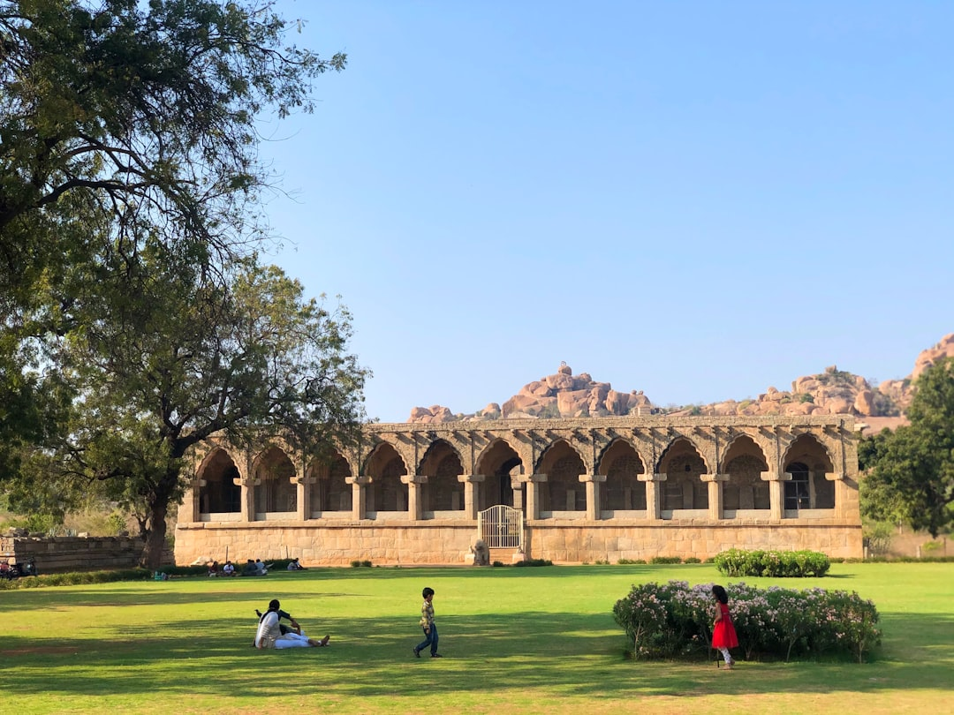
Aurangzeb: Expansion and Decline
• Aurangzeb aimed to expand the empire further, leading to prolonged conflicts.
• His religious policies, including the reimposition of the *jizya* tax, caused resentment.
• The Deccan Wars drained the empire's resources and weakened its military.
• Aurangzeb's strict adherence to Islamic law led to rebellions by various groups, including the Marathas.
• Internal conflicts and weak successors contributed to the gradual decline of the Mughal Empire.
• The empire eventually fragmented into smaller states during the 18th century, leading to the rise of British power.
Generated by AI Slide Generator

