Slide 1
What is a Noun?
• A noun is a word that names a person, place, animal, or thing.

Slide 2
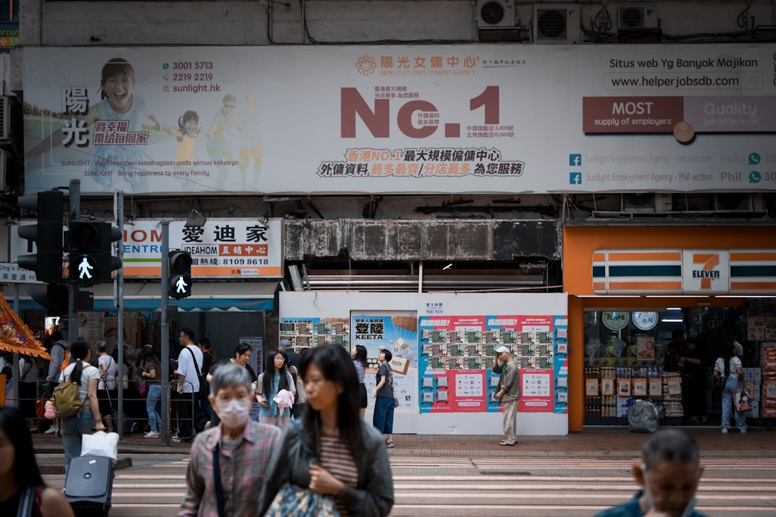
Nouns: People Around Us
• Nouns can name specific people, like your mom or dad.
• They can also name types of people, like police officer or baker.
• Examples: My mom reads me a story.
• Examples: The firefighter helps people.
• Remember, a name is a noun too!
Generated by AI Slide Generator

Slide 3
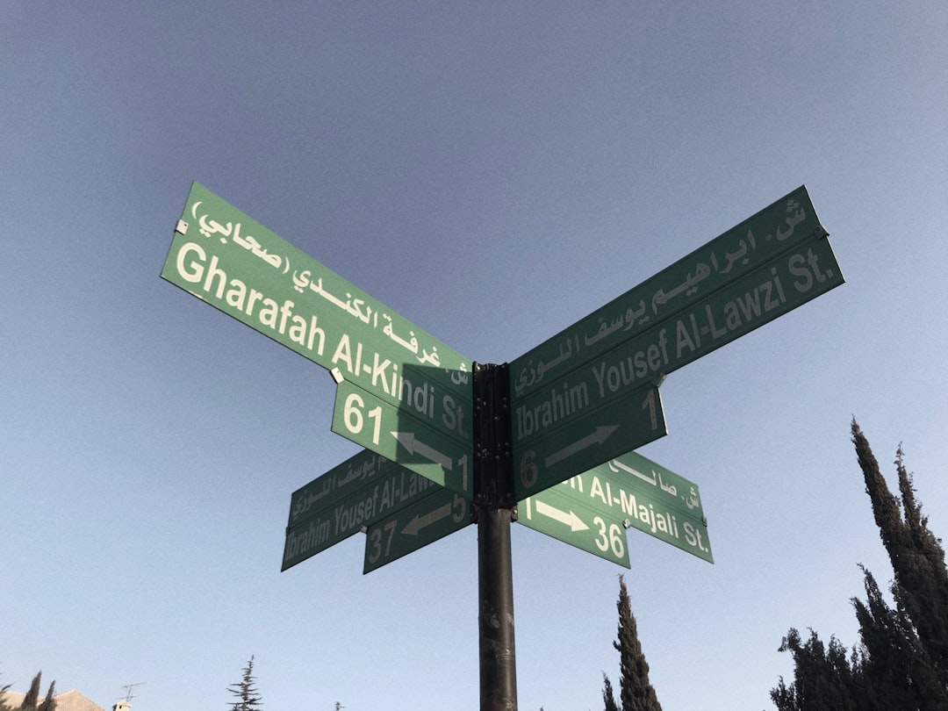
Nouns: Places We Go
• Nouns can name different places, like your house or the playground.
• They can also name places far away, like the beach or the mountains.
• Examples: We play at the playground.
• Examples: I love my house.
• Examples: Let's visit the zoo.
Generated by AI Slide Generator

Slide 4
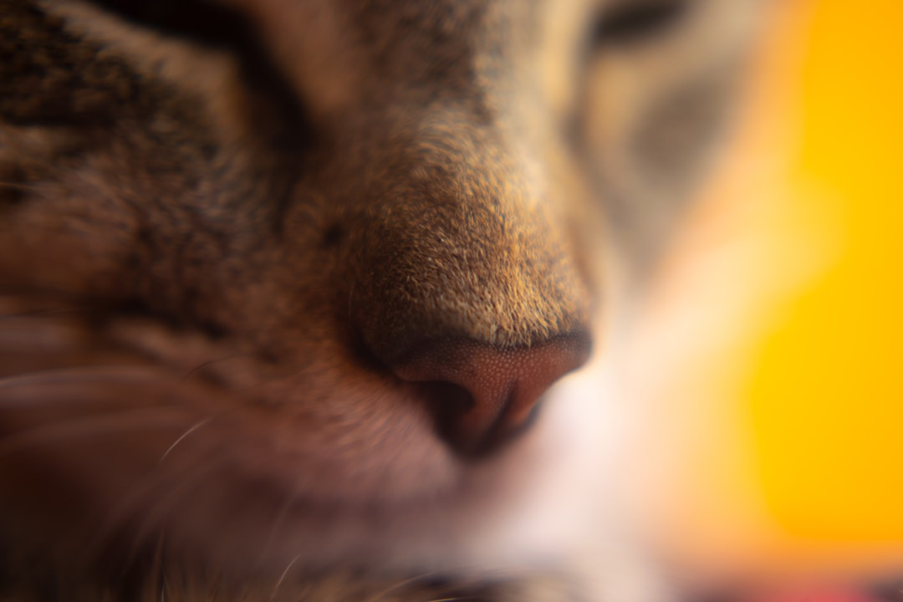
Nouns: Animals We See
• Nouns tell us the names of different animals.
• From big animals to small animals, they all have noun names.
• Examples: A dog barks.
• Examples: A bird sings.
• Examples: The cat purrs.
• Examples: A fish swims.
Generated by AI Slide Generator

Slide 5
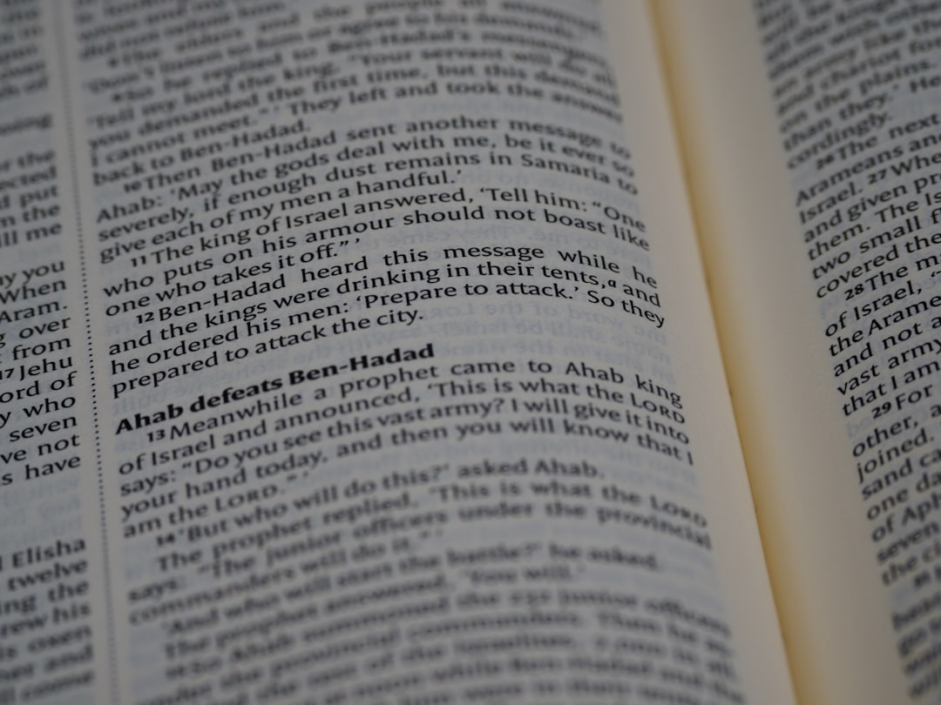
Nouns: Things We Use
• Nouns also name the things we use every day.
• Think about the things you see in your classroom or at home.
• Examples: I write with a pencil.
• Examples: I read a book.
• Examples: We sit on a chair.
• Examples: I play with my toy.
Generated by AI Slide Generator

