Slide 1
What is a Noun?
• A noun is a word that names a person, place, thing, or idea.

Slide 2
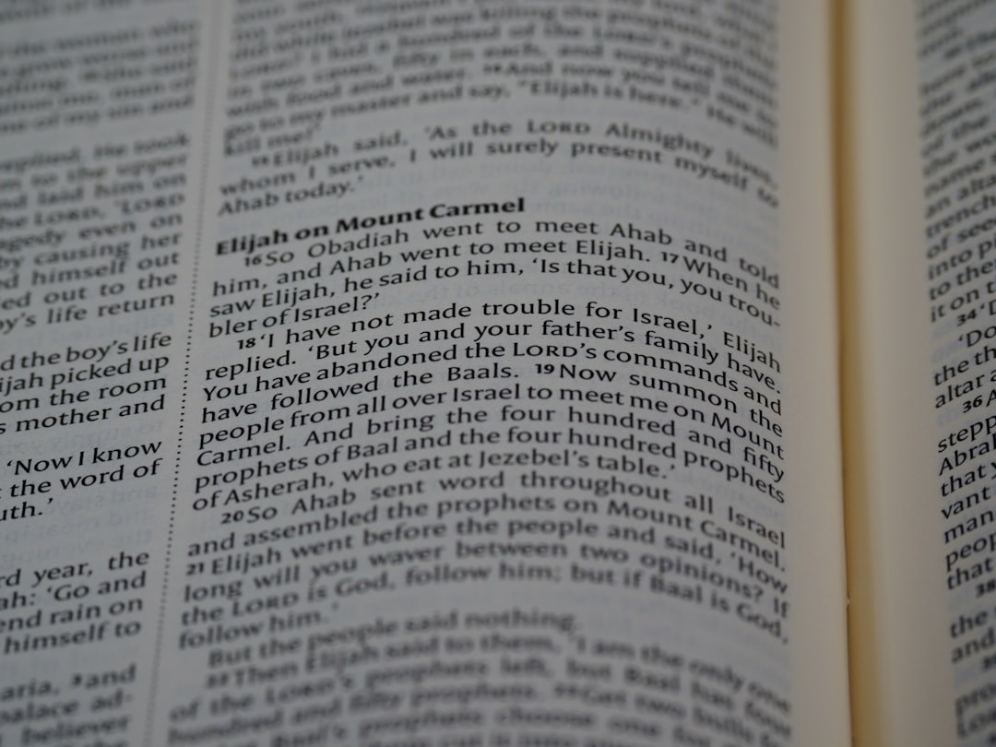
People as Nouns
• Nouns can be names of people.
• Names like *Sarah*, *David*, and *Emily* are nouns.
• Relatives like *mother*, *father*, and *brother* are nouns.
• Occupations like *doctor*, *artist*, and *firefighter* are nouns.
• The *student* raised their hand in *class*.
• Remember that names usually start with a capital letter!
Generated by AI Slide Generator

Slide 3
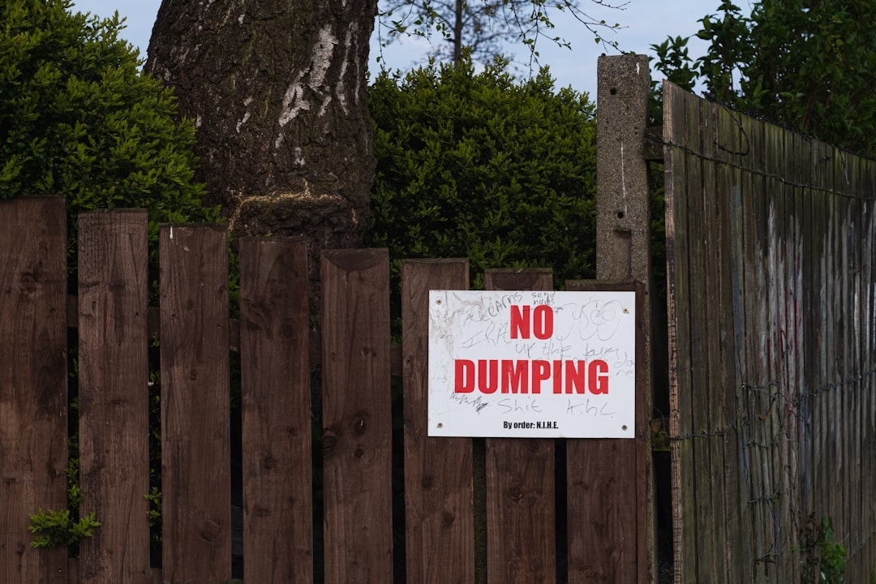
Places as Nouns
• Nouns can also name places.
• Places like *home*, *park*, and *store* are nouns.
• Cities like *New York*, *London*, and *Tokyo* are nouns.
• Countries like *Canada*, *Mexico*, and *France* are nouns.
• Let's go to the *library* after *school*.
• Proper Nouns for specific locations are always capitalized.
Generated by AI Slide Generator

Slide 4
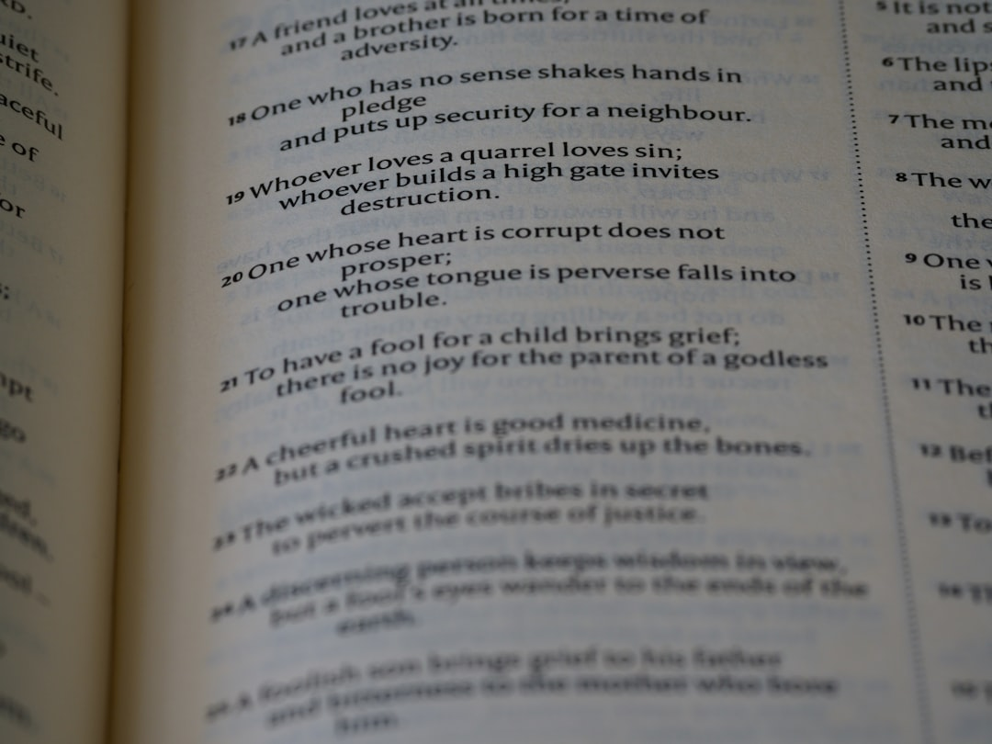
Things as Nouns
• Nouns can name things we can touch or see.
• Objects like *chair*, *table*, and *computer* are nouns.
• Animals like *dog*, *cat*, and *bird* are nouns.
• Food items like *apple*, *banana*, and *pizza* are nouns.
• The *cat* is sitting on the *mat*.
• I ate an *orange* for *lunch*.
Generated by AI Slide Generator

Slide 5
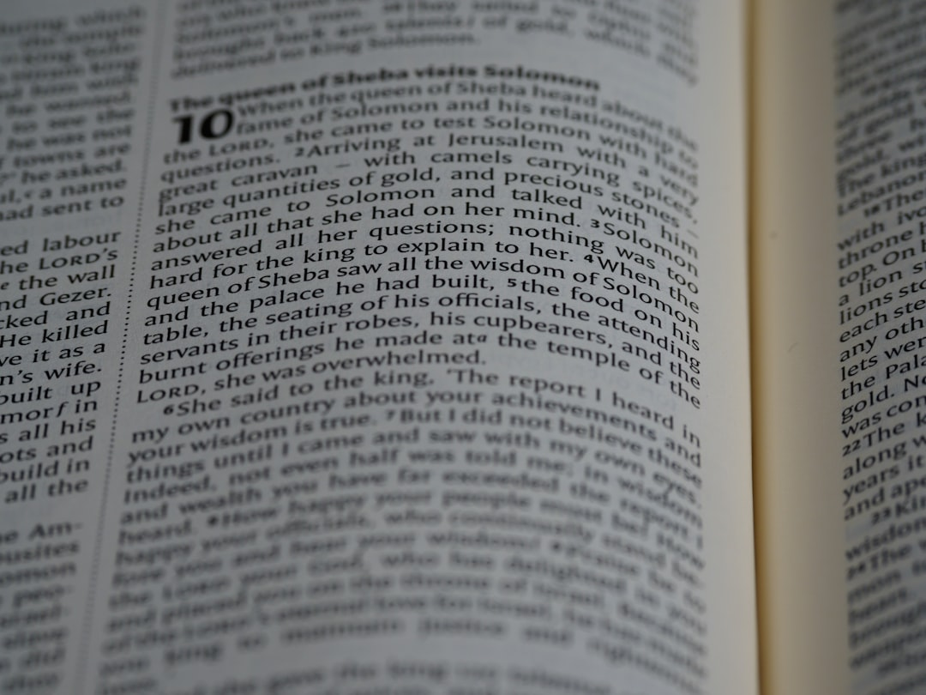
Ideas as Nouns
• Some nouns name things we can’t touch or see, but we can feel or think about.
• Emotions like *happiness*, *sadness*, and *anger* are nouns.
• Concepts like *love*, *peace*, and *friendship* are nouns.
• Qualities like *honesty*, *bravery*, and *kindness* are nouns.
• *Honesty* is the best policy.
• I value our *friendship*.
Generated by AI Slide Generator

