Slide 1
What is an Ecosystem?
• An ecosystem is a community of living things interacting with their non-living environment.

Slide 2
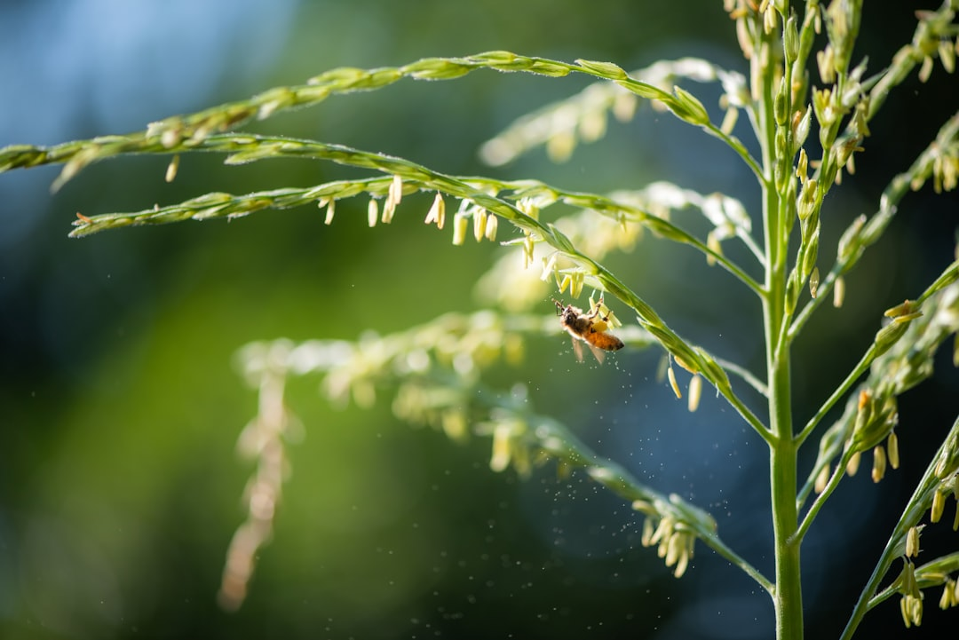
Living Things in an Ecosystem: Producers
• Producers are organisms that make their own food using sunlight.
• Plants are the main producers in most ecosystems, using photosynthesis.
• Algae in aquatic ecosystems are also important producers.
• Producers form the base of the food chain, providing energy for other organisms.
• Examples of producers include grass, trees, and seaweed.
• Without producers, the ecosystem would collapse.
Generated by AI Slide Generator

Slide 3
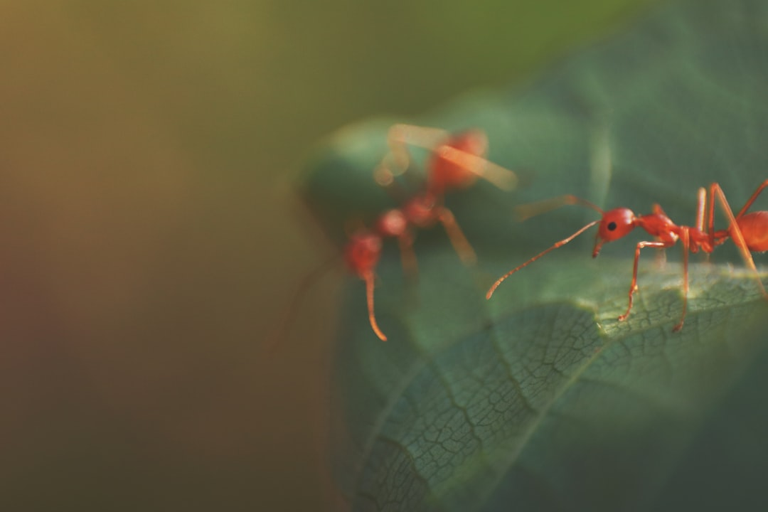
Living Things in an Ecosystem: Consumers
• Consumers are organisms that eat other organisms for energy.
• Herbivores are consumers that eat only plants, like deer and rabbits.
• Carnivores are consumers that eat only animals, like lions and snakes.
• Omnivores are consumers that eat both plants and animals, like bears and humans.
• Consumers rely on producers and other consumers for survival.
• The flow of energy from producers to consumers is called a food chain or food web.
Generated by AI Slide Generator

Slide 4
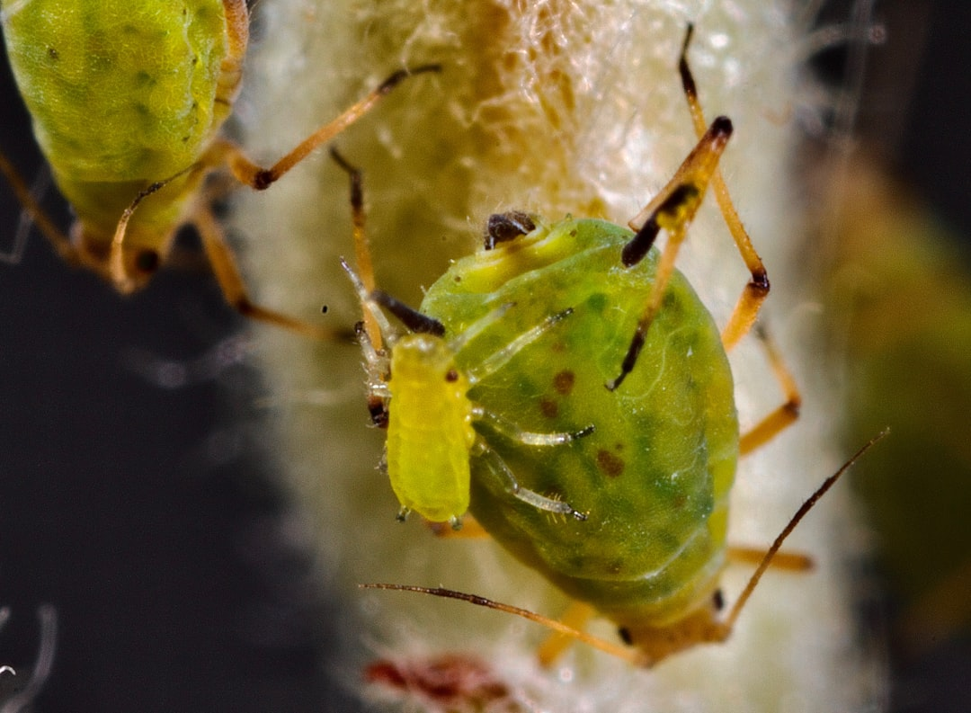
Living Things in an Ecosystem: Decomposers
• Decomposers break down dead plants and animals, returning nutrients to the soil.
• Bacteria and fungi are the main decomposers in most ecosystems.
• Decomposers recycle nutrients, making them available for producers to use.
• This process is essential for maintaining the health of the ecosystem.
• Earthworms also contribute to decomposition by breaking down organic matter.
• Without decomposers, nutrients would be locked up in dead organisms.
Generated by AI Slide Generator

Slide 5
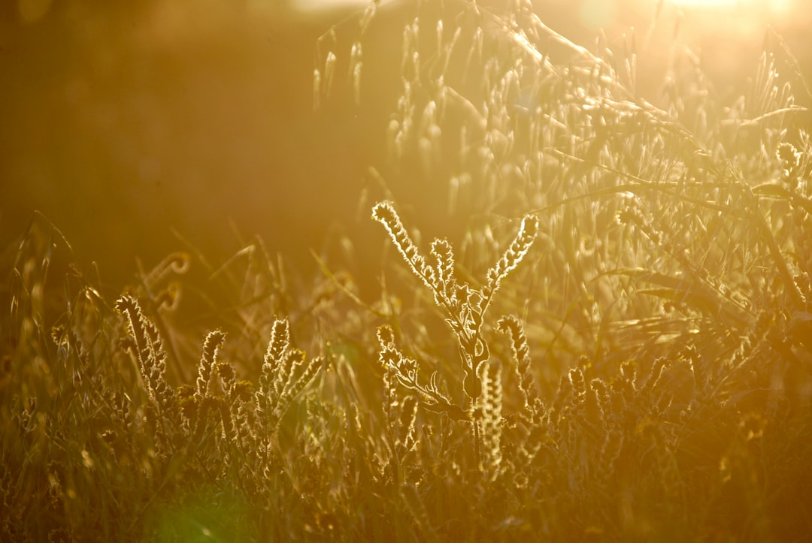
Non-Living Components: Sunlight, Water, and Soil
• Sunlight provides energy for producers to make food through photosynthesis.
• Water is essential for all living things to survive and carry out life processes.
• Soil provides nutrients and support for plants, as well as habitat for other organisms.
• The amount of sunlight, water, and soil quality can significantly affect the ecosystem.
• Different plants and animals are adapted to different amounts of these non-living factors.
• Changes in these factors can cause imbalances in the ecosystem.
Generated by AI Slide Generator

Slide 6
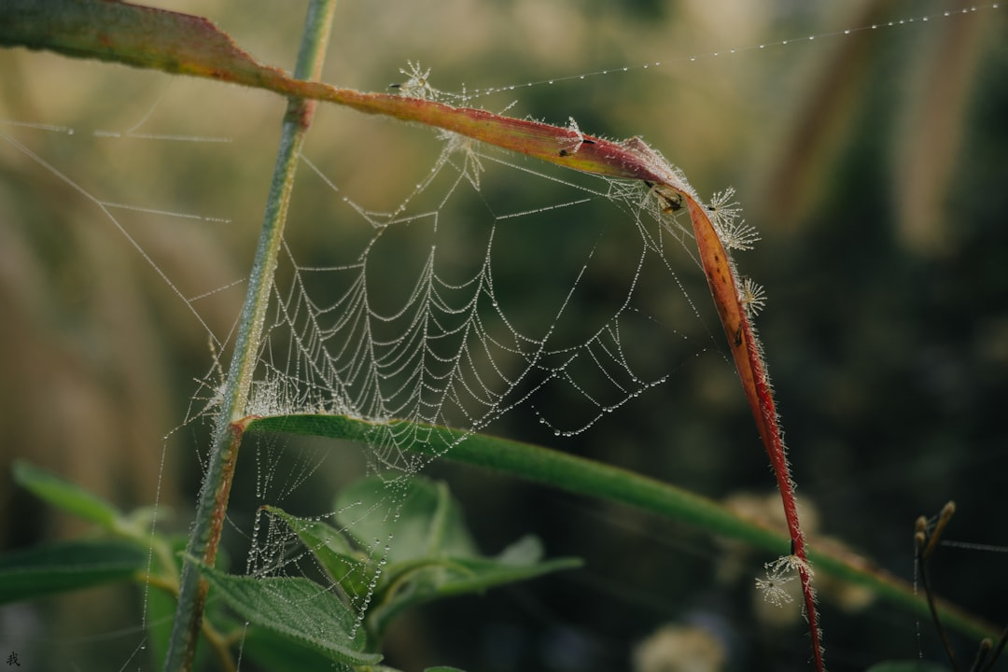
Food Chains and Food Webs
• A food chain shows a simple pathway of energy flow from one organism to another.
• A food web shows the complex network of interconnected food chains in an ecosystem.
• Arrows in a food chain or web indicate the direction of energy flow.
• Producers are always at the beginning of a food chain or web.
• Food webs show how changes in one population can affect other populations.
• Understanding food webs is important for understanding how ecosystems function.
Generated by AI Slide Generator

Slide 7
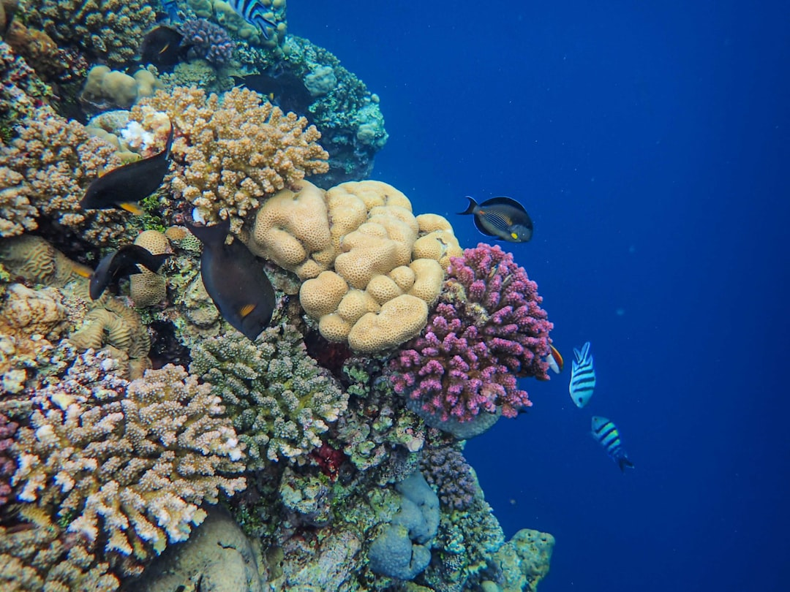
Ecosystems and Humans
• Humans are part of many ecosystems and can impact them in both positive and negative ways.
• Pollution, deforestation, and overhunting can damage ecosystems.
• Conservation efforts, such as protecting habitats and reducing pollution, can help preserve ecosystems.
• Understanding ecosystems helps us make responsible choices that benefit both humans and the environment.
• We all have a role to play in protecting the ecosystems around us.
• Healthy ecosystems provide us with clean air, clean water, and valuable resources.
Generated by AI Slide Generator

