Slide 1
What are Angles?
• An angle is formed when two lines or rays share a common endpoint.

Slide 2
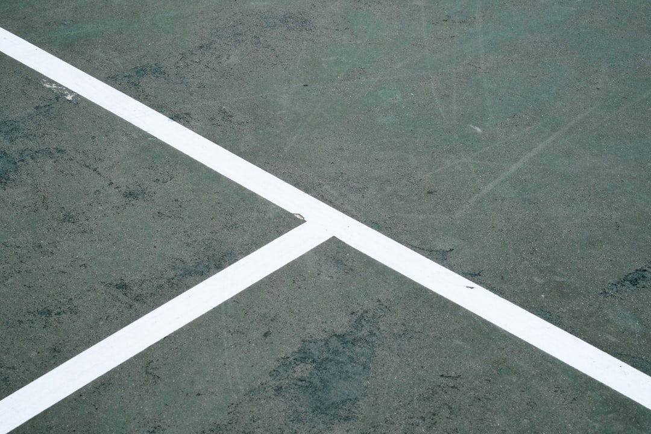
Types of Angles
• **Acute Angle:** An angle that measures less than 90°. Example: 45°
• **Right Angle:** An angle that measures exactly 90°. Example: Think of the corner of your Maths book.
• **Obtuse Angle:** An angle that measures more than 90° but less than 180°. Example: 120°
• **Straight Angle:** An angle that measures exactly 180°. Example: A straight line.
• **Reflex Angle:** An angle that measures more than 180° but less than 360°. Example: 270°
Generated by AI Slide Generator

Slide 3

Naming Angles
• Angles can be named using three points, with the vertex always in the middle. Example: ∠ABC, where B is the vertex.
• Angles can also be named using a single letter representing the vertex. Example: ∠B
• Sometimes, angles are named using a number. Example: ∠1
• The symbol "∠" is used to denote an angle.
• When naming an angle, make sure the order of the points makes sense based on how the lines are arranged.
• Consider a clock; the angle formed by the hour and minute hand can be described using three points on the clock face.
Generated by AI Slide Generator

Slide 4

Angle Relationships
• **Complementary Angles:** Two angles whose measures add up to 90°. Example: 30° + 60° = 90°
• **Supplementary Angles:** Two angles whose measures add up to 180°. Example: 80° + 100° = 180°
• **Adjacent Angles:** Angles that share a common vertex and a common side, but do not overlap.
• **Vertical Angles:** Angles formed by two intersecting lines that are opposite each other. Vertical angles are always equal.
• Think of a window frame; you can identify adjacent and supplementary angles within the frame.
• Knowing angle relationships helps solve for unknown angle measures.
Generated by AI Slide Generator

Slide 5

Angles in Real Life
• Angles are everywhere around us!
• The hands of a clock form different angles throughout the day.
• Buildings and bridges use angles for stability and design.
• Road intersections are designed using specific angles to ensure safety.
• The branches of a tree grow at angles from the trunk.
• Sports like cricket and football involve calculating angles for accurate throws and kicks.
Generated by AI Slide Generator

