Slide 1

WELCOME
TO
THE PRESENTATION
JESSORE UNIVERSITY OF SCIENCE AND TECHNOLOGY

Slide 2
A Study and Design of an Improved Belt Conveyor
Md. Delwar Hossain Chowdhury
ID:100724
Sk. Md. Zubayer-Al-Mahmud
ID:100729
Under the supervision of
Samrat Kumar Dey.
Assistant Professor, Dept. of IPE

Slide 3
Objectives
To increase efficiency of belt conveyor
To study reduce slippage of the material
To study reduce power consumption
To Study of Failure Analysis

Slide 4
Literature Review
Some of the recent development of belt conveyor had been carried out as:
1. Analysis & Prospects of Modification in Belt Conveyors - A Review by Devendra Kumar, R.K. Mandloi (January -February 2013)
(The paper presents the review of belt conveyor design modification and latest technologies or methodologies used in different applications to reduce failures, maintenance cost and equipment related fatal accidents occurs during operation.)
2. Design Optimization For Modification Of Trough Belt Conveyor To Reduce Material Spillage Used In Clinker Transport In Cement Plant by Shalom Akhai , Harpreet Singh (November 2013)
(The work presented in this paper focuses on the reduction of material spillage from a belt conveyor leading to excessive dust emission, frequent maintenance and repair of conveyor, Loss of power and reduction in material transport efficiency)

Slide 5
Literature Review
3. Development of a Conveyor Belt Idler Roller for Light Weight and Low Noise by Marcus Haines (June, 2007)
(Existing literature was used to determine the major sources of noise and vibration. Careful material selection was conducted to determine the most suitable material to use in an idler roller, with the aims of minimizing weight and the noise emitted.)
4. Selection of Belt Conveyors Drive Units Number by Technical – Economical Analysis by Zoran Despodov, Stojance Mijalkovski, Vanco Adziski and Zoran Panov(June-September, 2014)
(This paper presents a methodology for selection of belt conveyor drive units number by technical - economical analysis are including: Tension forces, Power of belt conveyor, Costs for belt, Costs for power and reducers, Total cost for belt conveyor system.)

Slide 6
Methodology
To design a belt conveyor needs to consider following parameters are :
Belt capacity and Dimension
Belt speed
Belt power and tension
Roller diameter
Pulley diameter
Power of motor

Slide 7
CALCULATION

Slide 8
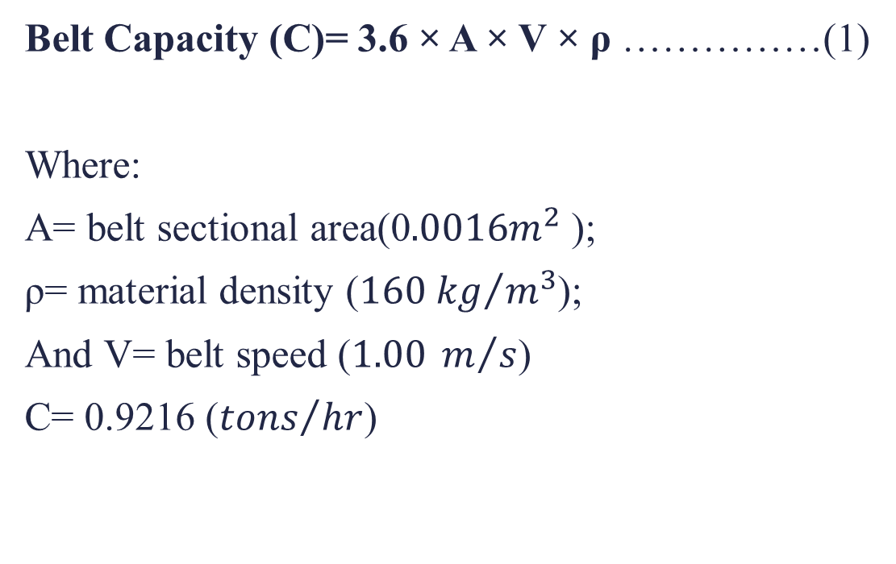
Belt Capacity
Belt Capacity (C)= 3.6 × A × V × ρ ……………(1)
Where:
A= belt sectional area(0$.0016m^{2}$ );
ρ= material density (${160 kg}/{m^{3}}$);
And V= belt speed ($1.00 m/s$)
C= 0.9216 (${tons}/{hr}$)

Slide 9
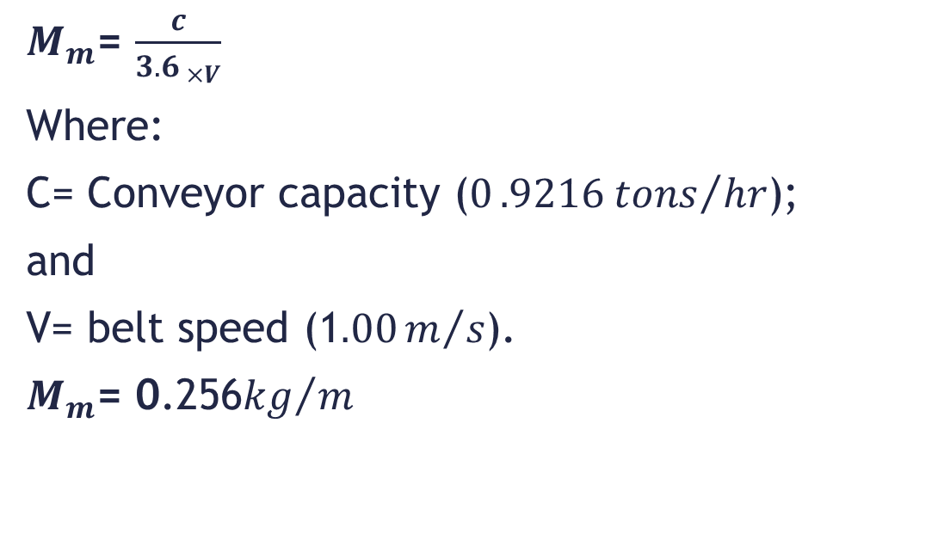
Mass of material live load per meter
$M_{m}$= $\frac{c}{{3.6}_{ ×V}}$
Where:
C= Conveyor capacity ($0{.9216 tons}/{hr}$);
and
V= belt speed (1$.00m/s$).
$M_{m}$= 0.256${kg}/m$

Slide 10
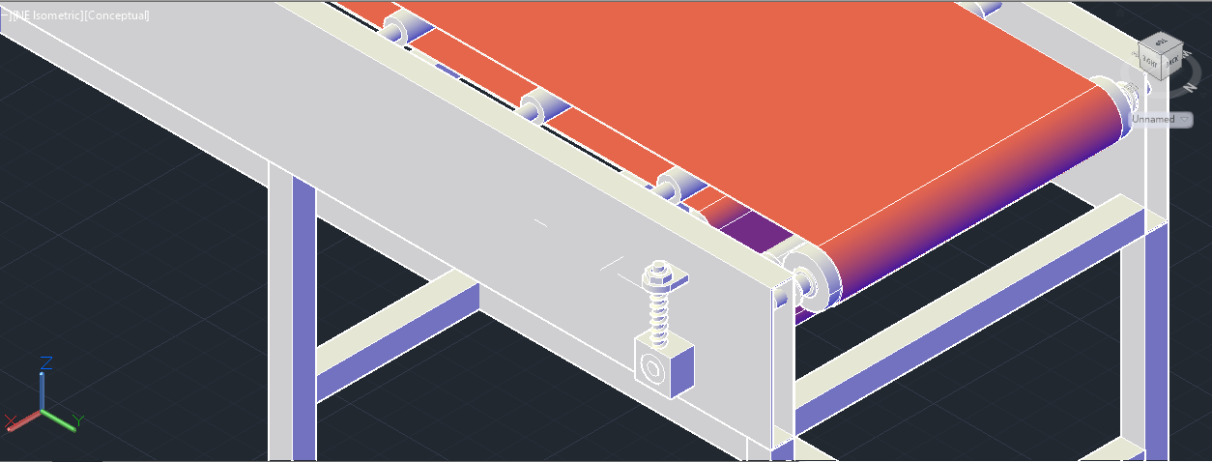
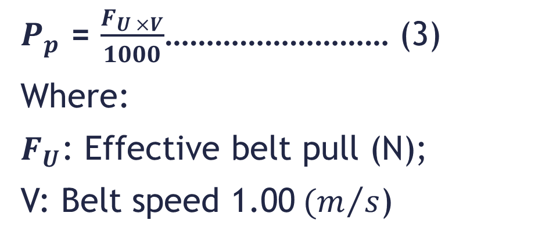
Belt Power and Tensions
$P_{p}$ = $\frac{F_{U ×V}}{1000}$……………………… (3)
Where:
$F_{U}$: Effective belt pull (N);
V: Belt speed 1.00$(m/s$)

Slide 11
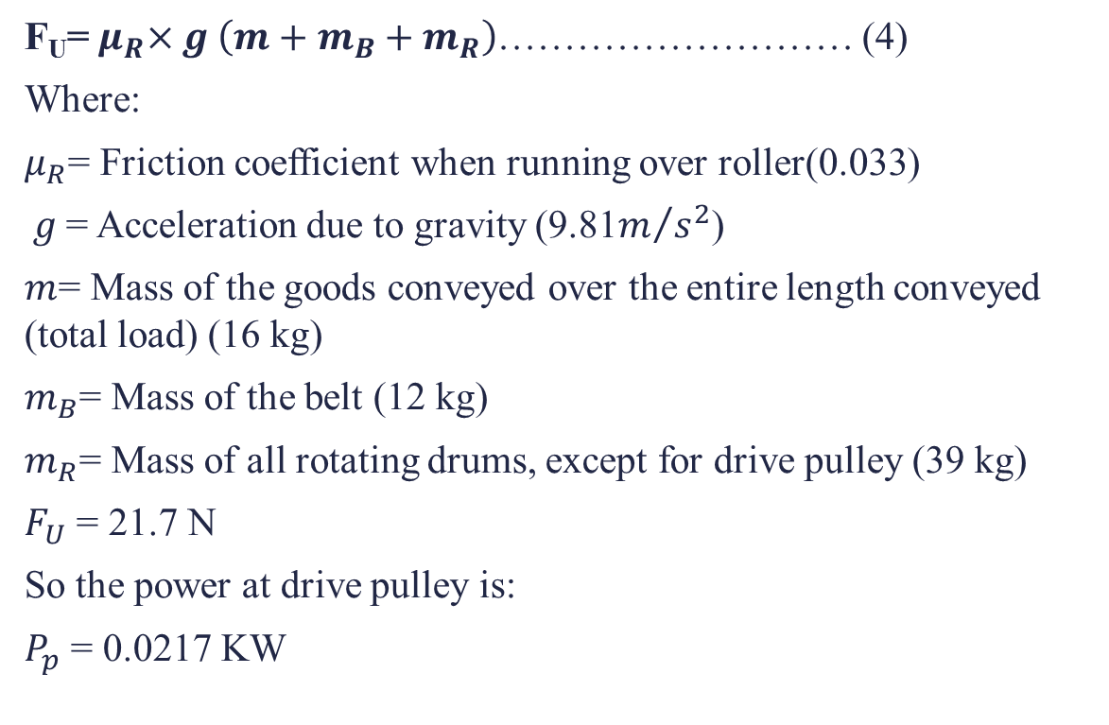
Belt Power and Tensions(cont..)
F_{U}=${ μ}_{R}×g \left(m+m_{B}+m_{R}\right)$……………………… (4)
Where:
$μ_{R}$= Friction coefficient when running over roller(0.033)
$g$= Acceleration due to gravity (9.81$m/{s^{2}}$)
$m$= Mass of the goods conveyed over the entire length conveyed (total load) (16 kg)
$m_{B}$= Mass of the belt (12 kg)
$m_{R}$= Mass of all rotating drums, except for drive pulley (39 kg)
$F_{U}$ = 21.7 N
So the power at drive pulley is:
$P_{p}$ = 0.0217 KW

Slide 12
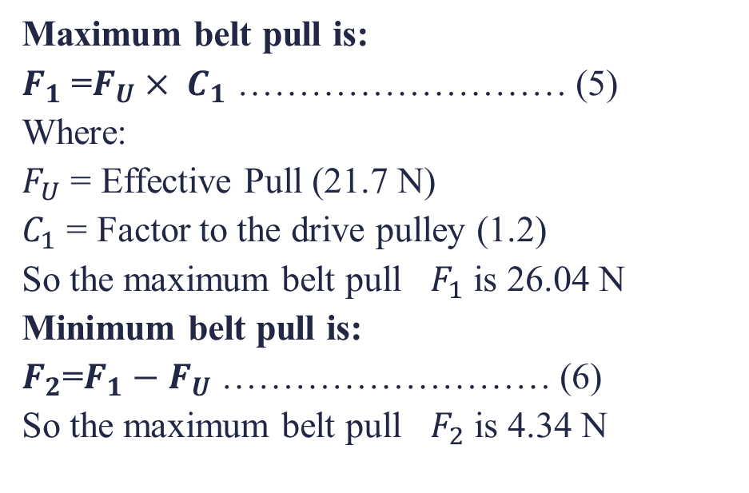
Belt Power and Tensions(cont..)
Maximum belt pull is:
$F_{1}$ =$F_{U}× C_{1}$ ……………………… (5)
Where:
$F_{U}$ = Effective Pull (21.7 N)
$C_{1}$ = Factor to the drive pulley (1.2)
So the maximum belt pull $F_{1}$ is 26.04 N
Minimum belt pull is:
$F_{2}$=$F_{1}−F_{U}$ ……………………… (6)
So the maximum belt pull $F_{2}$ is 4.34 N

Slide 13
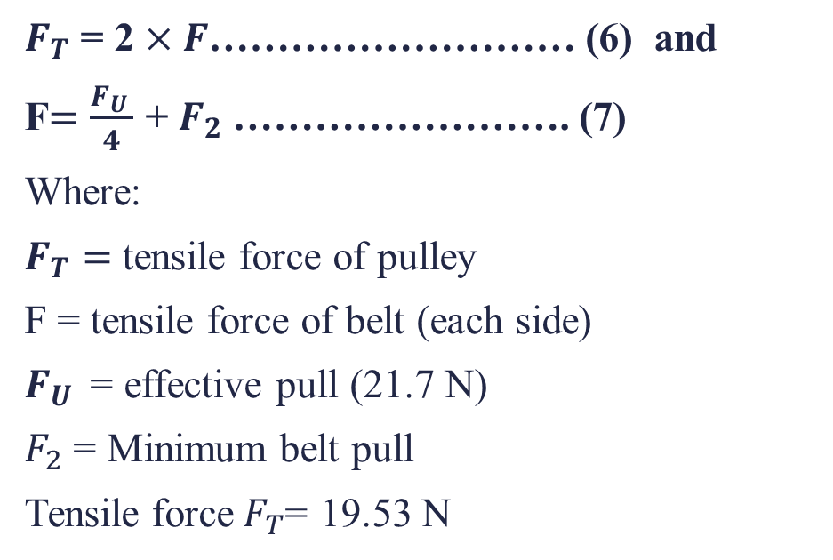
Tensile force of belt conveyor at rest
$F_{T}$ = 2 $×F$……………………… (6) and
F$=\frac{F_{U }}{4}$ + $F_{2}$……………………. (7)
Where:
$F_{T}=$ tensile force of pulley
F = tensile force of belt (each side)
$F_{U }$ = effective pull (21.7 N)
$F_{2}$ = Minimum belt pull
Tensile force$F_{T}$= 19.53 N

Slide 14
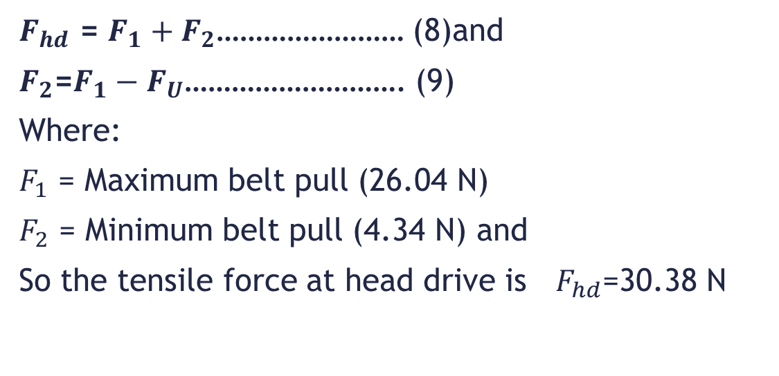
Tensile force at head drive at steady state
$F_{hd}$ = $F_{1}+F_{2}$…………………… (8)and
$F_{2}$=$F_{1}−F_{U}$………………………. (9)
Where:
$F_{1}$ = Maximum belt pull (26.04 N)
$F_{2}$ = Minimum belt pull (4.34 N) and
So the tensile force at head drive is $F_{hd}$=30.38 N

Slide 15
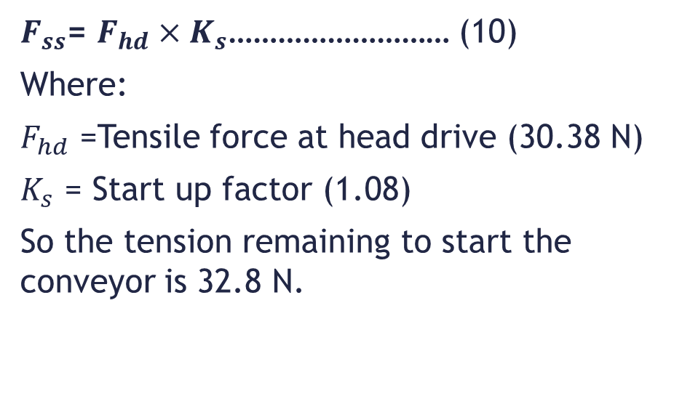
Tension of drive pulley at starting state
$F_{ss}$= $F_{hd}×K_{s}$……………………… (10)
Where:
$F_{hd}$ =Tensile force at head drive (30.38 N)
$K_{s}$ = Start up factor (1.08)
So the tension remaining to start the conveyor is 32.8 N.

Slide 16
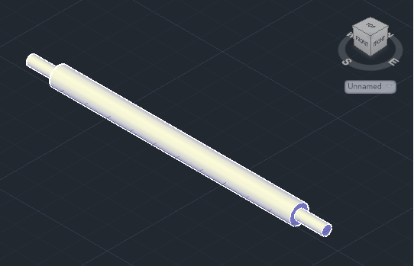
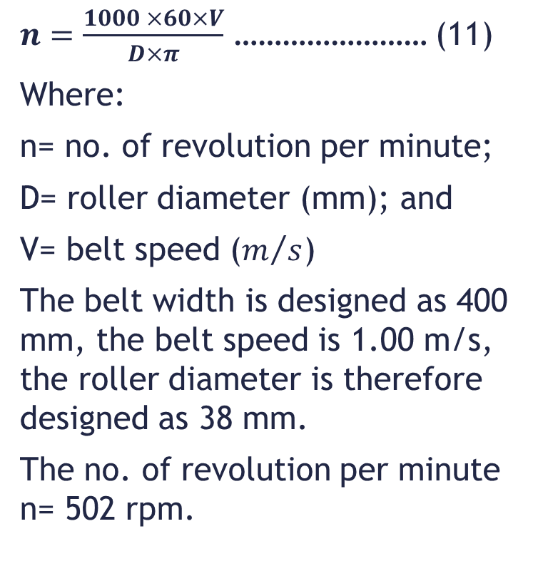
Roller diameter
$n=\frac{1000 ×60×V}{D×π}$ …………………… (11)
Where:
n= no. of revolution per minute;
D= roller diameter (mm); and
V= belt speed ($m/s$)
The belt width is designed as 400 mm, the belt speed is 1.00 m/s, the roller diameter is therefore designed as 38 mm.
The no. of revolution per minute n= 502 rpm.

Slide 17
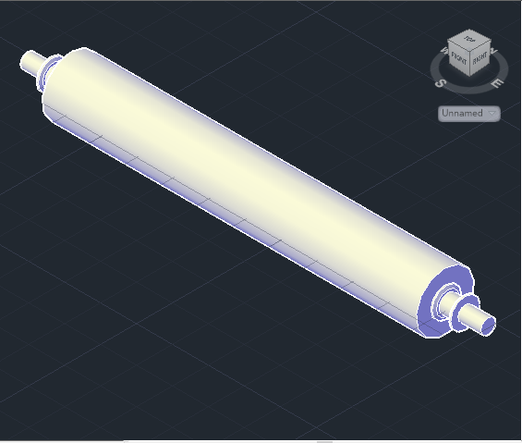
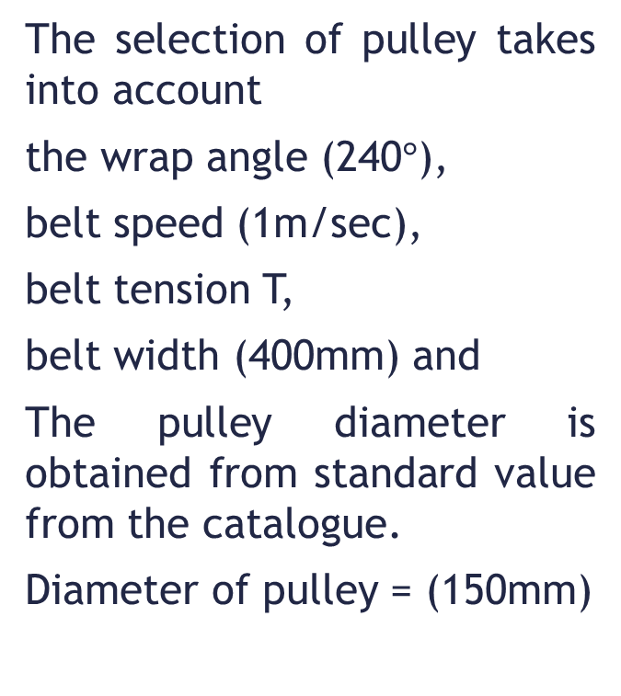
Pulley Diameter
The selection of pulley takes into account
the wrap angle (240$°$),
belt speed (1m/sec),
belt tension T,
belt width (400mm) and
The pulley diameter is obtained from standard value from the catalogue.
Diameter of pulley = (150mm)

Slide 18
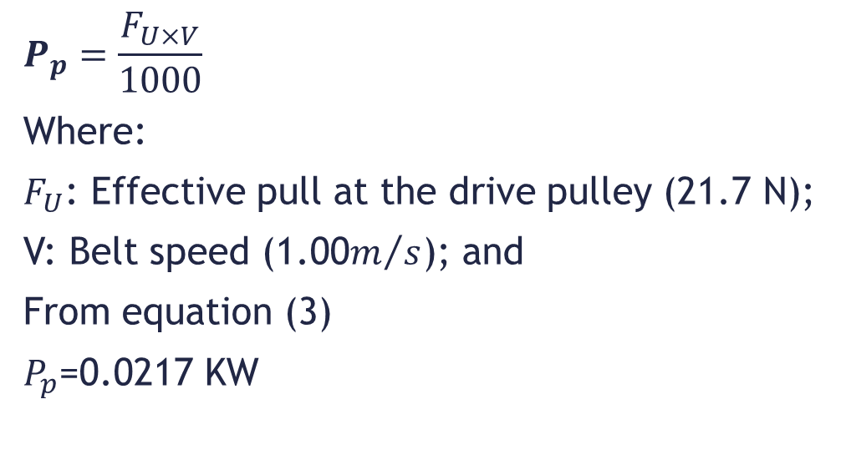
The power at drive pulley
$$P_{p}=\frac{F_{U×V}}{1000}$$
Where:
$F_{U}$: Effective pull at the drive pulley (21.7 N);
V: Belt speed (1.00$m/s$); and
From equation (3)
$P_{p}$=0.0217 KW

Slide 19
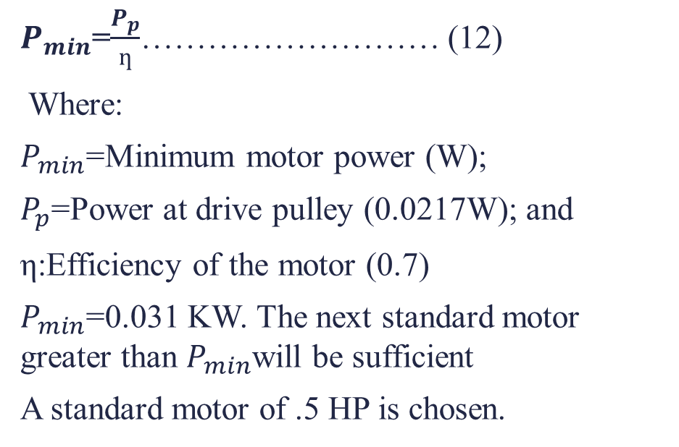
Motor Power
$P_{min}$=$\frac{P_{p}}{ƞ}$……………………… (12)
Where:
$P_{min}$=Minimum motor power (W);
$P_{p}$=Power at drive pulley (0.0217W); and
η:Efficiency of the motor (0.7)
$P_{min}$=0.031 KW. The next standard motor greater than $P_{min}$will be sufficient
A standard motor of .5 HP is chosen.

Slide 20
Results
No | Parameters | Values
1. | Conveyor capacity (tons/hr) | 0.9216
2. | Load due to materials conveyed (kg/m) | 0.256
3. | Tensile force of pulley at rest (N) | 19.53
4. | Tensile force of drive pulley at steady state (N) | 30.38
5. | Tension of drive pulley while starting (N) | 32.8
6. | Power at drive pulley (KW) | 0.0217
7. | Motor power (KW) | 0.031
8. | Roller diameter (mm) | 38
9. | Pulley diameter (mm) | 150
10. | Number of RPM (rev/min) | 502

Slide 21
Design of Parts

Slide 22
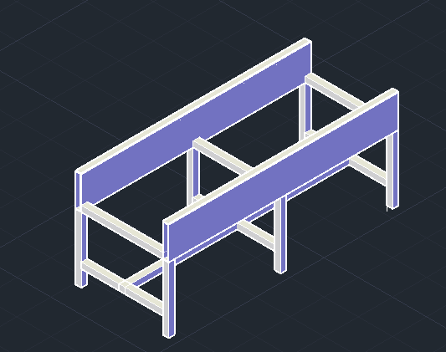
Support table

Slide 23
Pulley and Roller

Slide 24
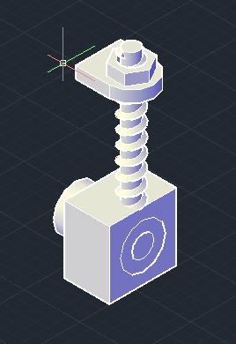
Take-up device

Slide 25
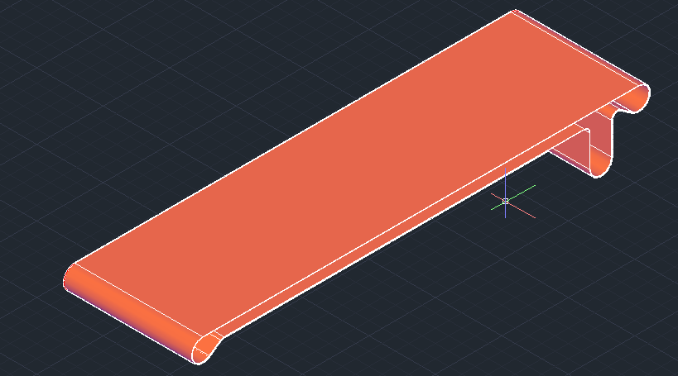
Belt

Slide 26
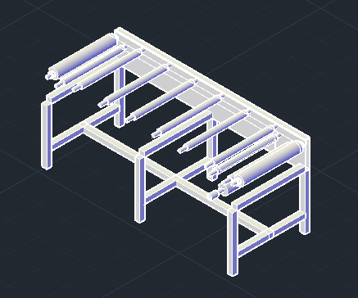
Assembly of belt conveyor

Slide 27
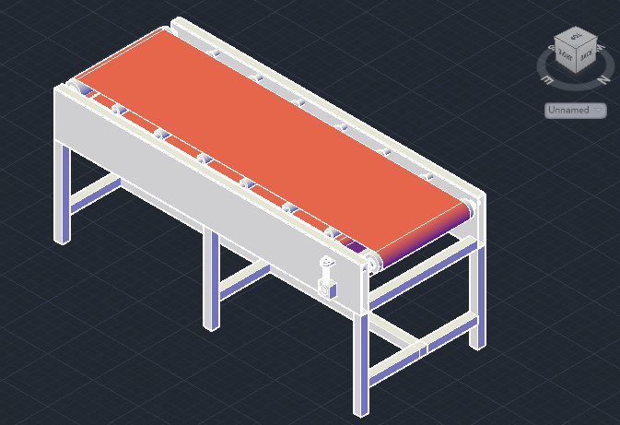
Design of belt conveyor

Slide 28
Maintenance and Safety
Adjustment During Operation
Lubrication
Guards And Safety Devices
Inspections
Cleaning
Safety Warning

Slide 29
Discussion and Recommendation
The results of the calculation of the belt conveyor are needed to be further justified and requires testing for final execution. Basically, it was a project under the development of laboratory apparatus on our workshop. But due to monetary constraints we could not build the conveyor that we have designed.

Slide 30
THANK YOU

