Slide 1
TCN-HMAC: A Lightweight Deep Learning and Cryptographic
Hybrid Security Framework for SDN
Md. Mahamudul Hasan Zubayer
ID: 2022000000006
Supervisor:
Dr. Md. Maruf Hassan
Associate Professor
Department of Computer Science & Engineering
Southeast University

Slide 2
Problem Statement
Software-Defined Networking (SDN) decouples the control plane from the data plane, centralizing all network intelligence into a single controller. While this enables programmability and agility, it introduces critical security vulnerabilities:
Single Point of Failure: The centralized controller becomes a high-value target if compromised, an attacker gains full control over the entire network: routing, forwarding, and policy enforcement.
Control Channel Vulnerability: The OpenFlow channel between controller and switches is susceptible to man-in-the-middle attacks, eavesdropping, and message injection. Even with TLS, semantic integrity of individual flow rules is not guaranteed.
Flow Rule Tampering: Malicious or compromised entities can inject, modify, or delete flow rules at the switch level. Without per-rule integrity verification, unauthorized flow table modifications go undetected.
Multi-Vector Attacks on SDN: Modern attackers combine data-plane threats (DDoS, probing, brute-force) with control-plane exploits (controller spoofing, rule injection). Existing solutions typically address only one attack surface.
Real-Time Constraints: SDN demands millisecond-scale responses. Heavyweight security mechanisms (blockchain, PKI) introduce seconds-level latency, making them impractical for production deployments.
These problems demand a unified, lightweight security solution that can simultaneously detect data-plane intrusions and verify control-plane integrity in real time which is the objective of this research.

Slide 3
Literature Review (1/2)
Reference | Approach | Year | Addressed Problem / Limitation
Pradeep et al. [2023] | EnsureS — batch hash flow rule verification | 2023 | Flow rule integrity only; no detection
Ahmed et al. [2023] | Modular HMAC for flow_mod verification | 2023 | Integrity only; no anomaly detection
Buruaga et al. [2025] | Quantum-safe TLS for SDN | 2025 | High overhead; not lightweight
Zhou et al. [2022] | SecureMatch — encrypted rule matching | 2022 | Requires switch hardware changes
Song et al. [2023] | Blockchain (IS2N) for intent-driven SDN | 2023 | Consensus latency (seconds per tx)
Rahman et al. [2022] | Blockchain survey for SDN security | 2022 | Storage/scalability overhead
Poorazad et al. [2023] | Blockchain + DL for IoT-SDN | 2023 | Very high computational overhead
Sharma & Tyagi [2023] | Lightweight ML-IDS for MITM/DoS | 2023 | No flow rule verification; 98.12% acc
Ayad et al. [2025] | ML classifiers (RF, XGBoost) for SDN-IDS | 2025 | No temporal modeling; no verification
Said et al. [2023] | CNN-BiLSTM on InSDN | 2023 | Bidirectional — not real-time; no verification
Shihab et al. [2025] | CNN-LSTM + SMOTE | 2025 | Hybrid overhead; synthetic data artifacts

Slide 4
Literature Review (2/2)
Reference | Approach | Year | Addressed Problem / Limitation
Ataa et al. [2024] | DNN Ensemble on InSDN | 2024 | Detection only; no deployment analysis
Basfar [2025] | Incremental LSTM Ensemble | 2025 | Sequential processing; high overhead
Kanimozhi et al. [2025] | DRL (DDQN) on InSDN | 2025 | Training instability; 98.85% acc
Wang et al. [2025] | TCN on InSDN (packet-length input) | 2025 | 97.00% acc; 2.1ms inference; no verification
Lopes et al. [2023] | TCN on CIC-IDS-2017 | 2023 | Not SDN-specific; no integrity mechanism
Li & Li [2025] | TCN-SE (squeeze-and-excitation) | 2025 | No SDN dataset; no verification
Deng et al. [2024] | BiTCN-MHSA | 2024 | Bidirectional — offline only; complex
Khan et al. [2021] | MITM-Defender for SDN | 2021 | Narrow focus — MITM only
Malik & Habib [2021] | Lightweight DoS agents at switches | 2021 | DoS-only; no general IDS
Liang et al. [2021] | Review of SDN-IDS vs. rule injection | 2021 | Identifies gap: detection ≠ verification
Elsayed et al. [2020] | InSDN dataset + DT/RF baselines | 2020 | 98.50% acc; foundational benchmark

Slide 5
Research Gaps
Gap 1: Detection without Verification
DL-based IDS focuses on anomaly detection without integrity verification. Control plane remains vulnerable to flow rule tampering that bypasses the detection layer.
Gap 2: Verification without Detection
Cryptographic schemes (HMAC, TLS) verify integrity but lack proactive threat detection. Cannot spot DDoS, probes, or brute-force attacks.
Gap 3: Heavyweight Hybrid Solutions
Existing hybrids (DL + Blockchain) introduce prohibitive latency and computational overhead.
Gap 4: No Comprehensive Lightweight Hybrid Framework
No existing work combines temporal DL-based IDS + HMAC flow rule verification + challenge-response controller authentication in a unified, lightweight, deployable solution.

Slide 6
Research Objectives
RO1: To design a TCN-based IDS model for binary classification of SDN traffic which achieves satisfactory result metrics (above 90% accuracy in detection).
RO2: Train and deploy a compact TCN model suitable for resource-constrained SDN controllers. [Gap 4]
RO3: Design a lightweight HMAC-based auxiliary agent for flow rule integrity verification and periodic challenge-response controller authentication. [Gaps 2, 4]
RO4: Integrate TCN-IDS and HMAC agent into a cohesive framework operating within the SDN control loop. [→ Gap 4]
RO5: Evaluate framework in simulated SDN environment (Ryu + Mininet + OVS) and measure detection performance + computational overhead. [ Gaps 3, 4]
RO6: Conduct comprehensive comparative analysis against existing researches spanning ML, DL, TCN variants, and cryptographic frameworks. [Gaps 1, 4]

Slide 7
Research Contribution
1. First framework to combine TCN based intrusion detection with HMAC based flow rule integrity verification and challenge-response controller authentication in a unified SDN security solution.
2. Bridges the detection-verification divide. TCN handles external threats (DDoS, probes, brute-force) and HMAC agent handles internal threats (flow rule tampering, controller spoofing, replay attacks).

Slide 8
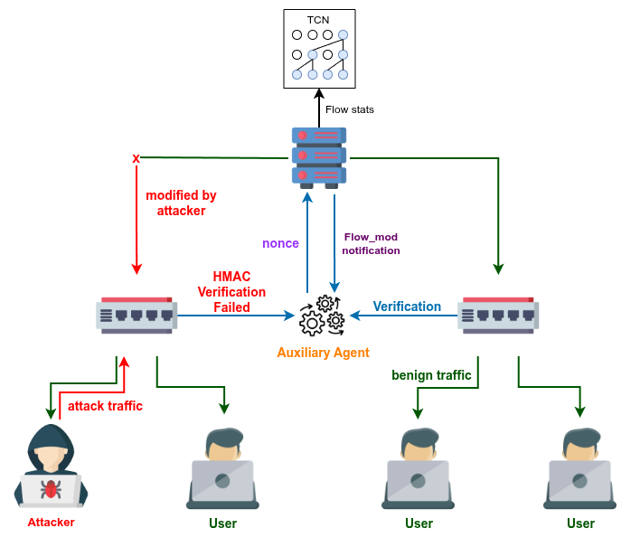
System Architecture
TCN-IDS (Detection Boundary)
• 6 dilated residual blocks
• 64 filters, kernel size 3
• GlobalAvgPool → Dense → Sigmoid
• 156,737 params | 612 KB
• Inference: 0.17 ms
HMAC Agent (Integrity Boundary)
• HMAC-SHA256 per flow_mod msg
• Shadow table verification
• Challenge-response auth
• ~2 μs/msg | +0.7 ms latency
• +4.4% CPU | +13.7 MB RAM

Slide 9
Dataset: InSDN
InSDN (Elsayed et al., 2020) — purpose-built for SDN intrusion detection research
Overview:
343,889 raw samples from SDN testbed (Mininet + Ryu + OVS)
84 flow-level features (CICFlowMeter) covering packet counts, byte volumes, IAT statistics, flag distributions, flow duration
4 attack categories: DDoS, MITM, Probe, Brute-force + Normal traffic
Why InSDN?
SDN-specific: Generated in a real SDN testbed — reflects actual SDN traffic patterns, unlike generic datasets (NSL-KDD, CIC-IDS-2017)
Comprehensive attack coverage: Covers the four most prevalent SDN threat classes
Widely adopted SDN IDS benchmark — enables direct comparison with prior work (Said et al., Ataa et al., Kanimozhi et al., Wang et al.)
Well-documented feature schema with flow-level statistics suitable for temporal modeling
Class Distribution (after preprocessing):
Normal: 68,424 (37.4%) | Attack: 114,407 (62.6%) — addressed via inverse-frequency class weighting

Slide 10
Experimental Setup
Preprocessing Pipeline (15 stages):
Data cleaning → duplicate removal (343,889 → 182,831) → Pearson correlation thresholding (|r| > 0.95) → 84 → 48 features
StandardScaler normalization → Label encoding → PCA dimensionality reduction (48 → 24, retaining 95.43% variance)
Inverse-frequency class weighting: Normal = 1.4258, Attack = 0.7700
Data Split: 70% train (127,981) / 10% validation (18,283) / 20% test (36,567)
Training Configuration:
Framework: TensorFlow 2.19.0 / Keras
Hardware: Google Colab — NVIDIA Tesla T4 GPU (16 GB), 12.7 GB RAM
Optimizer: Adam (lr = 0.001, β₁ = 0.9, β₂ = 0.999)
Loss: Binary Cross-Entropy with class weights
Batch size: 2,048 | Epochs: 30 (EarlyStopping patience = 10)
Training time: ~5 minutes total (~10 sec/epoch)
SDN Simulation: Mininet + Ryu controller + Open vSwitch (OVS)

Slide 11
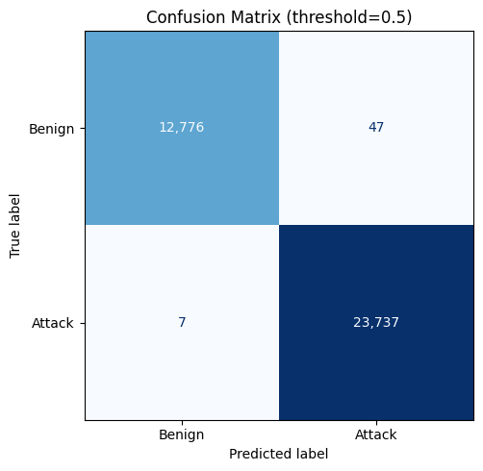
Results: TCN-IDS Performance
Metric | Value
Accuracy | 99.85%
Precision | 99.80%
Recall (Detection Rate) | 99.97%
F1-Score | 99.89%
False Alarm Rate (FAR) | 0.37%
Key Results:
• Only 54 errors / 36,567 samples
• 47 false alarms + 7 missed attacks
• HMAC: ~2 μs/msg, 500K msgs/sec
• +0.7 ms latency | +4.4% CPU
• End-to-end: ~170 μs per flow

Slide 12
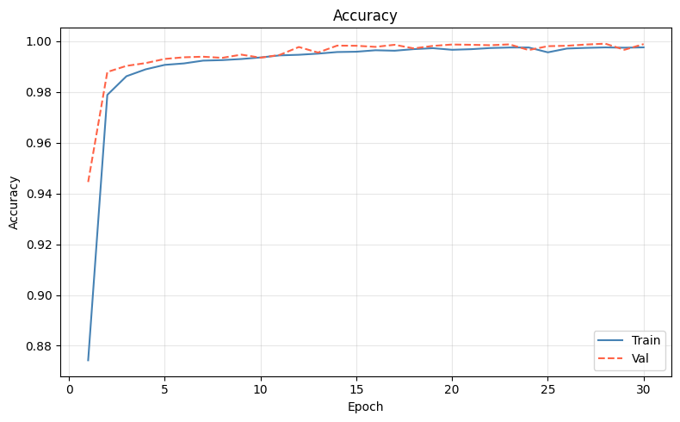
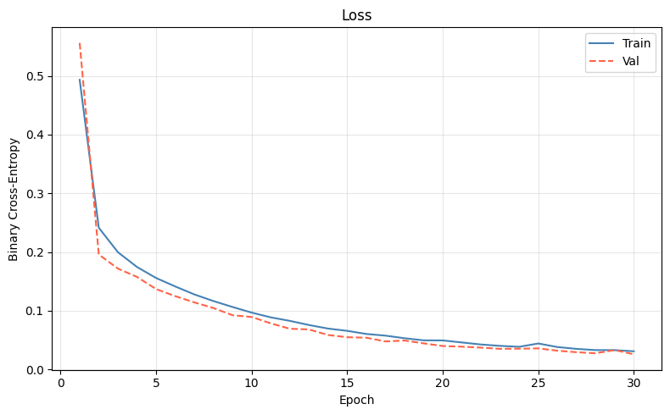
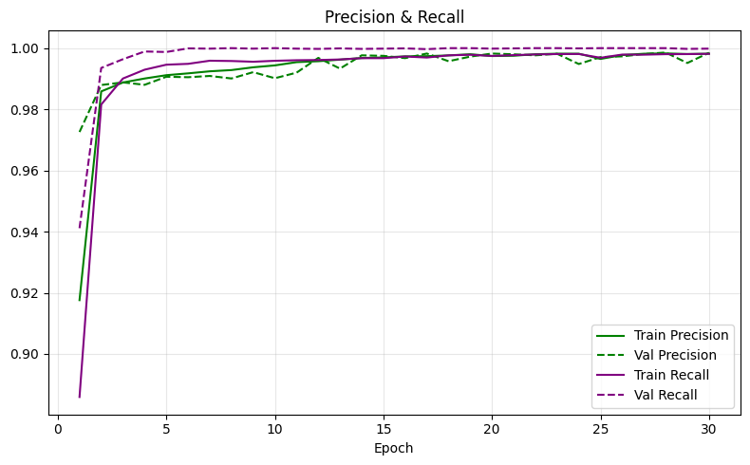
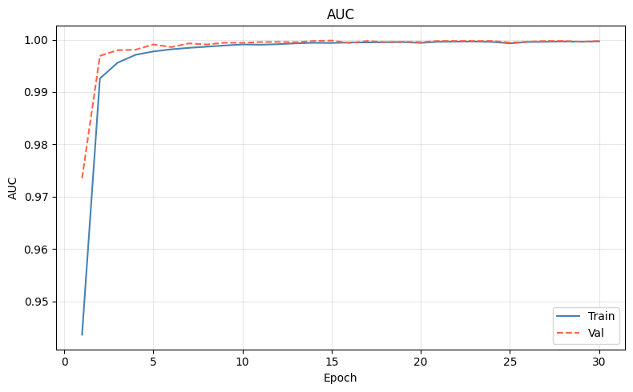
Training Dynamics

Slide 13
Comparison with Existing Approaches
Reference | Year | Model | Dataset | Acc% | Prec% | Rec% | F1%
Proposed | 2025 | TCN-HMAC | InSDN | 99.85 | 99.80 | 99.97 | 99.89
Said et al. | 2023 | CNN-BiLSTM | InSDN | 99.90 | 99.91 | 99.90 | 99.90
Shihab et al. | 2025 | CNN-LSTM | CIC-IDS | 99.67 | 99.68 | 99.67 | 99.67
Yang et al. | 2024 | CNN-GRU | NSL-KDD | 99.35 | 99.20 | 99.35 | 99.27
Ataa et al. | 2024 | DNN Ensemble | InSDN | 99.70 | 99.65 | 99.70 | 99.67
Basfar | 2025 | LSTM | NSL-KDD | 99.23 | 99.00 | 99.23 | 99.11
Kumar et al. | 2025 | Hybrid DL | CIC-IDS | 99.45 | 99.42 | 99.45 | 99.43
Kanimozhi et al. | 2025 | DRL (DDQN) | InSDN | 98.85 | 98.90 | 98.85 | 98.87
Lopes et al. | 2023 | TCN | CIC-IDS | 99.75 | 99.70 | 99.75 | 99.72
Li et al. | 2025 | TCN-SE | NSL-KDD | 99.62 | 99.58 | 99.62 | 99.60
Wang et al. | 2025 | TCN | InSDN | 97.00 | 96.40 | 96.91 | 96.72
Deng et al. | 2024 | BiTCN-MHSA | CIC-IDS | 99.72 | 99.68 | 99.72 | 99.70
Ahmad et al. | 2021 | CNN | InSDN | 99.20 | 99.10 | 99.20 | 99.15
Elsayed et al. | 2020 | DT/RF | InSDN | 98.50 | 98.40 | 98.50 | 98.45

Slide 14
Comparison with SDN Security Frameworks
Framework | IDS | Ctrl Auth. | Flow Verify | Anti-Replay | Overhead | Real-Time
TCN-HMAC (Proposed) | TCN (DL) | HMAC-SHA256 | Shadow Table | Seq + TS | Low | Yes
Ahmed et al. [2023] | None | HMAC-SHA256 | No | Partial | Low | Yes
Pradeep et al. [2023] | EnsureS | TLS | No | No | Moderate | Partial
Song et al. [2023] | Blockchain | Consensus | Yes | Yes | High | No
Poorazad et al. [2023] | ML + BC | Blockchain | Yes | Yes | Very High | No
Zhou et al. [2022] | Encryption | OPE | Partial | No | Moderate | Partial

Slide 15
Results Mapped to Research Objectives
RO1: Achieved satisfactory Restults with 99.85% accuracy.
RO2: Built Compact deployable TCN model with 156,737 params and 0.17 ms inference time.
RO3: Built a lightweight HMAC auxiliary agent with HMAC-SHA256 and challenge-response with only 0.7 ms added latency.
RO4: Integrated TCN with HMAC Dual level defense operating in the SDN control loop.
RO5: Evaluated the proposed framework in simulated SDN Ryu + Mininet + OVS testbed.
RO6: Benchmarked against 16 existing research papers in the similar domain of research.

Slide 16
Conclusion
TCN-HMAC is a lightweight, Hybrid security framework for Software-Defined Networks which,
1. Bridges the detection-verification divide
2. Outperforms many existing approaches, or match performance with significantly lower computational overhead.
3. Operates in real time: 0.17 ms inference + 2 μs HMAC
4. Requires no protocol modifications and runs entirely as a software controller application
Future Directions:
1. Online Training for concept drift adaptation.
2. Multi-controller SDN deployment support
3. Cross-dataset generalization (NSL-KDD, CIC-IDS-2017, UNSW-NB15)
4. Adversarial robustness evaluation
5. Multi-class attack type classification

Slide 17
Thank You
Questions & Discussion
Md. Mahamudul Hasan Zubayer
Department of Computer Science & Engineering
Southeast University, Dhaka, Bangladesh

Slide 18
References
[1-13]
[1] El-Sayed, M.S. et al., "InSDN: A Novel SDN Intrusion Dataset," IEEE Access, vol. 8, pp. 165263-165284, 2020.
[2] Khan, A. et al., "MITM-Defender: A Real-Time Defense System Against MITM Attacks in SDN," Proc. IEEE ICC, 2021.
[3] Liang, Y. et al., "A Review of Intrusion Detection Approaches in SDN," J. Information Security & Applications, vol. 59, 2021.
[4] Malik, S. & Habib, M., "Detection and Mitigation of DoS Attacks in SDN: Lightweight Agent-Based Model," Security and Privacy, vol. 4, 2021.
[5] Ahmad, Z. et al., "Network Intrusion Detection System: A Systematic Study of ML and DL Approaches," Trans. Emerging Telecom. Tech., vol. 32, 2021.
[6] Rahman, M.M. et al., "Blockchain Integration in SDN: Opportunities and Challenges," J. Network & Computer Applications, vol. 201, 2022.
[7] Zhou, H., Liu, Z. & Yang, J., "SecureMatch: Efficient Cryptographic Rule Matching for SDN," IEEE Trans. Dependable & Secure Computing, vol. 19, pp. 2345-2358, 2022.
[8] Ahmed, Z. & Haque, M., "A Modular HMAC-based Framework for Flow Verification in SDN," Intl J. Network Management, vol. 33, 2023.
[9] Lopes, I.O. et al., "Network Intrusion Detection Based on the Temporal Convolutional Model," Computers & Security, vol. 135, 2023.
[10] Poorazad, A. et al., "A Blockchain-Based Deep Learning IDS for SDN-Enabled IIoT," Ad Hoc Networks, vol. 145, 2023.
[11] Pradeep, M. et al., "EnsureS: Lightweight High-Performance Service Path Rule Verification in SDN," Computer Networks, vol. 235, 2023.
[12] Said, R.B. et al., "CNN-BiLSTM: A Hybrid Deep Learning Approach for NIDS in SDN with Hybrid Feature Selection," IEEE Access, vol. 11, 2023.
[13] Sharma, R. & Tyagi, S., "A Lightweight IDS Framework for SDN Using Adaptive Anomaly Detection," Computers & Security, vol. 127, 2023.

Slide 19
References (cont.)
[14-25]
[14] Song, Y., Lu, X. & Wang, Z., "Intent-Driven Secure SDN Using Blockchain," IEEE Trans. Network & Service Management, vol. 20, 2023.
[15] Ataa, M.S. et al., "Intrusion Detection in SDN Using Deep Learning Approaches," Scientific Reports, vol. 14, 2024.
[16] Deng, M. et al., "Network Intrusion Detection with Multi-Layer BiTCN and Multi-Headed Self-Attention Mechanisms," Proc. IEEE, 2024.
[17] Yang, J., "A New Attacks Intrusion Detection Model Based on Deep Learning in SDN Environments," Proc. IEEE MLISE, 2024.
[18] Ayad, S. et al., "Leveraging ML Techniques for Intrusion Detection in SDN," J. Interconnection Networks, 2025.
[19] Basfar, R. et al., "An Incremental LSTM Ensemble for Online Intrusion Detection in SDN," Intl J. Advanced CS & Applications, vol. 16, 2025.
[20] Buruaga, J.S. et al., "Quantum-Safe Integration of TLS in SDN Networks," arXiv:2501.04368, 2025.
[21] Kanimozhi, R. & Ramesh, P.S., "Deep Reinforcement Learning-Based IDS Scheme for SDN," Scientific Reports, vol. 15, 2025.
[22] Kumar, C.L. et al., "Metaparameter Optimized Hybrid Deep Learning Model for Next Gen Cybersecurity in SDN," Scientific Reports, vol. 15, 2025.
[23] Li, J. & Li, L., "A Lightweight NIDS Based on TCN and Attention Mechanisms," Computer Fraud & Security, 2025.
[24] Shihab, D. et al., "Optimized Hybrid CNN-LSTM Framework with SMOTE for IDS in SDN," AlKadhim J. Computer Science, vol. 3, 2025.
[25] Wang, Z. et al., "SDN Anomalous Traffic Detection Based on Temporal Convolutional Network," Applied Sciences, vol. 15, 2025.

