Slide 1

TCN-HMAC
A Lightweight Deep Learning and Cryptographic
Hybrid Security Framework for SDN
1
Md. Mahamudul Hasan Zubayer
ID: 2022000000006
Supervisor: Dr. Md. Maruf Hassan, Associate Professor
Department Head: Shahriar Manzoor, Associate Professor
Department of Computer Science and Engineering
Southeast University

Slide 2
Presentation Outline
● Background & Motivation
● Problem Statement
● Research Objectives
● Proposed Methodology — TCN-HMAC Framework
● Dataset & Preprocessing
● TCN Model Architecture
● Experimental Results & Analysis
● Comparative Analysis
● Conclusion & Future Work
2

Slide 3
Background & Motivation
▸ SDN Architecture: Separates control plane from data plane; a single controller orchestrates all switches via OpenFlow.
▸ Centralization Risk: The controller becomes a single point of failure—its compromise cascades across the entire network.
▸ Control Channel Vulnerability: OpenFlow messages (flow rules, stats) can be intercepted, modified, or injected if not properly secured.
▸ Flow Rule Integrity Gap: Switches blindly execute any received flow rule—no built-in mechanism to verify authenticity.
▸ Growing Attack Sophistication: Modern adversaries chain DDoS, MITM, probe, and brute-force attacks simultaneously.
▸ TLS Limitations: TLS protects transport only; it cannot verify flow rule semantics or stop a compromised controller.
3

Slide 4
Problem Statement
▸ Detection without Verification: ML/DL-based IDS can flag malicious traffic but cannot prevent tampered flow rules from being installed.
▸ Verification without Detection: Cryptographic mechanisms (HMAC, TLS) verify rule integrity but do not proactively detect intrusion attempts.
▸ Excessive Computational Overhead: Blockchain/PKI-based solutions introduce latency incompatible with real-time SDN operations.
▸ Limited Attack Coverage: Most solutions target a single attack vector (e.g., DDoS only), lacking multi-threat generality.
▸ Deployment Complexity: Solutions requiring OpenFlow protocol changes or custom switch firmware hinder real-world adoption.
Research Question: How can we build a lightweight, deployable security framework for SDN that combines proactive multi-class intrusion detection with real-time cryptographic verification—without exceeding the latency budget that production networks demand?
4

Slide 5
Research Objectives
▸ RO1: Design a TCN-based IDS achieving >99% accuracy for binary classification of DDoS, MITM, Probe, and Brute-force attacks.
▸ RO2: Develop a preprocessing pipeline (Pearson correlation, PCA, class weighting) for the InSDN dataset.
▸ RO3: Train & deploy the TCN model via TensorFlow/Keras with compact size suitable for resource-constrained environments.
▸ RO4: Design a lightweight auxiliary agent for HMAC-based flow rule verification and challenge–response controller authentication.
▸ RO5: Integrate the TCN-IDS and HMAC agent into a cohesive framework within the SDN control loop.
▸ RO6: Evaluate the framework on accuracy, precision, recall, F1-score, and computational overhead.
▸ RO7: Conduct comparative analysis against 15 existing models (LSTM, CNN-BiLSTM, Transformer, etc.).
5

Slide 6
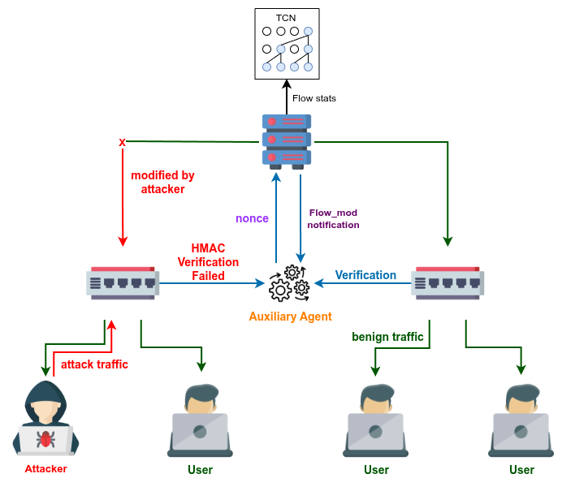
Proposed Methodology: TCN-HMAC Framework
▸ Layer 1 — TCN-IDS: Deployed as a controller app; inspects flow statistics in real time; classifies traffic as benign or malicious.
▸ Layer 2 — HMAC Agent: Co-located subprocess; HMAC-SHA256 verification of every flow rule; challenge–response for controller authenticity.
▸ Defense in Depth: If an attack bypasses the TCN, the HMAC prevents rogue flow rules. If keys are compromised, the TCN detects malicious patterns.
Key: No OpenFlow protocol modifications required. Runs entirely in software as a standard controller application + auxiliary agent.
6

Slide 7
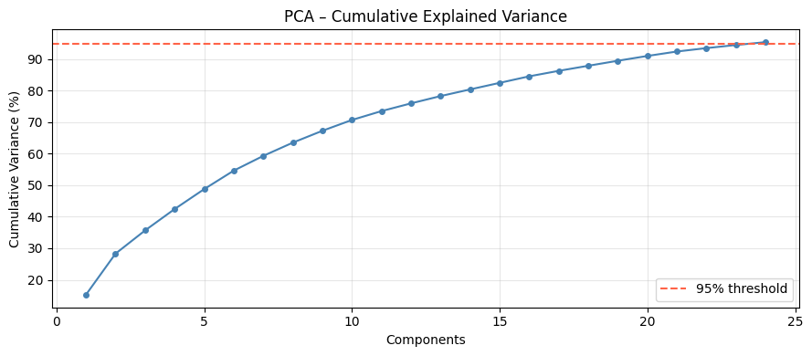
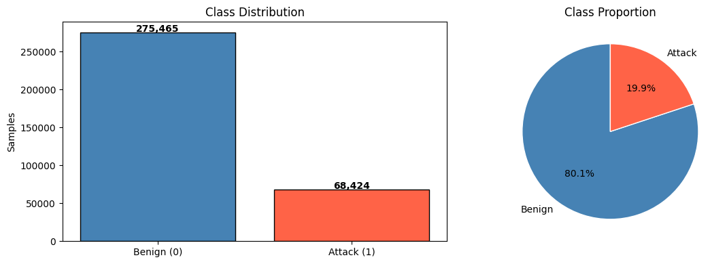
Dataset & Preprocessing Pipeline
▸ InSDN Dataset: Purpose-built for SDN IDS research; covers Normal, DDoS, MITM, Probe, Brute-force traffic.
▸ Raw: 343,889 samples × 84 features → Cleaned: 182,831 samples × 48 features.
▸ Feature Selection: Pearson correlation (|r| > 0.95 removal) → removed redundant highly-correlated features.
▸ Normalization: StandardScaler (zero mean, unit variance) for stable gradient-based training.
▸ Dimensionality Reduction: PCA: 48 → 24 features, retaining 95.43% of total variance.
▸ Class Weighting: Inverse-frequency weighting to counter class imbalance (65% attack, 35% benign).
▸ Train/Test Split: 80/20 stratified split → 146,264 training / 36,567 test samples.
7

Slide 8
TCN Model Architecture
▸ Input: 24-dimensional PCA-transformed feature vector reshaped to (24, 1).
▸ 6 Residual Blocks: Dilated causal Conv1D layers with dilation rates [1, 2, 4, 8, 16, 32], 64 filters, kernel size 3.
▸ Regularization: Batch Normalization + Spatial Dropout (20%) in each block.
▸ Pooling: Global Average Pooling to aggregate temporal features into a fixed-length vector.
▸ Classification Head: Dense(64, ReLU) → Dropout(30%) → Dense(1, Sigmoid) for binary output.
▸ Total Parameters: 156,737 (612 KB model size)—compact enough for edge deployment.
▸ Training: Adam optimizer, lr=10⁻³ with ReduceLROnPlateau; binary cross-entropy; ~30 epochs (~5 min on T4 GPU).
Why TCN? Fully parallelizable inference (unlike sequential LSTM/GRU) • Stable gradients via residual connections • Controllable receptive field via dilation • 5–30× smaller than comparable DL models
8

Slide 9
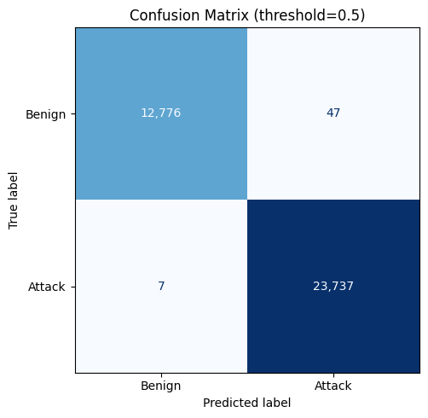
Experimental Results
Test Set: 36,567 samples (20% held-out, never seen during training)
99.85%
Accuracy
99.80%
Precision
99.97%
Recall / DR
99.89%
F1-Score
0.9999
AUC-ROC
0.37%
False Alarm Rate
▸ 23,737 / 23,744 attacks correctly detected (only 7 missed).
▸ 47 / 12,823 benign flows false-alarmed (0.37% rate).
▸ Error Bias: 87% of errors are FP (conservative); only 13% are FN.
▸ Operational: ~1 false alarm per 270 benign flows—manageable with whitelisting.
9

Slide 10
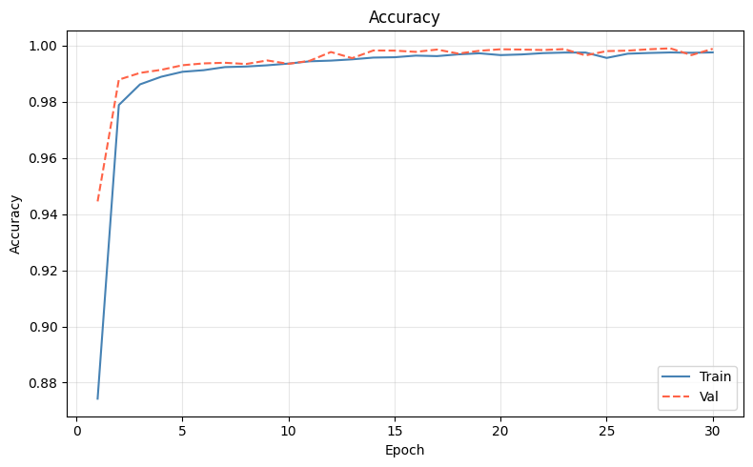
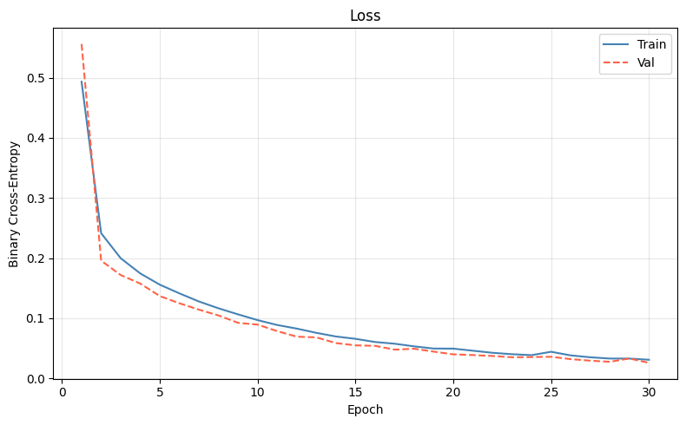
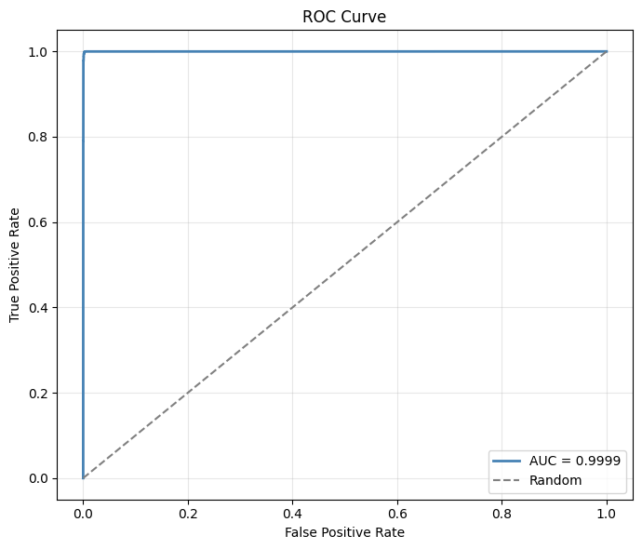
Training Convergence & ROC Analysis
✓ Converges in ~30 epochs (5 min on T4 GPU)
✓ Train/Val curves align closely → no overfitting
✓ AUC-ROC = 0.9999 → near-perfect discrimination
10

Slide 11
HMAC Verification Overhead
~2 µs
Per-Message
HMAC Compute
0.7 ms
Total Control
Latency Added
4.4%
CPU Usage
Overhead
13.7 MB
RAM
Overhead
32 B
Per-Message
Size Overhead
▸ Message Integrity: HMAC-SHA256 tag appended to every Flow_Mod message; switch-side verification via shadow table.
▸ Replay Prevention: Sequence numbers + timestamps reject replayed or out-of-order messages.
▸ Controller Authentication: Periodic challenge–response protocol confirms the controller’s identity.
▸ Key Management: Pre-shared symmetric keys with planned rotation; no PKI infrastructure required.
▸ Negligible Impact: Combined TCN inference + HMAC verification < 1 ms per flow—well within real-time budgets.
11

Slide 12
Comparative Analysis
Against 15 existing IDS models & SDN security frameworks
Model | Dataset | Acc.(%) | Prec.(%) | Recall(%) | F1(%) | Params | Inf. Time
TCN-HMAC (Ours) | InSDN | 99.85 | 99.80 | 99.97 | 99.89 | 157K | 0.17ms
CNN-BiLSTM | InSDN | 99.90 | 99.91 | 99.90 | 99.90 | ~2M | ~2ms
DNN Ensemble | InSDN | 99.70 | 99.65 | 99.70 | 99.67 | ~5M | ~3ms
CNN-LSTM | CIC-IDS | 99.67 | 99.68 | 99.67 | 99.67 | ~1.5M | ~1.5ms
DRL (DDQN) | InSDN | 98.85 | 98.90 | 98.85 | 98.87 | ~3M | ~5ms
BiTCN-MHSA | CIC-IDS | 99.72 | 99.68 | 99.72 | 99.70 | ~500K | ~0.5ms
LSTM | NSL-KDD | 99.23 | 99.00 | 99.23 | 99.11 | ~500K | ~1ms
DT/RF Baseline | InSDN | 98.50 | 98.40 | 98.50 | 98.45 | — | —
▸ Highest Detection Rate: 99.97% (70% reduction in miss rate vs next-best).
▸ Smallest Model: 612 KB / 157K params—5–30× smaller than comparable DL models.
▸ Fastest Inference: 0.17 ms—enables 5,000+ flow classifications/sec.
▸ Only Dual-Layer Framework: Combines DL-based IDS + cryptographic flow rule authentication.
12

Slide 13
Objectives Fulfilled
Mapping results back to research objectives
RO1 ✔ TCN achieves 99.85% accuracy, 99.97% recall across DDoS, MITM, Probe, Brute-force (target: >99%).
RO2 ✔ 15-stage pipeline: cleaning → Pearson correlation → StandardScaler → PCA (48→24 features, 95.43% variance).
RO3 ✔ TensorFlow/Keras model: 612 KB, 156,737 parameters, 0.17 ms inference—portable across platforms.
RO4 ✔ Auxiliary agent: HMAC-SHA256 verification (~2 µs/msg) + challenge–response authentication (0.7 ms overhead).
RO5 ✔ Integrated TCN-IDS + HMAC agent as Ryu controller app + co-located subprocess.
RO6 ✔ Full evaluation: Accuracy 99.85%, Precision 99.80%, Recall 99.97%, F1 99.89%, FAR 0.37%.
RO7 ✔ Benchmarked against 15 models—highest detection rate, smallest model, fastest inference.
13

Slide 14
Key Contributions
▸ Novel TCN-HMAC Framework: First to combine temporal DL with lightweight cryptographic verification in a unified, deployable SDN security solution.
▸ First TCN on InSDN: Highest detection rate (99.97%) and lowest FAR (0.37%) among 15 compared approaches.
▸ Compact Deployment: 612 KB model (157K params)—runs inside the SDN controller without additional hardware.
▸ Lightweight HMAC Agent: ~2 µs per message, 0.7 ms control latency, 4.4% CPU, 13.7 MB RAM—negligible overhead.
▸ Comprehensive Benchmark: Most extensive comparative analysis in SDN IDS literature (15 models, multiple metrics).
14

Slide 15
Conclusion & Future Work
✓ TCN-HMAC delivers near-perfect IDS (99.85% acc, 99.97% DR, 0.37% FAR) in a 612 KB, sub-millisecond package.
✓ Bridges the detection–verification divide: TCN handles data-plane threats; HMAC secures the control plane.
✓ Deployable as a standard controller app—no OpenFlow changes, no custom hardware.
✓ Outperforms or matches 15 state-of-the-art models while being 5–30× smaller and fastest at inference.
Future Work Directions
○ Multi-dataset evaluation (NSL-KDD, CIC-IDS-2017, UNSW-NB15)
○ Multi-class classification (identify specific attack types)
○ Adversarial robustness evaluation (FGSM, PGD)
○ Federated learning for cross-domain privacy-preserving training
○ Online / incremental learning for concept drift adaptation
○ Production HMAC implementation & hardware benchmarking
○ Model compression (INT8 quantization, pruning) for edge deployment
"TCN-HMAC narrows the gap between what the SDN control plane needs and what existing solutions provide."
15

Slide 16
Thank You
Questions & Discussion
16
Md. Mahamudul Hasan Zubayer • Supervisor: Dr. Md. Maruf Hassan
Department of Computer Science and Engineering, Southeast University

