Slide 1
VASIREDDY VENKATADRI INSTITUTE OF TECHNOLOGY (VVIT)
ARTIFICIAL INTELLIGENCE & MACHINE LEARNING
Multi-Agent AI Research Paper Assistant
Intelligent literature understanding, coordinated agents, and grounded research outputs
PROJECT GUIDE
TEAM MEMBERS
Dr. K. Gnanendra
SK. Zubedha Hurmath
R. Venkateswarlu
Y. J. Madhava Saikrishna
T. Geethamrutha
MAJOR PROJECT • AI & ML

Slide 2
01 · Problem Statement
2
Why research-paper analysis remains a time-consuming workflow
Growing Literature
Scattered Information
Researchers increasingly need to understand multiple scientific papers across rapidly evolving domains.
Methodology, findings, references, datasets and implementation details are distributed across lengthy papers.
Manual Synthesis
Multiple Outputs
Reading, comparing, extracting evidence and preparing research notes requires substantial effort.
The same research knowledge must often be transformed into summaries, references, slides, emails and code.
The challenge is not only understanding a research paper — it is transforming its knowledge into reliable, reusable research outputs.
AIML-C02 · Multi-Agent AI Research Paper Assistant

Slide 3
02 · Motivation & Proposed Shift
3
From a fragmented manual workflow to coordinated research assistance
×
Traditional Workflow
✓
Proposed Workflow
Search papers →
Download →
Read →
Extract notes →
Find references →
Prepare slides →
Write code →
Share findings
Upload paper(s) →
Parse →
Retrieve grounded context →
Manager Agent →
Specialized agents →
Multiple outputs
Paper(s)
RAG
Manager
Agents
Outputs
The architectural shift is orchestration: one uploaded paper becomes reusable grounded context for multiple specialized tasks.
AIML-C02 · Multi-Agent AI Research Paper Assistant

Slide 4
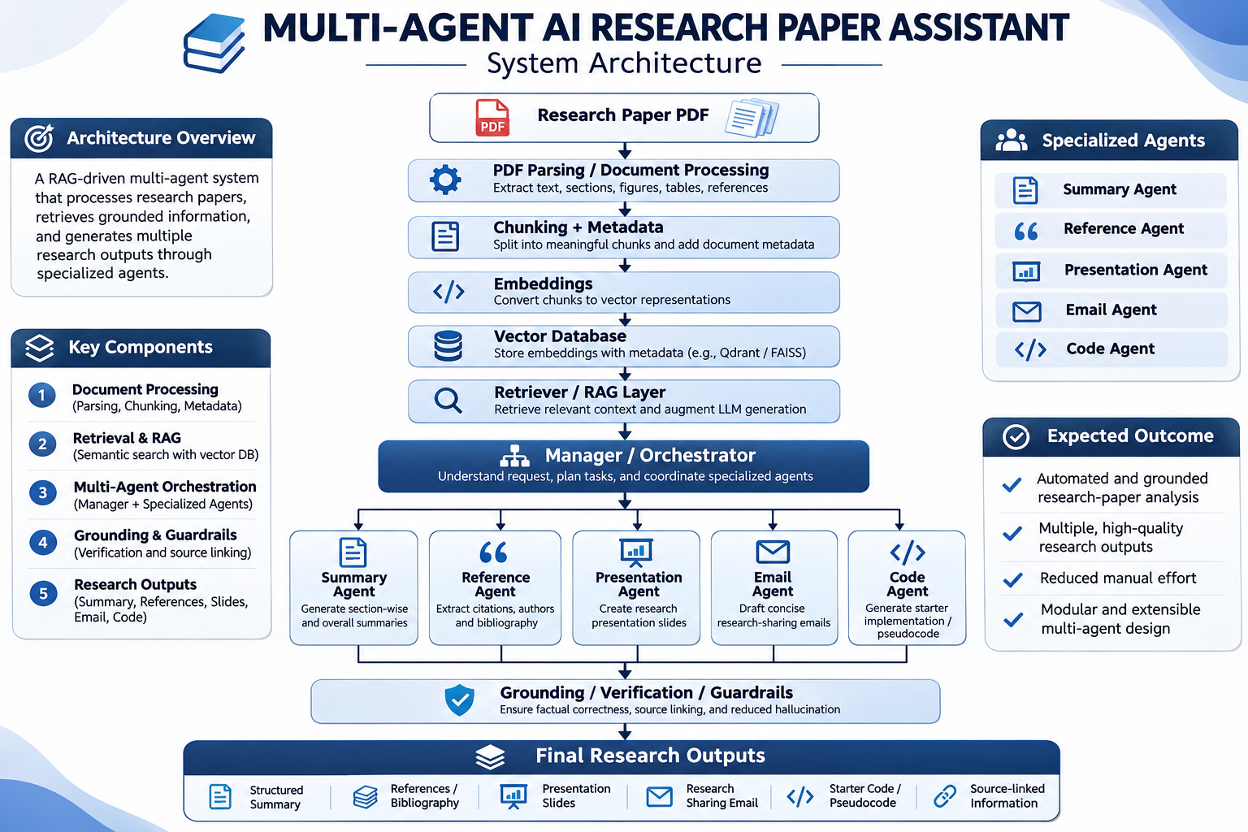
03 · Proposed Solution
4
A grounded multi-agent assistant for research-paper analysis
AIML-C02 · Multi-Agent AI Research Paper Assistant

Slide 5
04 · System Architecture
5
Document processing → retrieval → orchestration → grounded outputs
Research Paper PDF
✓
Grounding / Guardrails
PDF Parsing / Document Processing
Source-linked generation
Verification of retrieved context
Output citations
Faithfulness evaluation
Planned in M6
Chunking + Metadata
Embeddings
Vector Database
Retriever / RAG Layer
Manager / Orchestrator
Summary Agent
Reference Agent
Presentation Agent
Email Agent
Code Agent
AIML-C02 · Multi-Agent AI Research Paper Assistant

Slide 6
05 · Agent Responsibilities
6
Specialization under a central Manager / Orchestrator
1
Manager Agent
2
Summary Agent
3
Reference Agent
Understands request, creates task plan and coordinates specialist agents.
Generates section-wise and overall summaries from grounded context.
Extracts citations, authors, keywords and bibliography.
4
Presentation Agent
5
Email Agent
6
Code Agent
Converts grounded research content into presentation slides.
Drafts concise professional research-sharing emails.
Generates starter implementation / pseudocode when methodology permits.
Manager = coordination layer · Specialist agents = task-specific generation · RAG = shared grounded context
AIML-C02 · Multi-Agent AI Research Paper Assistant

Slide 7
06 · Literature Review
7
Ref 01 – AMAR: An Autonomous Multi-Agent Researcher for End-to-End Automated Scientific Literature Review and Draft Generation
Authors: Prof. Rajasekaran K., Prof. Lavanya Vijayan, Karthik Kashyap K S, Pratham C S, Kiran D.
Ref 02 – Agent Laboratory: Using LLM Agents as Research Assistants
Authors: Samuel Schmidgall, Yusheng Su, Ze Wang, Ximeng Sun, Jialian Wu, Xiaodong Yu, Jiang Liu
Ref 03 – MA-RAG: Multi-Agent Retrieval-Augmented Generation via Collaborative Chain-of-Thought Reasoning
Authors: Thang Nguyen, Peter Chin, Yu-Wing Tai
AIML-C02 · Multi-Agent AI Research Paper Assistant

Slide 8
07 · Next Steps
8
Implementation priorities for the upcoming phase
01
Complete scientific PDF parsing
02
Create evaluation corpus
Build structured extraction for sections, figures, tables, references and metadata.
Prepare 20–30 papers with labelled references and key facts.
03
Build retrieval layer
04
Start agent orchestration
Implement chunking, embeddings, vector storage and relevant-passage retrieval.
Design the Manager Agent and routing between specialist agents.
05
Prepare research outputs
06
Move toward evaluation
Integrate summary, reference, presentation, email and code-generation workflows.
Define retrieval, faithfulness and factual-correctness evaluation before reporting results.
AIML-C02 · Multi-Agent AI Research Paper Assistant

Slide 9
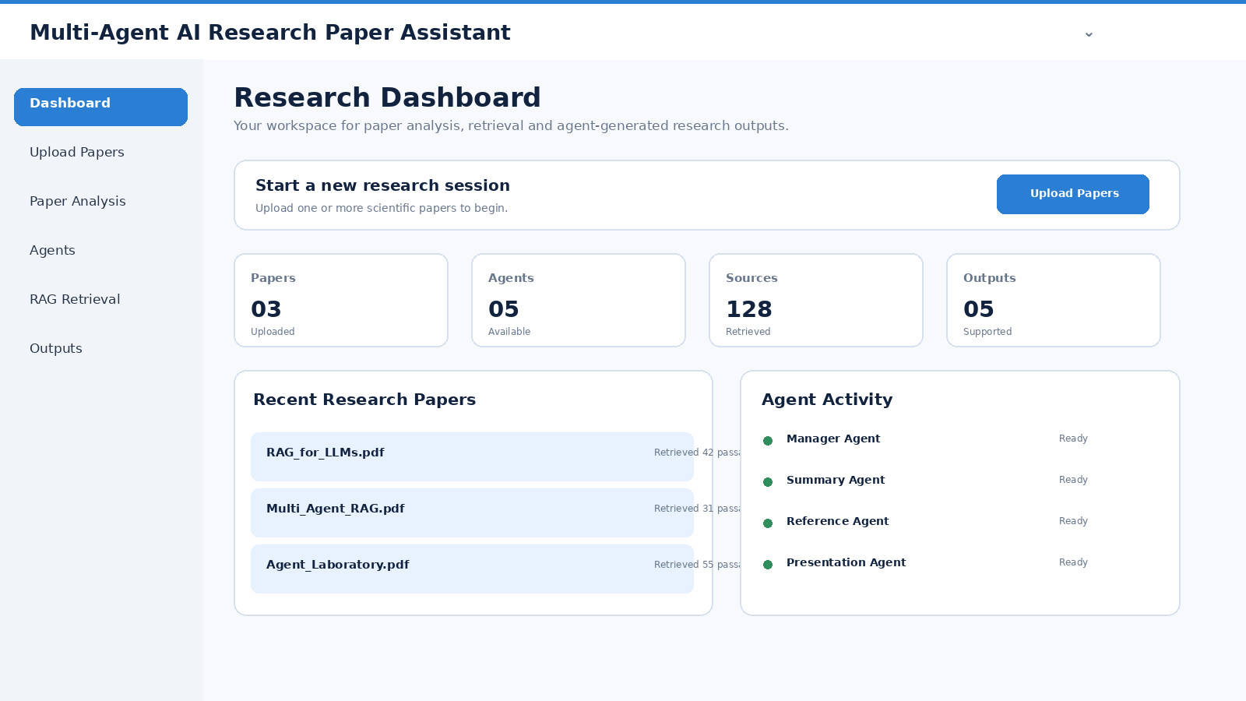
Example Screen · Research Dashboard
9
Upload papers, coordinate agents, retrieve grounded context, and access research outputs
AIML-C02 · Multi-Agent AI Research Paper Assistant

Slide 10
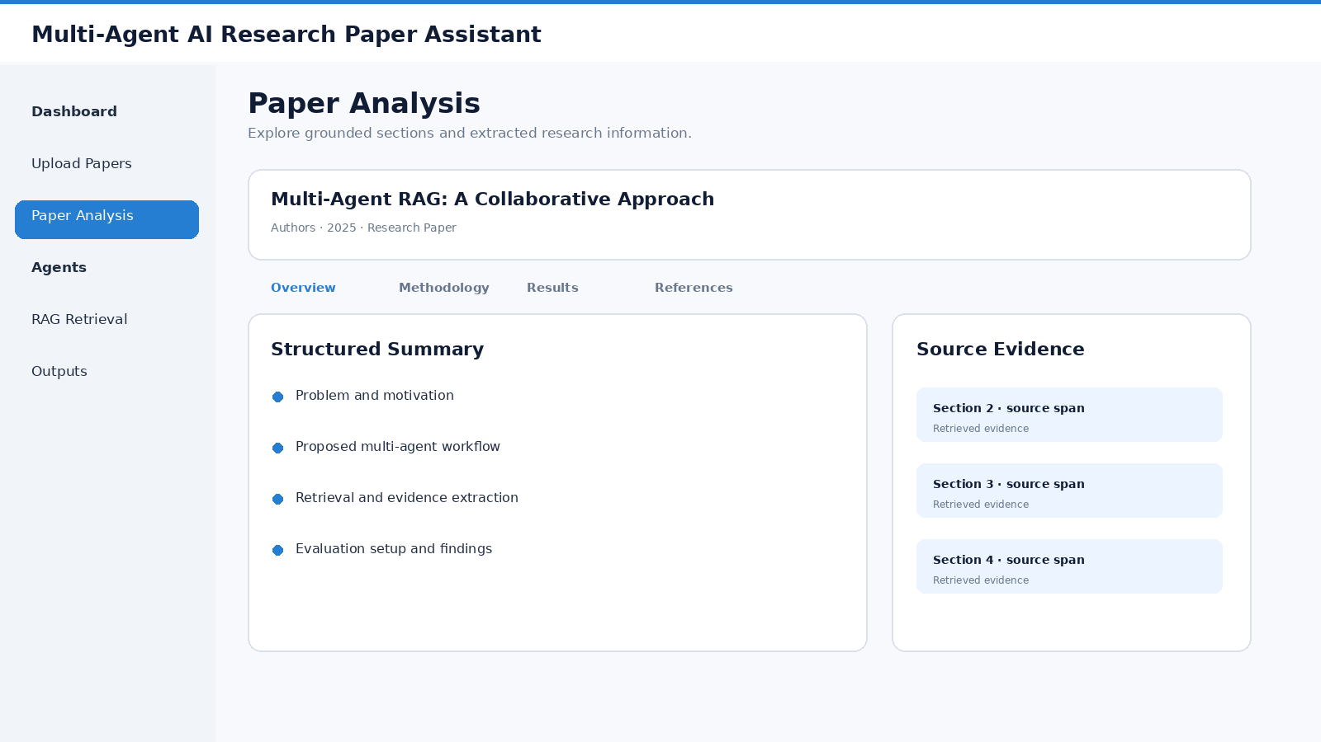
Example Screen · Paper Analysis
10
Product interface concept
AIML-C02 · Multi-Agent AI Research Paper Assistant

Slide 11
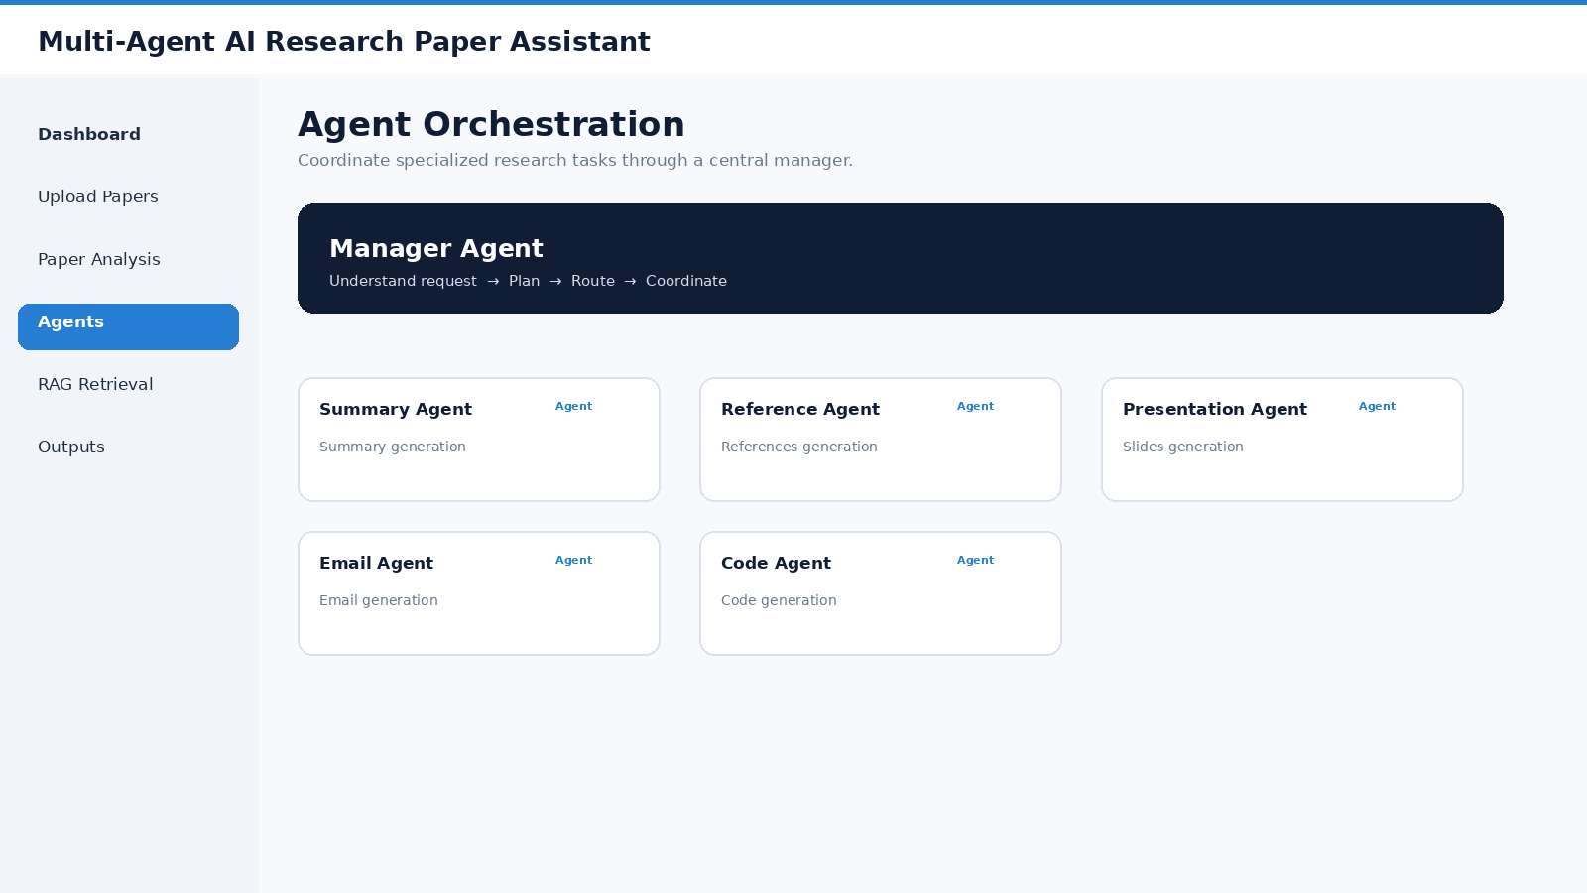
Example Screen · Agent Orchestration
11
Product interface concept
AIML-C02 · Multi-Agent AI Research Paper Assistant

Slide 12
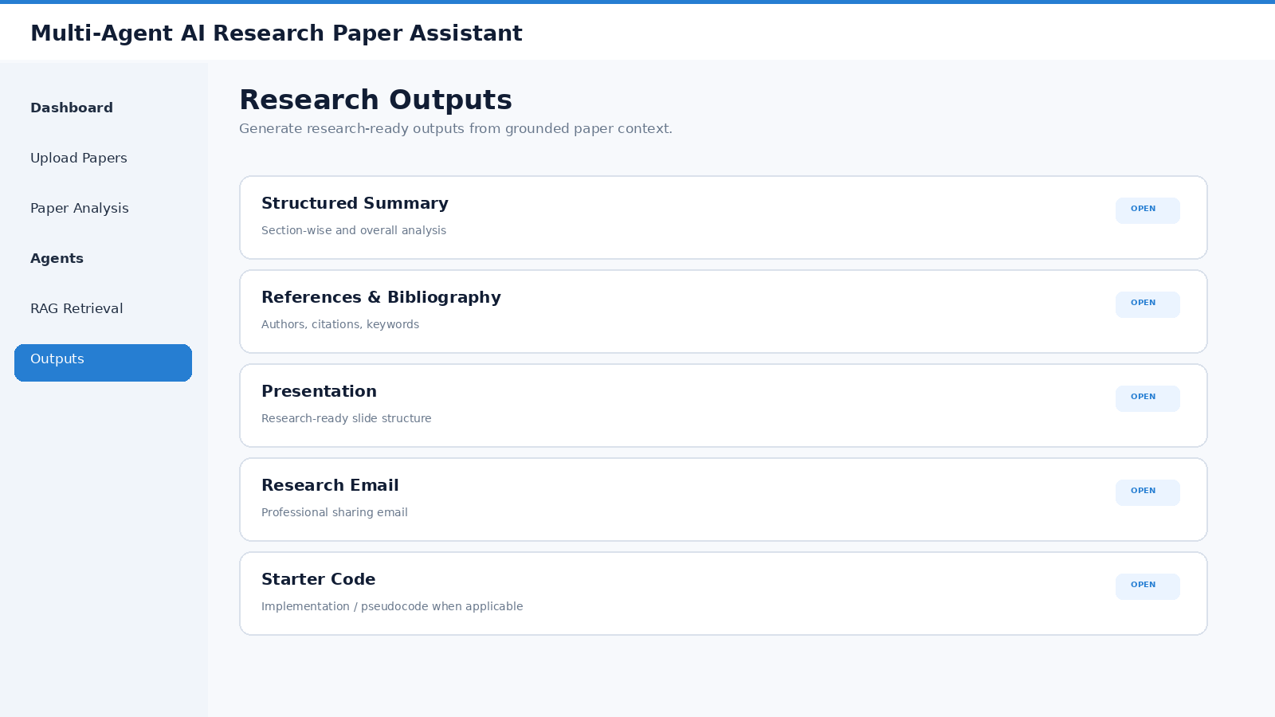
Example Screen · Research Outputs
12
Product interface concept
AIML-C02 · Multi-Agent AI Research Paper Assistant

Slide 13
08 · Conclusion
13
A coordinated, grounded workflow for research-paper analysis
Multi-Agent AI Research Paper Assistant aims to simplify the research-paper analysis workflow by combining Multi-Agent AI and Retrieval-Augmented Generation (RAG).
It brings together:
Research-paper understanding
Grounded information retrieval
Specialized AI agents
Coordinated task execution
Reusable research outputs
The system is designed to reduce repetitive manual effort and provide a structured workflow for transforming research papers into useful research artifacts.
FINAL TAKEAWAY
From reading individual papers to building a coordinated research workflow.
AIML-C02 · Multi-Agent AI Research Paper Assistant

