Slide 1

MULTI-AGENT AI
RESEARCH PAPER ASSISTANT
Major Project Review - 1
Batch ID: AIML-C02
Project Guide
Project Batch Members
Dr. K. Gnanendra
Professor, CSM, VVIT
SK. Zubedha Hurmath – 23BQ1A61D1
R. Venkateswarlu – 23BQ1A61B7
Y. J. Madhava Saikrishna – 23BQ1A61F2
T. Geethamrutha – 23BQ1A61D9

Slide 2
MULTI-AGENT AI
RESEARCH PAPER ASSISTANT
Guide: Dr. K. Gnanendra
Batch ID:AIML-C02
Regd No:23BQ1A61D1(TL) RegdNo:23BQ1A61B7,
Regd No:23BQ1A61F2, RegdNo:23BQ1A61D9
Problem statement
The rapid growth of scientific publications makes research-paper analysis difficult and time-consuming.
Researchers and students need to read multiple papers to understand existing work.
Extracting summaries, references, keywords, methodologies and implementation details manually requires significant effort.
Preparing presentations and communicating research findings also requires additional time.
Existing AI tools often address individual tasks rather than providing an integrated research-paper workflow.
There is a need for an AI-based multi-agent system that can analyze research papers and generate multiple useful outputs.
Proposed Solution
Develop a Multi-Agent AI Research Paper Assistant using:
Large Language Models (LLMs)
Retrieval-Augmented Generation (RAG)
Vector Database
Multi-Agent Architecture
Specialized Research Agents

Slide 3
MULTI-AGENT AI
RESEARCH PAPER ASSISTANT
Guide: Dr. K. Gnanendra
Batch ID:AIML-C02
Regd No:23BQ1A61D1(TL) RegdNo:23BQ1A61B7,
Regd No:23BQ1A61F2, RegdNo:23BQ1A61D9
Literature Review
Ref 01 – AMAR: An Autonomous Multi-Agent Researcher for End-to-End Automated Scientific Literature Review and Draft Generation
Authors: Prof. Rajasekaran K., Prof. Lavanya Vijayan, Karthik Kashyap K S, Pratham C S, Kiran D.
| Proposed Method | Data & Setup | key Results | Strengths & Limitations | Relevance to my research |
Main Idea
AMAR is an end-to-end multi-agent system that automates the academic research workflow from literature discovery to research-draft generation.
It coordinates multiple specialized AI agents through a central orchestrator.
AMAR uses a central Orchestrator to coordinate seven specialized agents:
Searcher Agent – retrieves relevant research papers.
Summarizer Agent – generates structured summaries.
Critic Agent – identifies research gaps.
Developer Agent – generates experiment code.
Experimenter Agent – executes experiments in a Docker sandbox.
Verifier Agent – verifies citations and experimental results.
Writer Agent – generates the final research draft.
Workflow
Research Topic → Search → Summarize → Gap Analysis → Code → Experiment → Verify → Draft
This demonstrates how complex research activities can be divided among specialized agents.

Slide 4
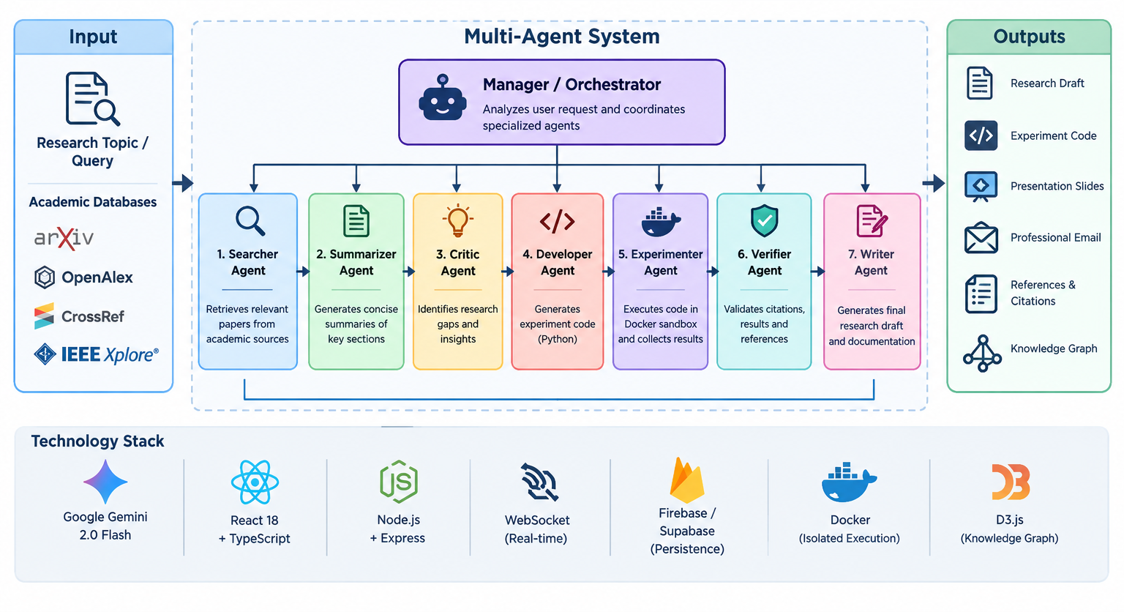
MULTI-AGENT AI
RESEARCH PAPER ASSISTANT
Guide: Dr. K. Gnanendra
Batch ID:AIML-C02
Regd No:23BQ1A61D1(TL) RegdNo:23BQ1A61B7,
Regd No:23BQ1A61F2, RegdNo:23BQ1A61D9
Literature Review
Ref 01 – AMAR: An Autonomous Multi-Agent Researcher for End-to-End Automated Scientific Literature Review and Draft Generation
Authors: Prof. Rajasekaran K., Prof. Lavanya Vijayan, Karthik Kashyap K S, Pratham C S, Kiran D.
| Proposed Method | Data & Setup | key Results | Strengths & Limitations | Relevance to my research |
Data Sources
arXiv
OpenAlex
CrossRef
IEEE Xplore
Technologies
Google Gemini 2.0 Flash
React 18 + TypeScript
Node.js + Express
WebSocket
Knowledge-graph visualization
The system integrates academic APIs with specialized agents to automate the research workflow.

Slide 5
MULTI-AGENT AI
RESEARCH PAPER ASSISTANT
Guide: Dr. K. Gnanendra
Batch ID:AIML-C02
Regd No:23BQ1A61D1(TL) RegdNo:23BQ1A61B7,
Regd No:23BQ1A61F2, RegdNo:23BQ1A61D9
Literature Review
Ref 01 – AMAR: An Autonomous Multi-Agent Researcher for End-to-End Automated Scientific Literature Review and Draft Generation
Authors: Prof. Rajasekaran K., Prof. Lavanya Vijayan, Karthik Kashyap K S, Pratham C S, Kiran D.
| Proposed Method | Data & Setup | key Results | Strengths & Limitations | Relevance to my research |
Average papers retrieved per topic: 18.4
Average research gaps identified per topic: 6.2
Average end-to-end latency: 48.3 seconds
94% syntactically valid code generated by the Developer Agent
91.7% experiment execution success
87.3% citation verification
Draft coherence: 4.1 / 5
Draft coverage: 3.9 / 5
Overall Finding
AMAR demonstrates that specialized agents can automate major stages of academic research while providing verification and reproducible experiment artifacts.

Slide 6
MULTI-AGENT AI
RESEARCH PAPER ASSISTANT
Guide: Dr. K. Gnanendra
Batch ID:AIML-C02
Regd No:23BQ1A61D1(TL) RegdNo:23BQ1A61B7,
Regd No:23BQ1A61F2, RegdNo:23BQ1A61D9
Literature Review
Ref 01 – AMAR: An Autonomous Multi-Agent Researcher for End-to-End Automated Scientific Literature Review and Draft Generation
Authors: Prof. Rajasekaran K., Prof. Lavanya Vijayan, Karthik Kashyap K S, Pratham C S, Kiran D.
| Proposed Method | Data & Setup | key Results | Strengths & Limitations | Relevance to my research |
Strengths
Limitations
Complete research workflow automation
Specialized agents for different tasks
Automated research-gap identification
Code generation and experiment execution
Citation and result verification
Modular architecture
Reproducible research artifacts
Dependent on coverage of integrated academic APIs
Experiment dependencies may cause failures
Specialized domains may still require expert review
Multi-agent workflow can increase processing time
Human verification is still required

Slide 7
MULTI-AGENT AI
RESEARCH PAPER ASSISTANT
Guide: Dr. K. Gnanendra
Batch ID:AIML-C02
Regd No:23BQ1A61D1(TL) RegdNo:23BQ1A61B7,
Regd No:23BQ1A61F2, RegdNo:23BQ1A61D9
Literature Review
Ref 01 – AMAR: An Autonomous Multi-Agent Researcher for End-to-End Automated Scientific Literature Review and Draft Generation
Authors: Prof. Rajasekaran K., Prof. Lavanya Vijayan, Karthik Kashyap K S, Pratham C S, Kiran D.
| Proposed Method | Data & Setup | key Results | Strengths & Limitations | Relevance to my research |
RELEVANCE TO MY RESEARCH
Provides a strong foundation for our multi-agent architecture.
Shows how research tasks can be divided among specialized agents.
The Orchestrator concept is related to our Manager Agent.
Summarization approach supports our Summary Agent.
Citation verification inspires our Reference Agent.
Developer Agent supports our Code Agent.
Demonstrates the value of automating repetitive research tasks.
Our Extension
Unlike AMAR's broad research workflow, our system focuses on uploaded research-paper PDFs and generates multiple outputs such as:
Summary + References + Presentation + Email + Code

Slide 8
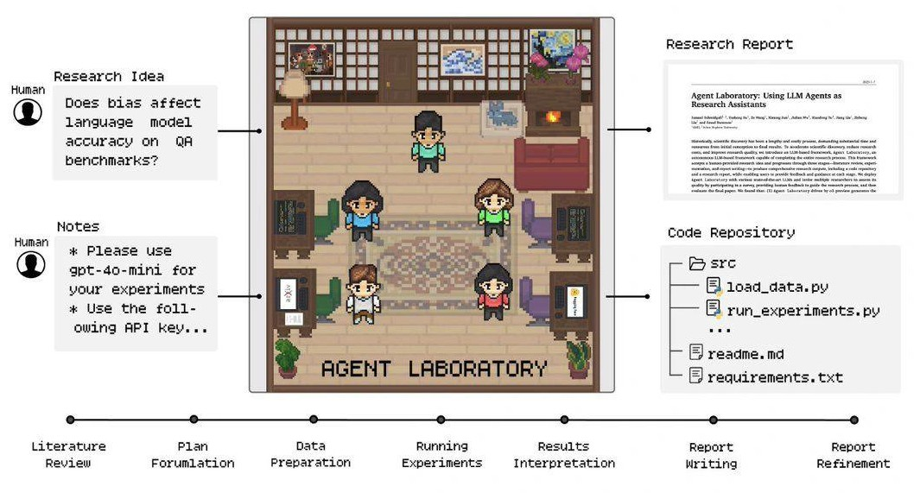
MULTI-AGENT AI
RESEARCH PAPER ASSISTANT
Guide: Dr. K. Gnanendra
Batch ID:AIML-C02
Regd No:23BQ1A61D1(TL) RegdNo:23BQ1A61B7,
Regd No:23BQ1A61F2, RegdNo:23BQ1A61D9
Literature Review
Ref-02 Agent Laboratory: Using LLM Agents as Research Assistants
Authors: Samuel Schmidgall, Yusheng Su, Ze Wang, Ximeng Sun, Jialian Wu, Xiaodong Yu, Jiang Liu
| Proposed Method | Data & Setup | key Results | Strengths & Limitations | Relevance to my research |
Main Idea
Agent Laboratory is an autonomous LLM-based framework designed to assist researchers throughout the research process.
It takes a human-provided research idea and supports:
Literature Review → Experimentation → Report Writing
The system produces research outputs including a research report and code repository.
PROPOSED METHOD
Research Idea → Literature Review → Research Planning → Experimentation → Analysis → Report Writing
LLM agents assist the researcher throughout the workflow, with human feedback and guidance.
Outputs
Research Report + Code Repository

Slide 9
MULTI-AGENT AI
RESEARCH PAPER ASSISTANT
Guide: Dr. K. Gnanendra
Batch ID:AIML-C02
Regd No:23BQ1A61D1(TL) RegdNo:23BQ1A61B7,
Regd No:23BQ1A61F2, RegdNo:23BQ1A61D9
Literature Review
Ref-02 Agent Laboratory: Using LLM Agents as Research Assistants
Authors: Samuel Schmidgall, Yusheng Su, Ze Wang, Ximeng Sun, Jialian Wu, Xiaodong Yu, Jiang Liu
| Proposed Method | Data & Setup | key Results | Strengths & Limitations | Relevance to my research |
Input
Human-provided research idea
Research Stages
Literature review
Research planning
Experimentation
Report writing
Outputs
Research report
Code repository
LLM-Based Architecture
Specialized agents perform different research tasks.
Human feedback can be incorporated at different stages.
The framework is designed to adapt to different computational resources.
Evaluation
The authors evaluated different state-of-the-art LLM configurations and collected researcher feedback on the generated research outputs.

Slide 10
MULTI-AGENT AI
RESEARCH PAPER ASSISTANT
Guide: Dr. K. Gnanendra
Batch ID:AIML-C02
Regd No:23BQ1A61D1(TL) RegdNo:23BQ1A61B7,
Regd No:23BQ1A61F2, RegdNo:23BQ1A61D9
Literature Review
Ref-02 Agent Laboratory: Using LLM Agents as Research Assistants
Authors: Samuel Schmidgall, Yusheng Su, Ze Wang, Ximeng Sun, Jialian Wu, Xiaodong Yu, Jiang Liu
| Proposed Method | Data & Setup | key Results | Strengths & Limitations | Relevance to my research |
o1-preview produced the best research outcomes among the evaluated configurations.
Generated machine-learning code achieved state-of-the-art performance in the reported experiments.
Human involvement improved the overall quality of research outputs.
The system reported an 84% reduction in research expenses compared with previous autonomous research methods.
Overall Finding
LLM agents can automate repetitive research activities while allowing researchers to focus more on ideation and critical thinking.

Slide 11
MULTI-AGENT AI
RESEARCH PAPER ASSISTANT
Guide: Dr. K. Gnanendra
Batch ID:AIML-C02
Regd No:23BQ1A61D1(TL) RegdNo:23BQ1A61B7,
Regd No:23BQ1A61F2, RegdNo:23BQ1A61D9
Literature Review
Ref-02 Agent Laboratory: Using LLM Agents as Research Assistants
Authors: Samuel Schmidgall, Yusheng Su, Ze Wang, Ximeng Sun, Jialian Wu, Xiaodong Yu, Jiang Liu
| Proposed Method | Data & Setup | key Results | Strengths & Limitations | Relevance to my research |
Strengths
Limitations
Supports the complete research workflow
Uses specialized LLM agents
Automates literature review
Supports experiment and code generation
Generates research reports
Keeps humans involved in the workflow
Reduces repetitive research effort
Requires human feedback for higher-quality research
Computational resources are needed for experimentation
Generated research still requires validation
Primarily focuses on the research lifecycle rather than multiple outputs from an uploaded paper

Slide 12
MULTI-AGENT AI
RESEARCH PAPER ASSISTANT
Guide: Dr. K. Gnanendra
Batch ID:AIML-C02
Regd No:23BQ1A61D1(TL) RegdNo:23BQ1A61B7,
Regd No:23BQ1A61F2, RegdNo:23BQ1A61D9
Literature Review
Ref-02 Agent Laboratory: Using LLM Agents as Research Assistants
Authors: Samuel Schmidgall, Yusheng Su, Ze Wang, Ximeng Sun, Jialian Wu, Xiaodong Yu, Jiang Liu
| Proposed Method | Data & Setup | key Results | Strengths & Limitations | Relevance to my research |
Supports the idea of using LLM agents as research assistants.
Demonstrates automation of literature-related research tasks.
Supports the use of specialized agents for different research activities.
Its code-generation capability relates to our Code Agent.
Our Extension
Agent Laboratory:
Research Idea → Literature Review → Experiments → Research Report
Our Project:
Uploaded PDF → RAG Retrieval → Manager Agent → Specialized Agents → Multiple Outputs
Our system focuses specifically on research-paper understanding and document-based assistance.

Slide 13
MULTI-AGENT AI
RESEARCH PAPER ASSISTANT
Guide: Dr. K. Gnanendra
Batch ID:AIML-C02
Regd No:23BQ1A61D1(TL) RegdNo:23BQ1A61B7,
Regd No:23BQ1A61F2, RegdNo:23BQ1A61D9
Literature Review
Ref 03 – MA-RAG: Multi-Agent Retrieval-Augmented Generation via Collaborative Chain-of-Thought Reasoning
Authors: Thang Nguyen, Peter Chin, Yu-Wing Tai
| Proposed Method | Data & Setup | key Results | Strengths & Limitations | Relevance to my research |
Main Idea
MA-RAG proposes a multi-agent RAG framework that uses specialized agents to handle complex information-seeking tasks.
It decomposes a complex query into smaller steps and performs retrieval, evidence extraction and answer synthesis collaboratively.
MA-RAG uses specialized agents:
Planner Agent
  Decomposes the user's complex query.
Step Definer
  Converts each step into a specific sub-query.
Retrieval
  Retrieves relevant information from the knowledge source.
Extractor Agent
  Selects relevant evidence from retrieved information.
QA Agent
  Synthesizes the final answer.
Workflow
User Query → Planner → Step Definer → Retrieval → Extractor → QA → Final Answer

Slide 14
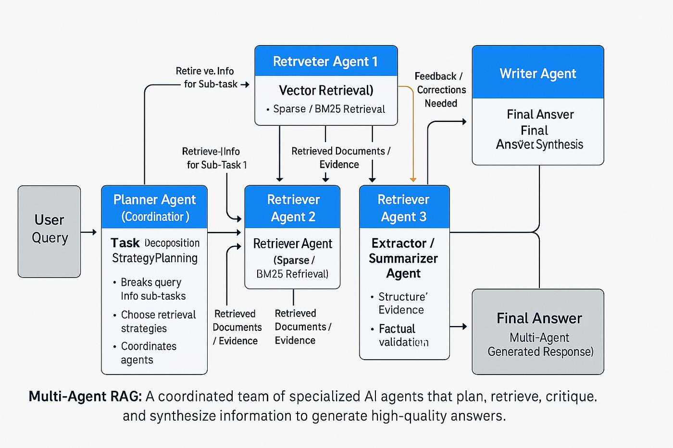
MULTI-AGENT AI
RESEARCH PAPER ASSISTANT
Guide: Dr. K. Gnanendra
Batch ID:AIML-C02
Regd No:23BQ1A61D1(TL) RegdNo:23BQ1A61B7,
Regd No:23BQ1A61F2, RegdNo:23BQ1A61D9
Literature Review
Ref 03 – MA-RAG: Multi-Agent Retrieval-Augmented Generation via Collaborative Chain-of-Thought Reasoning
Authors: Thang Nguyen, Peter Chin, Yu-Wing Tai
| Proposed Method | Data & Setup | key Results | Strengths & Limitations | Relevance to my research |
Benchmarks
Natural Questions (NQ)
TriviaQA
HotpotQA
2WikiMQA
FEVER
Models
LLaMA 3 8B
LLaMA 3 70B
GPT-4o-mini
Retrieval
Dense retrieval
FAISS
Text chunking
Embeddings
Top-k retrieval

Slide 15
MULTI-AGENT AI
RESEARCH PAPER ASSISTANT
Guide: Dr. K. Gnanendra
Batch ID:AIML-C02
Regd No:23BQ1A61D1(TL) RegdNo:23BQ1A61B7,
Regd No:23BQ1A61F2, RegdNo:23BQ1A61D9
Literature Review
Ref 03 – MA-RAG: Multi-Agent Retrieval-Augmented Generation via Collaborative Chain-of-Thought Reasoning
Authors: Thang Nguyen, Peter Chin, Yu-Wing Tai
| Proposed Method | Data & Setup | key Results | Strengths & Limitations | Relevance to my research |
KEY RESULTS
MA-RAG improved performance over corresponding training-free baselines on complex information-seeking tasks.
Specialized agents improved query decomposition and evidence extraction.
The framework handles information distributed across multiple sources.
Results demonstrate benefits for multi-hop and ambiguous question answering.
Overall Finding
Collaborative multi-agent reasoning can improve RAG performance by dividing complex retrieval and reasoning tasks among specialized agents.

Slide 16
MULTI-AGENT AI
RESEARCH PAPER ASSISTANT
Guide: Dr. K. Gnanendra
Batch ID:AIML-C02
Regd No:23BQ1A61D1(TL) RegdNo:23BQ1A61B7,
Regd No:23BQ1A61F2, RegdNo:23BQ1A61D9
Literature Review
Ref 03 – MA-RAG: Multi-Agent Retrieval-Augmented Generation via Collaborative Chain-of-Thought Reasoning
Authors: Thang Nguyen, Peter Chin, Yu-Wing Tai
| Proposed Method | Data & Setup | key Results | Strengths & Limitations | Relevance to my research |
Strengths
Limitations
Effective complex-query decomposition
Specialized retrieval and reasoning agents
Better evidence extraction
Reduces irrelevant context
Dynamic agent invocation
Training-free approach
Modular architecture
Supports multi-hop reasoning
Multi-agent coordination increases system complexity
Multiple retrieval/reasoning steps can increase computation
Stronger models may be required for complex agent tasks
Benefits may be smaller for simple single-hop questions
Maintaining intermediate reasoning across agents can be challenging

Slide 17
MULTI-AGENT AI
RESEARCH PAPER ASSISTANT
Guide: Dr. K. Gnanendra
Batch ID:AIML-C02
Regd No:23BQ1A61D1(TL) RegdNo:23BQ1A61B7,
Regd No:23BQ1A61F2, RegdNo:23BQ1A61D9
Literature Review
Ref 03 – MA-RAG: Multi-Agent Retrieval-Augmented Generation via Collaborative Chain-of-Thought Reasoning
Authors: Thang Nguyen, Peter Chin, Yu-Wing Tai
| Proposed Method | Data & Setup | key Results | Strengths & Limitations | Relevance to my research |
Directly supports our RAG architecture.
Planner concept supports our Manager Agent.
Retrieval mechanism supports searching relevant content from uploaded research papers.
Extractor concept supports extracting evidence from paper sections.
Specialized agents demonstrate how different tasks can be distributed.
Application in Our Project:
Research Paper PDF
↓
Text Extraction
↓
Embeddings + Vector Database
↓
Relevant Passage Retrieval
↓
Manager Agent
↓
Summary / Reference / Presentation / Email / Code Agents

Slide 18
MULTI-AGENT AI
RESEARCH PAPER ASSISTANT
Guide: Dr. K. Gnanendra
Batch ID:AIML-C02
Regd No:23BQ1A61D1(TL) RegdNo:23BQ1A61B7,
Regd No:23BQ1A61F2, RegdNo:23BQ1A61D9
Literature Review - Summary
Reference | Year | Main Idea | Strengths | Limitations
Schmidgall et al. | 2025 | LLM agents for research assistance | Automation, coding, report generation | Human validation, high computation
Nguyen et al. | 2025 | Multi-agent RAG for retrieval and reasoning | Query decomposition, evidence retrieval | Coordination complexity
Rajasekaran et al. | 2026 | Autonomous multi-agent research workflow | End-to-end automation, verification | API dependency, human review

Slide 19
MULTI-AGENT AI
RESEARCH PAPER ASSISTANT
Guide: Dr. K. Gnanendra
Batch ID:AIML-C02
Regd No:23BQ1A61D1(TL) RegdNo:23BQ1A61B7,
Regd No:23BQ1A61F2, RegdNo:23BQ1A61D9
Review – 1
Questions?

