Slide 1
Object-oriented Design
Naveen Kumar K S
Adith.naveen@gmail.com
http://naveenks.com

Slide 2
Objectives
To explain how a software design may be represented as a set of interacting objects that manage their own state and operations
To describe the activities in the object-oriented design process
To introduce various models that can be used to describe an object-oriented design
Discuss real life scenario based on E-R diagram.

Slide 3
Object-oriented development
Object-oriented analysis, design and programming are related but distinct.
OOA is concerned with developing an object model of the application domain.
OOD is concerned with developing an object-oriented system model to implement requirements.
OOP is concerned with realising an OOD using an OO programming language such as Java or C++.

Slide 4
Characteristics of OOD
Objects are abstractions of real-world or system entities and manage themselves.
Objects are independent and encapsulate state and representation information.
System functionality is expressed in terms of object services.
Shared data areas are eliminated. Objects
communicate by message passing.
Objects may be distributed and may execute
sequentially or in parallel.

Slide 5
Advantages of OOD
Easier maintenance. Objects may be
understood as stand-alone entities.
Objects are potentially reusable components.
For some systems, there may be an obvious
mapping from real world entities to system
objects.

Slide 6
Objects and object classes
Objects are entities in a software system which represent instances of real-world and system entities.
Object classes are templates for objects. They may be used to create objects.
Object classes may inherit attributes and services from other object classes.

Slide 7
UML associations
Objects and object classes participate in relationships with other objects and object classes.
In the UML, a generalised relationship is indicated by an association.
Associations may be annotated with information that describes the association.
Associations are general but may indicate that an attribute of an object is an associated object or that a method relies on an associated object.

Slide 8
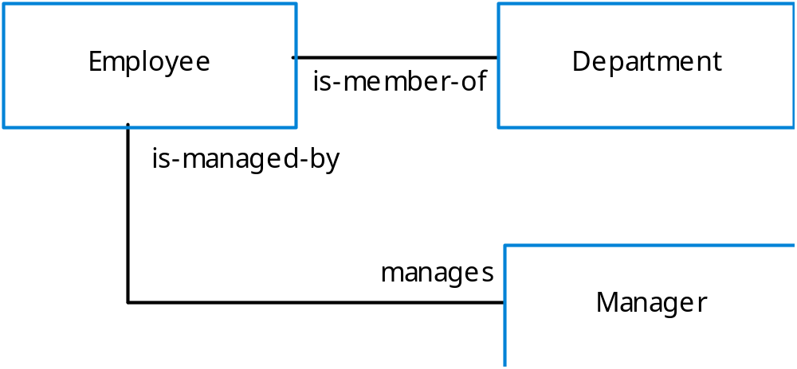
An association model

Slide 9
What is DBMS ?
(DataBase Management System)
A collection of programs that enables you to store, modify, and extract information from a database.
The general purpose of a DBMS is to provide for the definition, storage, and management of data in a centralized area that can be shared by many users.

Slide 10
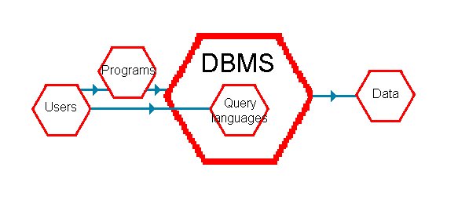
The place of a DBMS
The diagram shows that, in order to reach any of the data, a program must go via the DBMS.
Many DBMSs provide a query language or an enquiry language which allows you to make enquiries about their data and to handle the data without having to write a program.

Slide 11
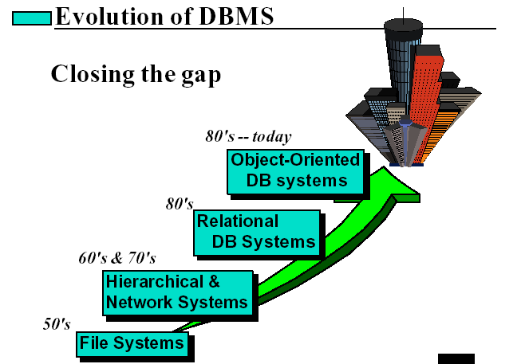

Slide 12
Data structure diagram
A useful way in which we can depict the entities and the relationships between them is by means of a data structure diagram or DSD.
It is a picture of the data encountered within a computer system.
The data structure diagram is also known as a data model or a logical model or an entity-relationship model.

Slide 13
A data structure diagram
Entities
This DSD tells us that we need to hold data about:
The tutors
The courses, and
The students
The information which we need to know about each entity are its attributes
TUTOR
teaches on
COURSE
attended by
STUDENT

Slide 14
Data structure diagram showing attributes
Tutor number
Name
Address
Subjects taught
TUTOR
teaches on
COURSE
Title
Examinations available
attended by
Student enrolment number
Name
Address
Telephone number
Subjects studied
STUDENT

Slide 15
Relationships
An entity does not exist in isolation, but is associated with other entities by means of a relationship.
On a DSD the entities are linked, one to another, by lines representing the relationships.
The relationships in our DSD are:
teaches on - One tutor teaches on many courses.
is attended by - Each course is attended by many students.
Note that the arrowed lines point from the one end to the many end: from the one tutor to the many courses, and from the one course to the many students.

Slide 16
Cardinality Ratio
One – One
One – Many
Many – One
Many - Many

Slide 17
Navigating through a data structure diagram
In any data structure diagram, it should be possible conceptually to navigate from entity to entity by way of the relationships.
By doing this, we shall be creating paths by which the DBMS – or our programs – can access the data and use these paths to answer enquiries about the data.

Slide 18
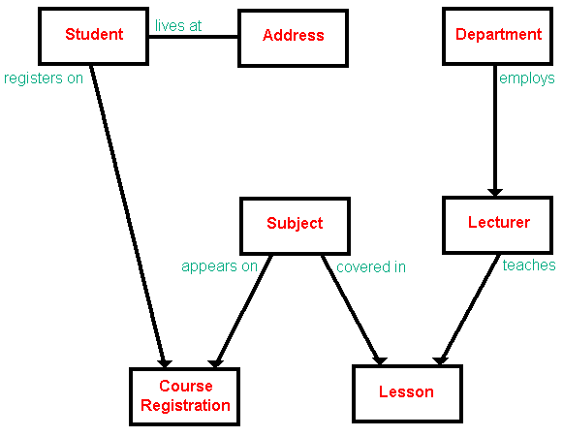

Slide 19
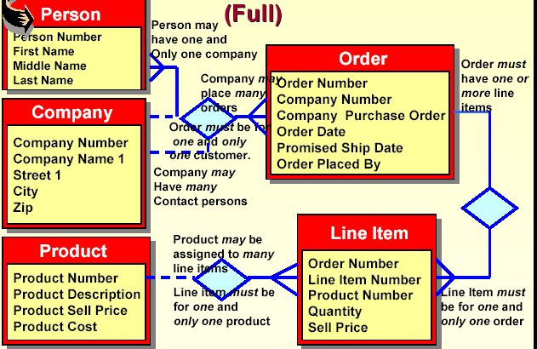

Slide 20
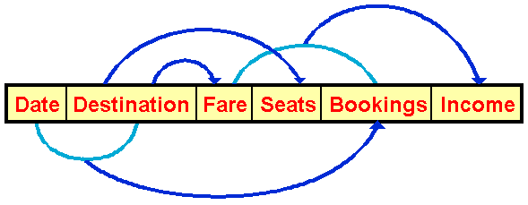
Functional dependencies
The fare is functionally dependent upon the destination (that is, if we know the destination then we can find the fare)
The number of seats is functionally dependent upon the destination (if we know the destination then we can find the number of seats)
The income is functionally dependent upon the fare and the number of bookings (if we know the fare and the number of bookings then we can find the income)
The number of bookings is functionally dependent upon the date and the destination (if we know the date and the destination then we can find the number of bookings)

Slide 21
NORMALIZATION
Normalization is the process of decomposing and arranging the attributes in a schema#, which results in a set of tables with very simple structures.
The purpose of normalization is to make tables as simple as possible.
There are different types of normal forms i.e., First normal form, Second normal form, Third normal form, Forth normal form, Boyce/Codd Normal Form etc.,
# A schema is a description of a particular collection of data, using the given data model (relational model).

Slide 22
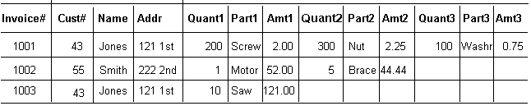
FIRST NORMAL FORM
Reduce entities to first normal form (1NF) by removing repeating or multivalued attributes to another, child entity

Slide 23
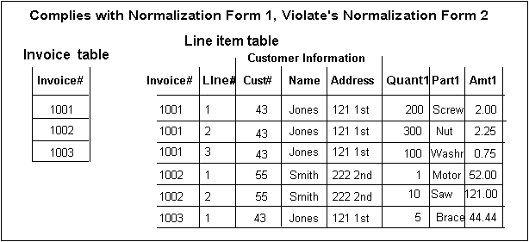
Relation in 1NF

Slide 24
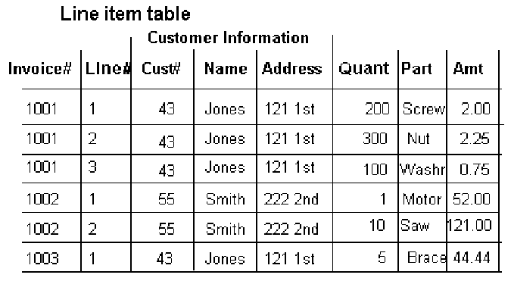
Second Normal Form
Reduce first normal form entities to second normal form (2NF) by removing attributes that are not dependent on the whole primary key (partial dependency)

Slide 25
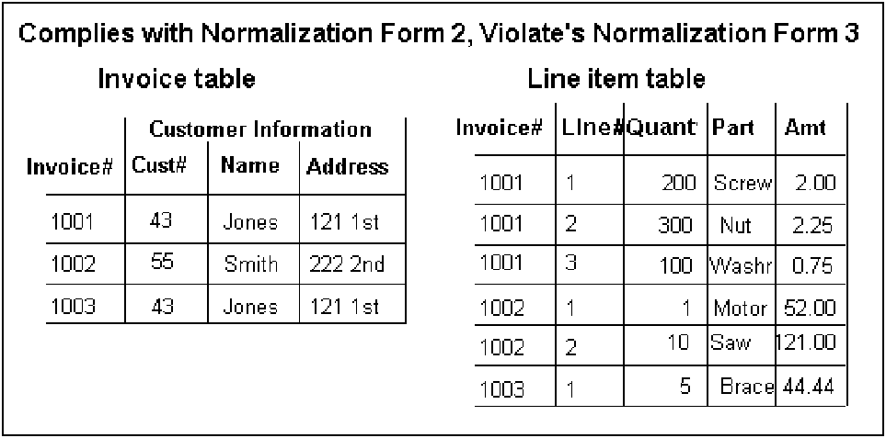
Relation in 2NF

Slide 26
Transitive dependency
An attribute in a table is dependent on another non primary key attribute rather than the primary key.
A condition where A, B, and C are attributes of a relation such that
if A -> B and B -> C
then C is transitively dependent on A via B i.e, A->C is a transitive dependency.
This situation is eliminated when the table is in third normal form.

Slide 27
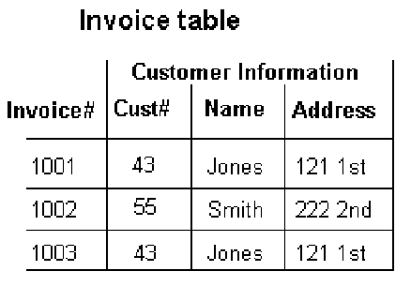
Third Normal Form
A relation is in third normal form (3NF) if it is in second normal form and it contains no transitive dependencies.
OR
Reduce second normal form entities to third normal form (3NF) by removing attributes that depend on other, nonkey attributes.

Slide 28
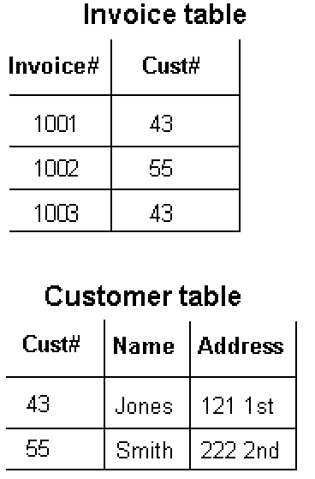
Decomposed into 3NF

Slide 29
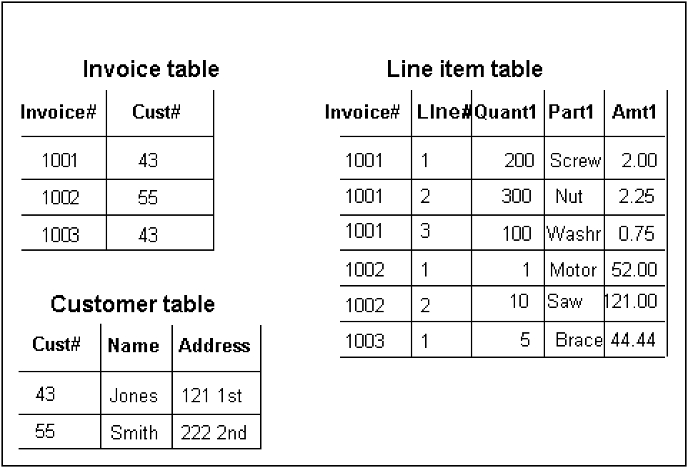
All the tables

Slide 30


