Slide 1
GIT
Naveen Kumar K S

Slide 2
Agenda
History of Git
Distributed V.S Centralized Version Control
GIT Architecture
Getting started
Branching and Merging
Working with remote
Summary

Slide 3
A Brief History
Linus Torvalds uses BitKeeper to manage Linux code
Ran into BitKeeper licensing issue
Liked functionality
Looked at CVS as how not to do things
April 5, 2005 - Linus sends out email showing first version
June 15, 2005 - Git used for Linux version control

Slide 4

GIT is not SCM
Never mind merging. It's not an SCM, it's a distribution and archival mechanism. I bet you could make a reasonable SCM on top of it, though. Another way of looking at it is to say that it's really a content-addressable filesystem, used to track directory trees.
Linus Torvalds, 7 Apr 2005

Slide 5
Centralized Version Control
Traditional version control system
Server with database
Clients have a working version
Examples
CVS
Subversion
Visual Source Safe
Challenges
Multi-developer conflicts
Client/server communication

Slide 6
Advantages
Resilience
No one repository has more data than any other
Speed
Very fast operations compared to other VCS (I’m looking at you CVS and Subversion)
Space
Compression can be done across repository not just per file
Minimizes local size as well as push/pull data transfers
Simplicity
Object model is very simple
Large userbase with robust tools

Slide 7
Disadvantages
Definite learning curve, especially for those used to centralized systems
Can sometimes seem overwhelming to learn
Conceptual difference
Huge amount of commends

Slide 8
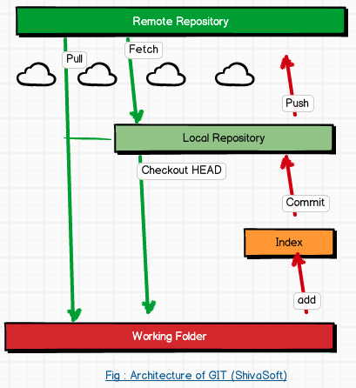
GIT Architecture

Slide 9
Before that lets Install
You can download GIT from
https://git-scm.com/downloads
Latest Version : 2.4.2

Slide 10
Getting Started
A basic workflow
(Possible init or clone) Init a repo
Edit files
Stage the changes
Review your changes
Commit the changes

Slide 11
git init
The git init command creates a new Git repository.
It can be used to convert an existing, unversioned project to a Git repository or initialize a new empty repository.
Executing git init creates a .git subdirectory in the project root, which contains all of the necessary metadata for the repo.
View with ls -la

Slide 12
git init
git init <directory>
Above command will create an empty Git repository in the specified directory. Running this command will create a new folder called <directory> containing nothing but the .git subdirectory.

Slide 13
git bare
Syntax : git init --bare <directory>
Example : git init –bare my-project.git
Initialize an empty Git repository, but omit the working directory.
Shared repositories should always be created with the --bare flag
Conventionally, repositories initialized with the --bare flag end in .git.

Slide 14
Bare Repositories
The --bare flag creates a repository that doesn’t have a working directory, making it impossible to edit files and commit changes in that repository.
Central repositories should always be created as bare repositories because pushing branches to a non-bare repository has the potential to overwrite changes
Virtually all Git workflows, the central repository is bare, and developers local repositories are non-bare.

Slide 15
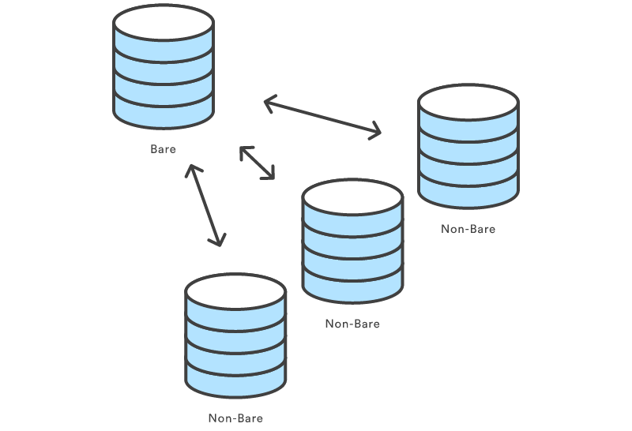
Bare Repositories

Slide 16
git clone
The git clone command copies an existing Git repository(This is sort of like svn checkout).
Git repository—it has its own history, manages its own files, and is a completely isolated environment from the original repository.
Usage : git clone <repo>
a remote machine accessible via HTTP or SSH.
git clone <repo> <directory>
Clone the repository located at <repo> into the folder called <directory> on the local machine.

Slide 17
GIT vs SVN
Unlike SVN, Git makes no distinction between the working copy and the central repository—they are all full-fledged Git repositories.
SVN depends on the relationship between the central repository and the working copy, Git’s collaboration model is based on repository-to-repository interaction.
In GIT you push or pull commits from one repository to another.

Slide 18
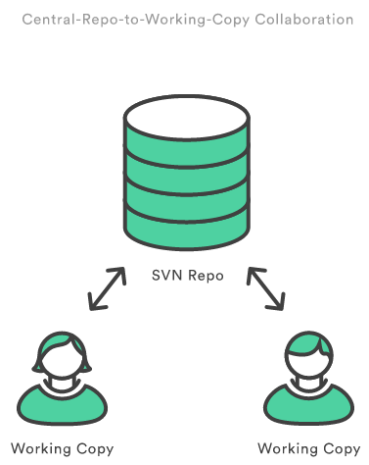
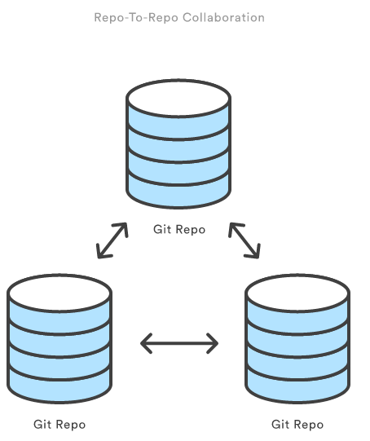
GIT vs SVN

Slide 19
git config
he git config command lets you configure your Git installation (or an individual repository) from the command line.
Usage: git config user.name <name>
Define the author name to be used for all commits in the current repository.
Typically, you’ll want to use the --global flag to set configuration options for the current user.

Slide 20
git config
git config --global user.name <name>
Define the author name to be used for all commits by the current user.
git config --global user.email <email>
Define the author email to be used for all commits by the current user.
git config --global alias.<alias-name> <git-command>
Create a shortcut for a Git command.

Slide 21
git config
git config --system core.editor <editor>
Define the text editor used by commands
Note: editor : vim, notepad.exe etc
git config --global --edit
Open the global configuration file in a text editor for manual editing.

Slide 22
git config
Git stores configuration options in three separate files, which lets you scope options to individual repositories, users, or the entire system:
<repo>/.git/config – Repository-specific settings.
~/.gitconfig – User-specific settings. This is where options set with the --global flag are stored.
$(prefix)/etc/gitconfig – System-wide settings.

Slide 23
git add
The git add command adds a change in the working directory to the staging area.
However, git add doesn't really affect the repository in any significant way—changes are not actually recorded until you run git commit.
Usage : git add <file>
Stage all changes in <file> for the next commit.
git add <directory>
Stage all changes in <file> for the next commit.

Slide 24
git add
Example
When you’re starting a new project, git add serves the same function as svn import.
git add . (dot for all files)
git commit
For Individual File
git add Hello.java
git commit

Slide 25
Stage Area
It helps to think of it as a buffer between the working directory and the project history.

Slide 26
git commit
Snapshots are always committed to the local repository. This is fundamentally different from SVN, wherein the working copy is committed to the central repository.
Just as the staging area is a buffer between the working directory and the project history, each developer’s local repository is a buffer between their contributions and the central repository.

Slide 27
Inspecting a repository
git status
The git status command displays the state of the working directory and the staging area.
It lets you see which changes have been staged, which haven’t, and which files aren’t being tracked by Git.
Usage: git status

Slide 28
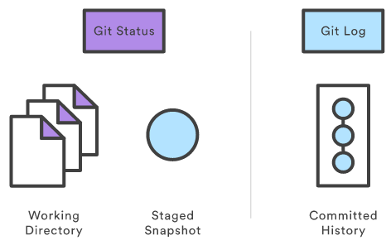
Inspecting a repository
git log
The git log command displays committed snapshots.
It lets you list the project history, filter it, and search for specific changes.
While git status lets you inspect the working directory and the staging area.

Slide 29
Customized git log
git log
Display the entire commit history using the default formatting.
git log -n <limit>
Limit the number of commits by <limit>. For example, git log -n 3 will display only 3 commits.
git log --oneline
Condense each commit to a single line.

Slide 30
Customized git log
git log --stat
Along with the ordinary git log information, include which files were altered
git log -p
Display the patch representing each commit.
git log --author="<pattern>"
Search for commits by a particular author.

Slide 31
Customized git log
git log --grep="<pattern>"
Search for commits with a commit message that matches <pattern>
git log <file>
Only display commits that include the specified file.
git log --graph --decorate –oneline
—graph flag that will draw a text based graph of the commits on the left hand side of the commit messages.
—decorate adds the names of branches or tags of the commits that are shown.

Slide 32
Viewing old commits
git checkout
The git checkout command serves three distinct functions: checking out files, checking out commits, and checking out branches.
Lets concentrate only on two, later on branches

Slide 33
Viewing old commits
Usage: git checkout master
Return to the master branch.
Usage: git checkout <commit> <file>
Example: git checkout a1e8fb5 Hello.java
Check out a previous version of a file.

Slide 34
Viewing old commits
Usage: git checkout <commit>
Example: git checkout a1e8fb5
Update all files in the working directory to match the specified commit.
You can check out the most recent version with the following:
Example: git checkout HEAD Hello.java

Slide 35
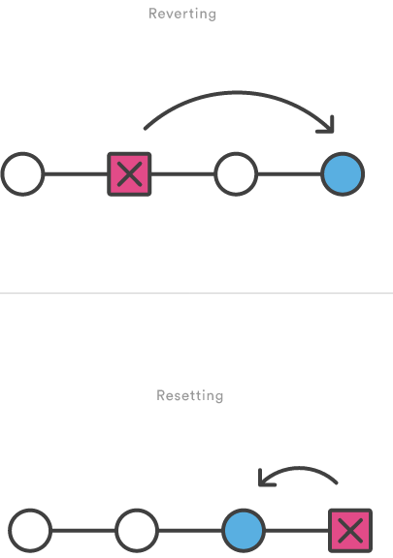
git revert
Usage: git revert <commit>
Generate a new commit that undoes all of the changes introduced in <commit>, then apply it to the current branch.
Note: It's important to understand that git revert undoes a single commit, as shown in next slide

Slide 36
git revert
Example
The following example is a simple demonstration of git revert. It commits a snapshot, then immediately undoes it with a revert.
# Edit some tracked files
# Commit a snapshot
git commit -m "Make some changes that will be undone”
# Revert the commit we just created
git revert HEAD

Slide 37
git revert
git revert –abort
To abort the revert process

Slide 38
git reset
If git revert is a “safe” way to undo changes, you can think of git reset as the dangerous method.
When you undo with git reset there is no way to retrieve the original copy—it is a permanent undo.
git reset --hard <commit>
Move the current branch tip backward to <commit> and reset both the staging area and the working directory to match. This obliterates not only the uncommitted changes, but all commits after <commit>, as well.
Notes:
git reset –hard a2ae83 commit version number

Slide 39
git clean
git clean –n
Perform a “dry run” of git clean. This will show you which files are going to be removed without actually doing it.
git clean -f
Remove untracked files from the current directory. The -f (force) flag is required unless the clean

Slide 40
git clean
git clean -f <path>
Remove untracked files, but limit the operation to the specified path.
git clean -df
Remove untracked files and untracked directories from the current directory.

Slide 41
git clean
git clean -xf
Remove untracked files from the current directory as well as any files that Git usually ignores.

Slide 42
Rewriting history
We discusses some of the most common reasons for overwriting committed snapshots and shows you how to avoid the pitfalls of doing so.

Slide 43
--amend
The git commit --amend command is a convenient way to fix up the most recent commit.
It lets you combine staged changes with the previous commit instead of committing it as an entirely new snapshot.
It can also be used to simply edit the previous commit message without changing its snapshot.

Slide 44
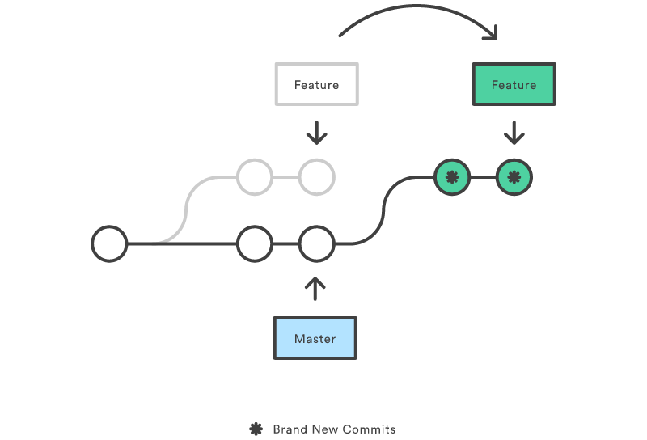
git rebase
Rebasing is the process of moving a branch to a new base commit.
The general process can be visualized as the following:

Slide 45
git rebase
Rebasing really is just moving a branch from one commit to another
But internally, Git accomplishes this by creating new commits and applying them to the specified base—it’s literally rewriting your project history.
Usage
git rebase <base>

Slide 46
Example - rebase
# Start a new feature
git checkout -b new-feature master
# Edit files
git commit -a -m "Start developing a feature"
Notes:
To delete the branch : Git branch –D <branch-name>
To View all branchs : git branch –a/git branch

Slide 47
In the middle of our feature, we realize there’s a security hole in our project
# Create a hotfix branch based off of master
git checkout -b hotfix master
# Edit files
git commit -a -m "Fix security hole"
# Merge back into master
git checkout master
git merge hotfix
git branch -d hotfix

Slide 48
After merging the hotfix into master, we have a forked project history. Instead of a plain git merge, we’ll integrate the feature branch with a rebase to maintain a linear history:
git checkout new-feature
git rebase master
This moves new-feature to the tip of master, which lets us do a standard fast-forward merge from master:
git checkout master
git merge new-feature

Slide 51
git reflog
Git keeps track of updates to the tip of branches using a mechanism called reflog.
Usage:git reflog
Show the reflog for the local repository.
git reflog --relative-date
Show the reflog with relative date information (e.g. 2 weeks ago).

Slide 52

Syncing

Slide 53
SVN vs GIT
SVN uses a single central repository to serve as the communication
This is different from Git’s collaboration model, which gives every developer their own copy of the repository, complete with its own local history and branch structure.
Git lets you share entire branches between repositories.

Slide 54
git remote
The git remote command lets you create, view, and delete connections to other repositories.

