Slide 1
PostgreSQL
Naveen Kumar K S

Slide 2
Lets Start
https://www.postgresql.org/docs/11/index.html
https://www.postgresqltutorial.com/psql-commands/

Slide 3
Command Line
To start postgres from comman line
> psql -U postgres -h localhost <enter>

Slide 4
Quick Commands
\c <db_name> or \connect <db_name>
\l – list all the databases
\dt - To list all tables in the current database
\d <table_name> - describe table
\du - To list all users and their assign roles
select version();
\g – execute previous command
\s – display command history

Slide 5
Create Table Schema
CREATE TABLE enrollment.student (
student_id INT,
name VARCHAR(25),
major VARCHAR(15),
gpa DECIMAL(6,3),
PRIMARY KEY (student_id)
);
CREATE TABLE enrollment.course (
course_id VARCHAR(15),
name VARCHAR(25),
department_id VARCHAR(10),
PRIMARY KEY (course_id)
);
CREATE TABLE enrollment.enroll (
student_id INT,
course_id VARCHAR(15),
grade CHAR(2),
PRIMARY KEY (student_id, course_id),
FOREIGN KEY (student_id) REFERENCES enrollment.student(student_id),
FOREIGN KEY (course_id) REFERENCES enrollment.course(course_id)
);

Slide 6
Add instances to tables
INSERT INTO enrollment.student VALUES (101, 'Bill', 'CIS', 3.45);
INSERT INTO enrollment.student VALUES (102, 'Mary', 'CIS', 3.10);
INSERT INTO enrollment.student VALUES (103, 'Sue', 'MKT', 3.90);
INSERT INTO enrollment.course VALUES ('CIS3100', 'Database', 'CIS');
INSERT INTO enrollment.course VALUES ('CIS3400', 'Network I', 'CIS');
INSERT INTO enrollment.course VALUES ('CIS3500', 'Network II', 'CIS');
INSERT INTO enrollment.course VALUES ('MKT3000', 'Advertizing', 'MKT');
INSERT INTO enrollment.course VALUES ('MKT3200', 'Marketing I', 'MKT');
INSERT INTO enrollment.course VALUES ('MKT4200', 'Marketing II', 'MKT');
INSERT INTO enrollment.enroll VALUES (101, 'CIS3100', 'A');
INSERT INTO enrollment.enroll VALUES (101, 'CIS3500', 'B+');
INSERT INTO enrollment.enroll VALUES (102, 'CIS3100', 'A-');
INSERT INTO enrollment.enroll VALUES (102, 'CIS3400', 'A');
INSERT INTO enrollment.enroll VALUES (103, 'MKT3000', 'A');
INSERT INTO enrollment.enroll VALUES (103, 'MKT3200', 'B');
INSERT INTO enrollment.enroll VALUES (103, 'MKT4200', 'B+');

Slide 7
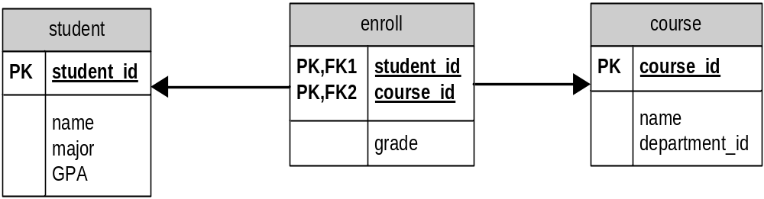
Example
student_id | name | major | GPA
101 | Bill | CIS | 3.45
102 | Mary | CIS | 3.10
103 | Sue | MKT | 3.90
student_id | course_id | grade
101 | CIS3100 | A
101 | CIS3500 | B+
102 | CIS3100 | A-
102 | CIS3400 | A
103 | MKT3000 | A
103 | MKT3200 | B
103 | MKT4200 | B+
course_id | name | department_id
CIS3100 | Database | CIS
CIS3400 | Network I | CIS
CIS3500 | Network II | CIS
MKT3000 | Advertising | MKT
MKT3200 | Marketing I | MKT
MKT4200 | Marketing II | MKT

Slide 8
SQL: Creating/Dropping table
Create Table
  CREATE TABLE enrollment.student1 (
  student_id INT,
  name VARCHAR(25),
  major VARCHAR(15),
  gpa DECIMAL(6,3),
  PRIMARY KEY (student_id)
  );
Drop table
  DROP TABLE enrollment.student1;

Slide 9
Modifying table data
INSERT INTO enrollment.student VALUES (104, 'Ying', 'SLIS', 3.5);
SELECT * FROM enrollment.student;
UPDATE enrollment.student SET name='Ding' WHERE student_id=104;
DELETE FROM enrollment.student WHERE student_id=104;

Slide 10
Altering tables
ALTER TABLE enrollment.student ADD Available CHAR(1);
ALTER TABLE enrollment.student DROP Available;

Slide 11
Queries
SELECT * FROM enrollment.course LIMIT 3;
SELECT * FROM enrollment.enroll WHERE grade='A';
SELECT * FROM enrollment.student WHERE student.student_id=(SELECT enroll.student_id FROM enrollment.enroll WHERE grade='A-');
SELECT * FROM enrollment.student WHERE student.student_id IN (SELECT enroll.student_id FROM enrollment.enroll WHERE grade='A');
SELECT student.name FROM enrollment.student, enrollment.enroll WHERE student.student_id=enroll.student_id AND enroll.grade='A';

Slide 12
Sorting and Grouping
SELECT * FROM enrollment.enroll ORDER BY grade, course_id;
SELECT major, max(gpa) FROM enrollment.student GROUP BY major, gpa HAVING max(gpa)>3.40;
SELECT DISTINCT grade FROM enrollment.enroll;

Slide 13
Joining tables
SELECT student.name, enroll.course_id, enroll.grade FROM enrollment.student INNER JOIN enrollment.enroll ON student.student_id=enroll.student_id;
SELECT * FROM enrollment.student LEFT JOIN enrollment.enroll ON student.student_id=enroll.student_id;
SELECT * FROM enrollment.student RIGHT JOIN enrollment.enroll ON student.student_id=enroll.student_id;

