Slide 1
UML, Use Case, Sequence Diagram
UML Training Program

Slide 2

What is Use Case Modeling?
Use Case Model: a view of a system that emphasizes the behavior as it appears to outside users. A use case model partitions system functionality into transactions (‘use cases’) that are meaningful to users (‘actors’).

Slide 3
Use Case Modeling: Core Elements

Slide 4
Use Case Modeling: Core Relationships
<<extend>>

Slide 5
Use Case Modeling: Core Relationships
<<include>>

Slide 6

Use Case Diagram Tour
Shows use cases, actor and their relationships
Use case internals can be specified by text and/or interaction diagrams
Kinds
use case diagram
use case description

Slide 7
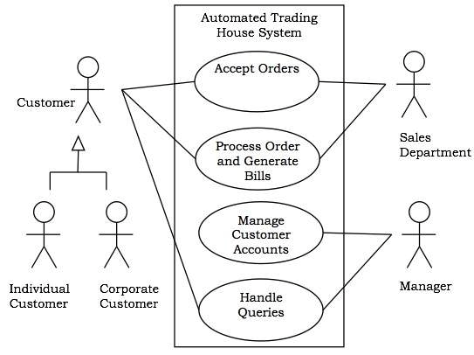
Use Case Diagram

Slide 8
Introduction to UML
What is UML?
Motivations for UML
Types of UML diagrams
UML syntax
Descriptions of the various diagram types
Rational Rose and UML
UML pitfalls

Slide 9
What is UML?
A standardized, graphical “modeling language” for communicating software design.
Allows implementation-independent specification of:
user/system interactions (required behaviors)
partitioning of responsibility (OO)
integration with larger or existing systems
data flow and dependency
operation orderings (algorithms)
concurrent operations
Pretty pictures.
UML is not “process”

Slide 10
Motivations for UML
UML is a fusion of ideas from several precursor modeling languages. We need a modeling language to:
help develop efficient, effective and correct designs, particularly Object Oriented designs.
communicate clearly with project stakeholders (concerned parties: developers, customer, etc).
give us the “big picture” view of the project.

Slide 11
Types of UML Diagrams
There are different types of UML diagram, each with slightly different syntax rules:
use cases.
class diagrams.
sequence diagrams.
package diagrams.
state diagrams
activity diagrams
deployment diagrams.

Slide 12
UML Syntax, 1
Actors: a UML actor indicates an interface (point of interaction) with the system.
We use actors to group and name sets of system interactions.
Actors may be people, or other systems.
An actor is NOT part of the system you are modeling. An actor is something external that your system has to deal with.
Boxes: boxes are used variously throughout UML to indicate discrete elements, groupings and containment.

Slide 13
UML Syntax, 2
Arrows: arrows indicate all manner of things, depending on which particular type of UML diagram they’re in. Usually, arrows indicate flow, dependency, association or generalization.
Cardinality: applied to arrows, cardinalities show relative numerical relationships between elements in a model: 1 to 1, 1 to many, etc.

Slide 14
UML Syntax, 3
Constraints: allow notation of arbitrary constraints on model elements. Used, for example, to constrain the value of a class attribute (a piece of data).
Stereotypes: allow us to extend the semantics of UML with English. A stereotype is usually a word or short phrase that describes what a diagram element does. That is, we mark an element with a word that will remind us of a common (stereotypical) role for that sort of thing. Stereotypes should always be applied consistently (with the same intended meaning in all instances).
Notes:
Stereotype - A conventional or formulaic conception or image

Slide 15
UML Diagrams: Use Cases
A use case encodes a typical user interaction with the system. In particular, it:
captures some user-visible function.
achieves some concrete goal for the user.
A complete set of use cases largely defines the requirements for your system: everything the user can see, and would like to do.
The granularity of your use cases determines the number of them (for you system). A clear design depends on showing the right level of detail.
A use case maps actors to functions. The actors need not be people.

Slide 16
UML Pitfalls, 1
UML is a language, with a (reasonably) rigorous syntax and accepted semantics; that is, the diagrams have a meaning. Thus you have to be careful that the meaning of your diagram is what you intended.
However, the semantics of UML are less well-defined than a programming language (where the semantics are defined by the compiler). Thus there is some leeway to use UML your own way: but you must be consistent in what you mean by the things you draw.

Slide 17
UML Pitfalls, 2
Arrow happiness: people tend to draw arrows (associations) everywhere in their diagrams, inconsistently without much regard for the UML meaning of a given arrow.
Diagram fever: it’s easy to do too many diagrams. The trick is to get the correct granularity. Eg, the requirements document should leave implementation detail to the architecture.
General loopiness: be careful about slapping together UML diagrams, or doing a diagram without thoroughly understanding your system. You should always be able to give a clear and concise explanation of your diagram, and why you did it that way.

Slide 18
UML Diagrams: Class Diagram
Motivated by Object-Oriented design and programming (OOD, OOP).
A class diagram partitions the system into areas of responsibility (classes), and shows “associations” (dependencies) between them.
Attributes (data), operations (methods), constraints, part-of (navigability) and type-of (inheritance) relationships, access, and cardinality (1 to many) may all be noted.

Slide 19
Class Diagram: Perspective
Class diagrams can make sense at three distinct levels, or perspectives:
Conceptual: the diagram represents the concepts in the project domain. That is, it is a partitioning of the relevant roles and responsibilities in the domain.
Specification: shows interfaces between components in the software. Interfaces are independent of implementation.
Implementation: shows classes that correspond directly to computer code (often Java or C++ classes). Serves as a blueprint for an actual realization of the software in code.

Slide 20
What is a Class Diagram?
A class diagram is a view of the static structure of a system. Models contain many class diagrams
Class diagrams contain packages, classes, interfaces, and relationships
Package
Class Name
<<Interface>>
Name
Interface Name

Slide 21
Relationships
Class diagrams may contain the following relationships: Association, aggregation, dependency, realize, and inheritance
Association
Aggregation
Dependency
Inheritance
Realize

Slide 22
Multiplicity Indicators
Each end of an association or aggregation contains a multiplicity indicator. Indicates the number of objects participating in the relationship
Exactly one
1
0..*
Zero or more
1..*
One or more
0..1
Zero or one
2..7
Specified range

