Slide 1
Mechanical Engineering: (Machine Learning project)
CAPSTONE PROJECT
Presented By:
1. ZUBER SHAIK-Raghu Engineering College-CSM(AI-ML)

Slide 2
OUTLINE
Problem Statement (Should not include solution)
Proposed System/Solution
System Development Approach (Technology Used)
Algorithm & Deployment
Result (Output Image)
Conclusion
Future Scope
References

Slide 3
Problem Statement
Develop a predictive maintenance model for a fleet of industrial machines to anticipate failures before they occur. This project will involve analyzing sensor data from machinery to identify patterns that precede a failure. The goal is to create a classification model that can predict the type of failure (e.g., tool wear, heat dissipation, power failure) based on real-time operational data. This will enable proactive maintenance, reducing downtime and operational costs.

Slide 4
Proposed Solution
The proposed system aims to address the challenge of predicting the required bike count at each hour to ensure a stable supply of rental bikes. This involves leveraging data analytics and machine learning techniques to forecast demand patterns accurately. The solution will consist of the following components:
Data Collection:
Gather historial data developing a model of data in meachine learning
Utilize real-time data sources, such as Air temperature,process temperature, Rotational speed , Target
Data Preprocessing:
Clean and preprocess the collected data to handle missing values, outliers, and inconsistencies.
Feature engineering to extract relevant features from the data that might impact future demand.
Machine Learning Algorithm:
Implement a machine learning algorithm, such as a time-series forecasting model (e.g., ARIMA, SARIMA, or LSTM), to predict bike counts based on historical patterns.
Consider incorporating other factors like weather conditions, day of the week, and special events to improve prediction accuracy.
Deployment:
Develop a user-friendly interface or application that provides real-time predictions for bike counts at different hours.
Deploy the solution on a scalable and reliable platform, considering factors like server infrastructure, response time, and user accessibility.
Evaluation:
Assess the model's performance using appropriate metrics such as Mean Absolute Error (MAE), Root Mean Squared Error (RMSE), or other relevant metrics.
Fine-tune the model based on feedback and continuous monitoring of prediction accuracy.
Result:

Slide 5
System Approach
The "System Approach" section outlines the overall strategy and methodology for developing and implementing the rental bike prediction system. Here's a suggested structure for this section:
System requirements
Library required to build the model

Slide 6
Algorithm & Deployment
In the Algorithm section, describe the machine learning algorithm chosen for predicting bike counts. Here's an example structure for this section:
Algorithm Selection:
Provide a brief overview of the chosen algorithm (e.g., time-series forecasting model, like ARIMA or LSTM) and justify its selection based on the problem statement and data characteristics.
Data Input:
Specify the input features used by the algorithm, such as historical bike rental data, weather conditions, day of the week, and any other relevant factors.
Training Process:
Explain how the algorithm is trained using historical data. Highlight any specific considerations or techniques employed, such as cross-validation or hyperparameter tuning.
Prediction Process:
Detail how the trained algorithm makes predictions for future bike counts. Discuss any real-time data inputs considered during the prediction phase.

Slide 7
Result
Present the results of the machine learning model in terms of its accuracy and effectiveness in predicting machine learning. Include visualizations and comparisons between predicted and actual counts to highlight the model's performance.

Slide 8
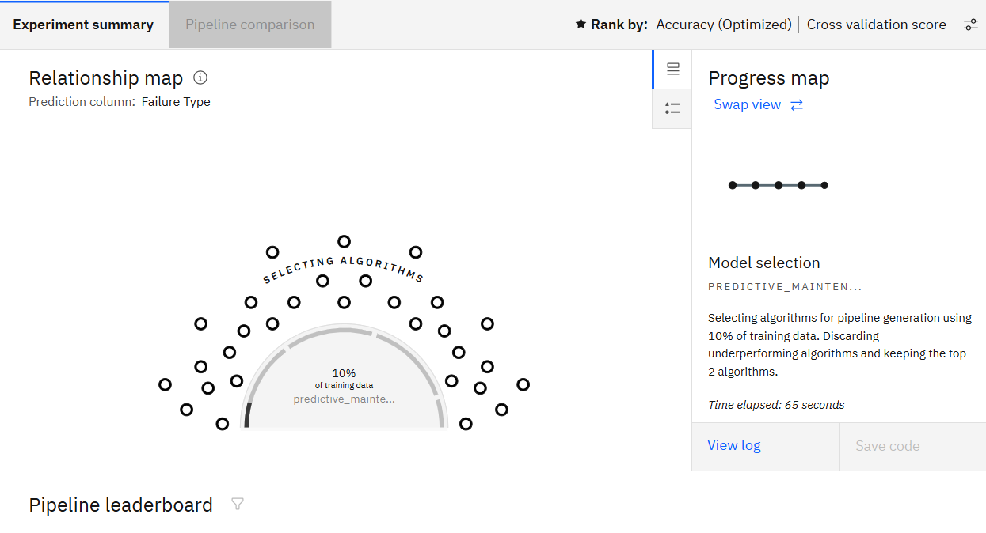

Slide 9
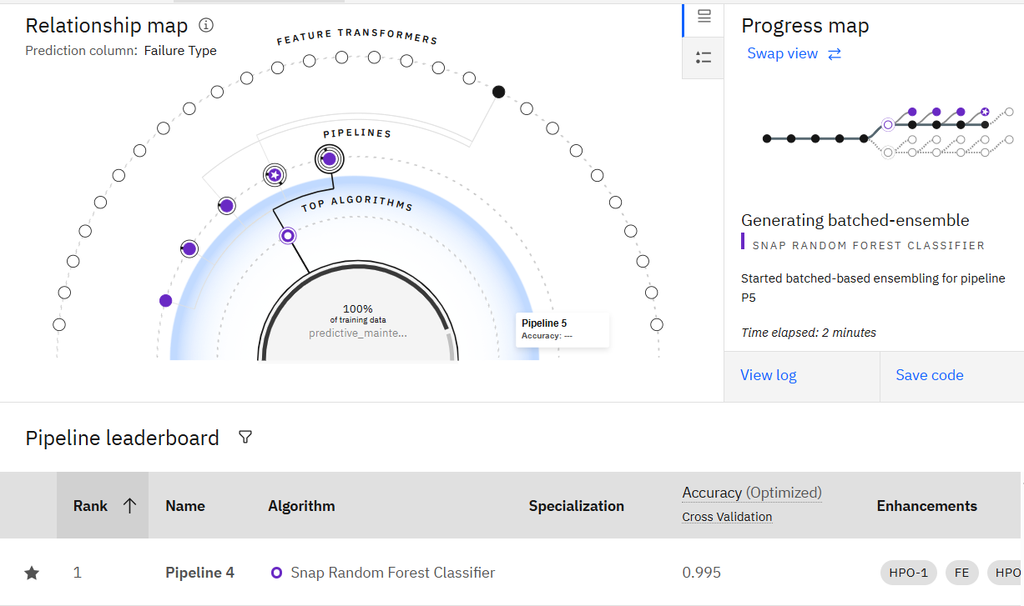

Slide 10
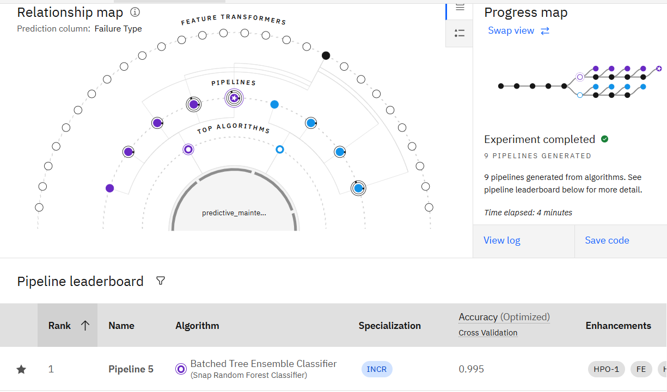
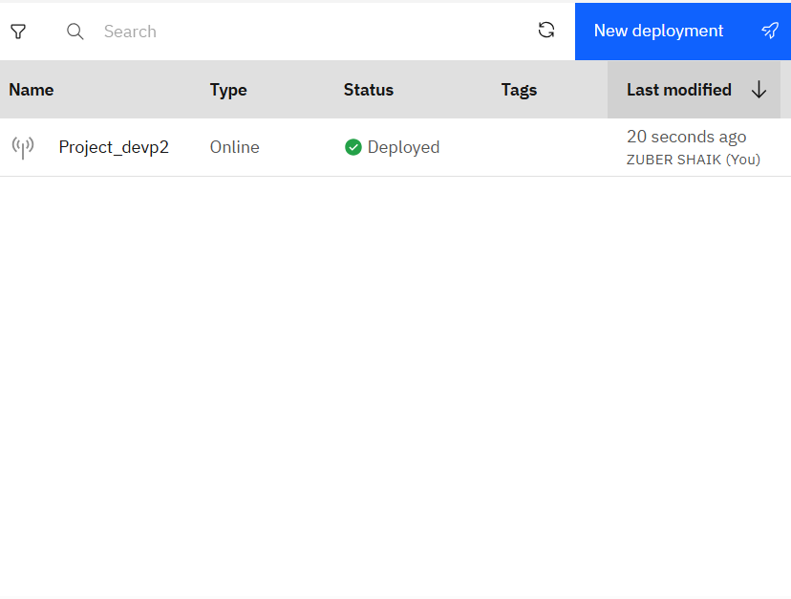

Slide 12
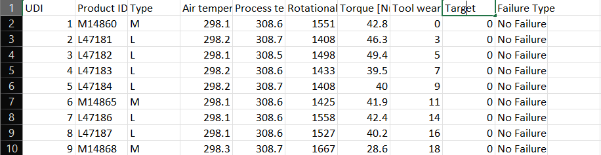

Slide 13
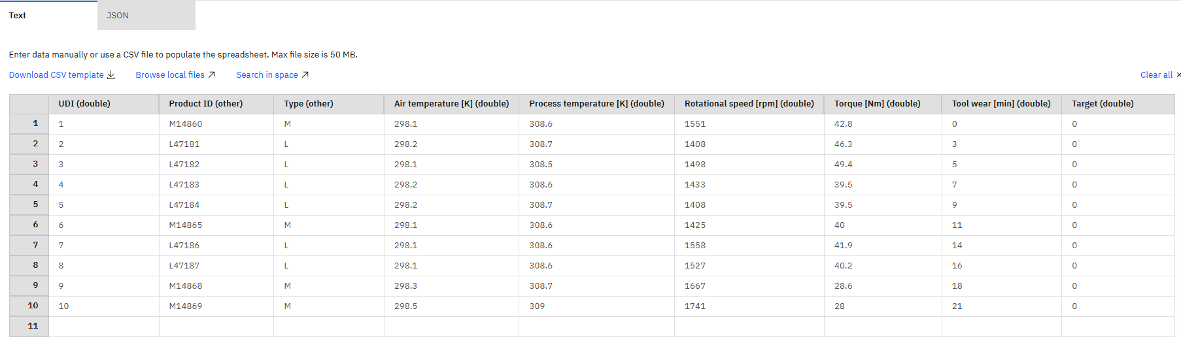

Slide 14
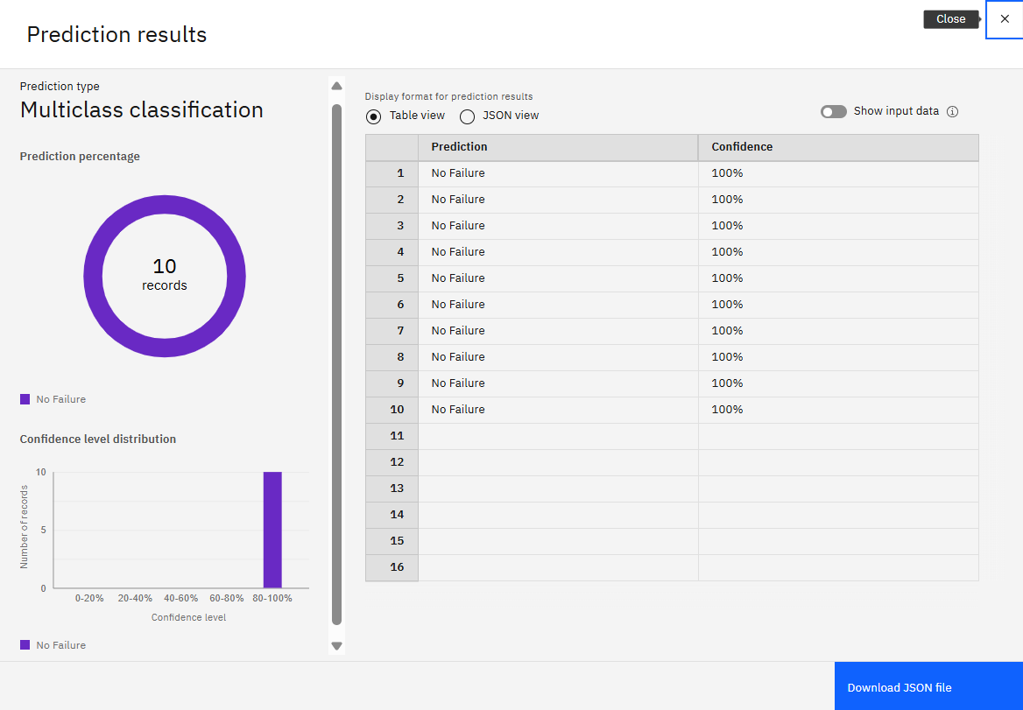

Slide 15
Conclusion
Summarize the findings and discuss the effectiveness of the proposed solution. Highlight any challenges encountered during the implementation and potential improvements. Emphasize the importance of accurate bike count predictions for ensuring a stable supply of rental bikes in urban areas.

Slide 16
Future scope
Discuss potential enhancements and expansions for the system. This could include incorporating additional data sources, optimizing the algorithm for better performance, and expanding the system to cover multiple cities or regions. Consider the integration of emerging technologies such as edge computing or advanced machine learning techniques.

Slide 17
References
List and cite relevant sources, research papers, and articles that were instrumental in developing the proposed solution. This could include academic papers on bike demand prediction, machine learning algorithms, and best practices in data preprocessing and model evaluation.

Slide 18
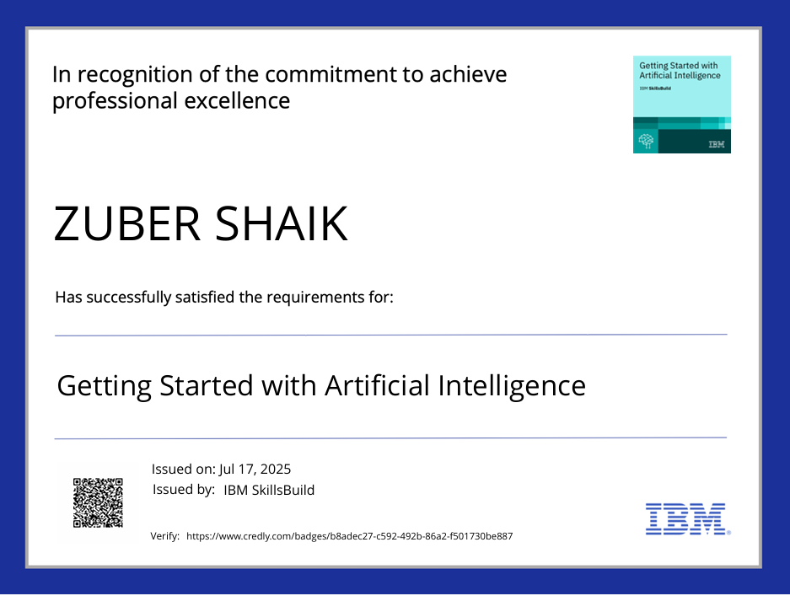
IBM Certifications

Slide 19

IBM Certifications

Slide 20
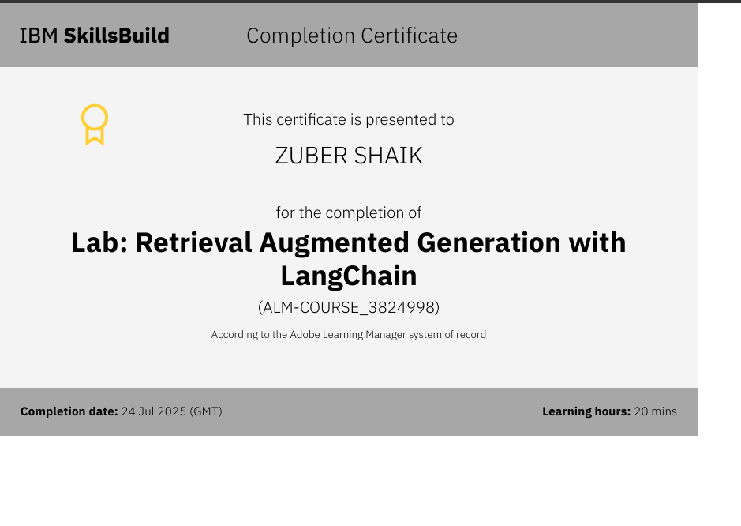
IBM Certifications

Slide 21
THANK YOU

