Slide 1
“Vote-Blocks”
Online E-Voting System Using Blockchain
By Team: BlockHacks

Slide 2
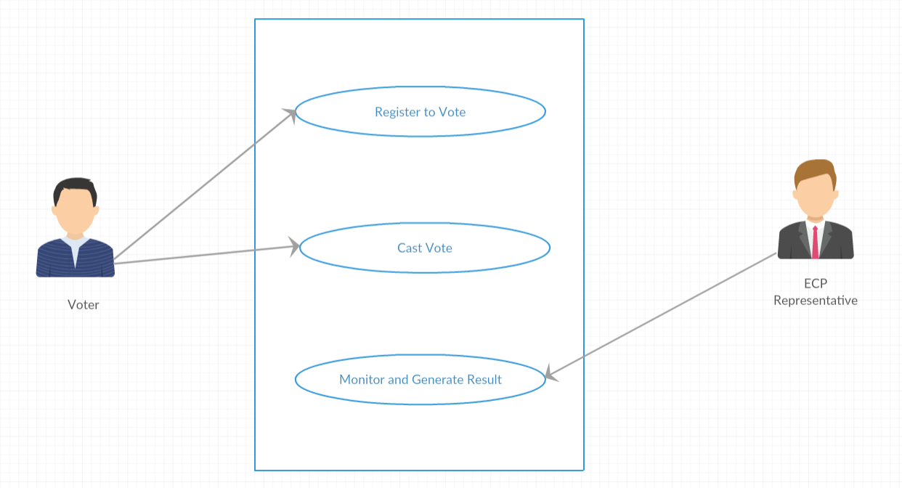
Problem Statement & Use Case
Secure application to;
Voter registration
Vote casting
Result calculation and monitoring

Slide 3
Proposed Solution: “Vote-Blocks”
Comprised of three basic modules:
Voter Registration
Vote Casting by Voter
Vote Count and Result Generation
Our focus of study was on Modules A & B for the hackathon, however final solution will incorporate all three modules mentioned above.

Slide 4
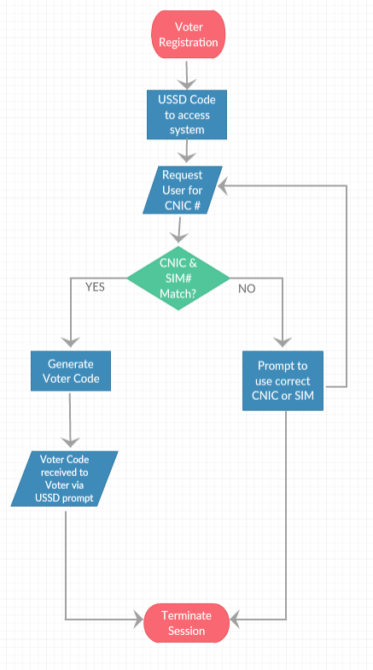
Module A: Voter Registration

Slide 5
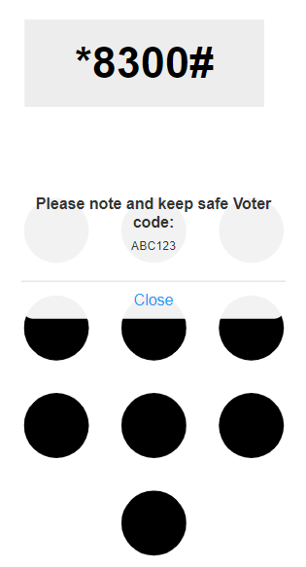

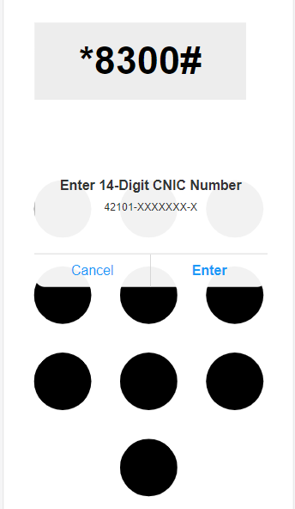
Module A: UI Design

Slide 6
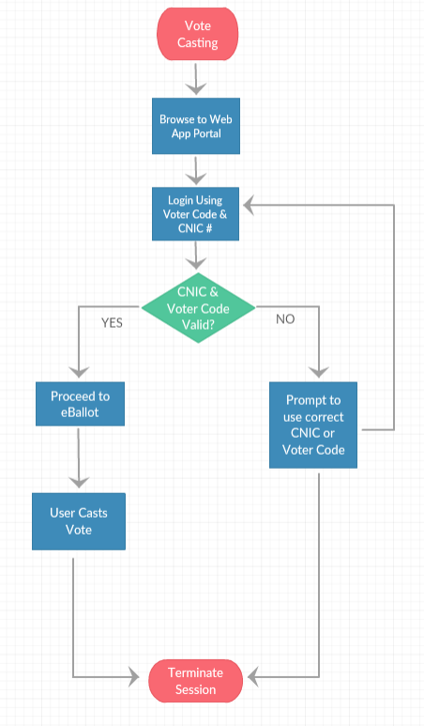
Module B: Vote Casting

Slide 7
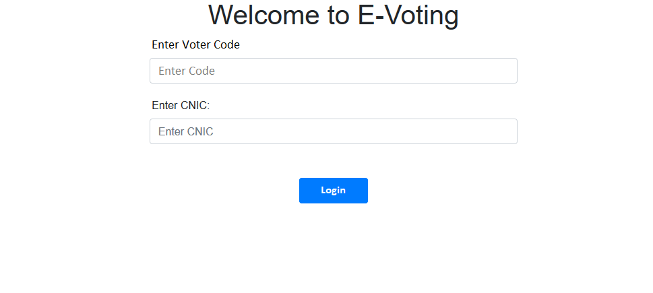
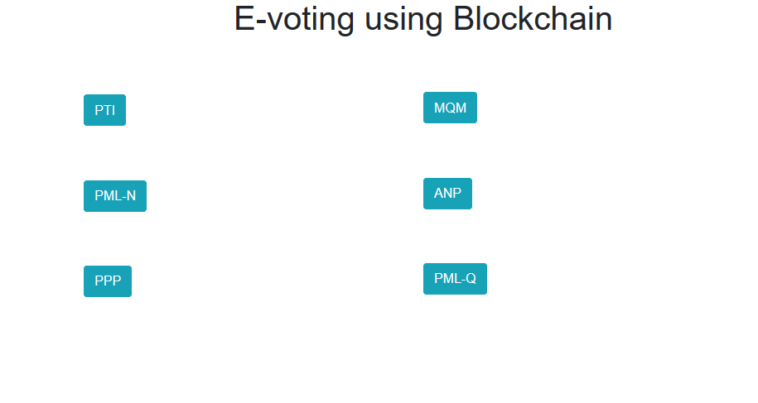
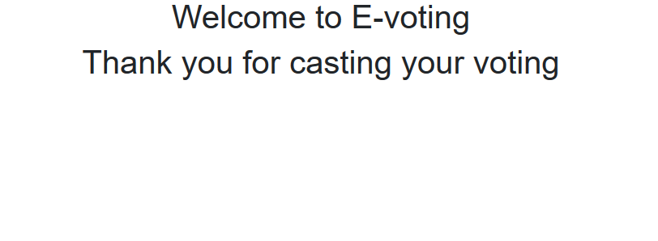
Module B: UI Design

Slide 8
Other Benefits of Vote Blocks
Effecting the PTA SIM registration
Effective calculation of eligible voters in total population
Spreading technological knowledge to rural/developing areas

Slide 9
Thank You

