Slide 1
TECHNOLOGY BEHIND
Azure Cloud
Visual Studio Community
.NET Future
Web API, Entity Framework

Slide 2


16 datacentres worldwide
North Europe region – Grange Castle, Dublin West
30000sq metres , 500million 2009, only 50 technicians
Month free access (150euro worth) after that 10 web sites free with Visual Studio 2013 Community installation

Slide 3
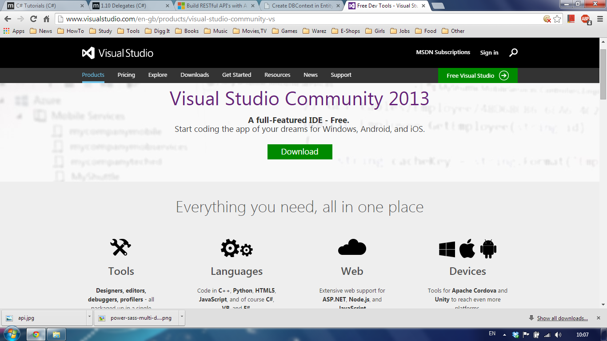
Free now
Whole Development stack
Azure Deployment integrated

Slide 4
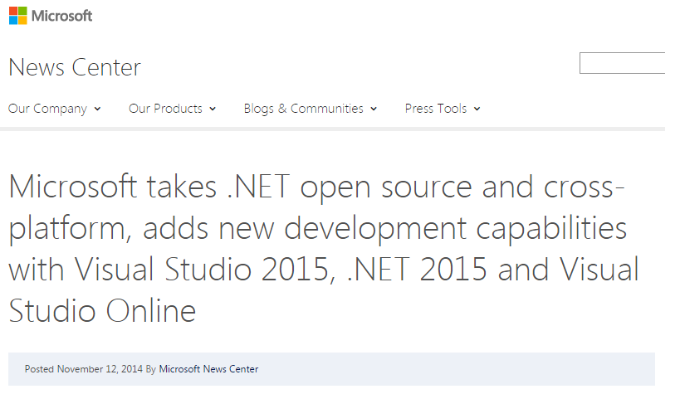
Great news, time to learn

Slide 5
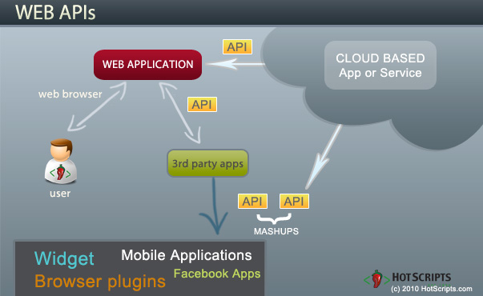
Web api overview
Database in up on the cloud
Web Service is up on the cloud with API published
Clients make AJAX http requests using API
Web Service returns JSON (XML) data

Slide 6
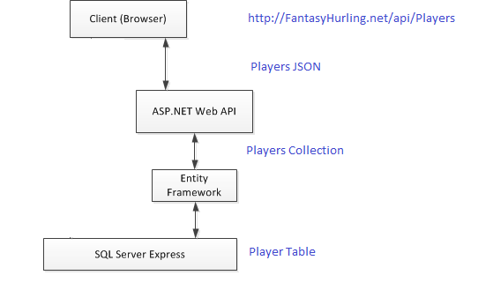
Our use case
Browser makes ajax http request asking for all the player statistics
Web Service retrieves player table rows from database and maps them to entity objects collection
Web service transforms collection to json text and sends it back in the response body
All the mappings and transformations are done by underlying frameworks

