Slide 1

Fantasy Hurling with Social Media Capabilities
Author: David Kelly (B00060572)
Module: Project Skills (COMP H3029)
Course: BSc Computing (BN104)
Lecturer: Dr. Luke Raeside
Institute of Technology Blanchardstown

Slide 2
Proposal
Create a web based game connected with social media
No existing fantasy hurling game connected with the GAA (Gaelic Athletic Association)
Provide a unique and interactive platform to connect an existing 200,000 GAA followers on social media[1] (Facebook, Twitter)

Slide 3
Proposal: Existing Data
No current fantasy GAA platform provides members with social media capabilities
Fantasy sport games in America, Canada and UK have over 40 million members[2]
13 million members play via mobile device
4 million members use social media to interact with other fantasy gamers

Slide 4
Methods
The team of 3 has essential skills to design and build the website backed by a java server (HTML, CSS, XML, JSON, AJAX, JQuery, PHP, JavaScript, JAVA)
Implementing a waterfall model for our Software Development Life Cycle (SDLC), enabled the team to manage each phase of the system

Slide 5
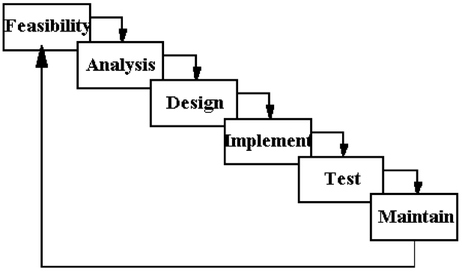
Methods

Slide 6
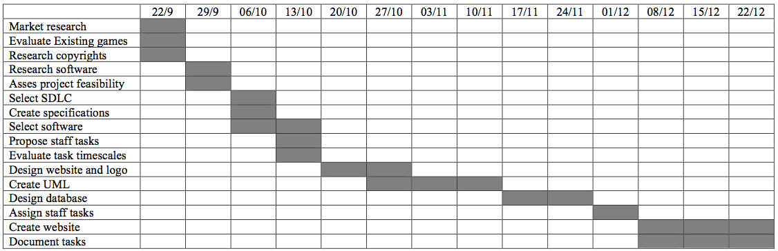
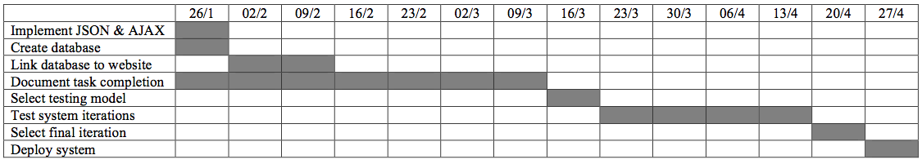
Methods
Creating a Gantt chart for active tasks

Slide 7
Research
Creating and Sustaining Social Media Communities[3]
The Effects of Fantasy Sport Participation[4]
Focus on Fantasy Sport Consumption[5]
Sport Fandom in the digital world[6]

Slide 8
Results
Fantasy sports gaming has a huge market with over 40 million gamers
4 million gamers use social media to communicate with one another
Enabling a social community to sustain itself requires regular content updates

Slide 9
Results
Social media can be used to maintain connections with organizations (GAA)
There is currently no fantasy hurling game for fans of the GAA
A successful game could function by itself but could also be sold to the GAA and implemented on their website

Slide 10
Results
Users are able to post their results and scores on social media sites
Playing the game is intuitive and simple
Users are able to retrieve their results on the final day of a game week

Slide 11
Results
The project team is currently in the creation phase of the website and database
The team has followed the Gantt chart and is on track for all current deadlines

Slide 12
Summary
10% of all fantasy sports gamers use social media to interact with one another
There are over 200,000 GAA followers on social media
There is no hurling game platform that allows fans to interact

Slide 13
Summary
A fantasy hurling game offers GAA fans a unique and interactive way of engaging with their sport and their community
The project is on track to fulfill all the deadlines set out at the beginning of the implementation phase

Slide 14
Questions
How many fantasy GAA games currently exist?
2 online football games
Can this game be sold if successful?
Yes, the game is designed to be modular and adaptable to more than 1 sport
Is the project meeting the deadline?
Yes, Currently the project is on schedule

Slide 15
References
Official GAA Facebook page, 2014. . [ONLINE] Available at: https://www.facebook.com/officialgaa. [Accessed 19 October 2014].
Industry Demographics - Fantasy Sports Trade Association. 2014. Industry Demographics - Fantasy Sports Trade Association. [ONLINE] Available at: http://www.fsta.org/?page=Demographics. [Accessed 21 November 2014].
Nicole A. Buzzetto-More. (2013). Social Media and Prosumerism, Issues in Informing Science & Information Technology, p67.
Joris Drayer, Stephen L. Shapiro, Brendan Dwyer, Alan L. Morse, Joel White. (2010). “The effects of fantasy football participation on NFL (National Football League) consumption: A qualitative analysis”. Sport Management Review, 13, 129- 141.

Slide 16
References
Brody J. Ruihley, Robin L. Hardin. (2013). Focus On Fantasy (an overview of fantasy sport consumption). In: Paul M. Pederson Routledge Handbook of Sport Cummunication. USA: Routledge. p269-277.
Ann Pegoraro. (2013). Sport Fandom in the Digital World. In: Paul M. Pederson Routledge Handbook of Sport Cummunication. USA: Routledge. p248-257.

