Slide 1
Proposal
Create a web based game connected with social media
No existing fantasy hurling game connected with the GAA (Gaelic Athletic Association)
Provide a unique and interactive platform to connect an existing 200,000 GAA followers on social media (Facebook, Twitter)

Slide 2
Proposal: Existing Data
No current fantasy GAA platform provides members with social media capabilities
Fantasy sport games in America, Canada and UK have over 40 million members
13 million members play via mobile device
4 million members use social media to interact with other fantasy gamers

Slide 3
The Project
A web based fantasy hurling game
Social media capabilities
Real time score/player updates
Real time news updates

Slide 4
TECHNOLOGY BEHIND
Azure Cloud
Visual Studio Community
.NET Future
Web API, Entity Framework

Slide 5


16 datacentres worldwide
North Europe region – Grange Castle, Dublin West
30000sq metres , 500million 2009, only 50 technicians
Month free access (150euro worth) after that 10 web sites free with Visual Studio 2013 Community installation

Slide 6
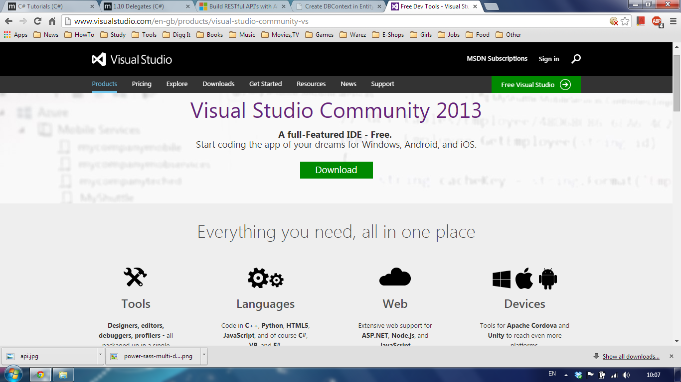
Free now
Whole Development stack
Azure Deployment integrated

Slide 7
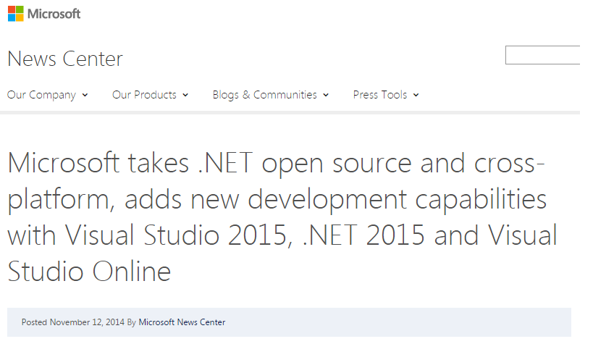
Great news, time to learn

Slide 8
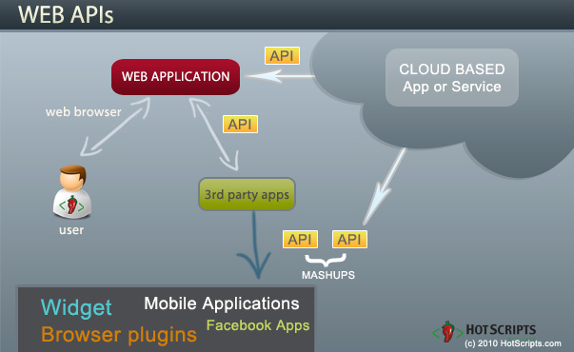
Web api overview
Database in up on the cloud
Web Service is up on the cloud with API published
Clients make AJAX http requests using API
Web Service returns JSON (XML) data

Slide 9
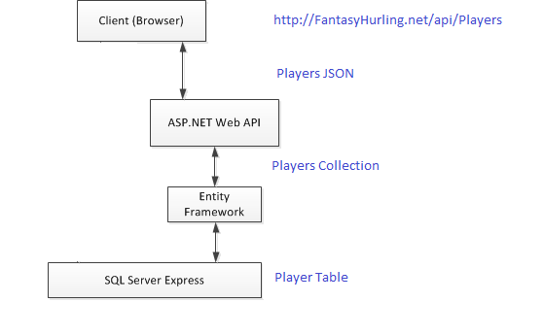
Our use case
Browser makes ajax http request asking for all the player statistics
Web Service retrieves player table rows from database and maps them to entity objects collection
Web service transforms collection to json text and sends it back in the response body
All the mappings and transformations are done by underlying frameworks

Slide 10
WHAT HAS been DONE?
Wireframe & design of site
All web pages complete
RSS feed for news
Player analysis

Slide 11
The WEBSITE
JavaScript & JQuery
HTML & CSS
PHP

Slide 12
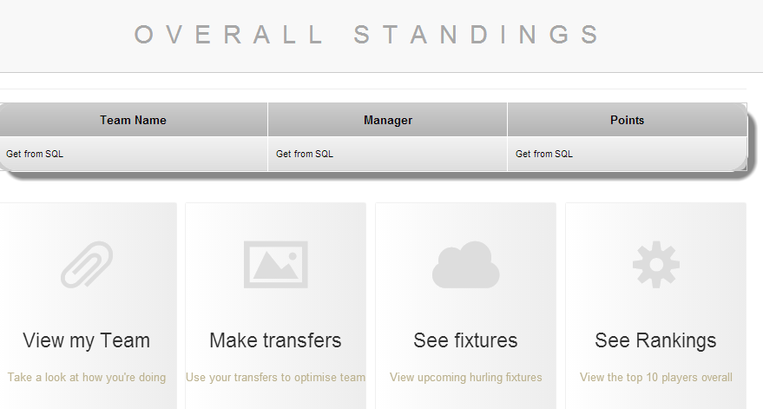
.
Standings page
Score will be retrieved using java from sql database

Slide 13
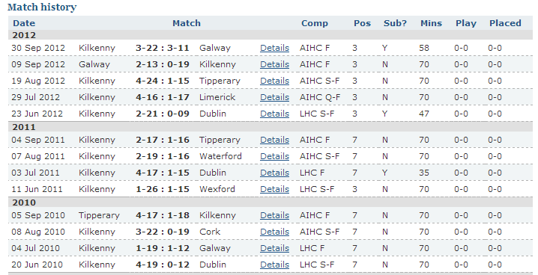
Hurlingstats.com
.

Slide 14
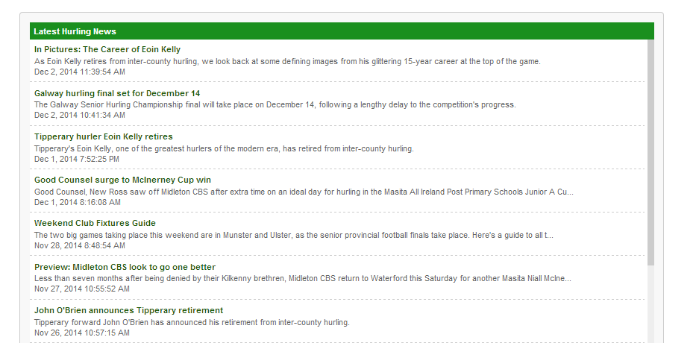
RSS FEED
.

Slide 15
What IS needed?
Login
Team changer & viewer
Social media aspect
Connection of front end to back

