Slide 1
FACTOR ANALYSIS (FA) NON-NEGATIVE MATRIX FACTORIZATION (NMF)
Group 6:
Taher Patanwala
Zubin Kadva
Notes:
Today, we will explain two dimensionality reducing algorithms viz. factor analysis (FA) and non-negative matrix factorization (NMF)

Slide 2
FACTOR ANALYSIS (FA)
Notes:
So, we start with factor analysis or FA

Slide 3
Introduction
Used to determine the variability among the data
Used to reduce the dimensionality of the data
Focus more on key distinguishing factors
Summarize data to identify patterns
Notes:
Factor analysis is used to identity the variability among the data. Based on this variability, Factor analysis reduces the dimensionality of the data.
It becomes easier to analyze the data, after it has been reduced, allowing us to focus more on key distinguishing factors
The main purpose of factor analysis is to summarize data so that relationships and patterns can be easily interpreted and understood

Slide 4
Types of Factor Analysis
Exploratory factor analysis (EFA)
Confirmatory factor analysis (CFA)
Notes:
Now, there are 2 types of FA:
Exploratory FA which uses a correlation matrix and
Confirmatory FA which uses a covariance matrix
In EFA, the researcher is not required to have any specific hypotheses about how many factors will emerge, and what items or variables these factors will comprise
CFA evaluates a priori hypotheses and is largely driven by theory. CFA analysis require the researcher to hypothesize in advance, the number of factors, whether or not these factors are correlated, and which items/measures load onto and reflect which factors.
Note: If the variables can be meaningfully compared -> covariance since it will explain the variable with the highest variance else -> correlation

Slide 5
Exploratory FA
Requirements
Linear Relationship
Works better with larger sample size
Smaller size works if dataset has high factor loading(> .80)
Notes:
Now, there are certain assumptions that EFA is based on.
EFA requires that there exists a linear relationship between the variables and the factors.
EFA works better with larger sample size.
If the dataset has several high factor loading scores (> .80), then a smaller small size should be sufficient.
Note: A factor loading for a variable is a measure of how much the variable contributes to the factor

Slide 6
Theoretical Background
Mathematical Models
Geometrical Approach
Notes:
Broadly speaking, there are many different ways to express the theoretical ideas behind factor analysis.
Over here, we will just focus on basic mathematical and geometric approaches.

Slide 7

Mathematical Models
Variables:
$X_{j}=a_{j1}F_{1}+ a_{j2}F_{2}+…+ a_{jm}F_{m}+ e_{j}$
Correlation Matrix of Variables:
$R=P C P^{′}+ U^{2}$
Notes:
These equations that can be used to express the mathematical model.
In the first equation, the Xj is the variable and F1, F2… are the factors. Aj1,aj2… are the factor loadings. ej is a constant that represents a unique factor
The second equation R is the correlation matrix of the variables. P is the matrix of factor loadings, C is the correlation matrix among the factors, and U is a diagonal matrix that represents the unique variances of the variables.

Slide 8
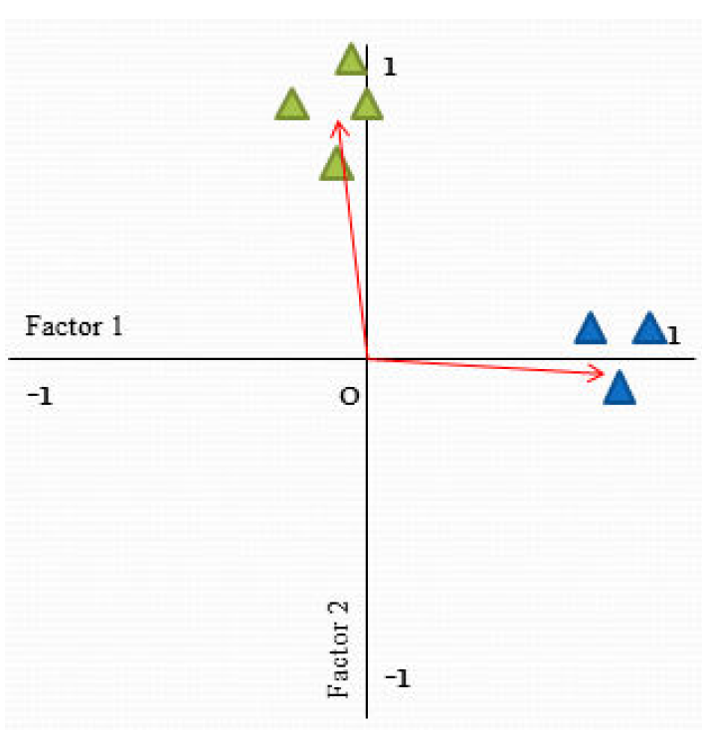
Geometrical Approach
Notes:
We can represent factor analysis using geometry to for better understanding. In this representation each axis represents a factor and the vectors or lines on the graph represents the variable. So if a variable is highly correlated to a factor than, it will be very close to that axis.
The axis will range from -1 to 1 which represents the factor loading.
two axis are the two factors. Factor 1 and Factor 2 and the triangles are the variables. The Blue triangles have higher correlation with Factor 1 and the Green triangles have a higher correlation with Factor 2.

Slide 9
Components of Factor Analysis
Factor Extraction
Maximum Likelihood
Principal Axis Factor
Rotation Methods
Interpretations of Factor Loadings
Number of Factors to Retain
Notes:
There are many extraction techniques available to extract factors. We can select a technique based on our requirements.
Some techniques are Maximum Likelihood, Principal Axis Factor.
After factors are identified, rotation is performed on the factors. The objective of performing rotation on the factors is to reduce ambiguity. This allows us to fit more variables into less number of factors.
Next we need to determine the strength of the factors by examining the factor loadings. We need to examine the factors with high factor loading, and factors with low factor loading, and ensure that they are consistent with the data. Like there should not be cases where a factor that should have low correlation with a variable has high factor loading.
The next step is to determine the number of factors to retain. This is very important, because if we keep too many factors than it may result in a high error variance, on the other end keeping very few factors may result in loss of important data.

Slide 10
Data Set
AEIS(Academic Excellence Indicator System) which is provided by Texas Education Agency
This dataset has records of thousands of schools in Texas
It has State level, Region level, District level, and Campus level data of the schools

Slide 11
NON-NEGATIVE MATRIX FACTORIZATION (NMF)
Notes:
Then, we present non-negative matrix factorization or NMF

Slide 12
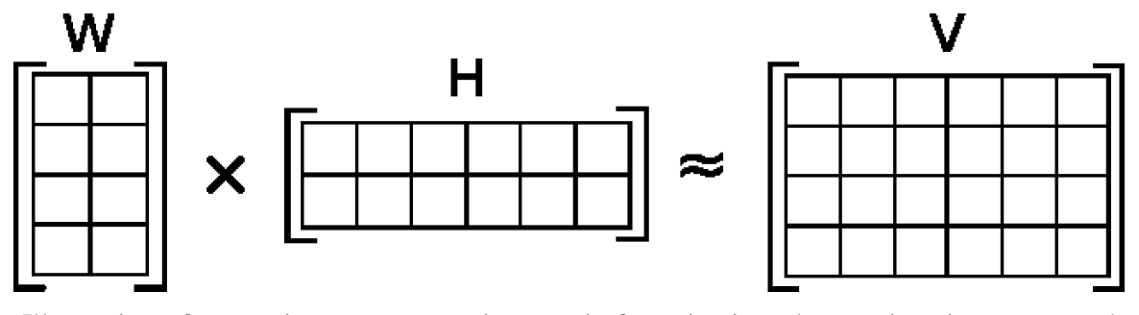
What is NMF?
W * H = V
V _{m x n}
W _{m x r}
H _{r x n}
By Qwertyus - Own work, CC BY-SA 3.0, https://commons.wikimedia.org/w/index.php?curid=29114677
Notes:
NMF is a group of algorithms where a matrix V can be decomposed into two matrices W and H, each of which are easier to work with and when multiplied together, yield the original matrix.
In the figure, V (4 X 6) is approximated as the multiplication of W (4 X 2) and H (2 X 6)
Given, a matrix V of dimension m x n and each element of V is positive, NMF decomposes it into 2 matrices W and H of dimension m x r and r x n where each element of W and H are positive.

Slide 13
Why use NMF?
V is a large dataset where each column is an observation and each row is a feature
Machine Learning
New way of reducing dimensionality of data
Non-negative constraint
Intuitive
Similarity to PCA
Notes:
Suppose V is a large dataset where each column is an observation and each row is a feature. For example, in a database of images, a column might represent some image and a row can represent a pixel.
In machine learning, it is necessary to reduce the feature space for easy computation. In the above example, it is difficult to consider each pixel value every time an image is handled, so it is worthwhile to break it down into fewer components.
Thus, NMF is used as a new way of reducing the dimensionality of data.
Since NMF has a non-negative constraint, it is used to represent data with positive features. This advantage can be used in image processing since each image has a positive pixel value.
This is compatible with the intuitive notion of combining parts to a whole which is how NMF learns part based representation.
NMF is similar to PCA where each base is assigned a weight. But in NMF, the weights are constrained to be positive. So, only additive combinations are allowed.

Slide 14
Applications
Computer Vision
Reduce feature space
Identifying and classifying
Text Mining
Extract features
Speech denoising
Break audio into parts
Notes:
NMF is beginning to be used in many fields. It is used in computer vision to reduce the feature space in images. This can be useful in identifying and classifying images.
NMF is also used in text mining. For example, you might organize a series of documents into a matrix where each column may represent the frequency a particular word and a row might represent the document. Then you would extract sematic features about the data.
NMF is used to break audio recordings of speech into speech parts and noise parts so that the speech parts alone can be isolated.

Slide 15
Problem
Minimize ‖V-WH‖²
subject to the constraints W, H ≥ 0
Often, the Eucledian or Frobenius distance is used
Non Convex
NP (Hard)
Notes:
So far, the black box is taking in a matrix V and return W and H. How is this done? We are trying to solve the problem: minimize the square of the distance between V and WH and WH should be non-negative. Often, the eucledian distance or frobenius norm is used. Moreover, it is nonconvex which makes the problem difficult. It is of type NP (hard)
Note: Frobenius distance is the sum of the squares of individual elements in a matrix
Note: Nonconvex is a concept from optimization; is a problem where the objective or any of the constraints are non convex or unbounded eg. A sine wave

Slide 16
Framework
Block Coordinate Descent (BCD)
while(tolerance met) {
fix H
update W
fix W
update H
}
Notes:
Several algorithms have been proposed for this. But all of them use a framework from optimization called block coordinate descent framework because of its convergence. This is based on alternating updates on W and H until a tolerance is met. So when it converges, it will converge at a local minimum and because the problem is nonconvex, this is what a good algorithm should achieve

Slide 17
Algorithms
Multiplicative update [Lee and Seung, 2001]
Converges slow
Objective function does not increase with every iteration
Alternating least squares (ALS) [Berry, 2006]
Alternating non-negative least squares (ANLS) [Lin, 2007]
Notes:
The multiplicative update algorithm proposed by Lee and Seung is the most commonly used NMF algorithm. On the downside, it converges slow and the objective function does not increase with every iteration.
Then after several years, Michael Berry and others presented alternating least squares algorithm. Non-negativity is expensive to impose, the problem is considered to be fully non-negative and even if there is any negative component in the solution, it is set to 0. So, the goal was to find a fast solution but it suffers from lack of convergence.
Later, people found out that although it is expensive locally, it is important to impose non-negativity explicitly. Those algorithms are called alternating non-negative least squares.

Slide 18
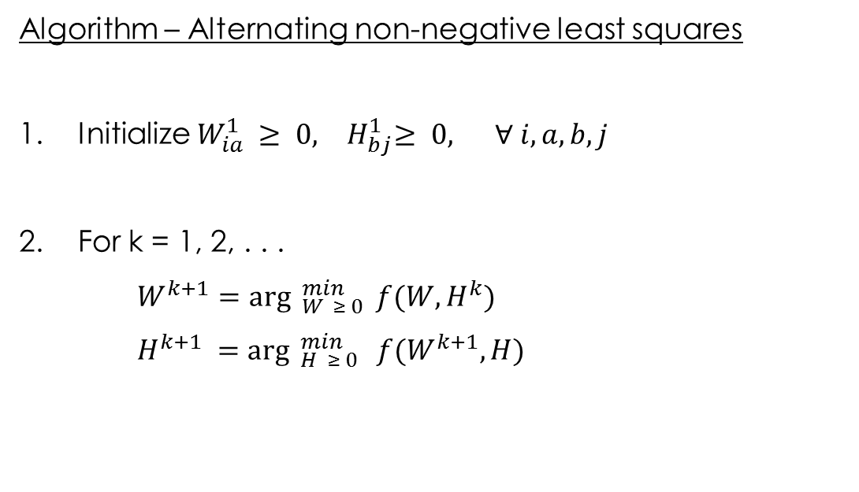
ANLS using projected gradient
Algorithm – Alternating non-negative least squares
1. Initialize $W_{ia}^{1} ≥ 0,{ H}_{bj}^{1}≥ 0, ∀ i,a,b,j$
2. For k = 1, 2, . . .
$W^{k+1}={\arg{ }}_{W ≥ 0}^{min} f(W,H^{k})$
$H^{k+1} ={\arg{ }}_{H ≥ 0}^{min} f(W^{k+1},H)$
Notes:
This works as randomly initializing non-negative matrices and then alternatively solving. So, fix either W or H and then solve the other one by solving the non-negative basis problem

Slide 19
Face data
CBCL face image database
This data set consists of:-
Training set: 2,429 faces, 4,548 non-faces
Test set: 472 faces, 23,573 non-faces
CBCL Face Database #1 MIT Center For Biological and Computation Learning http://www.ai.mit.edu/projects/cbcl
Notes:
We will be using the CBCL face database.
Although we do not require to train the network, we can simply use any of the two for our purpose.

