Slide 1
FACTOR ANALYSIS (FA) NON-NEGATIVE MATRIX FACTORIZATION (NMF)
Presentation 2
Group 6:
Taher Patanwala
Zubin Kadva

Slide 2
FACTOR ANALYSIS (FA)

Slide 3
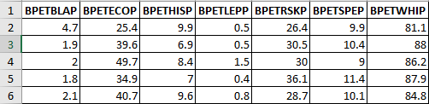
Data for Schools in Texas
BPETBLAP - African American Students Percent
BPETECOP – Economically Disadvantaged Students Percent
BPETHISP – Hispanic Students Percent
BPETLEPP – Limited English Proficient Students Percent
BPETRSKP – At Risk Students Percent
BPETSPEP – Special Education Students Percent
BPETWHIP – White Students Percent

Slide 4
Program
Load the data into variable X
Call factoran(), which is inbuilt method in matlab
factoran(X,<no_of_factors>,'rotate','<type>');

Slide 5
Output
Lambda – Factor loading matrix
Psi – Diagonal matrix of unique variances
T - Component Transformation Matrix
stats – Maximum log likelihood value and Error degree
F – Factor scores

Slide 6

Output - cont
Calculate correlation Matrix.
$$R=P C P^{′}+U$$
C = inv(T'*T);
R = Lambda*C*Lambda' + diag(Psi);

Slide 7
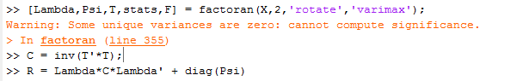
Output – Correlation Matrix

Slide 8
Output – Factor Loadings

Slide 9
NON-NEGATIVE MATRIX FACTORIZATION (NMF)

Slide 10
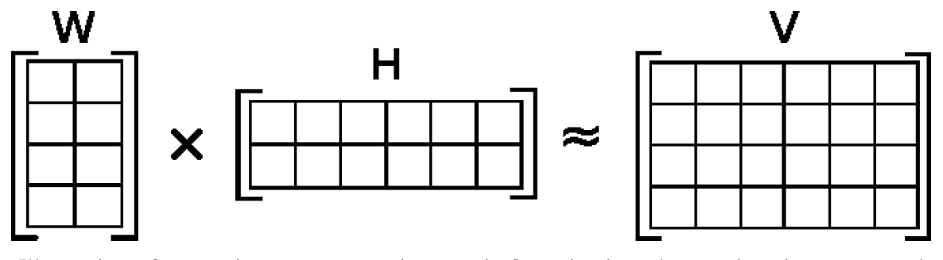
NMF - review
W * H = V
V _{m x n}
W _{m x r}
H _{r x n}
By Qwertyus - Own work, CC BY-SA 3.0, https://commons.wikimedia.org/w/index.php?curid=29114677
Notes:
A few refresher slides. So quickly, decomposes a matrix V into two matrices W and H, each of which are easier to work with and when multiplied together, yield the original matrix.

Slide 11
Problem - review
Minimize ‖V-WH‖²
subject to the constraints W, H ≥ 0
Often, the Eucledian or Frobenius distance is used
Non Convex
NP (Hard)
Notes:
The NMF problem: minimize the square of the distance between V and WH and WH should be non-negative

Slide 12
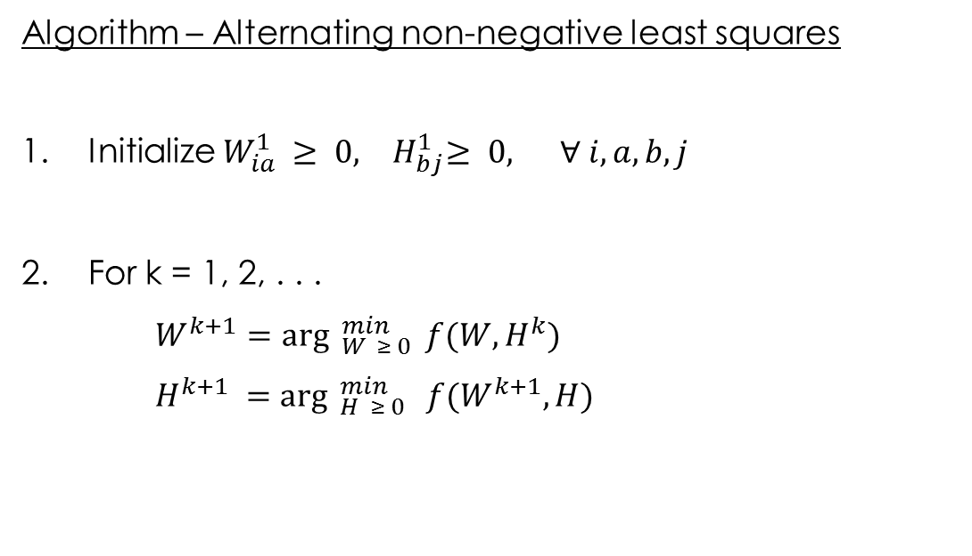
ANLS using projected gradient - review
Algorithm – Alternating non-negative least squares
1. Initialize $W_{ia}^{1} ≥ 0,{ H}_{bj}^{1}≥ 0, ∀ i,a,b,j$
2. For k = 1, 2, . . .
$W^{k+1}={\arg{ }}_{W ≥ 0}^{min} f(W,H^{k})$
$H^{k+1} ={\arg{ }}_{H ≥ 0}^{min} f(W^{k+1},H)$
Notes:
So, we use the alternating non-negative least squares algorithm using projected gradient techniques
Note: Gradient descent minimizes a function by moving in the negative gradient direction without any constraints on the variables. On the other hand, projected gradient descent minimizes a function subject to a constraint. At each step, we move in the direction of the negative gradient and then “project” onto the feasible set.

Slide 13
MATLAB code
function [W,H] = nmf(V, Winit, Hinit, tol,
timelimit, maxiter)
W, H = output matrices
V = input matrix
Winit = abs(randn(size(V, 1), r));
Hinit = abs(randn(r, size(V, 2)));
tol = tolerance for stopping condition
timelimit = stopping condition
maxiter = maximum iterations; will break if tolerance or time limit reached
By Chih-Jen Lin, National Taiwan University
Reference: https://www.csie.ntu.edu.tw/~cjlin/nmf/
Notes:
The MATLAB code is downloaded from the link below. I decided to use this function rather than the system defined nnmf function.
Its parameters are:
input matrix V, output matrices W and H
Initial values for H and W. This plays an important role in the final result. Larger the value of r, accurate will be the result, but then you are sacrificing on something that is described later.
Tolerance, timeilimt are used as stopping conditions. An initial value of the gradient is calculated (computing forbenius norm between gradW and gradH). During iteration, another value of project gradient is computed (norm([gradW(gradW<0 | W>0); gradH(gradH<0 | H>0)]);) If this values is less than multiplication of tolerance and intial gradient, it terminates.
Timelimit is another stopping condition. An initial value of cputime is computed. Then during iteration, the current value of cputime is subtracted from the earlier value. If it is greater than timelimit, it terminates.
Maxiter is the number of iterations, but again this depends on values of tolerance and timelimit.

Slide 14
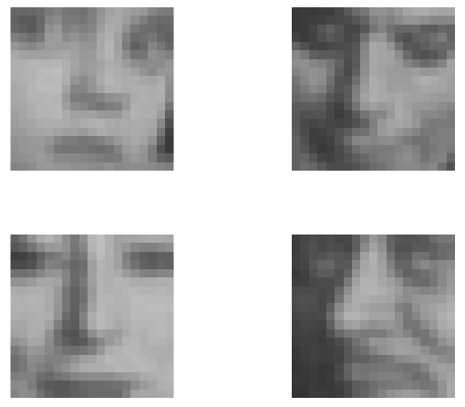
Input data
Original images (19 X 19)
CBCL Face Database #1,
MIT Center for Biological and Computation Learning,
http://www.ai.mit.edu/projects/cbcl
Notes:
This is a subset of the original face data. It consists of 19 X 19 images.

Slide 15
Input parameters
Winit = abs(randn(size(V, 1), 16));
Hinit = abs(randn(16, size(V, 2)));
[W, H] = nmf(V,
Winit,
Hinit,
0.0000000001,
25,
8000);
Notes:
On each of these images, I ran nmf with the parameters as:
V is my input matrix
Initial values for H and W are for now random with W being a 19 X 16 matrix and H being a 16 X 19 matrix since r (16) < min(m, n) [19, 19]
Tolerance is maximum of 0.001 and the tolerance value multiplied by the initial gradient value.
I’m passing a timelimt as 25 and maximum iterations as 8000

Slide 16
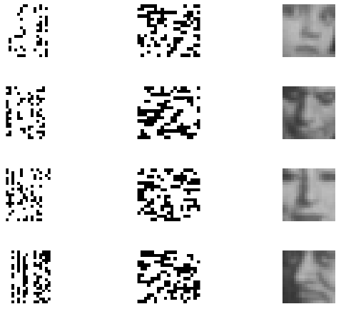
Output data
W (19 X 16) | H (16 X 19) | W*H (19 X 19)
Notes:
And the output is obtained as:
W, H and theoretically, when we multiply W and H, we get back the original matrix.
Visually, these can be represented as that.

Slide 17
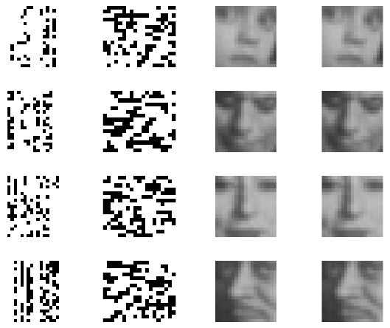
Verification - images
W (19 X 16) | H (16 X 19) | W*H (19 X 19) | Original (19 X19)
Notes:
Now, to verify, we simply compare the output of W*H with the original image. We find that is remarkably similar.

Slide 18
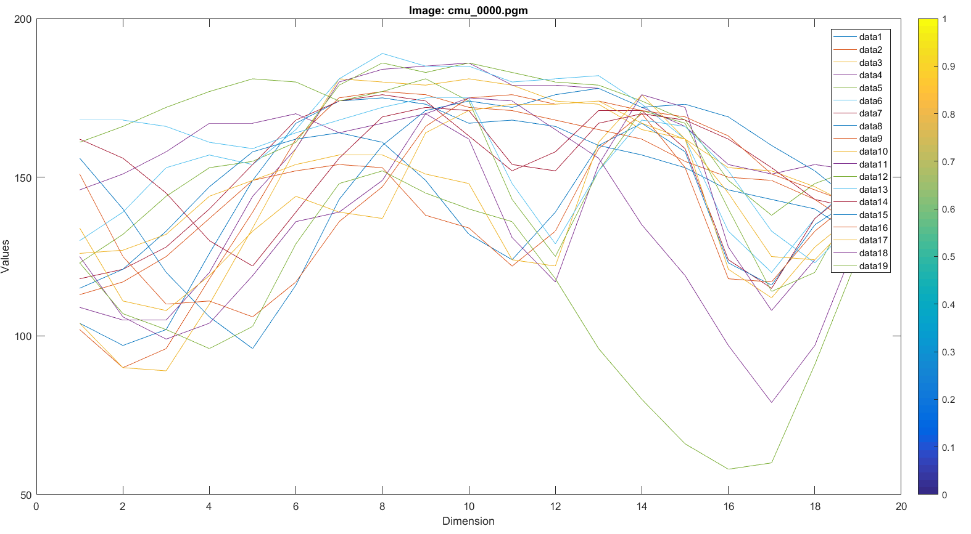

Verification - graphs
Notes:
Even if we compare graphically, we see that there is hardly any distinction between the original matrix and W*H

Slide 19
Conclusion
Dimension reduction
Input to a classifier algorithm
Easier to learn
Faster computation with accurate results (maybe?)
Notes:
In conclusion, we have thus reduced the dimensionality of the original matrix V by decomposing it into smaller W and H
The output matrices (W, H) can be provided as input to a classification algorithm.
Since W and H are smaller matrices than the original image, it becomes easier for the classification algorithm to learn a set of NMF basis images
I haven’t tried this, but I presume that since we are providing smaller learning data, the classifier learns faster and may produce accurate results

