Slide 1
The rabin-karp algorithm
Louay elbiche | siddhesh jethe | Zubin kadva
Group 2 | Algorithmics 2017
Analysis of algorithms | spring 2017

Slide 2
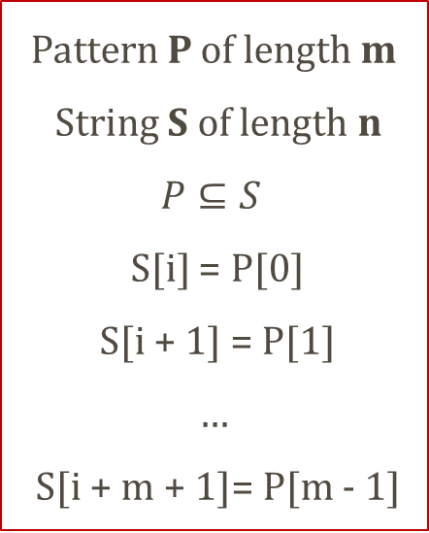
String matching
Returns the position where a given pattern is found in a text
Pattern P of length m
String S of length n
$$P⊆S$$
S[i] = P[0]
S[i + 1] = P[1]
…
S[i + m + 1]= P[m - 1]
∑ = alphabet
∑ = {A, … , Z}
∑ = {0, 1}
∑ = {A, C, G, T}
BASICS | NAÏVE SEARCH | RABIN-KARP | BIOINFORMATICS
Notes:
String matching is a class of algorithms that return the position of a given pattern in a given text.
So, if we consider a pattern P of length m and a string S of length n, then P is a subset of S i.e. P is a substring of S.
Therefore, it follows that S of i is P of 0, s of i+1 is P of 1 and so on till S of i+m+1.
Now, suppose a set of alphabets is denoted by sigma, then sigma can be a human alphabet from A to Z or a binary set or even a DNA alphabet.

Slide 3
example
∑ = {X, Y, Z}
S = X Y X Y X Y Z Y
P = X Y X Y Z
Index | 0 | 1 | 2 | 3 | 4 | 5 | 6 | 7
Text | X | Y | X | Y | X | Y | Z | Y
BASICS | NAÏVE SEARCH | RABIN-KARP | BIOINFORMATICS
Notes:
Here is an example, given a set of alphabets X, Y, Z and a string and a pattern.
We see that the given pattern is a substring of S

Slide 4
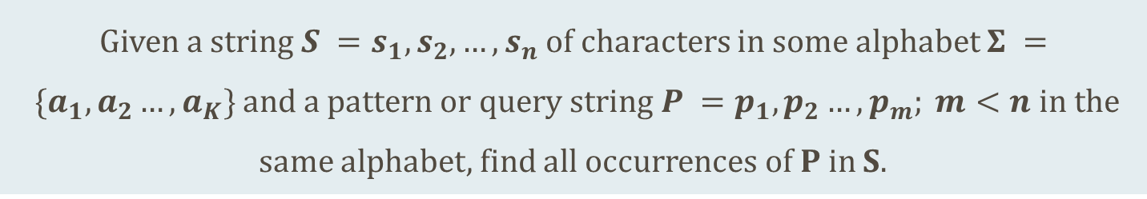
The problem
Given a string $S =s_{1},s_{2},…,s_{n}$of characters in some alphabet $Σ = \{a_{1},a_{2}…,a_{K}\}$ and a pattern or query string $P =p_{1},p_{2}…,p_{m}; m<n$ in the same alphabet, find all occurrences of P in S.
BASICS | NAÏVE SEARCH | RABIN-KARP | BIOINFORMATICS
Notes:
Thus, the problem can be formulated as: given an alphabet, a string and a pattern, find occurrences of the pattern within a text

Slide 5
algorithms
Naïve string searching algorithm
Rabin-Karp string searching algorithm
Knuth-Morris-Pratt algorithm
Boyer-Moore string search algorithm
BASICS | NAÏVE SEARCH | RABIN-KARP | BIOINFORMATICS
Notes:
There are many algorithms proposed for string matching. Some of them are listed here.
In our project we emphasize on the Rabin-Karp algorithm. We compare it against the naïve search approach.

Slide 6
Brute force
Naïve search algorithm
function NaiveSearch(string, pattern)
n := length(string)
m := length(pattern)
for i = 0 to n – m + 1
for j = 0 to m
if string[i + j] != pattern[j]
break
if j == m
return i
return not found
BASICS | NAÏVE SEARCH | RABIN-KARP | BIOINFORMATICS
Notes:
This is also known as the naïve algorithm. The main idea is to make a character by character comparison of the text
We start by computing the length of the text and pattern.
Then traversing throughout the text we compare each character of the text with one character of the pattern. When a match is found, we compare the next character of the text with the pattern and so on.

Slide 7
Algorithm trace
Text | F | I | N | D |  | M | E
Pattern | M | E
BASICS | NAÏVE SEARCH | RABIN-KARP | BIOINFORMATICS
Notes:
Consider this example.

Slide 8
Algorithm trace
Index | 0 | 1 | 2 | 3 | 4 | 5 | 6
Text | F | I | N | D |  | M | E
Pattern | M | E
BASICS | NAÏVE SEARCH | RABIN-KARP | BIOINFORMATICS
Notes:
So, we start at the first index. Since there is no match, we simply break into the outer loop.

Slide 9
Algorithm trace
Index | 0 | 1 | 2 | 3 | 4 | 5 | 6
Text | F | I | N | D |  | M | E
Pattern |  | M | E
BASICS | NAÏVE SEARCH | RABIN-KARP | BIOINFORMATICS
Notes:
Again, at the next position there is no match

Slide 10
Algorithm trace
Index | 0 | 1 | 2 | 3 | 4 | 5 | 6
Text | F | I | N | D |  | M | E
Pattern |  |  | M | E
BASICS | NAÏVE SEARCH | RABIN-KARP | BIOINFORMATICS
Notes:
No match here

Slide 11
Algorithm trace
Index | 0 | 1 | 2 | 3 | 4 | 5 | 6
Text | F | I | N | D |  | M | E
Pattern |  |  |  | M | E
BASICS | NAÏVE SEARCH | RABIN-KARP | BIOINFORMATICS
Notes:
No match here too

Slide 12
Algorithm trace
Index | 0 | 1 | 2 | 3 | 4 | 5 | 6
Text | F | I | N | D |  | M | E
Pattern |  |  |  |  | M | E
BASICS | NAÏVE SEARCH | RABIN-KARP | BIOINFORMATICS
Notes:
No match here

Slide 13
Algorithm trace
Index | 0 | 1 | 2 | 3 | 4 | 5 | 6
Text | F | I | N | D |  | M | E
Pattern |  |  |  |  |  | M | E
BASICS | NAÏVE SEARCH | RABIN-KARP | BIOINFORMATICS
Notes:
We get a match here, so the algorithm moves on to the inner loop to further compare the pattern

Slide 14
Algorithm trace
Index | 0 | 1 | 2 | 3 | 4 | 5 | 6
Text | F | I | N | D |  | M | E
Pattern |  |  |  |  |  | M | E
BASICS | NAÏVE SEARCH | RABIN-KARP | BIOINFORMATICS
Notes:
A match is found here too. Now, the pattern in completely matched and thus it returns 5 as the position.

Slide 15
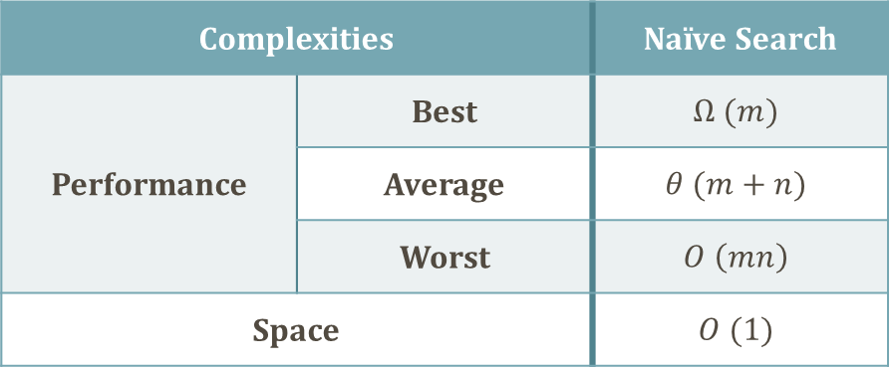
analysis
function NaiveSearch(string, pattern)
for i = 0 to n – m + 1
for j = 0 to m
if string[i + j] != pattern[j]
break
if j == m
return i
return not found
Complexities |  | Naïve Search
Performance | Best | $$Ω (m)$$
 | Average | $$θ (m+n)$$
 | Worst | $$O \left(mn\right)$$
Space |  | $$O (1)$$
BASICS | NAÏVE SEARCH | RABIN-KARP | BIOINFORMATICS
Notes:
The example earlier is a worst case where the pattern occurs at the end of a text. Another worst case is this:
Suppose there is a string A A A A B and a pattern A A B. We start at index 0. A matches, A matches, B does not match. So, the inner loop executes m times i.e. 3
So, the total time is m(n-m+1)
The best case occurs, if the pattern is found within the first m characters. So it is omega of m
It does not require any pre processing, so takes constant space

Slide 16
Visual performance
BASICS | NAÏVE SEARCH | RABIN-KARP | BIOINFORMATICS
Notes:
Here, we consider two cases:
here is the first case where the length of the pattern is kept constant and the length of the text is varied. So, we get a quadratic graph as expected.

Slide 17
Visual performance
BASICS | NAÏVE SEARCH | RABIN-KARP | BIOINFORMATICS
Notes:
The second case is where we reverse the parameters by keeping n constant and varying m. Again, we get a quadratic graph. Although reverse quadratic

Slide 18
RABIN-KARP
Based on computing hash of a pattern and then comparing it
function RabinKarp(string, pattern)
hpattern := hash(pattern);
hstring := hash(string)
for i = 1 to n – m + 1
if hstring = hpattern
if string = pattern
return i
hstring:= reHash(i, i + m - 1)
return not found
BASICS | NAÏVE SEARCH | RABIN-KARP | BIOINFORMATICS

Slide 19
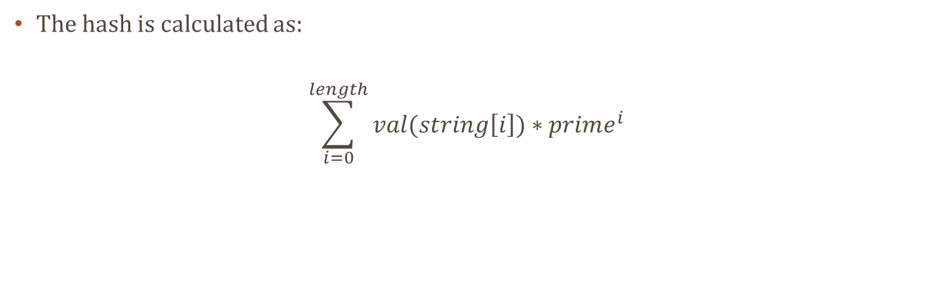
RABIN-KARP
The hash is calculated as:
$$\sum_{i=0}^{length}{val(string\left[i\right])∗prime^{i}}$$
function hash(string, length)
for i = 0 to length
hash := hash + value(string[i]) * prime^{i}
return hash
BASICS | NAÏVE SEARCH | RABIN-KARP | BIOINFORMATICS

Slide 20
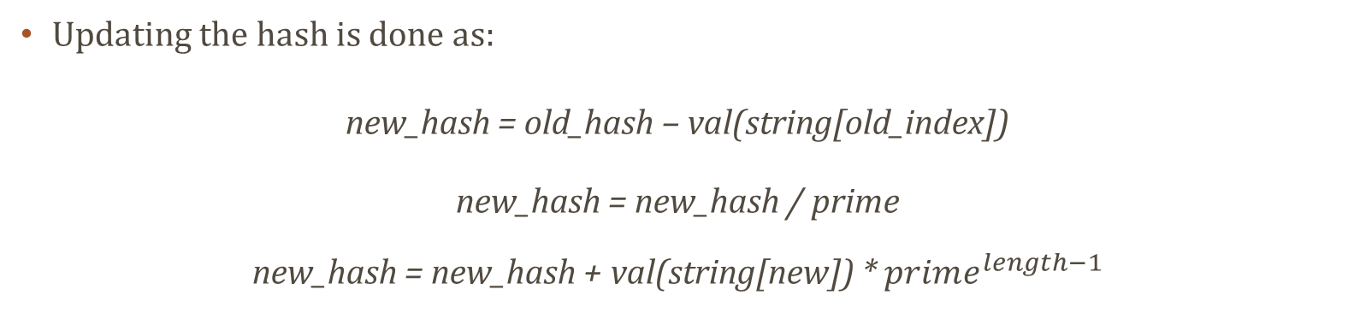
RABIN-KARP
Updating the hash is done as:
new_hash = old_hash – val(string[old_index])
new_hash = new_hash / prime
new_hash = new_hash + val(string[new]) * $prime^{length−1}$
function reHash(string, length, old, new, hash)
newHash := hash – value(string[old])
newHash := newHash / prime
newHash := newHash + value(string[new]) * prime^{length - 1}
return newHash
BASICS | NAÏVE SEARCH | RABIN-KARP | BIOINFORMATICS

Slide 21
Modular rabin-karp
To reduce:
Size of the hash result and
# of hash collisions
Elements:
Radix d
Prime q
BASICS | NAÏVE SEARCH | RABIN-KARP | BIOINFORMATICS

Slide 22
BASIS FOR RABIN-karp
q = 23
i | 0 | 1 | 2
 | 6 | 4 | 7 | % 23 = 3
i | 0 | 1 | 2 | 3
 | 9 | 6 | 4 | 7
0 | 9 | 6 | 4 | % 23 = 21
1 |  | 6 | 4 | 7 | % 23 = 3
BASICS | NAÏVE SEARCH | RABIN-KARP | BIOINFORMATICS

Slide 23
KEY COMPUTATION
d = 10
i | 0 | 1 | 2 | 3 | 4 | …
current value | 6 | 3 | 2 | 1 | 7
new value |  | 3 | 2 | 1 | 7
 |  | 3 | 2 | 1 | current value
 | - | 3 | 0 | 0
 |  |  | 2 | 1 | subtract leading digit
 | * |  | 1 | 0 | multiply by radix
 |  | 2 | 1 | 0
 | + |  |  | 7 | add trailing digit
 |  | 2 | 1 | 7 | new value
BASICS | NAÏVE SEARCH | RABIN-KARP | BIOINFORMATICS

Slide 24
Horner’s method
i | 0 | 1 | 2
 | 3 | 1 | 2
0 | 3 | % 23 = 3
1 | 3 | 1 | % 23 = (3 * 10 + 1) % 23 = 8
2 | 3 | 1 | 2 | % 23 = (8 * 10 + 2) % 23 = 13
BASICS | NAÏVE SEARCH | RABIN-KARP | BIOINFORMATICS

Slide 25
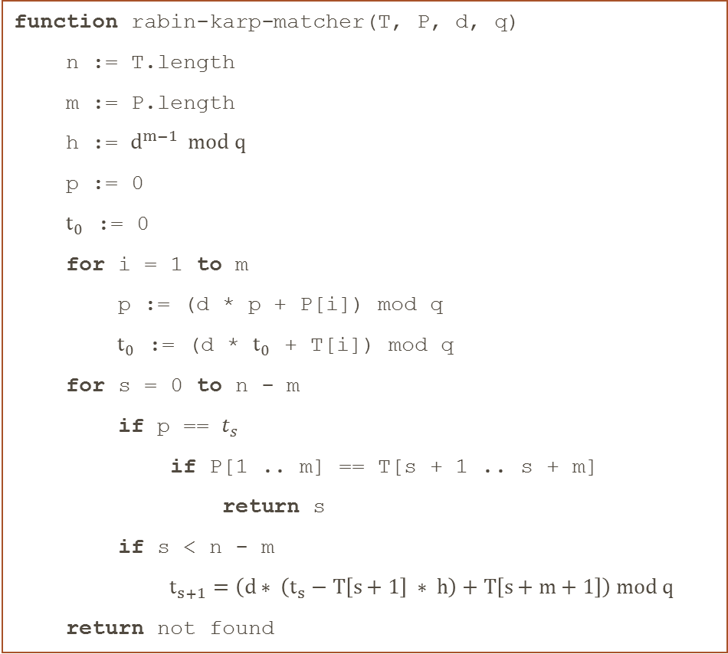
Modular rabin-karp
function rabin-karp-matcher(T, P, d, q)
n := T.length
m := P.length
h := $d^{m−1} mod q$
p := 0
$t_{0}$ := 0
for i = 1 to m
p := (d * p + P[i]) mod q
$t_{0}$ := (d * $t_{0}$ + T[i]) mod q
for s = 0 to n - m
if p == $t_{s}$
if P[1 .. m] == T[s + 1 .. s + m]
return s
if s < n - m
$t_{s+1}=\left(d∗ \left(t_{s}−T\left[s+1\right] ∗ h\right)+T\left[s+m+1\right]\right) mod q$
return not found
BASICS | NAÏVE SEARCH | RABIN-KARP | BIOINFORMATICS

Slide 26
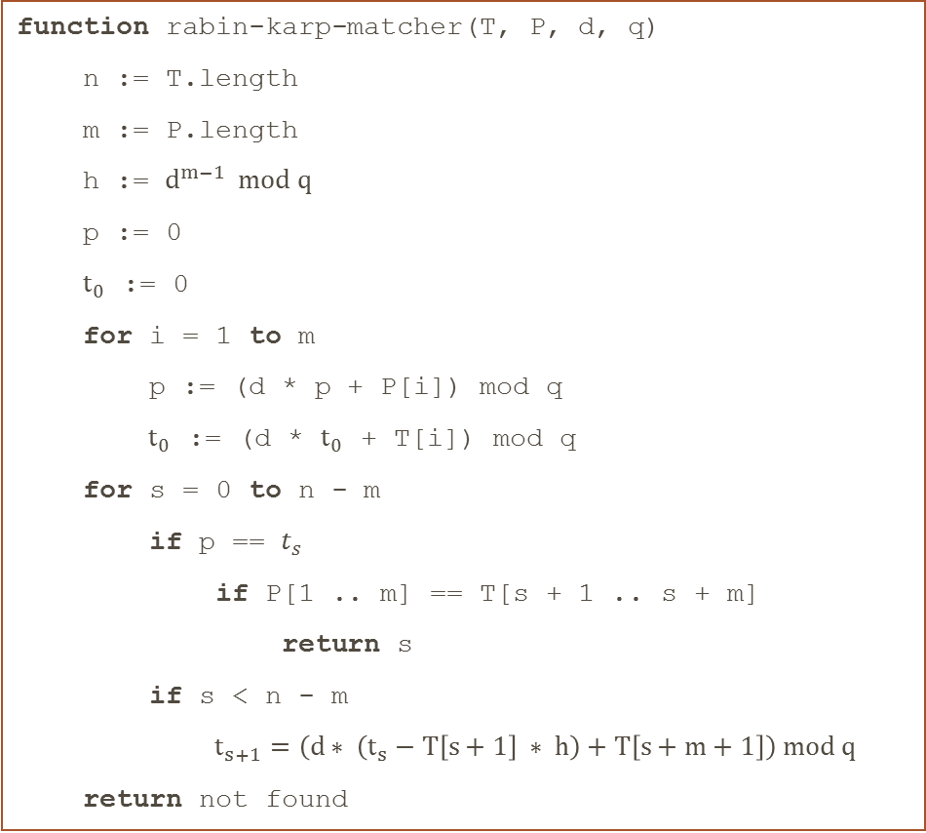
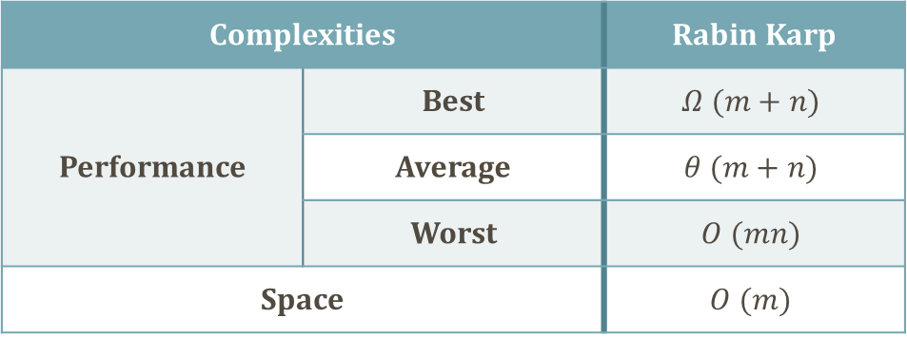
analysis
function rabin-karp-matcher(T, P, d, q)
n := T.length
m := P.length
h := $d^{m−1} mod q$
p := 0
$t_{0}$ := 0
for i = 1 to m
p := (d * p + P[i]) mod q
$t_{0}$ := (d * $t_{0}$ + T[i]) mod q
for s = 0 to n - m
if p == $t_{s}$
if P[1 .. m] == T[s + 1 .. s + m]
return s
if s < n - m
$t_{s+1}=\left(d∗ \left(t_{s}−T\left[s+1\right] ∗ h\right)+T\left[s+m+1\right]\right) mod q$
return not found
Complexities |  | Rabin Karp
Performance | Best | $$Ω (m+n)$$
 | Average | $$θ (m+n)$$
 | Worst | $$O (mn)$$
Space |  | $$O (m)$$
BASICS | NAÏVE SEARCH | RABIN-KARP | BIOINFORMATICS

Slide 27
Visual performance
BASICS | NAÏVE SEARCH | RABIN-KARP | BIOINFORMATICS

Slide 28
Visual performance
BASICS | NAÏVE SEARCH | RABIN-KARP | BIOINFORMATICS

Slide 29
Visual space
BASICS | NAÏVE SEARCH | RABIN-KARP | BIOINFORMATICS

Slide 30
Comparative performance
BASICS | NAÏVE SEARCH | RABIN-KARP | BIOINFORMATICS

Slide 31
Comparative performance
BASICS | NAÏVE SEARCH | RABIN-KARP | BIOINFORMATICS

Slide 32
APPLICATION EXAMPLE: bioinformatics
Certain known nucleotide and/or amino acid sequences have properties known to biologists
ATG is a string which must be present at the beginning of every protein (gene) a DNA sequence.
A primer is a conserved DNA sequence used in the Polymerase Chain Reaction (PCR) to identify the location of the DNA sequence that will be amplified
Genetic code is redundant. Consider the following sequence of nucleotides: GCTACTATTTTTCAT
When read in forward frame 0, this sequence encodes the following sequence of amino acids: ATIFH
BASICS | NAÏVE SEARCH | RABIN-KARP | BIOINFORMATICS
Notes:
Considering we have a specific substring to look for, it is advantageous to preprocess and pre-compute its hashvalue to save time and complexity for the string matching operation
Finding if a DNA sequence contains a specific prime is therefore paramount to the ability to run a correct PCR

Slide 33
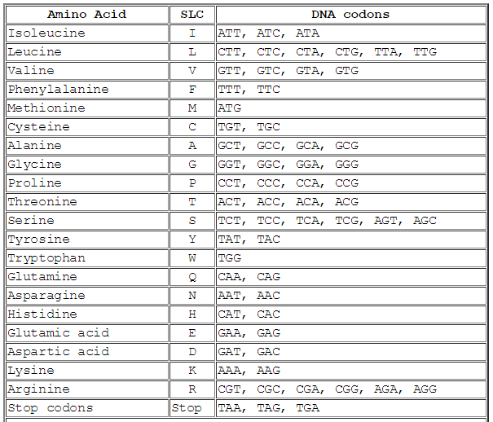
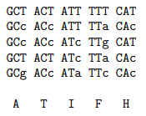
APPLICATION EXAMPLE: BIOINFORMATICS
Because of redundancy of the genetic code, the following sequences of nucleotides will produce the same sequence of amino acids
http://www.cbs.dtu.dk/courses/27619/codon.html
http://users.csc.calpoly.edu/~dekhtyar/448-Spring2013/lectures/lec03.448.pdf
BASICS | NAÏVE SEARCH | RABIN-KARP | BIOINFORMATICS
Notes:
(lower case letters show differences with the original string)
If we look closely, we can see that each Amino Acid is actually identified by the first 2 letter of the DNA codon. (Except for a couple that share those first 2 letters).
Therefore it is possible to approximate the string-matching, which slightly improves the Rabin-Karp efficiency

Slide 34
APPLICATION EXAMPLE: BIOINFORMATICS
Example: Consider for following string S = "ATTCCGT".
Suppose we are looking for four-letter substrings.
BASICS | NAÏVE SEARCH | RABIN-KARP | BIOINFORMATICS

Slide 35
function end-presentation()
THANK YOU
if questions?
solve()

