Slide 1
Analysis of the Used Car Market in the US
DS5110 Intro to Data Management
GROUP MEMBER: Zubin Zhang, Zidao wang, zhiheng Feng

Slide 2





DS5110 Intro to Data Management
CONTENTS
Literature Review &
Methodology
Introduction
Analysis and Results
Question & Discussion
Conclusion

Slide 3
1.Introduction
DS5110 Intro to Data Management
1.1 Objectives and Goals
Primary Goal: To generalize and analyze trends in the US used car market.
Specific Goal: Provide insights into pricing trends, popular car models, and the factors most influence the used car market.
Final Goal: Build predictive models to estimate car prices based on attributes like make, model, year, and mileage in the future.

Slide 4
1.Introduction
DS5110 Intro to Data Management
1.2 Project Scope
Data will be collected directly from the Cars.com website through web scraping.
Attributes to be analyzed include vehicle make, model, year, price, mileage, location, and seller type (dealer or private).
Deliverables include a cleaned and structured dataset, comprehensive analysis, and visualized vital findings.

Slide 5
2.Literature Review
DS5110 Intro to Data Management
2.1 Summary of Relevant Existing Work
Our Current Focus: 420,000 static datasets before being cleaned, as well as traditional factors like mileage, year, and make.
Gaps Identified: Lack of up-to-date datasets; Limited attention to secondary attributes like fuel type or paint color.

Slide 6
2.Literature Review
DS5110 Intro to Data Management
2.2 Relation of Your Project to Previous Work
Innovations: Analysis based on the latest data from Cars.com, Inclusion of underexplored attributes (e.g., paint color, fuel type), Enhanced visualizations for clear and actionable insights.,
Impact: More closely reflects the current used car market; implement a predictive model that forecasts future car prices for different used cars.

Slide 7
3.Methodology
DS5110 Intro to Data Management
3.1 Data Info & Resource
1
2

Slide 8
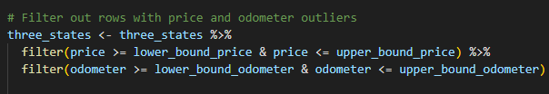
3.Methodology
DS5110 Intro to Data Management
3.2 Data Cleaning
Objective: Prepare raw data for analysis by removing inconsistencies, handling missing values, and filtering relevant records.
Steps Taken:
Remove Invalid Data
Standardization
Outlier Removal

Slide 9
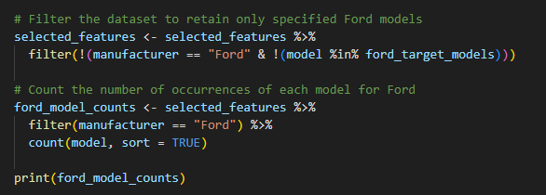
3.Methodology
DS5110 Intro to Data Management
3.3 Data Standardization for Modeling
Objective: Clean and structure data for model training by standardizing vehicle models and manufacturers.
Steps Taken:
Feature Selection
Model Standardization
Filtered Manufacturers

Slide 10
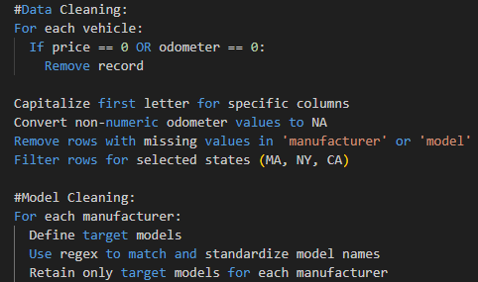
3.Methodology
DS5110 Intro to Data Management
3.4 Complexity Estimation and Techniques
Data Cleaning: Filtering and transformations: O(n), where n is the number of rows in the dataset.
Model Standardization: Regex matching: O(n*m), where m is the number of target models.
Techniques:

Slide 11
3.Methodology
DS5110 Intro to Data Management
3.5 Data Structures Utilized
Primary Data Structures:
Data frames ( vehicles, three_states, selected_features) for tabular data manipulation.
Vectorized operations(e.g., mutate(), filter()) using the dplyr library for efficient processing.

Slide 12
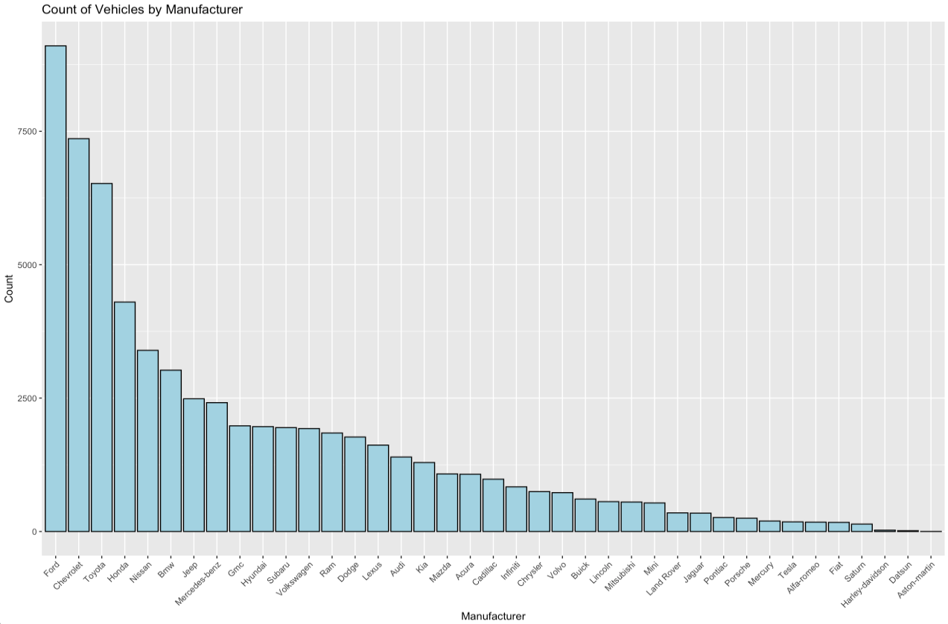
4.Analysis and Result
DS5110 Intro to Data Management
4.1.1 Key Findings
Graph: Count of Vehicles by Manufacturer (Bar Plot).
Key Findings: Ford, Chevrolet, and Toyota are the most popular brands in the Boston area; Niche brands like Audi and BMW have lower counts but are still significant.
Interpretation: Mainstream brands dominate due to reliability and maintenance accessibility.

Slide 13
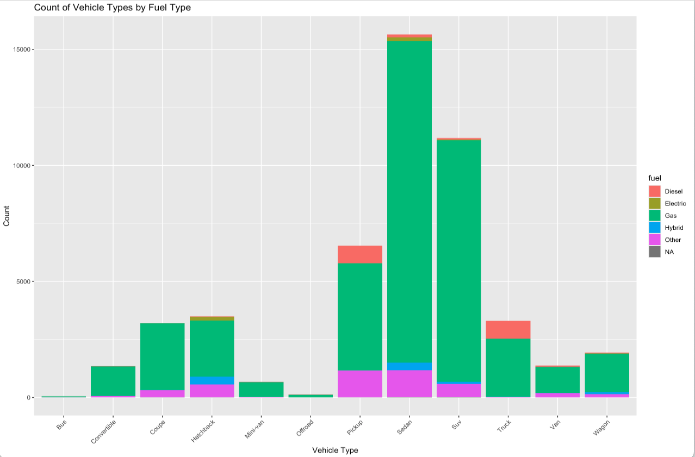
4.Analysis and Result
DS5110 Intro to Data Management
4.1.2 Key Findings
Graph: Count of Vehicle Types by Fuel Type (Stacked Bar Chart).
Key Findings: Gas-powered sedans and SUVs dominate the market; Hybrid and electric vehicles have lower representation, suggesting limited adoption in the used car market.
Interpretation: Fuel preferences reflect cost and infrastructure limitations but suggest potential growth for hybrid/electric vehicles.

Slide 14
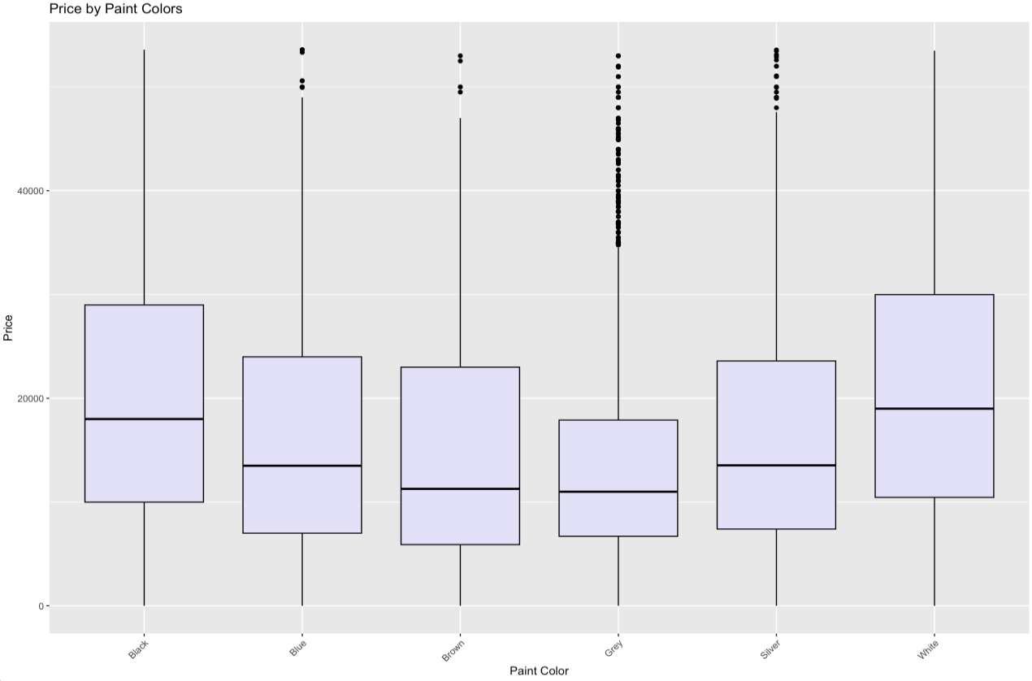
4.Analysis and Result
DS5110 Intro to Data Management
4.1.3 Key Findings
Graph: Price by Paint Colors (Box Plot).
Key Findings: White and silver vehicles tend to have higher median prices; Gray vehicles show a lower price distribution.
Interpretation: Paint color preferences may influence resale value and consumer demand.

Slide 15
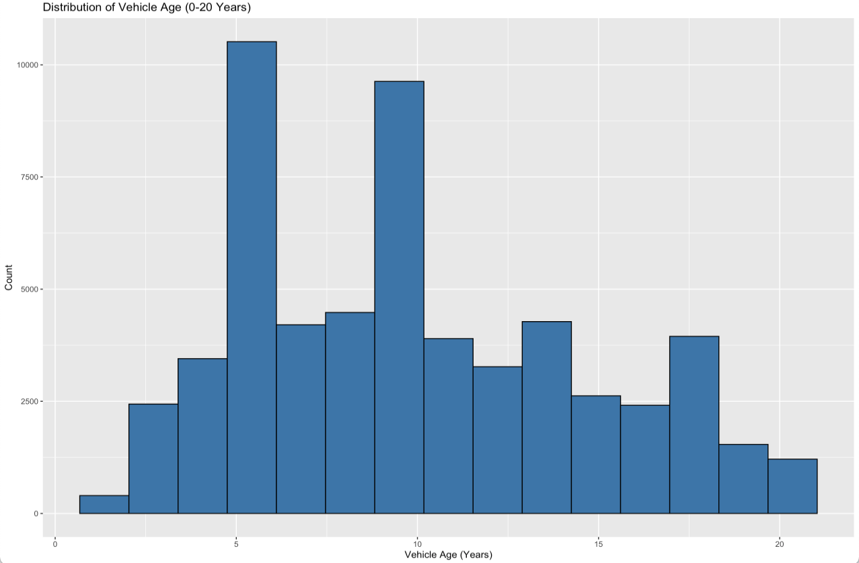
4.Analysis and Result
DS5110 Intro to Data Management
4.1.4 Key Findings
Graph: Distribution of Vehicle Age (0-20 Years) (Histogram).
Key Findings: Vehicles aged 5 to 10 years dominate the used car market; Older cars (>15 years) have lower representation.
Interpretation: The market leans towards cars that balance affordability with reliability.

Slide 16
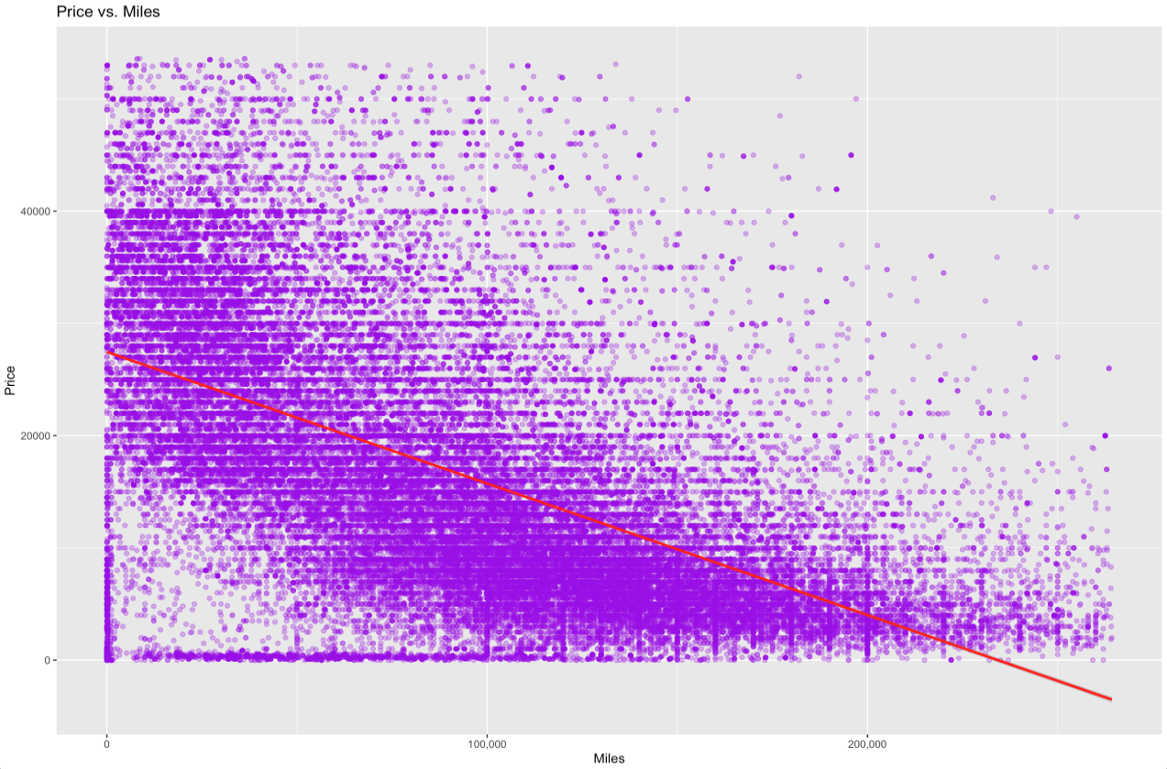
4.Analysis and Result
DS5110 Intro to Data Management
4.1.5 Key Findings
Graph: Price vs. Miles (Scatter Plot).
Key Findings: Strong negative correlation: Higher mileage typically results in lower prices; Some high-mileage vehicles retain high prices (e.g., luxury brands).
Interpretation: Mileage is a critical factor influencing used car prices, especially for mainstream vehicles.

Slide 17
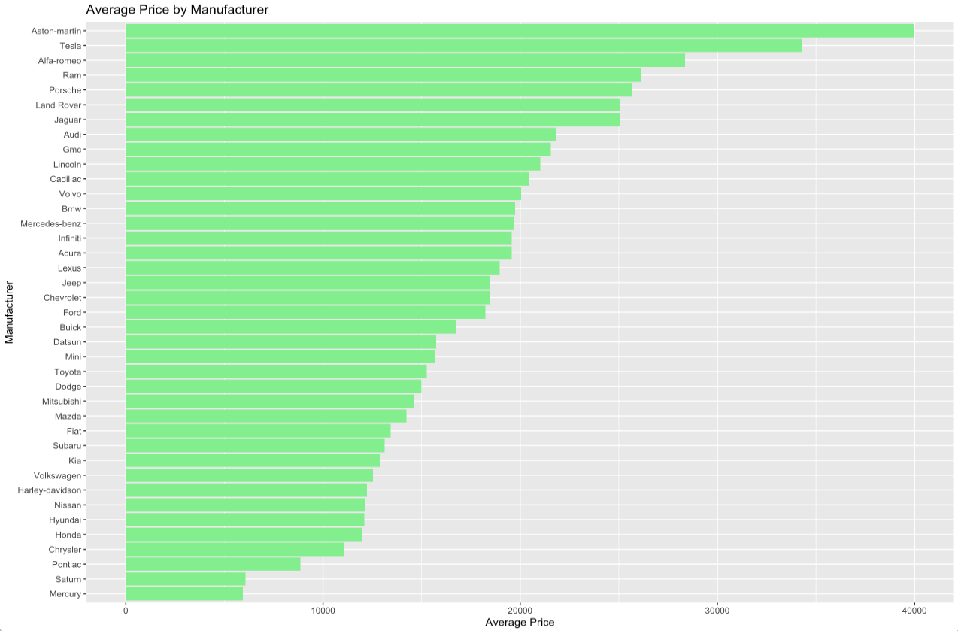
4.Analysis and Result
DS5110 Intro to Data Management
4.1.6 Key Findings
Graph: Average Price by Manufacturer (Bar Plot).
Key Findings: Luxury brands like Aston Martin, Tesla, and Porsche have significantly higher average prices; Mainstream brands (Ford, Toyota) have lower but more stable price ranges.
Interpretation: Luxury brands retain value, highlighting a high-end market niche in used cars.

Slide 18
4.Analysis and Result
DS5110 Intro to Data Management
4.2 Interpretation of Result
Market Trends:
Popular brands dominate the market, with Ford, Chevrolet, and Toyota leading.
Gas-powered vehicles remain the most sought-after, but hybrid/electric cars indicate a potential emerging trend.
Key Price Influencers:
Mileage and vehicle age are the primary determinants of price.
Secondary factors like paint color and drive type (e.g., 4WD) also play roles.

Slide 19
5.Discussion & Conclusion
DS5110 Intro to Data Management
5.1 Key Implications
Linear regression identified year and odometer as key features.
XGBoost excelled in handling non-linearities.
Stacked model outperformed individual models in predictive accuracy.
This part needs more data to exp.
Maybe have a visual of R square for the model.

Slide 20
5.Discussion & Conclusion
DS5110 Intro to Data Management
5.2 Project Limitations
Static dataset limits temporal trends.
Excluded features (e.g., market demand, regional variations).
Computational challenges in ensemble methods.
This part needs more data to exp.
Maybe have a visual of R square for the model.

Slide 21
5.Discussion & Conclusion
DS5110 Intro to Data Management
5.3 Project Summary
Stacked model achieved the best accuracy, suitable for real-world applications.-Hope
Predictive insights are valuable for pricing assistance and market analysis.-Hope
This part needs more data to exp.
Maybe have a visual of R square for the model.

Slide 22
5.Discussion & Conclusion
DS5110 Intro to Data Management
5.4 Future Directions
Enhance data sources with dynamic and real-time updates.-Maybe
Deploy pricing prediction as an interactive web tool.
Experiment with deep learning models for further performance gains.
This part needs more things to exp.
Maybe have a visual of R square for the model.

Slide 23
6.Reference
DS5110 Intro to Data Management
https://github.com/zubinzhang1997/Used-Car-Analysis.git
More links

