Slide 1
IMAGE Super Resolution
by Ivan Maloshtan, Rostyslav Zubko, Rashid Aghayev
Objective – enhance the resolution of images using deep learning techniques ​

Slide 2
Datasets
DIV2K
Set5
Set14
Preprocessing: downsampling high-resolution images -> Low-resolution

Slide 3
Architectures of learning models:
SRCNN – baseline model;
More advanced:
EDSR
SRGAN
VDSR

Slide 4
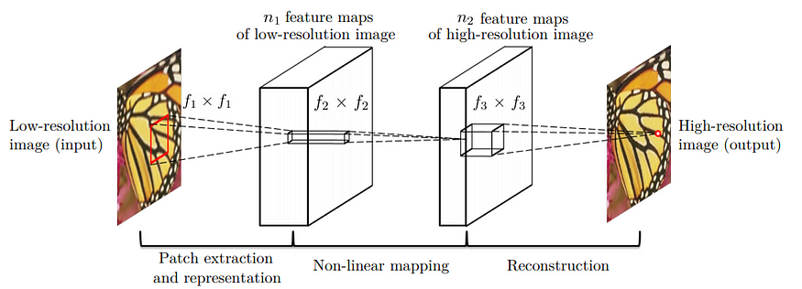
SRCNN
3 Convolutional layers
Filters: 128-64-1
Kernel size: 9-3-5
Optimization: Adam optimizer
Loss function: MSE

Slide 5
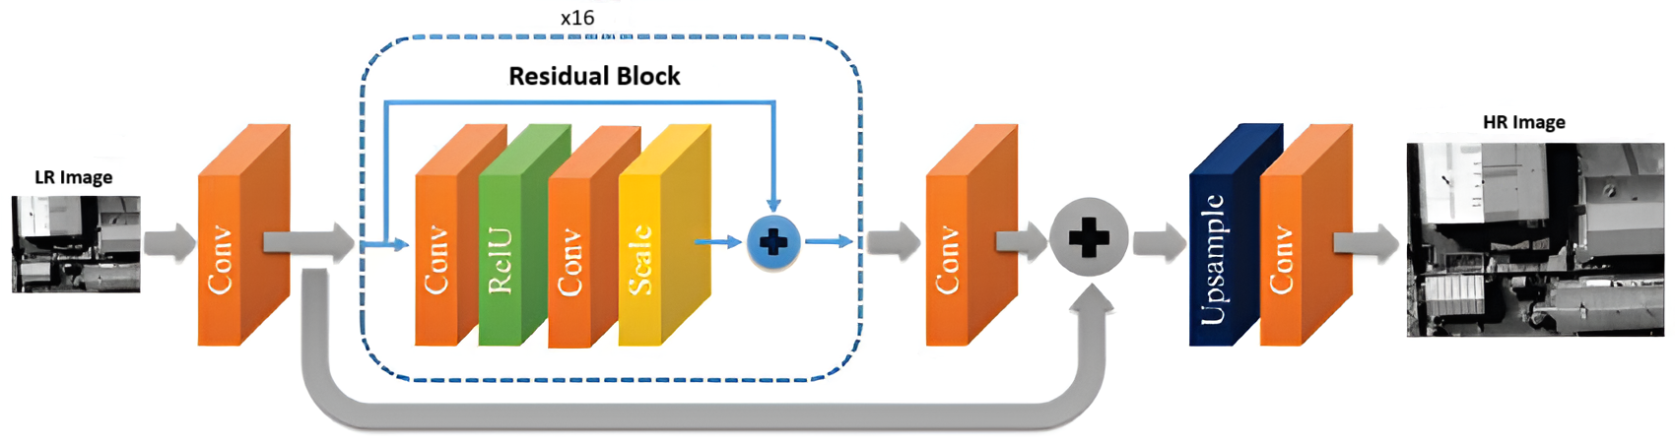
EDSR
Pre-residual block: 1 convolutional layer
Residual blocks (x16): 2 convolutional layers + ReLU activation function
Post-residual block: 1 convolutional layer
Optimizer: Adam optimizer

Slide 6
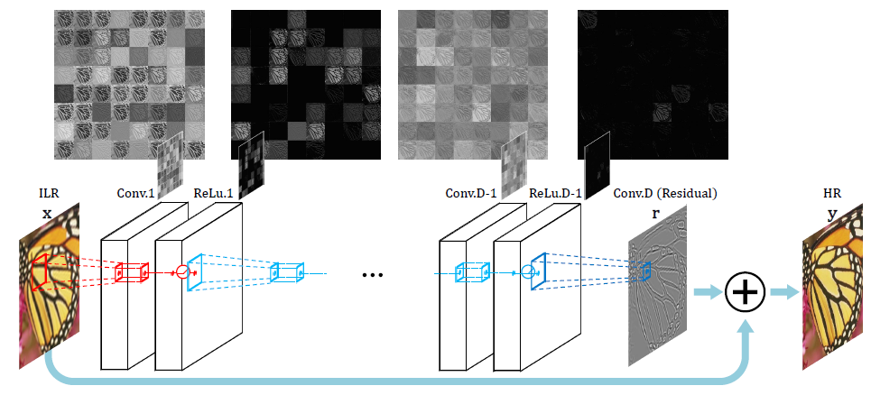
VDSR
Input Layer
Convolutional Layers
Residual Learning
Output Layer

Slide 7
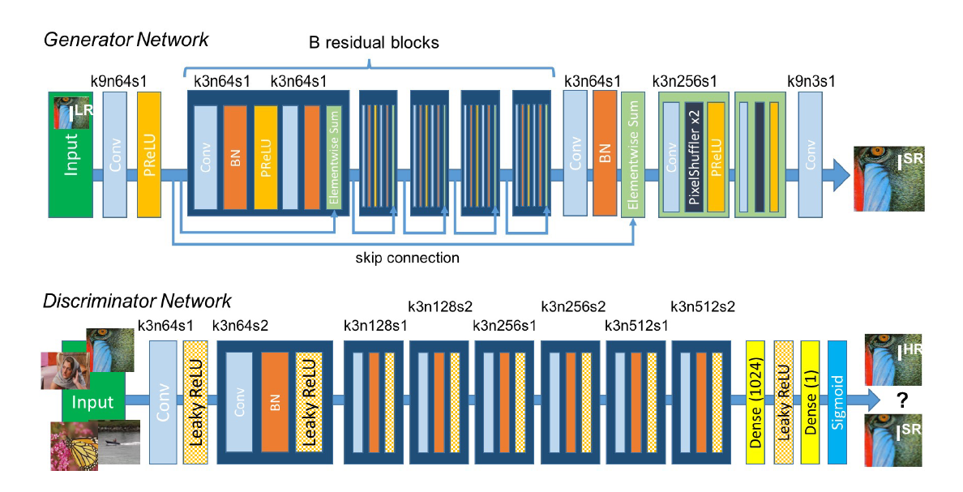
SRGAN
Generator - produce fake data (SR image)
Discriminator -binary classifier; evaluates whether a given data instance is real or fake
Adversarial Training: The generator and discriminator are trained together, refining the image quality through adversarial feedback
Discriminator generate the adversarial loss which then backpropagated into the generator architecture.

Slide 8
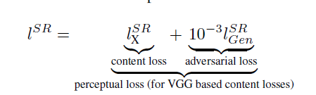
SRGAN
Optimization: Adam optimizer
Problem: solutions of MSE optimization problems often lack high-frequency content (details)
Introduces Perceptual Loss - weighted sum of a content loss and adversarial loss component.
MSE-based content loss is replaced with a loss calculated on feature maps of the VGG network (VGG19 classifier); VGG loss is a MSE between the feature representations of a constructed image and reference image.

