Slide 1
G16-zucc软件工程论坛
测试用例
组长：周德阳
组员：何银超、冯一鸣

Slide 2
目
录
01
引言
02
测 试 计 划/编 码 规 范
CONTENTS
03
测试工具
04
测试数据
05
白盒测试
06
评价

Slide 3
01
引言
We have many PowerPoint templates that has been specifically designed to help anyone that is stepping into the world of PowerPoint for the very first time.

Slide 4
引言
1.1参考资料
a.《软件工程导论》，张海藩，清华大学出版社。

Slide 5
引言
1.1介绍
帮助用户实现专注的微信小程序，以种树模式以及排行榜模式增强用户体验感。

Slide 6
02
测试计划
We have many PowerPoint templates that has been specifically designed to help anyone that is stepping into the world of PowerPoint for the very first time.

Slide 7
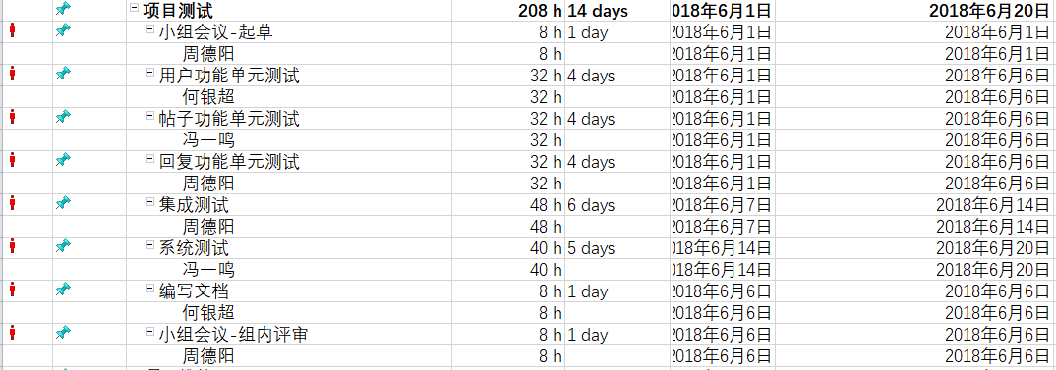
测试计划
2
测试计划

Slide 8
编码规范
1、分号
2、行长度
3、括号
4、缩进
5、空行
6、空格
7、注释
8、文档字符串
9、模块
10、函数和方法
11、类
12、字符串
13、导入格式
编码规范

Slide 9
03
测试工具
We have many PowerPoint templates that has been specifically designed to help anyone that is stepping into the world of PowerPoint for the very first time.

Slide 10
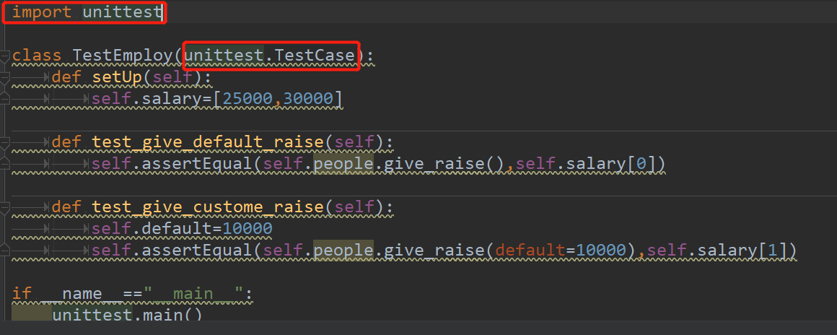
测试工具
3.1
python.Unittest

Slide 11
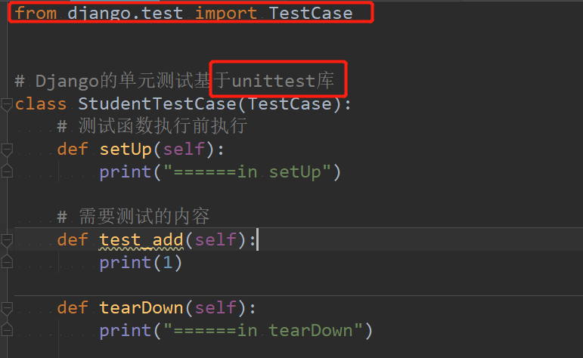
测试工具
3.2
django.test

Slide 12
04
白盒测试
We have many PowerPoint templates that has been specifically designed to help anyone that is stepping into the world of PowerPoint for the very first time.

Slide 13
白盒测试
被测试模块
流程图

Slide 14
白盒测试
1、 Login in request.POST
2、 Login is not in request.POST
3、 User is not None
4、 User is None
5、 User is not active
6、 User is active
被测试模块
可能情况

Slide 15
白盒测试
1、 Login in request.POST, User is not None, User is active
2、 Login in request.POST, User is not None, User is not active
3、 Login in request.POST, User is None, User is active
4、 Login in request.POST, User is None, User is not active
5、 Login in not request.POST, User is None, User is active
6、 Login in not request.POST, User is None, User is not active
7、 Login in not request.POST, User is not None, User is active
8、 Login in not request.POST, User is not None, User is not active
被测试模块
条件组合覆盖结果

Slide 16
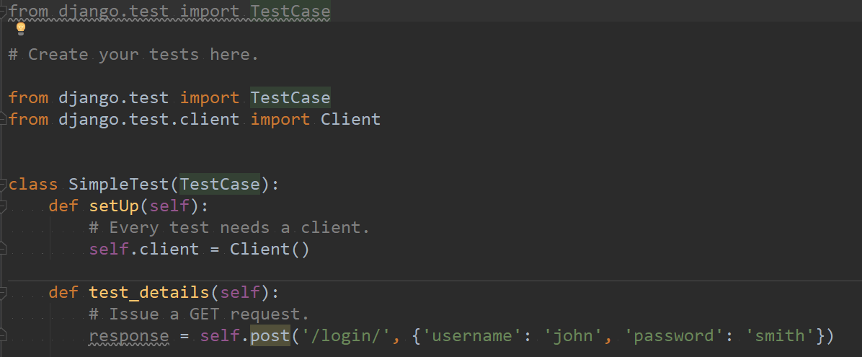
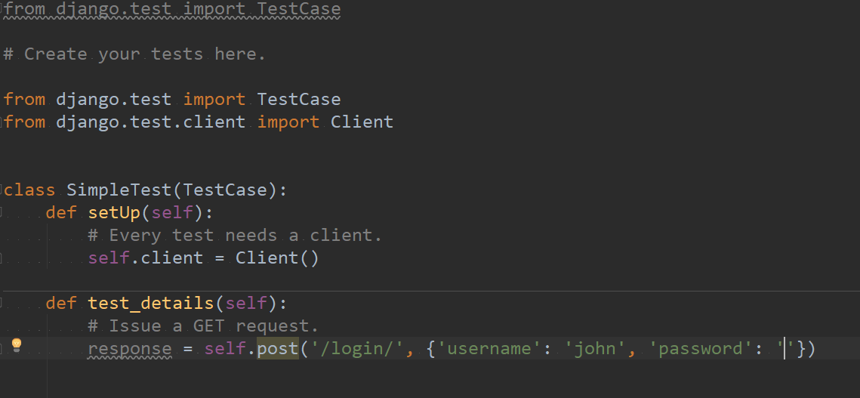
白盒测试
测试截屏

Slide 17
05
评价
We have many PowerPoint templates that has been specifically designed to help anyone that is stepping into the world of PowerPoint for the very first time.

Slide 18
小组分工
小组分工
周德阳
何银超
冯一鸣
ppt制作
小组会议组织
文档编写
用户案例测试
部分伪代码
会议记录编写
86
85
86

Slide 19
谢谢观赏~
PLANNING FOR SIMPLE BUSINESS
---

