Slide 1

Organizational Identity
for MCP Agents
vLEI × Model Context Protocol
An additive extension: org.gleif.vlei/identity
github.com/zuemen/mcp-vlei · Apache 2.0
Notes:
Fifteen minutes on one question: when an agent calls a tool across an organizational boundary, who is accountable, and how does the other side check?

Slide 2
THE STACK TODAY
What MCP verifies
LAYER | WHAT IT PROVES | WHAT IT DOES NOT
TLS | Control of a domain name | — Which legal entity
OAuth iss | Which authorization server | — Which legal entity
OAuth client_id | Control of a metadata URL | — Which legal entity
OAuth sub | Which human user | — Which organization they bind
clientInfo | Nothing. It is self-asserted | — MUST NOT be used for security
Domain control, domain control, domain control, human user.
2 / 20
Notes:
MCP inherits a well-specified authentication stack. Every layer answers a real question. TLS proves control of a domain name. The OAuth issuer identifies the authorization server. The client ID proves control of the URL serving the client metadata. The subject identifies the human user.
Read the right-hand column. Domain control, domain control, domain control, human user. No layer expresses a legal entity, and the specification is explicit that clientInfo must not be used for security decisions — correctly, because nothing backs it.

Slide 3
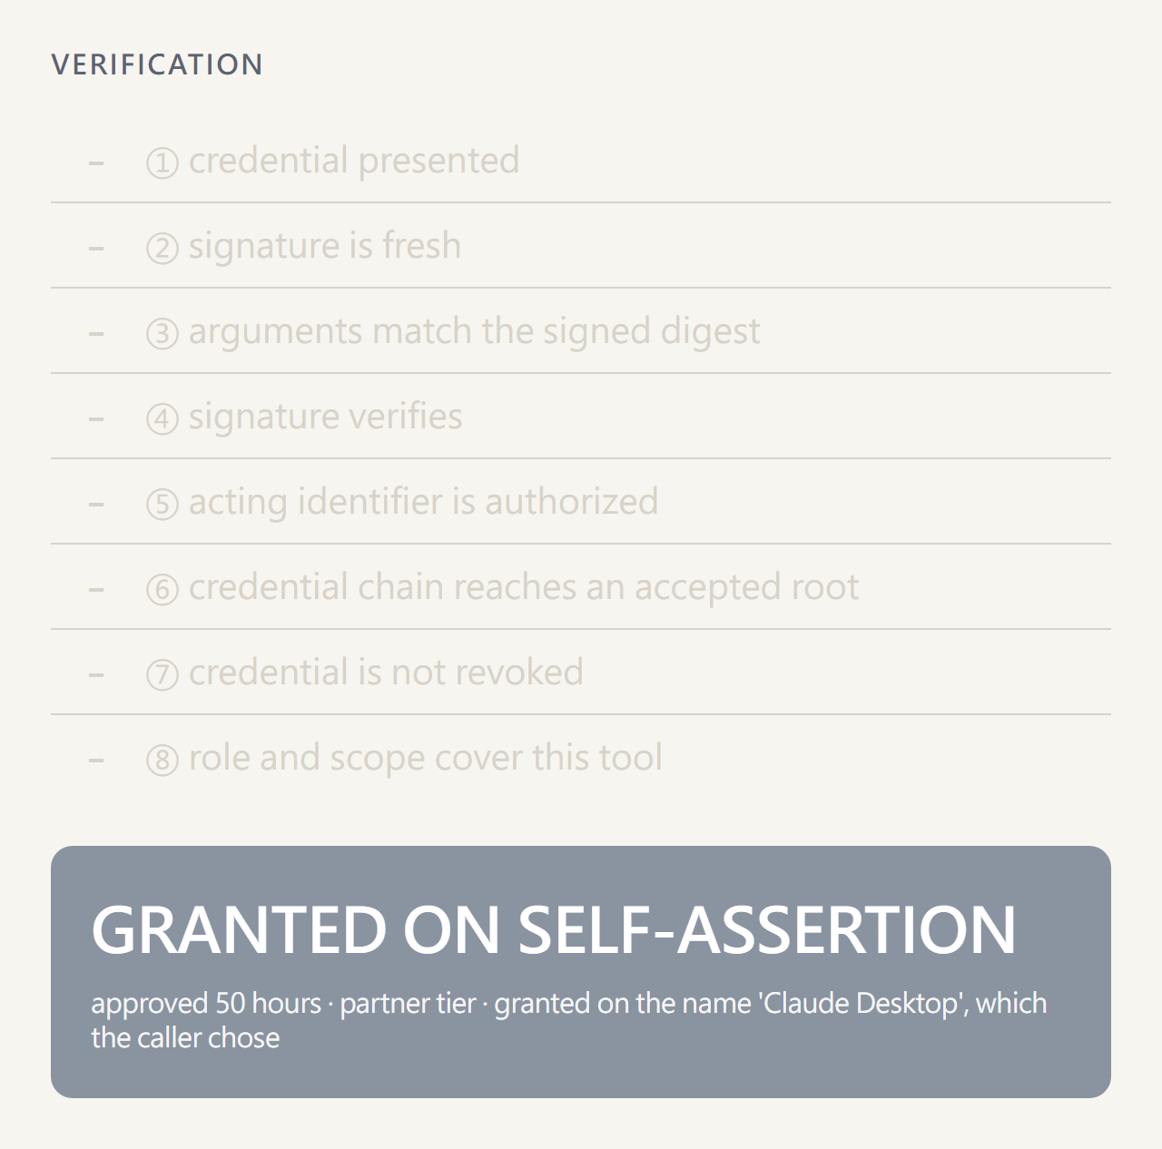
MEASURED, NOT ASSERTED
The measurement
RUN | NAME RECEIVED | APPROVED
Honest | zuemen-script | 1 hour
Spoofed | Claude Desktop | 50 hours
Omitted | mcp | 1 hour
Scene 0 · nothing to check, and 50 hours granted
One binary, one variable. The server's policy deliberately violates the specification — that is the experiment.
3 / 20
Notes:
We measured it rather than asserting it. One binary, one server, fifty hours requested three times, changing only what the client said its name was.
The server's policy deliberately violates the specification — that is the experiment, not a recommendation. What it establishes is that no layer of the stack can tell the three runs apart.
The code is in the repository. Nothing was run against anyone else's service.

Slide 4
THE PROTOCOL ITSELF
The agent is absent from the protocol
schema.ts · revision 2026-07-28 · 3,197 lines
agent 0 occurrences
principal 0 occurrences
delegation 0 occurrences
mandate 0 occurrences
host modelled
client modelled
server modelled
It cannot be named, delegated to, constrained, or revoked — there is nothing there to name.
4 / 20
Notes:
The protocol models a host, a client, and a server. The thing that decides to invoke a tool has no representation — so it cannot be named, delegated to, constrained, or revoked at the protocol layer, because there is nothing there to name.

Slide 5
READ IT FAIRLY
This is a boundary, not a defect
"MCP's trust model assumes a human in the loop" — the Tools chapter's warning box
NSA, May 2026 — MCP does not define how a session maps to a verifiable identity
Security IG proposals — root in domain, DNS, or registry
Those answer which deployment is this. None answers which legal entity is this.
5 / 20
Notes:
Under that premise, self-asserted metadata is harmless: a person is accountable at the point of action. When the agent executes autonomously, the premise no longer holds, and the layer carrying accountability is simply not present.
Everyone has noticed. The published server-identity proposals all root trust in a domain, DNS, or a registry. Those answer 'which deployment is this'. None answers 'which legal entity is this', and none is revocable by an authority the counterparty's regulator also recognizes.

Slide 6
WHY THIS YEAR
Why now
Autonomous execution — no human at the point of action
Actions with legal effect — a filing, a payment, a submission
Across organizations — a counterparty that has never met the agent
Any one alone is survivable. Together they are not.
6 / 20
Notes:
Any one alone is survivable. Together they are not: an agent acting without review, on something that binds its organization, against a counterparty that has never met it.

Slide 7
NOT A NEW IDENTITY SYSTEM
GLEIF already solved the identity half
Legal Entity (LE) — binds an identifier to an LEI
Engagement Context Role (ECR) — binds a person's identifier to a role within that entity
Both chained ACDCs · both revocable · both verifiable offline
Anchored in KERI — key event logs, not a certificate authority
7 / 20
Notes:
This is not a proposal for a new identity system. The Legal Entity credential binds an identifier to an LEI. The Engagement Context Role credential binds a person's identifier to a role within that entity. Both are chained ACDCs, both revocable, both verifiable offline.

Slide 8
A DELIBERATE CHOICE
Why ECR and not OOR
 | OOR | ECR
Names | A public office | An engagement context
Vocabulary | Controlled | Defined by the entity
Validated by | GLEIF | The entity itself
"May file regulatory returns up to this amount" is an engagement context, not a public office.
8 / 20
Notes:
An agent's mandate — 'may file regulatory returns up to this amount' — is an engagement context, not a public office. ECR is the correct credential type, and the vocabulary belongs to the entity that defines the engagement.

Slide 9
THE EXTENSION
What we added: the schema
capabilities.extensions["org.gleif.vlei/identity"]
presents / requires / acceptedRoots / ttlMs
params._meta
org.gleif.vlei/credential
org.gleif.vlei/credentialSaid
org.gleif.vlei/delegatedAid
org.gleif.vlei/signature
Tool._meta
org.gleif.vlei/requires { credential, role, scope }
Four keys in _meta. Nothing in core changes.
9 / 20
Notes:
Everything travels in fields MCP already reserves for extensions, so a party that does not understand them behaves exactly as core MCP specifies.
The last line is the one I would point at. The permission is declared in the schema the client already reads, so an agent can determine before calling whether it is entitled — and decline in terms a user understands, instead of attempting the call and interpreting a rejection.

Slide 10
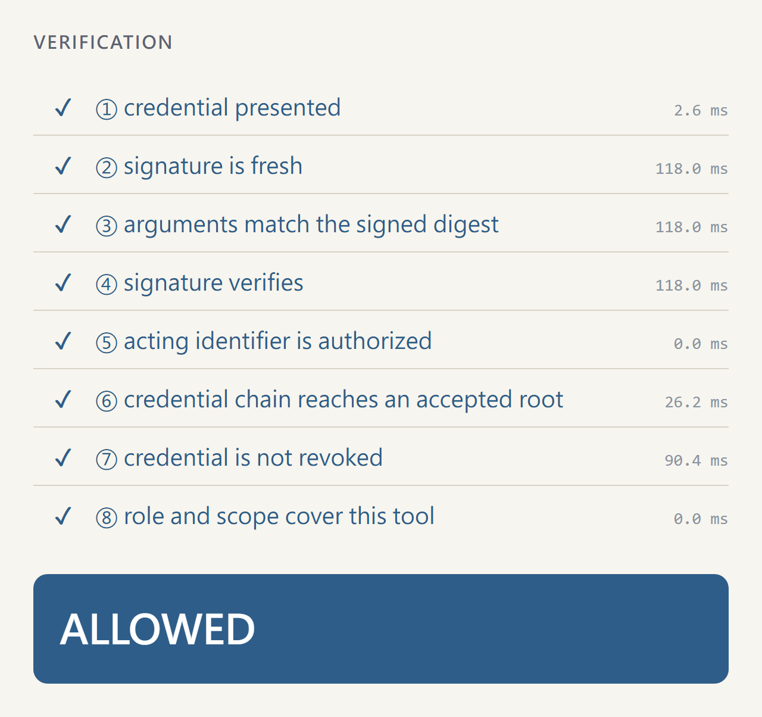
THE EXTENSION
What we added: verification
1 credential_present request
2 freshness request
3 digest request
4 signature signer's key log · witness
5 delegation holder's key log
6 chain stream · issuers' logs
7 revocation issuers' live logs
8 authority credential
Scene 1 · the same checks, run on a live call
The key a request is checked against comes from the signer's own log — never from the request.
10 / 20
Notes:
Eight checks, and the order is the design. The first three are decided from the request itself, before anything is fetched. Two read from a witness: the signer's current key, and the issuers' logs for revocation. A witness that is slow or down then costs you those checks, never the ones before them — a tampered request is refused as tampered, not as a timeout.
Nine failure layers, and the correct response differs for each. A stale signature is retried once. revoked means stop and tell the user a new credential is needed. unknown_root means two organizations disagree about whom they trust and only they can fix it. An agent that receives 'access denied' can do none of that.

Slide 11
FROM BUILDING IT
Three things the paper design did not predict
1 Presentation is the holder's step — so a counterparty's credential must be verified locally
2 Ask about the issuee, not the signer
3 Protocol version negotiation decides whether extensions exist at all
None of the three is derivable from the design. They are what a second implementer would otherwise pay for again.
11 / 20
Notes:
Three things cost us days; I will name two, because a second implementer would otherwise pay for them again. Presentation is the holder's step: a relying party cannot hand someone else's credential to a service and ask about it, so it verifies the chain itself — that one fact shapes every deployment. And ask about the issuee, never the signer.

Slide 12
TRACEABILITY
Every requirement, traced
docs/CONFORMANCE.md — every normative statement, its code, its test
One defect every green test missed: the signature was checked under a key the request carried. Found, fixed, recorded.
A server written from the skill alone found one more gap in ours — the ECR's LEI was not tied to its legal entity. Fixed.
A section listing what is deliberately not claimed
A conformance document that lists only successes is not evidence of anything.
12 / 20
Notes:
Every MUST and SHOULD in our specification has a row: the code that implements it and the test that holds it.
A review found something worse than a missing row, and I would rather tell you than have you find it: our verifier checked the request signature under a key the request itself carried. Every test passed, because every test signed with the right key. It now reads the key from the signer's own log, and the tests that would have caught it fail against the old code.
And a server written by a fresh model from our skill alone found one more gap in ours: nothing tied an ECR's LEI to its legal entity. Both are fixed.

Slide 13
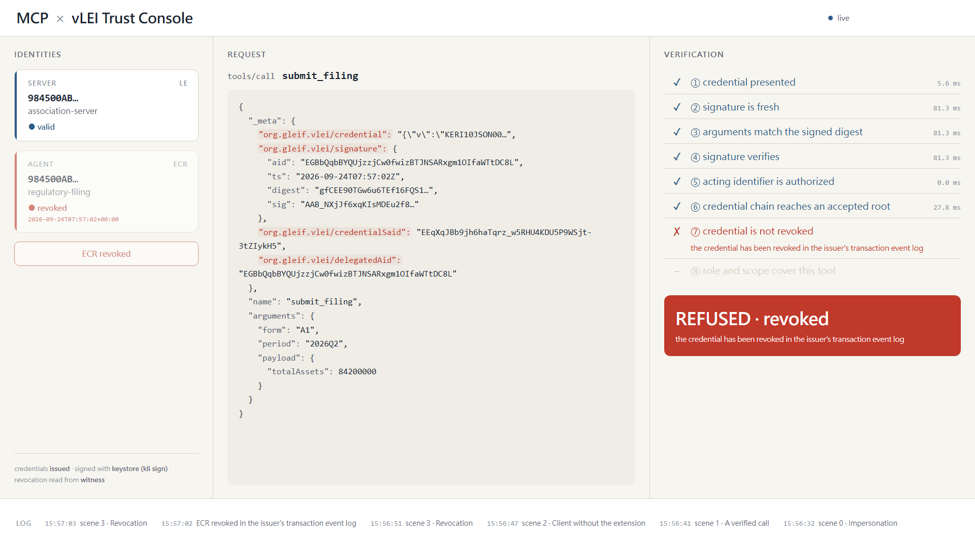
Real KERI, real ACDC, real revocation.
The root of trust is self-configured; in production it would be GLEIF's.
13 / 20
Notes:
Everything you are about to see is real KERI and real ACDCs, issued through GLEIF's own schemas, with a revocation read from the issuer's transaction event log. The one thing I control is the root of trust, because I do not have a production vLEI. In production the chain terminates at GLEIF's root.
One more thing while this slide is up. We did use GLEIF's verifier, and we found a defect in its revocation path that takes the service down. It is written up and ready to file.
[Play demo-full.mp4, 2:50.]

Slide 14
CLOSE TO HOME
Taiwan already runs this model
 | TAIWAN TODAY | THIS PROPOSAL
Holder | People — Digital Identity Wallet 數位憑證皮夾; companies — MOEA business certificate 工商憑證 | Legal entities, and the agents acting for them
Delegation | To employees — the certificate's attached card 附卡; per site and time limit announced for the phone | To an agent — a delegated identifier under the ECR holder, scoped
Identifier | Unified business number 統一編號 | LEI — a Taiwanese entity's record carries its 統一編號
Reach | Domestic — over 180 G2B and B2B systems | Verifiable abroad, back to GLEIF — ISO 17442-3:2024
Built on | X.509 (certificate) · OpenID4VC, SD-JWT VC (wallet) | KERI, ACDC — GLEIF's vLEI
Taiwan already delegates a company's authority to its people. What it does not yet do is delegate it to an agent, or make it verifiable abroad.
14 / 20
Notes:
Taiwan already runs this model — for people. The Digital Identity Wallet lets a person show only what a counter needs to see. And the MOEA business certificate already lets a company hand its authority to an employee, through an attached card; the ministry has announced the same on the phone, per site and per time limit.
What neither does is the holder on the right: an agent acting for the entity. The certificate's own practice statement marks authenticating server software 'not applicable'. And it is domestic by design — but a Taiwanese company's LEI record already carries its unified business number, so the two meet at the same number. The Deputy Minister made the point this month: agents may need an ID.
Same idea, a different holder — and one a counterparty abroad can verify.
[Say "attached card" and, for the phone, "announced": MOEA's own release says the mobile delegation "will be provided" (將提供), and today every mobile certificate is itself an attached card. Do not say the business certificate is in the wallet — it has its own app, and its place in the wallet ecosystem is reported by the press, not shown. The finance, HR and sales example is CNA's reporting, not the ministry's release. GLEIF's data lists Taiwan as "Taiwan (Province of China)": put no GLEIF search page on screen. The Deputy Minister's words are as reported; say "made the point".]

Slide 15
BOTH ALREADY EXIST IN INSTITUTIONS
Two ways to check an identity
(a) Passive, from a public location — publish once, verify anywhere, no per-check cost
(b) Attested confirmation (來函確認) — one institution confirms to another, signed
The limit, stated: relying on an attestation means relying on that institution's judgment — exactly as relying on a letter does today.
The attesting institution must itself have been verified first.
15 / 20
Notes:
Institutions already check identity two ways. A public directory: publish once, anyone verifies, even before making contact. And the letter of confirmation — office A writes to office B, B replies, A relies on the reply.
As an agent call, B returns a signed attestation and A verifies B's signature: a second instead of days, a signature instead of a letterhead. The limit is today's: relying on an attestation means relying on that institution's judgment. The system insists only that the attesting institution was verified first, and records whose word it took.
[來函確認 stays in Chinese on the slide on purpose: it is the name this room uses for the procedure, and recognising it is the point of the slide. Say it in English; let the slide say it in Chinese.]

Slide 16
ADOPTION
Six stages, one of which touches IT
0 Credential and role vocabulary — the business unit, not IT
1 Publish at a well-known location
2 Declare the requirement per tool
3 Verify at the gateway ← the only IT change
4 Attestations between institutions
5 Audit records
The filing service contains no verification code. It reads five headers the gateway sets.
16 / 20
Notes:
Each stage is independently useful. An institution that stops after stage two has gained something real.
Stage zero is the substantive one and it is not technical: the business unit defines its role vocabulary. Those names appear in every authorization decision and every audit record afterwards.
Only stage three touches IT, and it is the one that decides whether this is a configuration change or a project. Verification goes at the gateway; the systems behind it read headers, as they already do.

Slide 17
ADOPTION
What an institution gets
 | TODAY | AFTER STAGE 3
Who filed | A session, a token | A named entity and role
Authority changed | A ticket | Revoke the credential
New system built | — | None
Existing sign-on | Answers which user | Unchanged — still required
Audit record | An IP and a timestamp | LEI, role, signature
vLEI answers which organization. Your existing sign-on still answers which user. A high-value action should require both.
17 / 20
Notes:
One row deserves emphasis, because it is the one most likely to be misread. This does not replace existing user authentication. vLEI answers which organization; your existing sign-on still answers which user. A high-value action should require both. An institution that drops one because it gained the other has weakened itself.

Slide 18
STATED, NOT WAITED FOR
Limits
Verifiable is not the same as trustworthy
LEIs are not issued to private individuals
There is a cost, and QVI coverage is still expanding
Our demo root is self-configured
Key logs are compared across the configured witnesses — no independent watcher yet
Revoking one agent's delegation is not implemented; revoking the credential is
Agent delegation conventions are not yet settled
A valid credential proves an organization asserted a role. It does not prove the request is legitimate.
18 / 20
Notes:
I would rather state these than be asked. A valid credential proves an organization asserted a role; it does not prove the request is legitimate — that policy stays yours.
Two are ours to fix. We compare key logs across the witnesses we are given, but run no independent watcher. And withdrawing one agent without touching the person's credential is not built; withdrawing the credential works, and stops every agent under it.

Slide 19
THE ASK
Three requests
Government one small pilot: one filing or lookup procedure, stages 0 to 3, no change to the department's systems
GLEIF an ECR role vocabulary for agent contexts · confirmation of the delegation model against the EGF · test credentials
AAIF take this to the Security Interest Group and the ext-auth discussion
We chose a reading of the existing mechanisms, and would rather be corrected now than at deployment.
19 / 20
Notes:
To the institutions here, first, because you would carry the risk: one procedure, one counterpart, stages zero to three, and no change to the system behind your gateway.
To GLEIF: an ECR role vocabulary for agent contexts; a confirmation or correction of our delegation model against the Ecosystem Governance Framework — we would rather be corrected now than at deployment; and test credentials against a real root, so the honesty statement can be retired.
To AAIF: this belongs in the Security Interest Group and the ext-auth discussion. I would like to be told where it is wrong.

Slide 20
ONE REPOSITORY, APACHE 2.0
Artifacts
spec/ specification v0.2 · types · wire examples · test vectors
packages/ mcp-vlei — KEL + chain verification, 155 tests
skills/ implementing-vlei (build) · vlei-identity (runtime)
examples/ console · impersonation · regulator · skill-server
deploy/ gateway configuration — zero-code-change adoption
docs/ problem · adoption · conformance · upstream defect
github.com/zuemen/mcp-vlei
Real KERI, real ACDC, real revocation. The root of trust is self-configured; in production it would be GLEIF's.
20 / 20
Notes:
Everything is in one repository, Apache licensed. The specification, the package, both skills, the reference implementations, the gateway configuration, the conformance table — and the defect report, because we used your verifier and we owe you that.
Thank you. I have time for questions.

