Slide 1
Nur-Sultan heat consumption PROJECT
Made by Astana IT University students

Slide 2
01
02
03
04
05
OUR
MAIN TASK
Used
data
The main goal of the project
Data that was used in the project
MAIN
methods
Methods that were used for the analysis
PROJECT STAGES
Stages of our work
OUR TEAM
Here you could describe the topic of the section

Slide 3
OUR MAIN Task
Make a correlation analysis of heat energy consumption by zones of Astana with changes in ambient temperature, determination of the heat front speed, visualization on the map.

Slide 4
Data that we used for our analysis
Data 1
Dataset that contains information of measurements on the consumer side - inlet and outlet temperatures, hot water flow in tons, heat in gcal, errors, daily, for 2016. 5700 rows. Also the dataset with 66000 rows.
GEOPY AND GOOGLE MAPS
The API was used to get exact location for maps.

Slide 5
MAIN METHODS
Reading / parsing / processing / cleaning data, 7 point moving average, standardization, clustering
color GIS visualization.

Slide 6
PROJECT STAGES
STAGE 1
Preparing xls files.
STAGE 2
Preprocessing. Data parsing, cleaning were done,
STAGE 3
Clustering
STAGE 4
Visualization

Slide 7
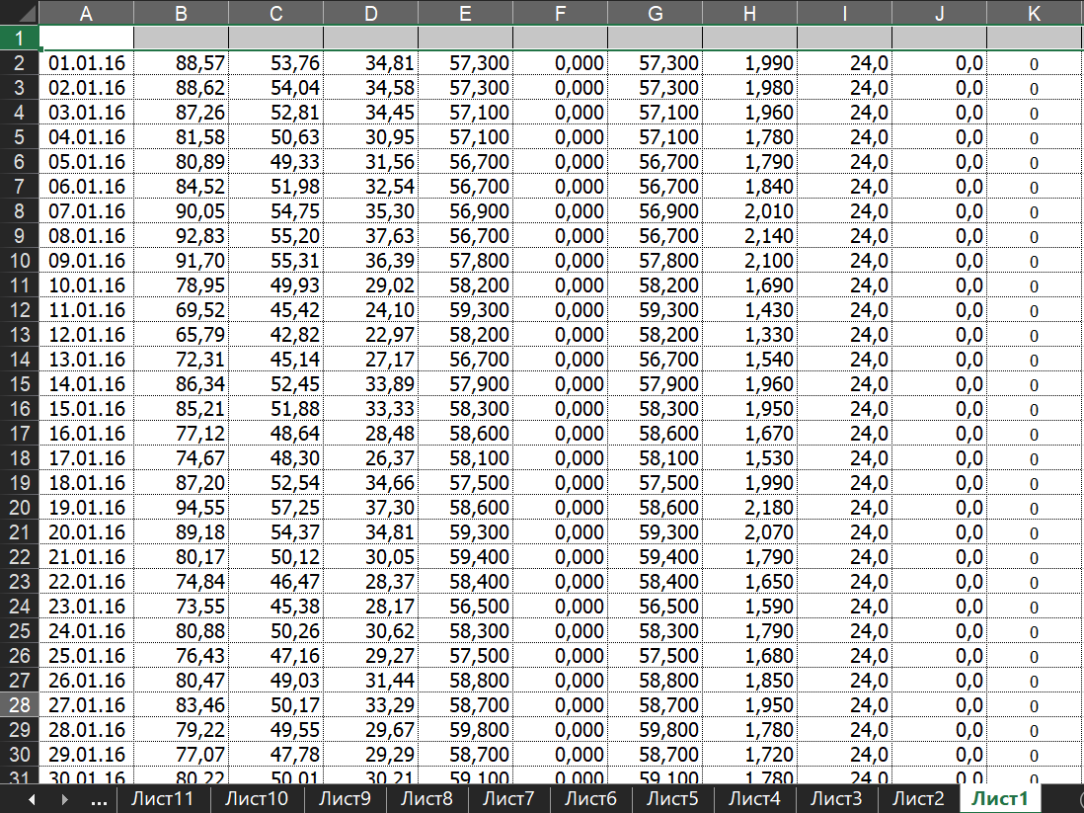
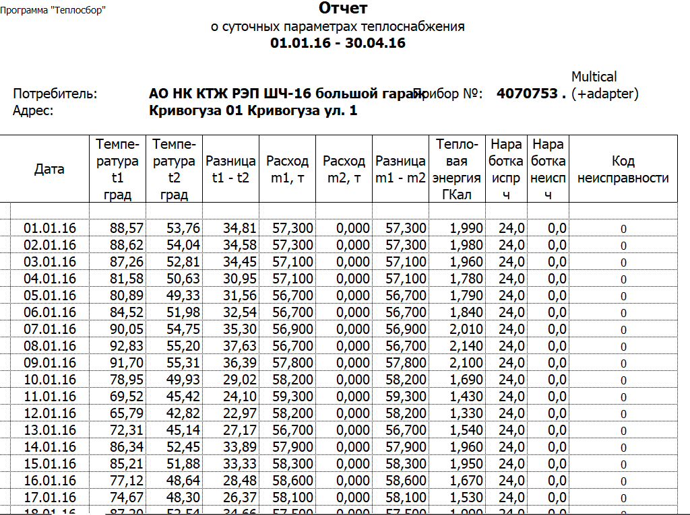
preparation
That is the part, where xls files were prepared for the further work.

Slide 8
Preprocessing
In Preprocessing stage the reading, parsing and cleaning were done.

Slide 9
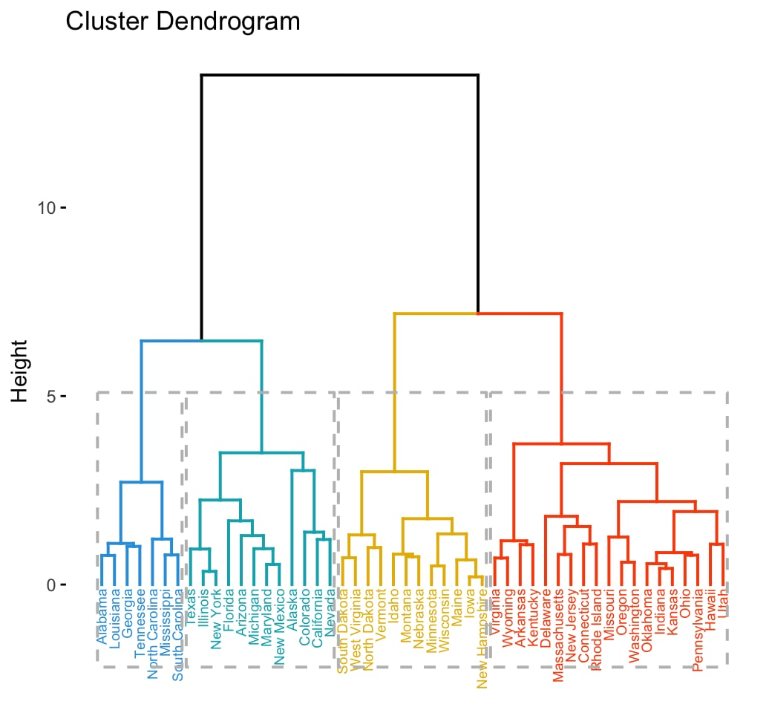
clustering
In Clustering Part, it was decided to use the Agglomerative clustering Method. The Dendrogram represents how it functions as hierarchical clustering. It also was used to determine optimal cluster number.

Slide 10
visualization
The Visualization Part was made Dash Leaflet on geolocations.
Leaflet is the leading open-source JavaScript library for interactive maps

Slide 11
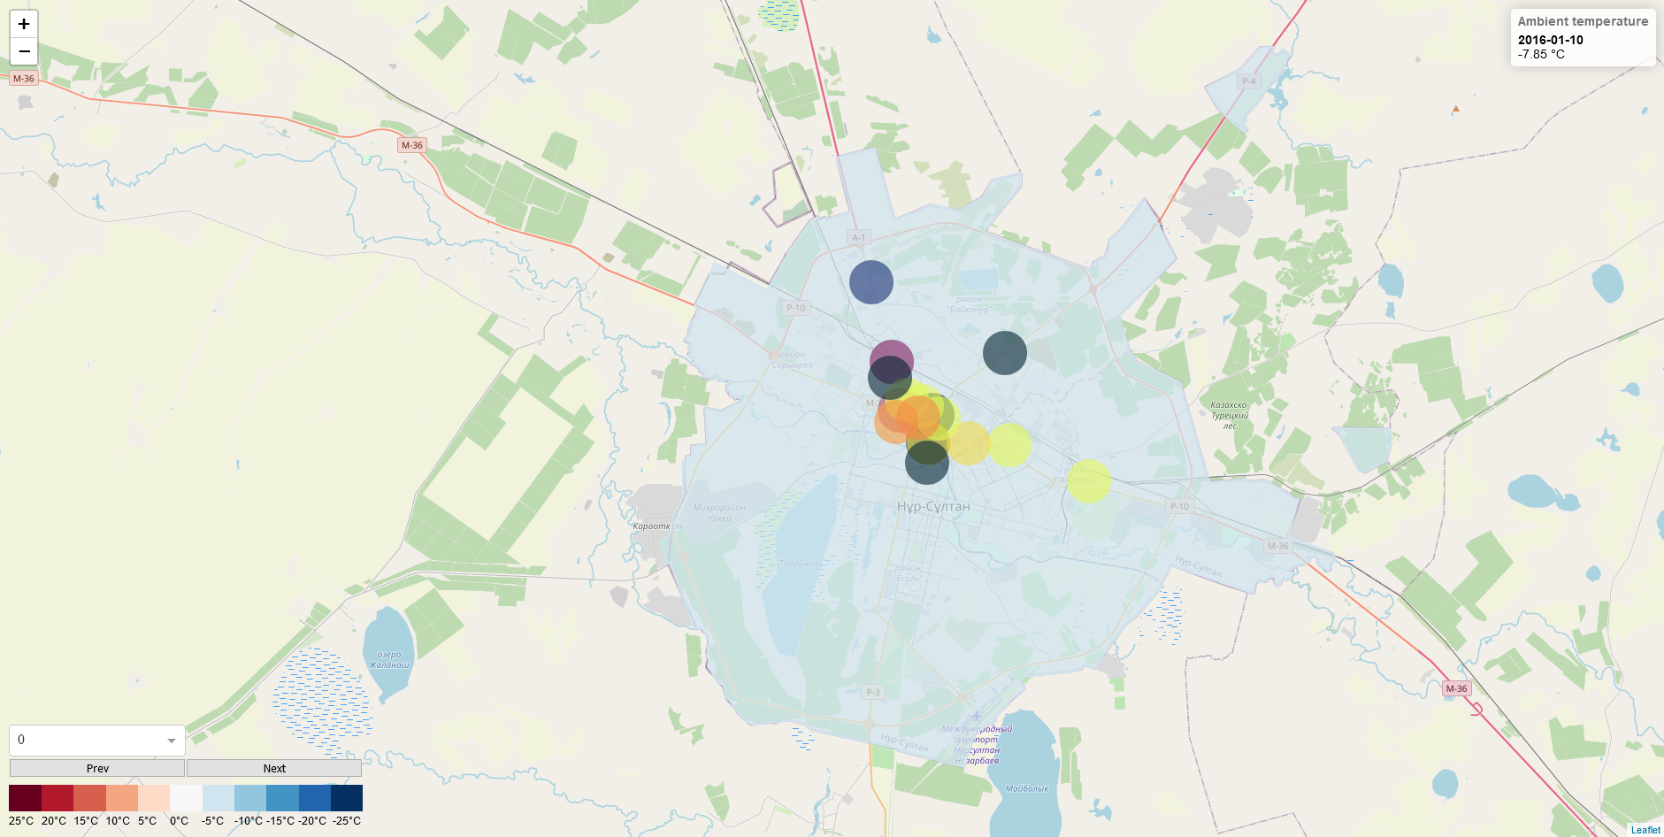

Slide 12
OUR TEAM
Zufar Idoyatov
Diana dalenova
Yedyge Ashmet
Bakhtiyar Mautov

Slide 13
THANKS
Does anyone have any questions?
Please keep this slide for attribution.

