Slide 1
Rent problems in Almaty and how it affects people, in example of students
Kair Daniyal
Zhashkeev Erkanat
Idoyatov Zufar

Slide 2
Hypothesis
It is supposed that Kazakhstani government wasn’t ready for results of baby-boom happened in 2000-2005
Fact of insufficient number of rooms in university-connected hostels, leads to rent costs increase
There may be other factors that influence the hypothesis but do not rule it out

Slide 3


Why it is important?
Quality of life
Costs regulation
Safety
Educational process

Slide 4
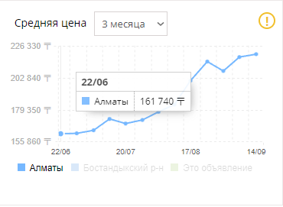
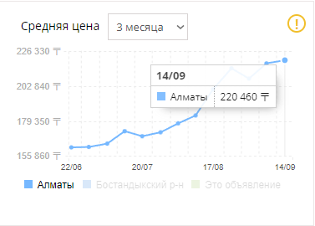
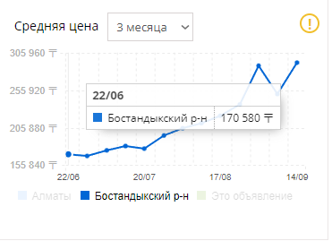
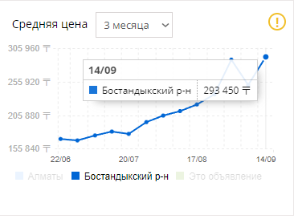
Change in rent cost for last 3 months
krisha.kz

Slide 5
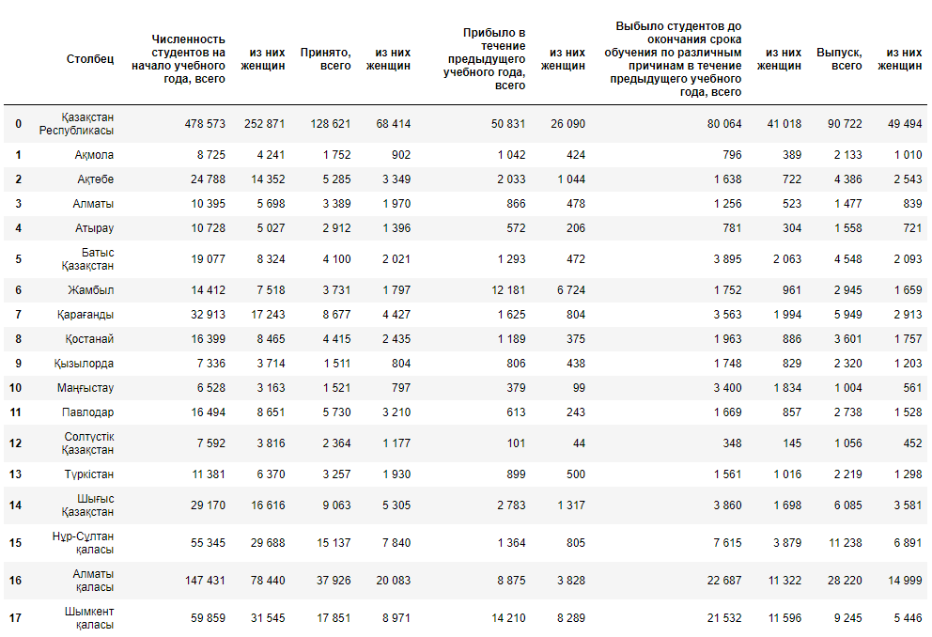
2020

Slide 6
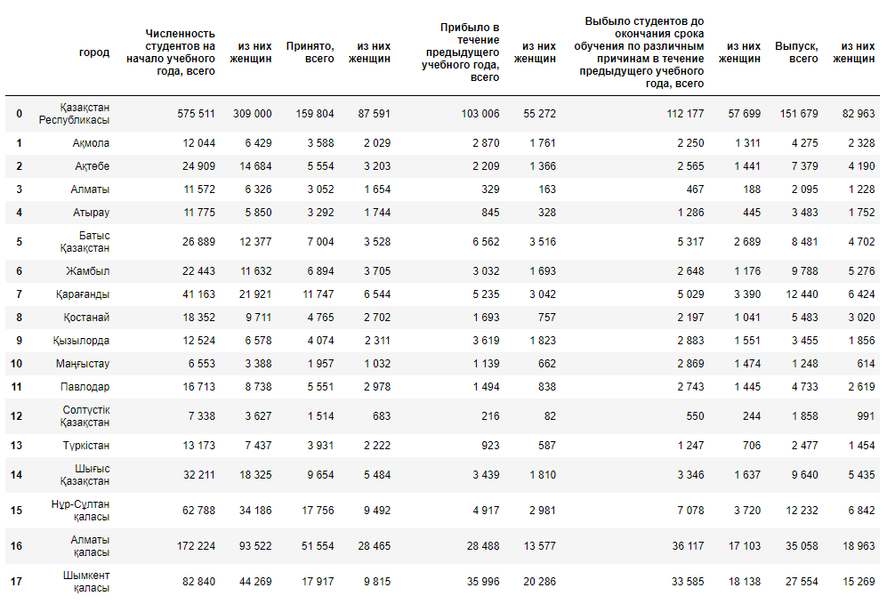
2021

Slide 7
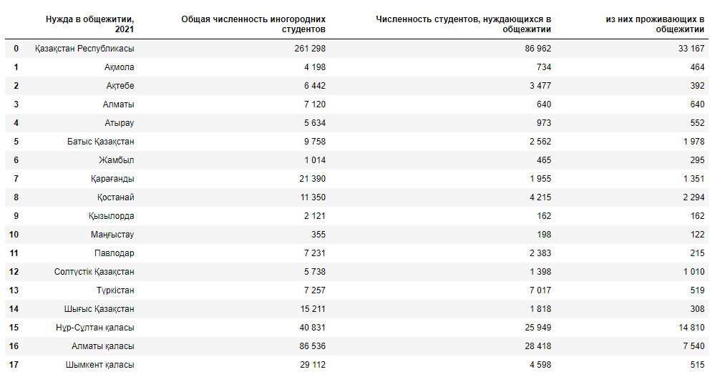
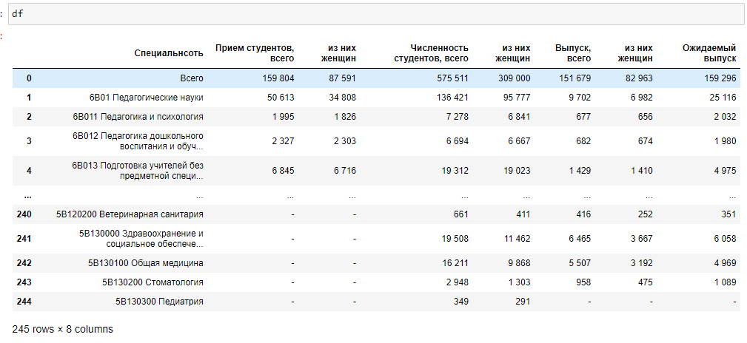
2021

Slide 8
2021

Slide 9
Data link: https://stat.gov.kz/official/industry/62/statistic/5
…
data available from 1999 to 2021, in presentation a small part of all data

