Slide 1
AI Based Video Monitoring System
Taking security to next level
Kumar Shubham(1SI16CS132)

Slide 2
Introduction
Today’s security services rely a lot on CCTV cameras and video footage.
It’s a revolution in modern markets, shops, facilities in terms of security.
But there is one
major flaw
“There is a necessity for a person to constantly sit by the
screen and keep watch”.
And here comes the necessity of our product.

Slide 3
Objectives Of The Product
Developing an autonomous system to monitor any illegitimate activity as configured and defined by the customer.
-The idea is to use GPU accelerated Deep Learning methods to train a Neural Network that
can identify for illegitimate activity to tackle the problem effectively.
The CCTV network will be fully connected to the system running this trained neural network, so that every unwanted activity is recognised on-spot.
When the monitoring is going on, the program will keep a constant track of any illegitimate activity by generating an alert at the time of detection and storing about 10 min frames around it.

Slide 4
Motivation
The majority of the motivation comes from the impact that it will have on society.
Increased security and reduction in errors.
Better utilization of the human resource as time will be saved and manual monitoring.
Part of the society concerned about their security –
Shopkeepers, Educational Institutions, warehouses, Shopping Malls and all other
person or organization using video surveillance for security purposes.

Slide 5
Literature Survey
PAPERS REFFERED TILL NOW IN ACCORDANCE WITH THE DETAILED OBJECTIVE
Crowd Counting in Low-Resolution Crowded Scenes Using Region-Based Deep Convolutional Neural Networks
BY: MUHAMMAD SAQIB 1, SULTAN DAUD KHAN 2, NABIN SHARMA1, AND MICHAEL BLUMENSTEIN
1Centre for Artificial Intelligence, Faculty of Engineering and Information Technology, School of Software, University of Technology Sydney, Ultimo, NSW
2007, Australia
2University of Hail, Ha'il 2440, Saudi Arabia
Corresponding author: Muhammad Saqib (muhammad.saqib@student.uts.edu.au)
Improve crowd counting algorithm to accurately identify the number of the people in the vision of the video camera in low resolution environment using faster CNN algorithm and better smoothening and sharpening effect.
Improved Crowd Counting
BY: JUN SANG , WEIQUN WU, HONGLING LUO, HONG XIANG, QIAN ZHANG, HAIBO HU, AND XIAOFENG XIA
Key Laboratory of Dependable Service Computing in Cyber Physical Society of Ministry of Education, Chongqing University, Chongqing 40004, China
School of Big Data and Software Engineering, Chongqing University, Chongqing 401331, China
Corresponding author: Jun Sang (jsang@cqu.edu.cn)
This work was supported in part by the National Key R&D Program of China under Grant 2017YFB0802400, and in part by the Chongqing Research Program of Basic Science and Frontier Technology under Grant
cstc2017jcyjB0305.
To obtain better performance on crowd counting, an improved crowd counting method based on SaCNN(scale-adaptive convolutional neural network) was proposed in this paper.

Slide 6
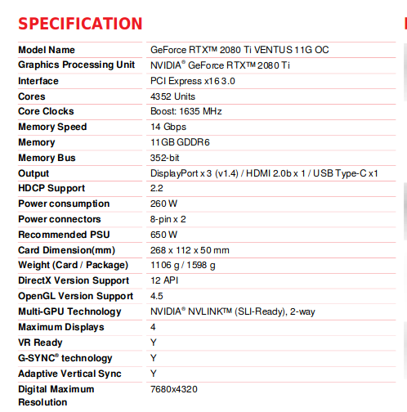
Requirements
Hardware
GPU GeForce RTX 2080Ti VENTUS
Video Camera
Raspberry Pi Board
Connecting wires
Software and Technology
Standard databases to test the algorithms
Tensor Flow Anaconda, Keras and others to be decided at the time of development.
* Cost of requirements depends on project scope

Slide 7
Conclusion
The major takeaway from this product will be its live detection capacity.
In addition to that, the log keeping feature of the system is also worth noting and that comes in handy.
It is going to significantly reduce the Human error caused due to various reasons, thus making the whole system more sturdy and robust.
Use of machine learning in the technology gives it a cutting edge feature.
Though majority of the application of the product that we have focused on, has been security but this can be used in other sectors too, example being Crowd behaviour analysis, Road safety and lot more. Hence there is a huge scope and scalability of the product.

