Slide 1
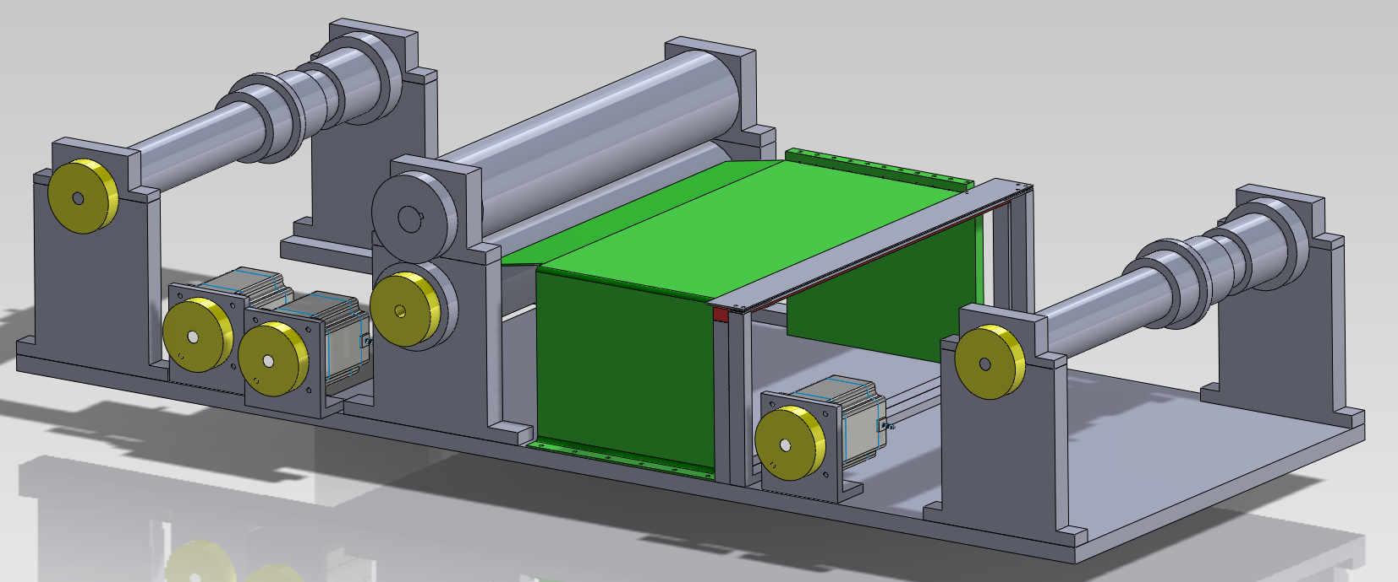
Piano roll scanner
Group 4
Matthias Bönhof, Simon Durrer, Tim Müller, Isabel Züger

Slide 2
Content
Problem description
Piano roll scanner
Scanner module
Data processing
Conclusion
Further work
Questions

Slide 3
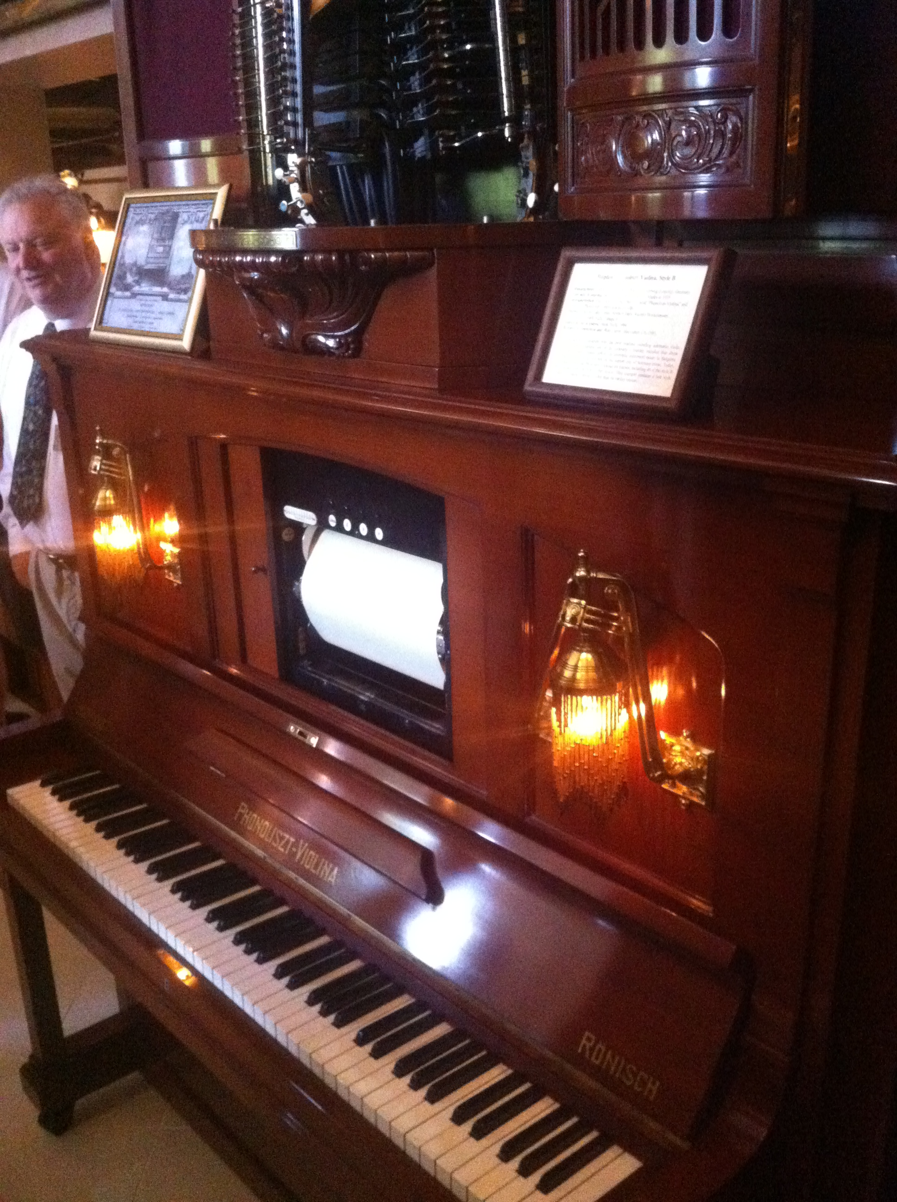
Problem description

Slide 4
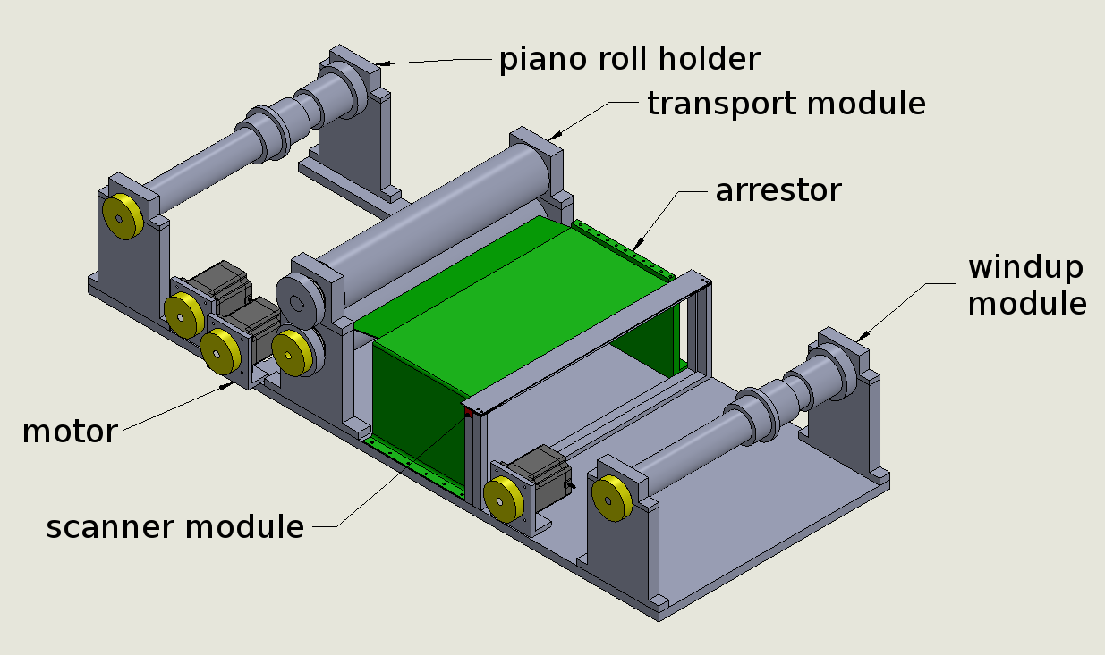
Piano roll scanner

Slide 5
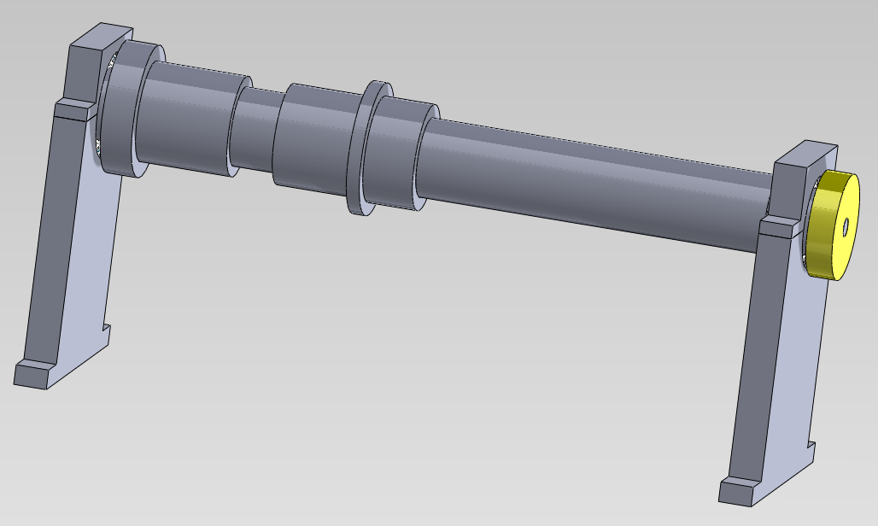
Piano roll scanner

Slide 6
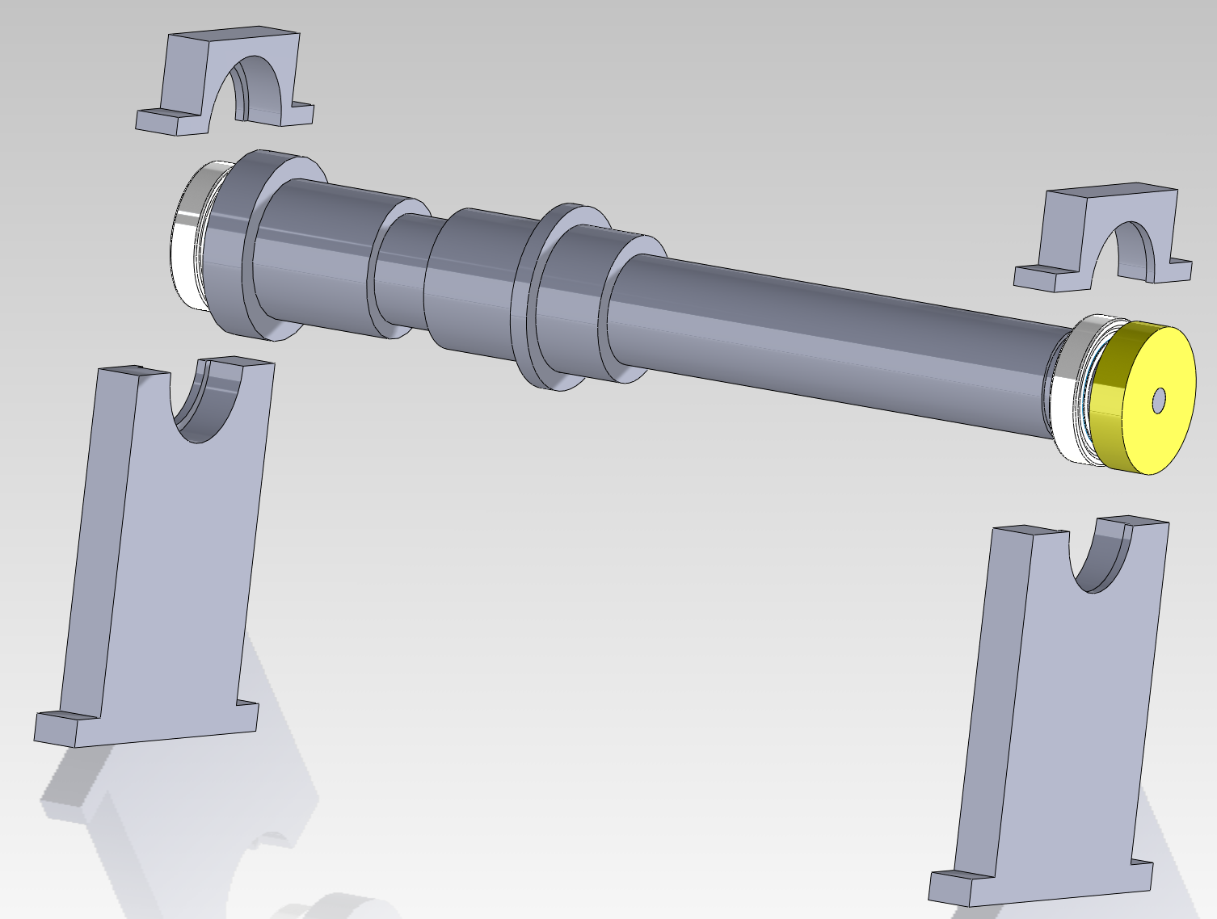
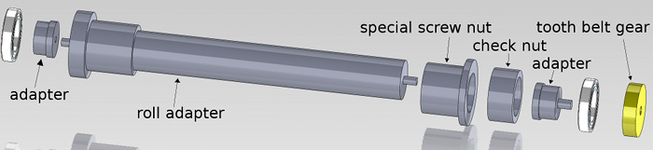
Piano roll scanner

Slide 7
Piano roll scanner

Slide 8
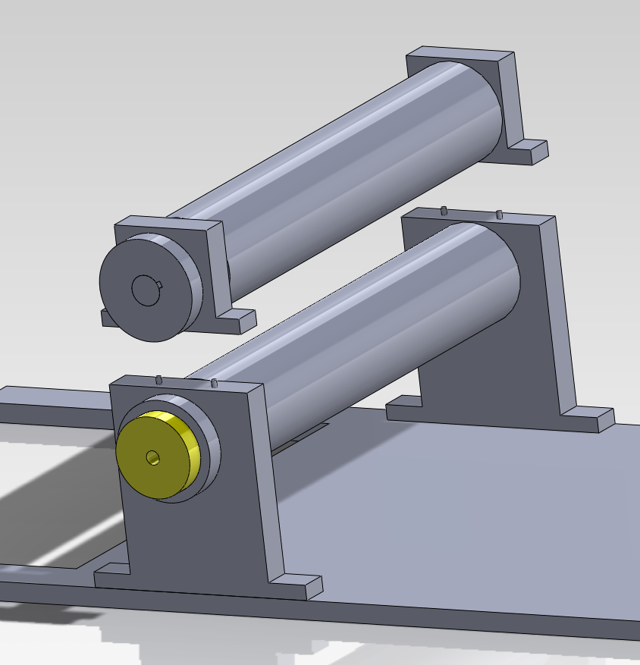
Piano roll scanner

Slide 9
Piano roll scanner

Slide 10
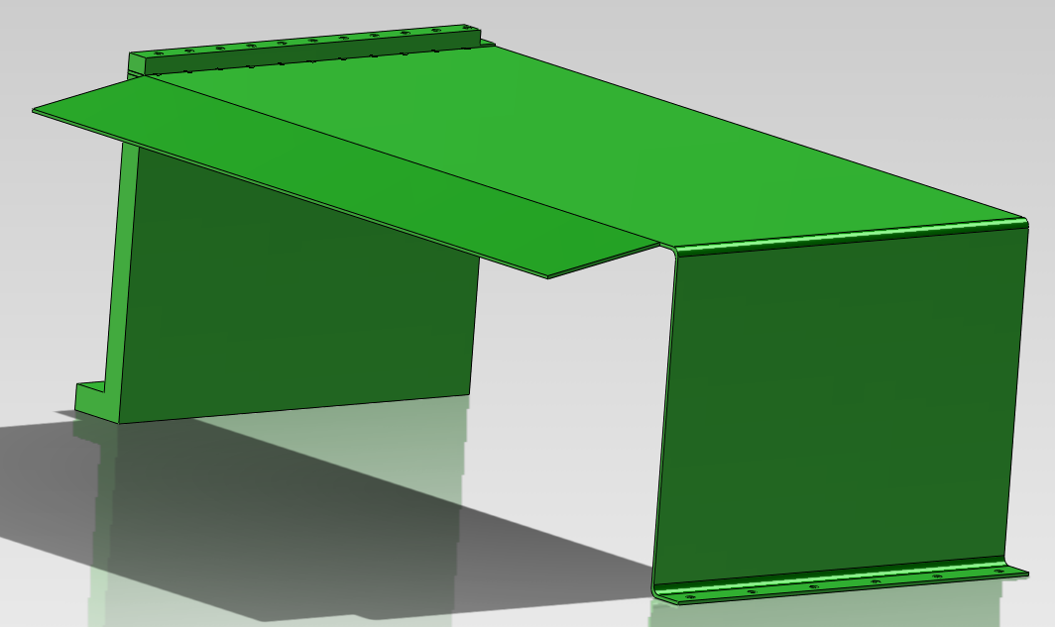
Piano roll scanner

Slide 11
Piano roll scanner

Slide 12
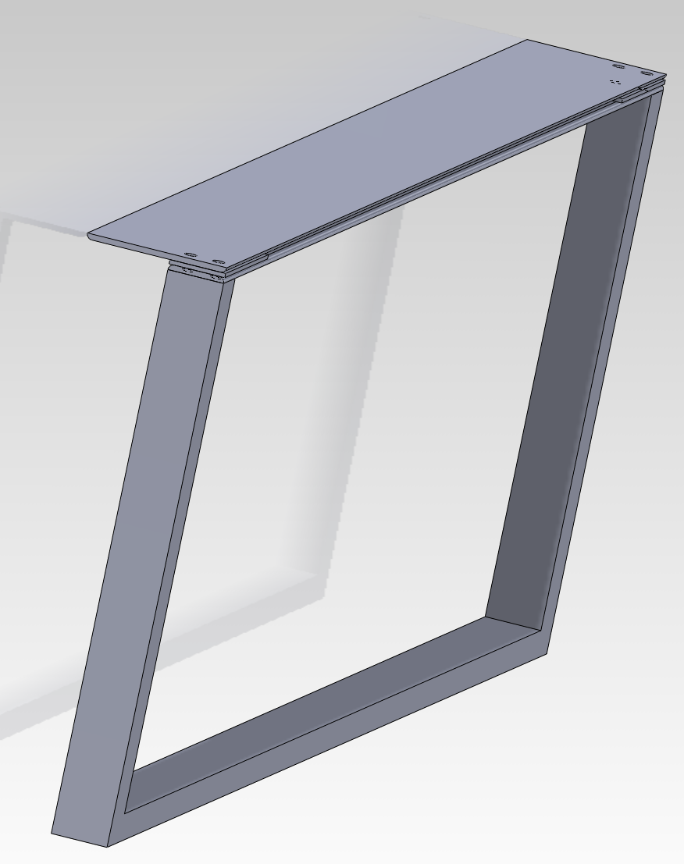
Piano roll scanner

Slide 13
Piano roll scanner

Slide 14
Piano roll scanner

Slide 15
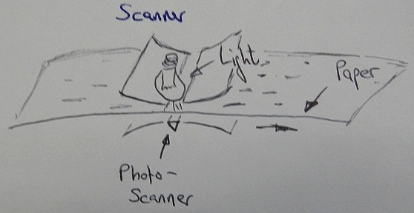
Scanner
CIS Scanner
0.1mm tolerance
1200dpi
0.72 s per inch
33min per 70m

Slide 16
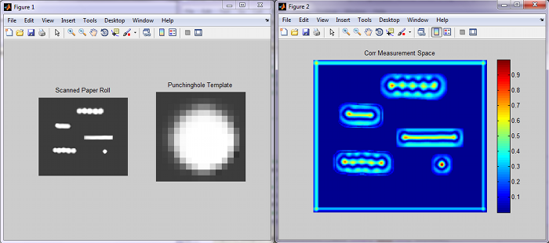
Data processing
Connected component labeling
Template matching algorithm
Central moment calculation

Slide 17
Data processing
XML file
Flexible
Extensible
Readable
Simple

Slide 18
Conclusion
Flexible data output
Automatical
Small effort to scan endless rolls
Expensive scanner
Exactly produced hardware

Slide 19
Further work
Tighter arranged construction
Additional speed surveillance
MIDI output
Construction for endless rolls

Slide 20
Thank you!
Any questions?

