Slide 1
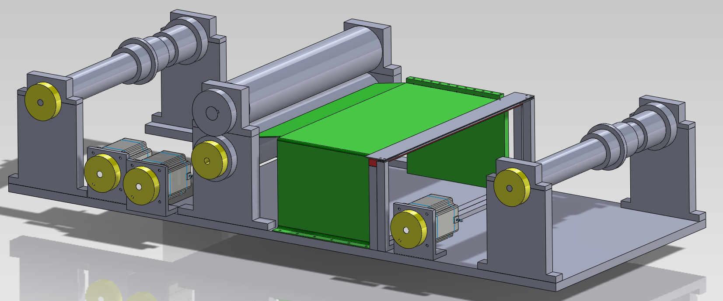
Piano roll scanner
Group 4
Matthias Bönhof, Simon Durrer, Tim Müller, Isabel Züger

Slide 2
Content
Introduction
Problem description
Piano roll scanner
Scanner module
Data processing
Further works
Questions

Slide 3
Introduction
Three main parts
Transport system
Scanner
Data processing

Slide 4
Problem description
Piano player

Slide 5
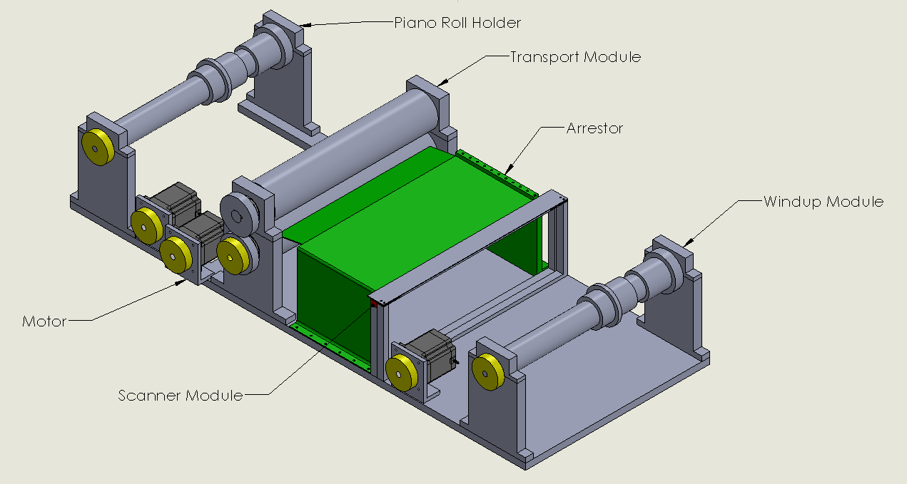
Piano roll scanner

Slide 6
Piano roll scanner

Slide 7
Piano roll scanner

Slide 8
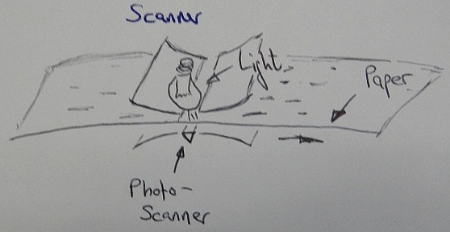
Scanner
CIS Scanner
1200dpi
0.72 s per inch
33min per 70m

Slide 9
Data processing
Central moment calculation
Connected component labeling
Template matching algorithm

Slide 10
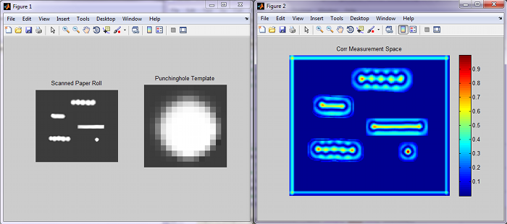
Data processing

Slide 11
Further works
Smaller
Better speed recognition
MIDI output

Slide 12
Thank you!
Any questions?

