Slide 1
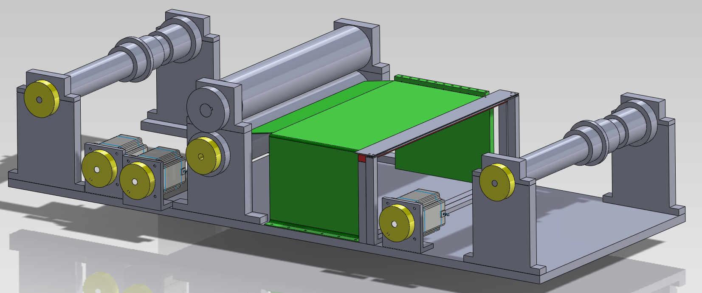
Piano roll scanner
Group 4
Matthias Bönhof, Simon Durrer, Tim Müller, Isabel Züger

Slide 2
Content
Problem description
Piano roll scanner
Scanner module
Data processing
Conclusion
Further works
Questions

Slide 3
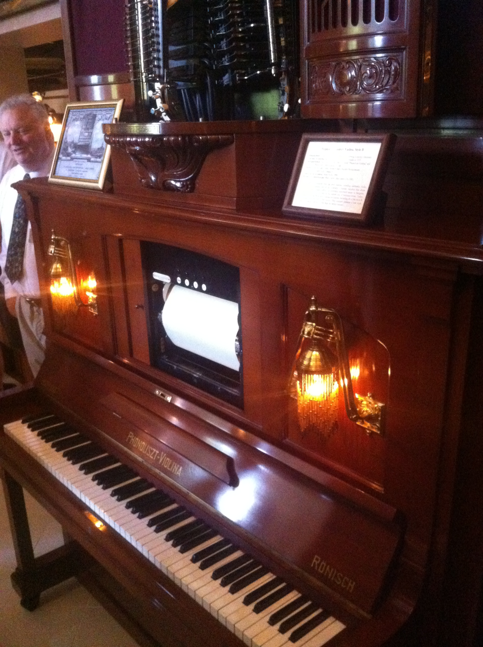
Problem description

Slide 4
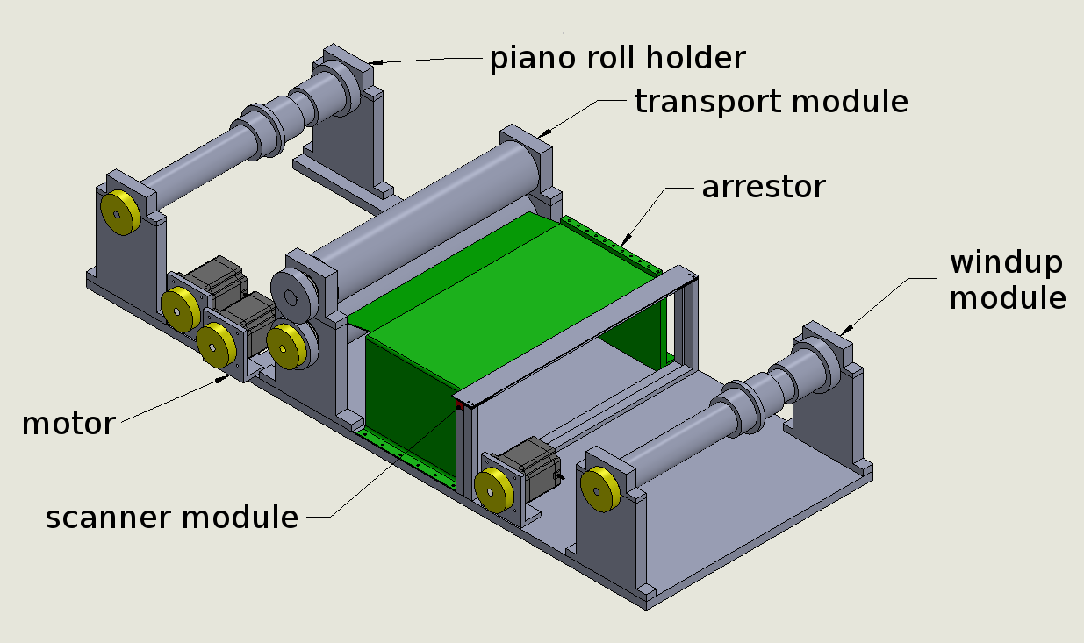
Piano roll scanner

Slide 5
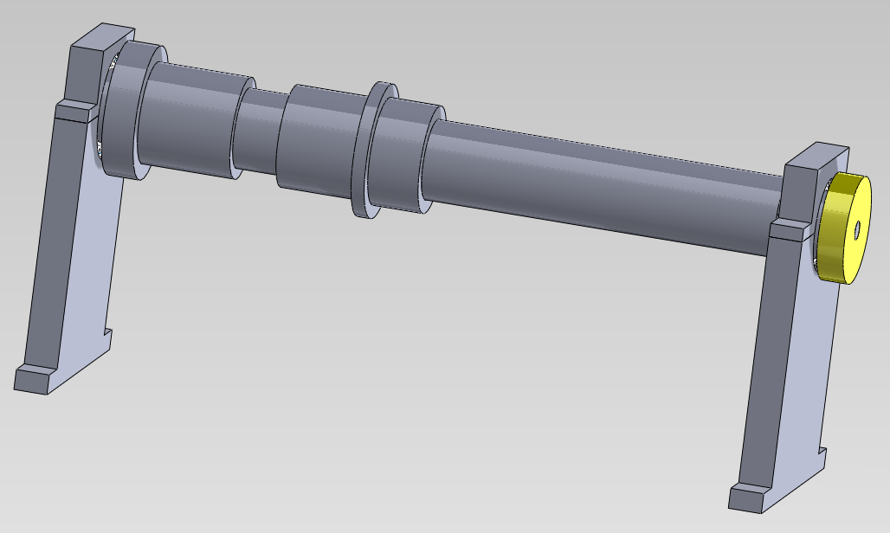
Piano roll scanner

Slide 6
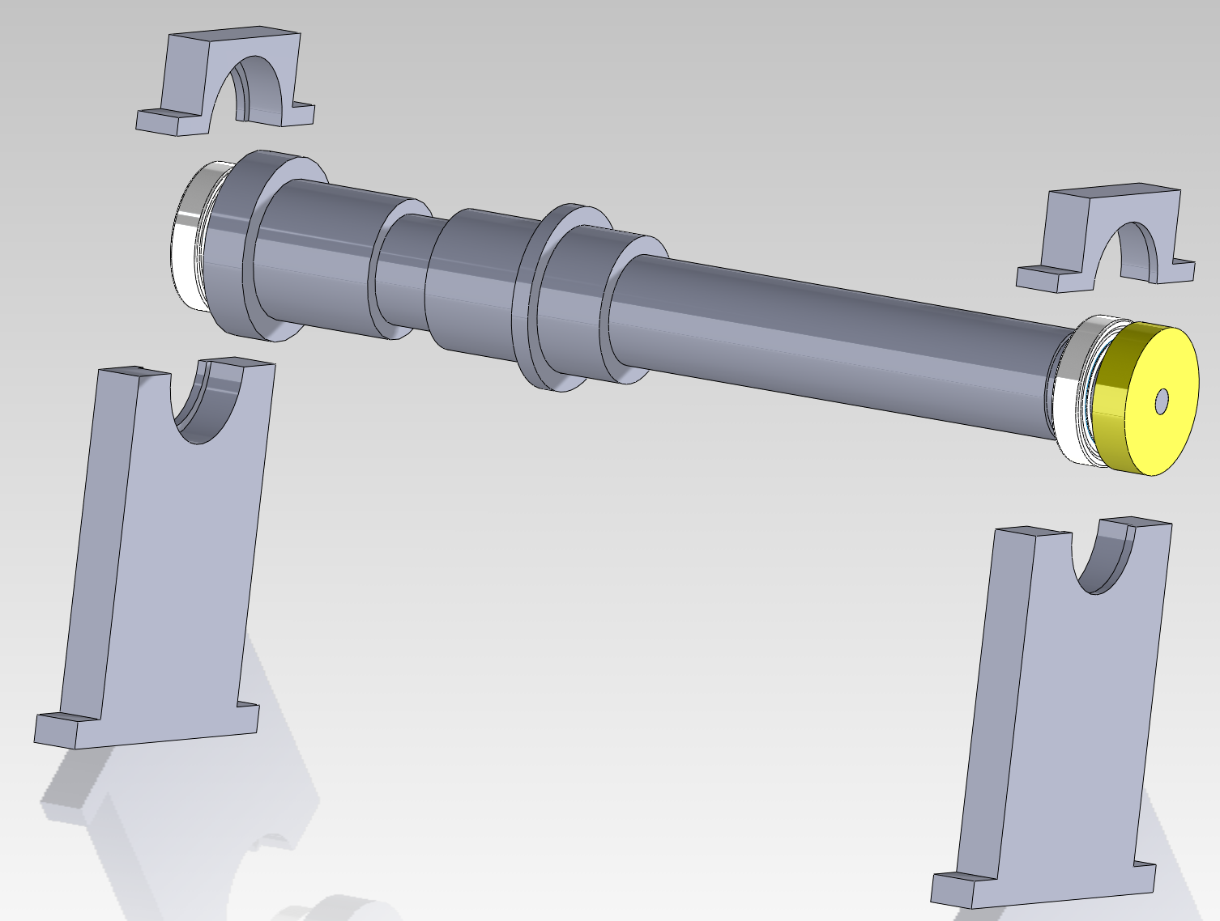
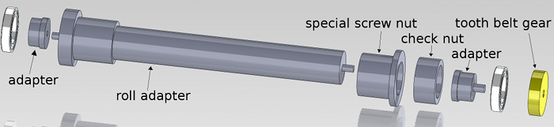
Piano roll scanner

Slide 7
Piano roll scanner

Slide 8
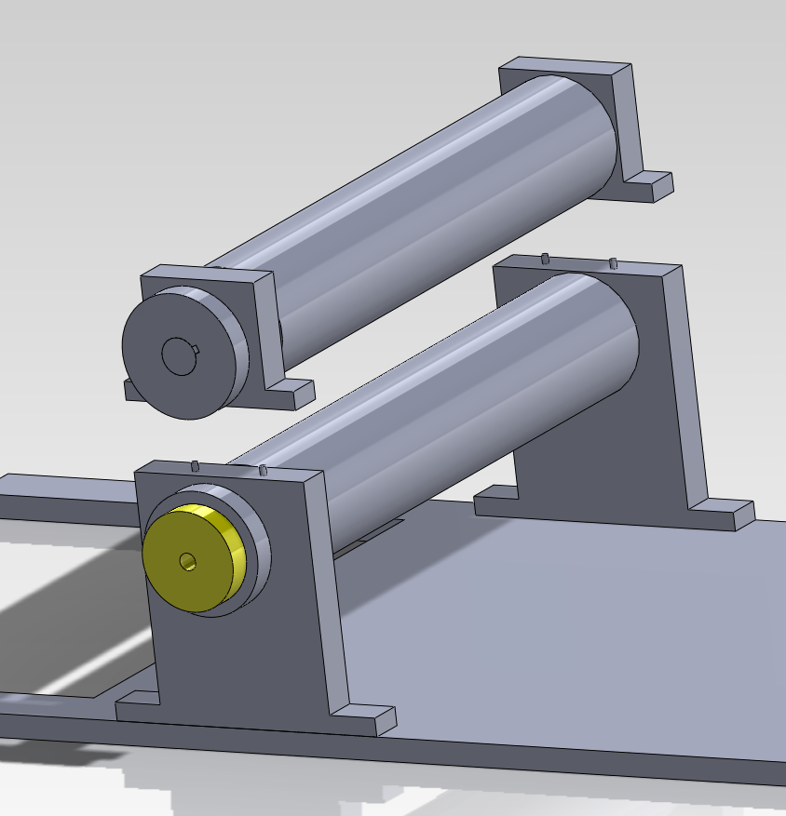
Piano roll scanner

Slide 9
Piano roll scanner

Slide 10
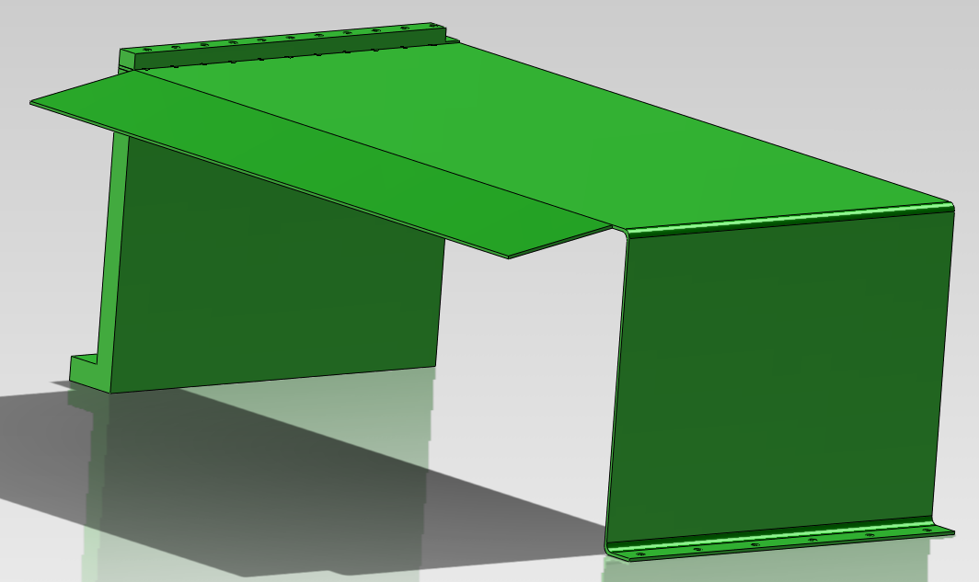
Piano roll scanner

Slide 11
Piano roll scanner

Slide 12
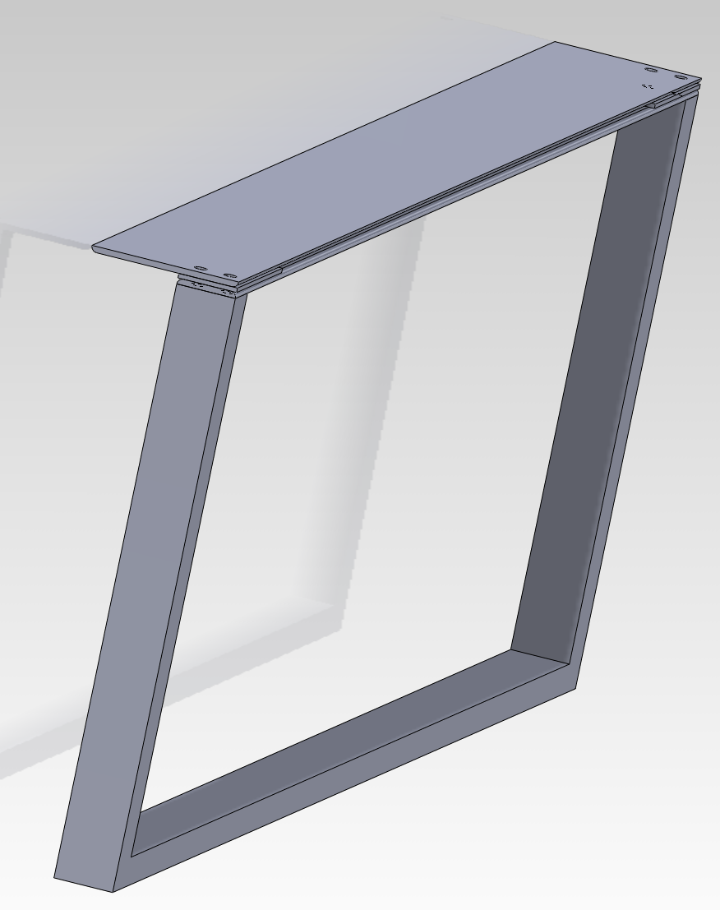
Piano roll scanner

Slide 13
Piano roll scanner

Slide 14
Piano roll scanner

Slide 15
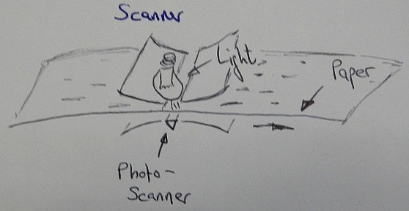
Scanner
CIS Scanner
1200dpi
0.72 s per inch
33min per 70m

Slide 16
Data processing
Central moment calculation
Connected component labeling
Template matching algorithm

Slide 17
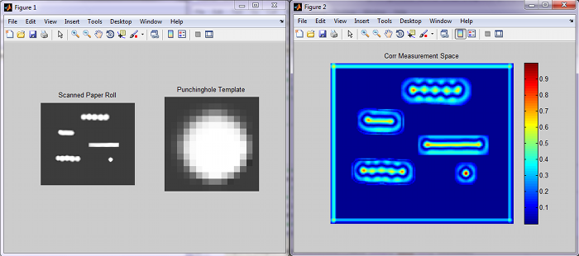
Data processing

Slide 18
Conclusion
Flexible data output
Automatical
Small effort to scan endless rolls
Expensive scanner
Exactly produced hardware

Slide 19
Further work
Tighter arranged construction
Additional speed surveillance
MIDI output
Construction for endless rolls

Slide 20
Thank you!
Any questions?

