Slide 1
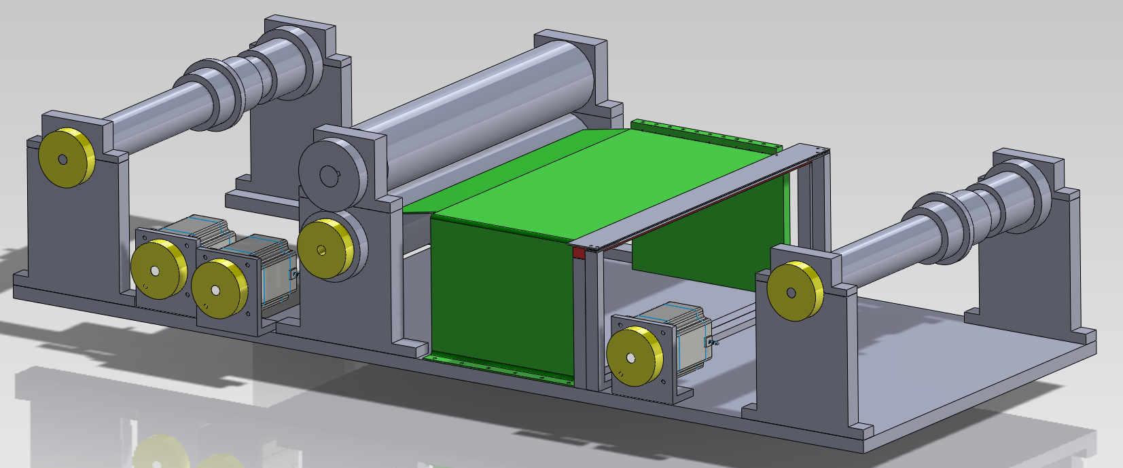
Piano roll scanner
Group 4
Matthias Bönhof, Simon Durrer, Tim Müller, Isabel Züger

Slide 2
Content
Introduction
Problem description
Piano roll scanner
Scanner module
Data processing
Further works
Questions

Slide 3
Introduction
Three main parts
Transport system
Scanner
Data processing

Slide 4
Problem description
Piano player

Slide 5
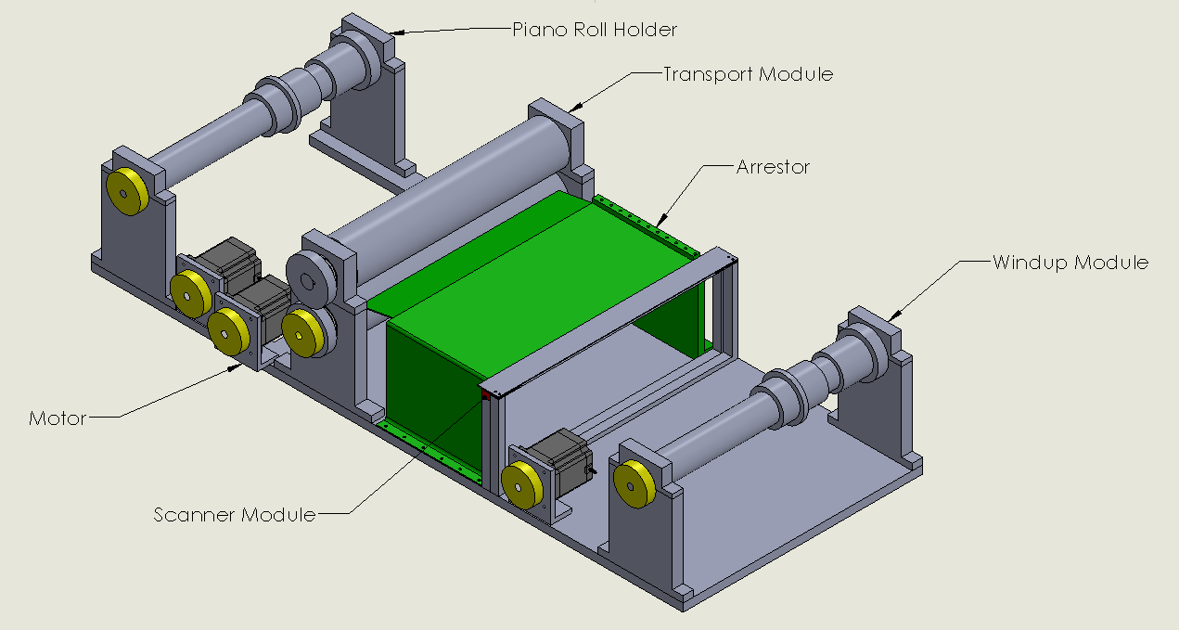
Piano roll scanner

Slide 6
Piano roll scanner

Slide 7
Piano roll scanner

Slide 8
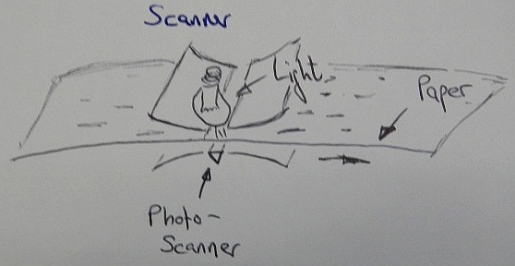
Scanner
CIS Scanner
1200dpi
0.72 s per inch
33min per 70m

Slide 9
Data processing
Central moment calculation
Connected component labeling
Template matching algorithm

Slide 10
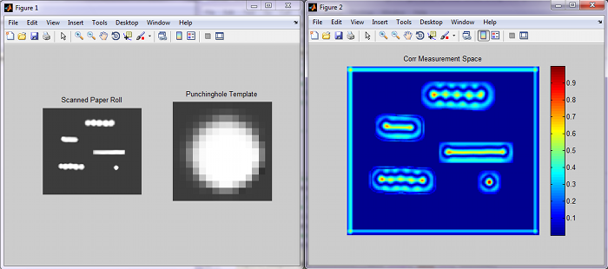
Data processing

Slide 11
Further works

Slide 12
Thank you!
Any questions?

