Slide 1
Week 10
Interrupt Programming in C

Slide 2
Topics
Polling Vs. interrupt
Interrupt unit
Steps in executing an interrupt
Edge trigger Vs. Level trigger in external interrupts
Timer interrupt
Interrupt priority
Task switching and resource conflict

Slide 3
Polling Vs. Interrupt
Polling
  Ties down the CPU
while (true)
{
if(PIND.2 == 0)
//do something;
}
Interrupt
  Efficient CPU use
  Has priority
  Can be masked
main( )
{
Do your common task
}
whenever PIND.2 is 0 then
do something

Slide 4
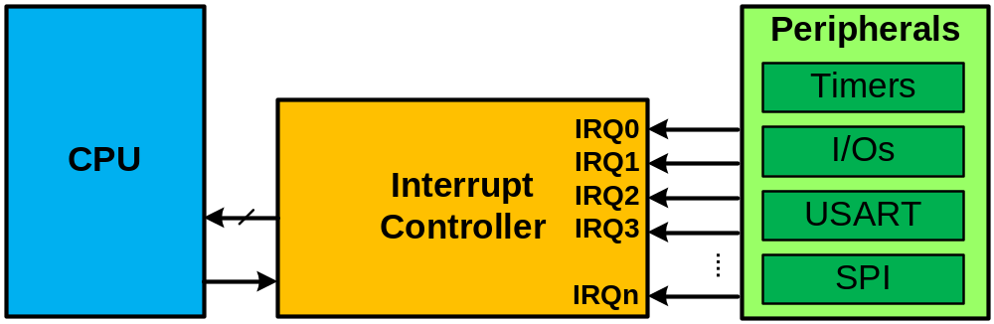
Interrupt Controllers

Slide 5
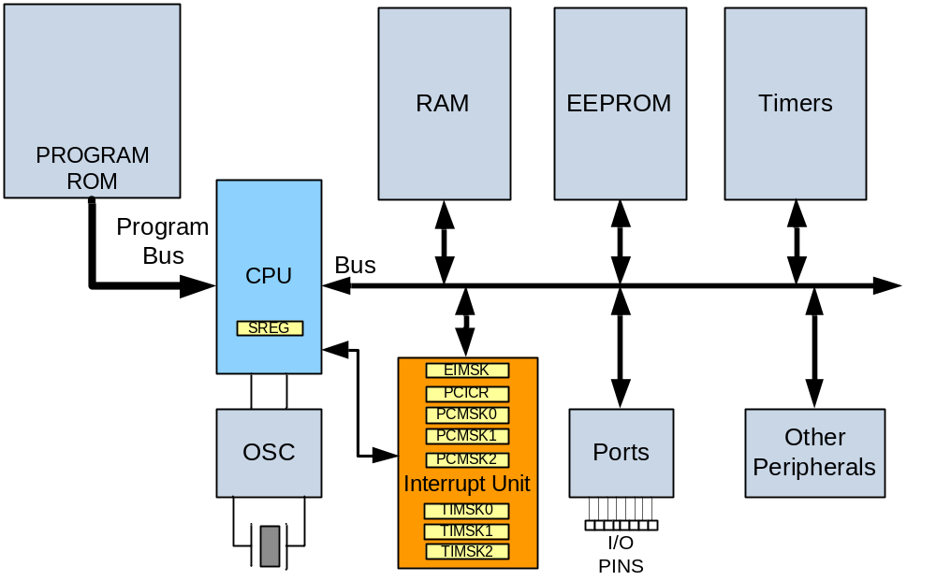
Interrupt control unit in AVR

Slide 6
Step in execution of Interrupt
Upon activation of an interrupt, the microcontroller goes through the fol- lowing steps:
1. It finishes the instruction it is currently executing and saves the address of the next instruction (program counter) on the stack.
2. It jumps to a fixed location in memory called the interrupt vector table. The interrupt vector table directs the microcontroller to the address of the interrupt service routine (ISR).
3. The microcontroller starts to execute the interrupt service subroutine until it reaches the last instruction of the subroutine, which is RETI (return from inter- rupt).
4. Upon executing the RETI instruction, the microcontroller returns to the place where it was interrupted. First, it gets the program counter (PC) address from the stack by popping the top bytes of the stack into the PC. Then it starts to execute from that address.

Slide 7
Interrupt vectors in ATmega328
Interrupt | Address (hex)
Reset | 0000
External Interrupt Request 0 | 0002
External Interrupt Request 1 | 0004
Pin Change Interrupt Request 0 | 0006
Pin Change Interrupt Request 1 | 0008
Pin Change Interrupt Request 2 | 000A
Watchdog Time-out Interrupt | 000C
Timer/Counter2 Compare Match A | 000E
Timer/Counter2 Compare Match B | 0010
Timer/Counter2 Overflow | 0012
Timer/Counter1 Capture Event | 0014
Timer/Counter1 Compare Match A | 0016
Timer/Counter1 Compare Match B | 0018
Timer/Counter1 Overflow | 001A
Timer/Counter0 Compare Match A | 001C
Timer/Counter0 Compare Match B | 001E
Timer/Counter0 Overflow | 0020
SPI Serial Transfer Complete | 0022
USART Rx Complete | 0024
USART Data Register Empty | 0026
USART Tx Complete | 0028
ADC Conversion Complete | 002A
EEPROM ready | 002C
Analog Comparator | 002E

Slide 8
Sources of Interrupt in AVR
There are many sources of interrupts in the AVR, depending on which peripheral is incorporated into the chip. The following are some of the most wide- ly used sources of interrupts in the AVR:
1. There are at least two interrupts set aside for each of the timers, one for over- flow and another for compare match.
2. Three interrupts are set aside for external hardware interrupts. Pins PD2 (PORTD.2), PD3 (PORTD.3), and PB2 (PORTB.2) are for the external hard- ware interrupts INTO, INT1, and INT2, respectively. See Section 10.3.
3. Serial communication's USART has three interrupts, one for receive and two interrupts for transmit.
4. The SPI interrupts.
5. The ADC (analog-to-digital converter).

Slide 9
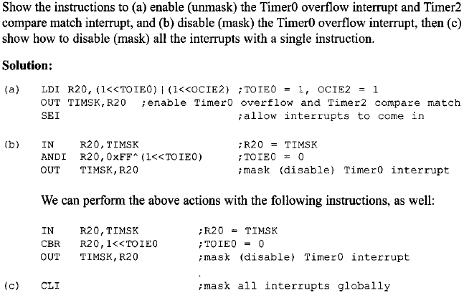
Example of enable Interrupts

Slide 10
External Interrupts

Slide 11
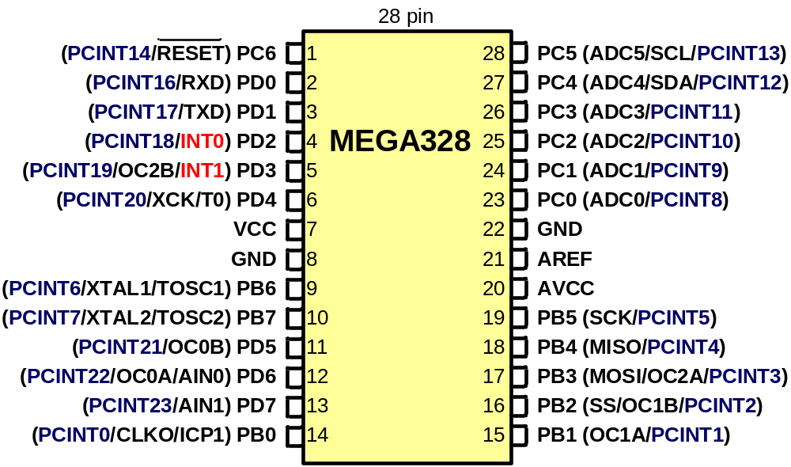
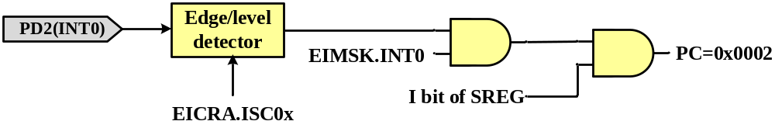
External Interrupts

Slide 12
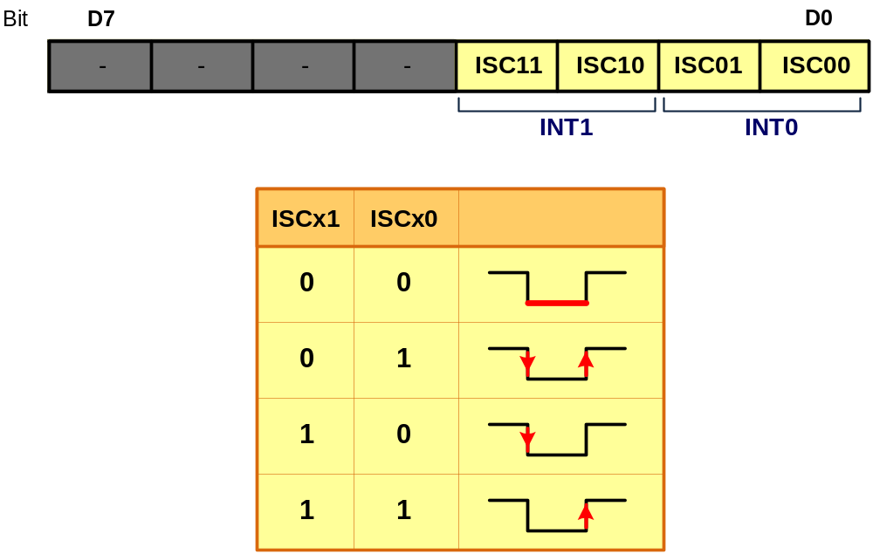
Edge trigger Vs. Level trigger in external interrupts
EICRA:
EICRA = 0x02; //INT0 on falling edges

Slide 13
External Interrupt Sample Code
Write a program that whenever INT0 goes low, it toggles PB5 once.
1
2
3
4
5
6
7
8
9
10
11
12
13
14
15
16
17
.ORG 0 ;location for reset
JMP MAIN
.ORG 0x02 ;loc. for external INT0
JMP EX0_ISR
MAIN:
LDI R20,HIGH(RAMEND)
OUT SPH,R20
LDI R20,LOW(RAMEND)
OUT SPL,R20 ;initialize stack
LDI R20,0x2 ;make INT0 falling
STS EICRA,R20
SBI DDRB,5 ;PORTB.5 = output
SBI PORTD,2 ;pull-up activated
LDI R20,1<<INT0 ;enable INT0
OUT EIMSK,R20
SEI ;enable interrupts
HERE:JMP HERE
18
19
20
21
22
23
24
25
EX0_ISR:
IN R21,PORTB
LDI R22,(1<<5) ;for toggling PB5
EOR R21,R22
OUT PORTB,R21
RETI
INT0
ISR
Ex. INT0.
enable

Slide 14
C programming Example 3
Assume that the INT0 pin is connected to a switch that is normally high. Write a program that toggles PORTB.5, whenever INT0 pin goes low.
#include <avr/io.h>
#include <avr/interrupt.h>
int main ()
{
DDRB = 1<<5; //PB5 as an output
PORTD = 1<<2; //pull-up activated
EICRA = 0x2; //make INT0 falling edge triggered
EIMSK = (1<<INT0); //enable external interrupt 0
sei (); //enable interrupts
while (1); //wait here
}
ISR (INT0_vect) //ISR for external
interrupt 0
{
PORTB ^= (1<<5); //toggle PORTB.5
}

Slide 15
Steps in executing an interrupt
PC6
1
2
3
4
5
6
7
8
9
10
11
12
13
14
28
27
26
25
24
23
22
21
20
19
18
17
16
15
PC5
Code
PD0
PC4
Address
.ORG 0
JMP MAIN
.ORG 0x02
JMP EX0_ISR
MAIN: LDI R20,HIGH(RAMEND)
OUT SPH,R20
LDI R20,LOW(RAMEND)
OUT SPL,R20
LDI R20,0x2 ;make INT0 falling
STS EICRA,R20
SBI PORTD,2 ;pull-up activated
LDI R20,1<<INT0 ;enable INT0
OUT EIMSK,R20
SEI ;enable interrupts
SBI DDRB,5 ;PORTB.5 = output
HERE: INC R25
JMP HERE
EX0_ISR:
IN R21,PORTB
LDI R22,(1<<5) ;for toggling PB5
EOR R21,R22
OUT PORTB,R21
RETI
PD1
PC3
0000 0002 0002 0004 0005 0006 0007 0008 0009 000A 000B 000C 000D 000E 000F 0010 0012 0013 0014 0015 0016
(INT0) PD2
PC2
(INT1) PD3
0002
PC1
PD4
PC0
VCC
ATmega328
GND
GND
PB7
PB6
AVCC
0012
0013
0014
0015
0016
000D
000A
0009
000C
000B
0008
0006
000F
000E
0004
0007
PB5
0005
PB7
PC:
0000
PD5
PB4
PD6
PB3
PD7
PB2
PB0
PB1
00
0F
SP
Stack
Stack

Slide 16
Timer Interrupts

Slide 17
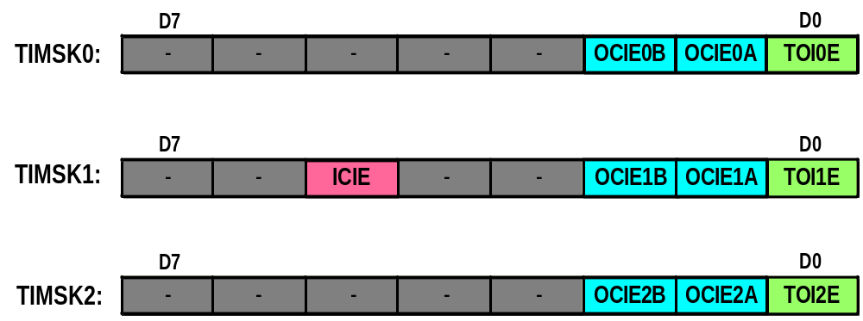
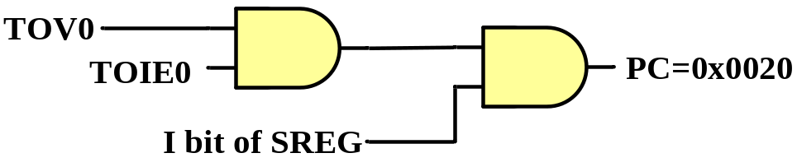
Timer Interrupts

Slide 18
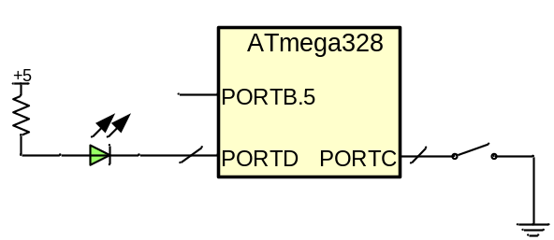
Using Timer0 overflow interrupt
This program uses Timer0 to generate a square wave on pin PORTB.5, while at the same time data is being transferred from PORTC to PORTD.
1
2
3
4
5
6
7
8
9
10
11
12
13
14
15
16
17 18
.ORG 0x0 ;location for reset
JMP MAIN
.ORG 0x20 ;location for Timer0 ov.
JMP T0_OV_ISR ;jump to ISR for T0
;-main program for initialization
MAIN: LDI R20,HIGH(RAMEND)
OUT SPH,R20
LDI R20,LOW(RAMEND)
OUT SPL,R20 ;initialize stack
LDI R20,-32 ;value for 2 us
OUT TCNT0,R20 ;load Timer0
LDI R20,0x00
OUT TCCR0A,R20
LDI R20,0x01
OUT TCCR0B,R20 ;Normal, no scaler
LDI R20,(1<<TOIE0)
STS TIMSK0,R20 ;enable Timer0 Ov.
SEI ;set I (enable Ints)
19
20
21
22
23
24
25
26
27
28
29
30
31
32
33
34 35
SBI DDRB,5 ;PB5 as an output
LDI R20,0x00
OUT DDRC,R20 ;make PORTC input
LDI R20,0xFF
OUT PORTC,R20 ;enable pull-up
OUT DDRD,R20 ;make PORTD output
HERE:IN R20,PINC ;read from PORTC
OUT PORTD,R20 ;give it to PORTD
JMP HERE
T0_OV_ISR:
IN R16,PORTB ;read PORTB
LDI R17,(1<<5) ;for toggling PB5
EOR R16,R17
OUT PORTB,R16 ;toggle PB5
LDI R16,-32 ;timer value for 2 us
OUT TCNT0,R16;load Timer0 with -32
RETI ;return from interrupt
Timer0
ISR
Timer Init.
Timer Int.
enable

Slide 19
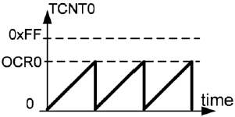
Timer0 Compare Match Interrupt
using Timer0 and CTC mode generate a square wave on pin PORTB.5, while at the same time data is being transferred from PORTC to PORTD.
.ORG 0x0 ;location for reset
JMP MAIN
.ORG 0x1C ;ISR location for Timer0 compare match A
JMP T0_CM_ISR
;main program
MAIN:
LDI R20,HIGH(RAMEND)
OUT SPH,R20
LDI R20,LOW(RAMEND)
OUT SPL,R20;set up stack
SBI DDRB,5;PB5 as an output
LDI R20,239
OUT OCR0A,R20 ;load Timer0 with 239
LDI R20,(1<<WGM01)
OUT TCCR0A,R20
LDI R20,0x01
OUT TCCR0B,R20 ;start Timer0, CTC mode, no scaler
LDI R20,(1<<OCIE0A)
STS TIMSK0,R20 ;enable Timer0 compare match interrupt
SEI ;set I (enable interrupts globally)
LDI R20,0x00
OUT DDRC,R20 ;make PORTC input
LDI R20,0xFF
OUT DDRD,R20 ;make PORTD output
Time (µs)
;--------------- Infinite loop
HERE:
IN R20,PINC ;read from PORTC
OUT PORTD,R20 ;and send it to PORTD
JMP HERE
;--ISR for Timer0 (executed every 40 µs)
T0_CM_ISR:
IN R16,PORTB ;read PORTB
LDI R17,1<<5 ;00100000 for toggling PB5
EOR R16,R17
OUT PORTB,R16 ;toggle PB5
RETI ;return from interrupt

Slide 20
C programming
Using Timer0 generate a square wave on pin PORTB.5, while at the same time transferring data from PORTC to PORTD.
Interrupt | Vector Name
External Interrupt Request 0 | INT0_vect
External Interrupt Request 1 | INT1_vect
Pin Change Interrupt Request 0 | PCINT0_vect
Pin Change Interrupt Request 1 | PCINT1_vect
Pin Change Interrupt Request 2 | PCINT2_vect
Watchdog Time-out Interrupt | WDT_vect
Timer/Counter2 Compare Match A | TIMER2_COMPA_vect
Timer/Counter2 Compare Match B | TIMER2_COMPB_vect
Timer/Counter2 Overflow | TIMER2_OVF_vect
Timer/Counter1 Capture Event | TIMER1_CAPT_vect
Timer/Counter1 Compare Match A | TIMER1_COMPA_vect
Timer/Counter1 Compare Match B | TIMER1_COMPB_vect
Timer/Counter1 Overflow | TIMER1_OVF_vect
Timer/Counter0 Compare Match A | TIMER0_COMPA_vect
Timer/Counter0 Compare Match B | TIMER0_COMPB_vect
Timer/Counter0 Overflow | TIMER0_OVF_vect
SPI Serial Transfer Complete | SPI_STC_vect
USART Rx Complete | USART_RX_vect
USART Data Register Empty | USART_UDRE_vect
USART Tx Complete | USART_TX_vect
ADC Conversion Complete | ADC_vect
EEPROM ready | EE_READY_vect
Analog Comparator | ANALOG_COMP_vect
Two-wire Serial Interface | TWI_vect
Store Program Memory Ready | SPM_READY_vect
#include "avr/io.h"
#include "avr/interrupt.h"
int main ()
{
DDRB |= (1<<5); //DDRB.5 = output
TCNT0 = -32; //timer value for 2 µs
TCCR0A = 0x00;
TCCR0B = 0x01; //Normal mode, int clk, no prescaler
TIMSK0 = (1<<TOIE0); //enable Timer0 overflow interrupt
sei (); //enable interrupts
DDRC = 0x00; //make PORTC input
DDRD = 0xFF; //make PORTD output
while (1) //wait here
PORTD = PINC;
}
ISR (TIMER0_OVF_vect) //ISR for Timer0 overflow
{
TCNT0 = -32;
PORTB ^= 0x20; //toggle PORTB.5
}
sei ( ); //set I
cli ( ); //clear I

Slide 21
C programming Example 2
Using Timer1 and CTC mode write a program that toggles pin PORTB.5 every second, while at the same time transferring data from PORTC to PORTD. Assume XTAL = 16 MHz.
#include <avr/io.h>
#include <avr/interrupt.h>
int main () {
DDRB |= (1<<5); //make DDRB.5 output
OCR1A = 15624;
TCCR1A = 0x00; //CTC mode, internal clk, prescaler=1024
TCCR1B = 0x0D;
TIMSK1 = (1<<OCIE1A); //enable Timer1 compare match A int.
sei (); //enable interrupts
DDRC = 0x00; //make PORTC input
DDRD = 0xFF; //make PORTD output
while (1) //wait here
PORTD = PINC;
}
ISR (TIMER1_COMPA_vect) { //ISR for Timer1 compare match A
PORTB ^= (1<<5); //toggle PORTB.5
}

Slide 22
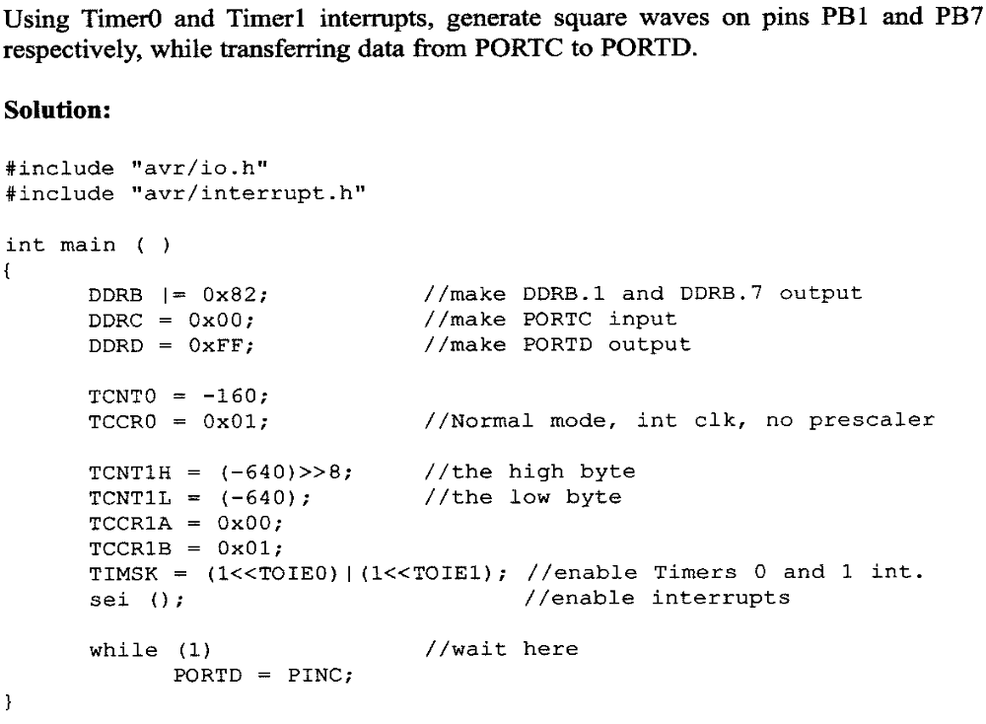

Slide 23
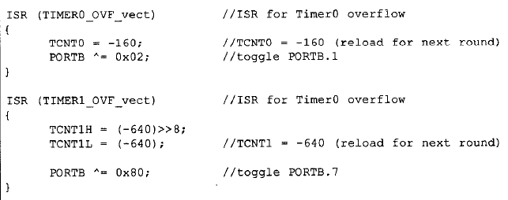

Slide 24
Pin Change Interrupts

Slide 25
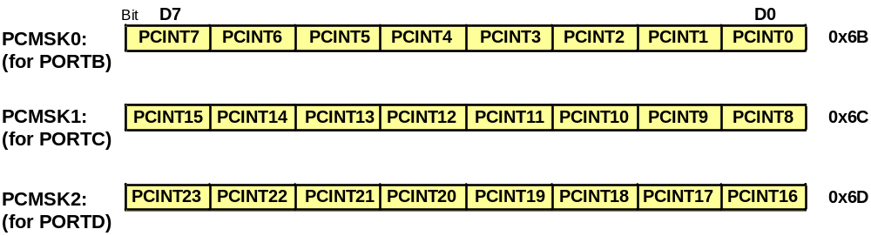
Pin Change Mask Registers

Slide 26
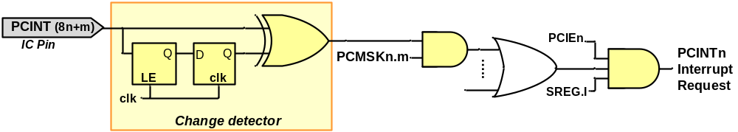
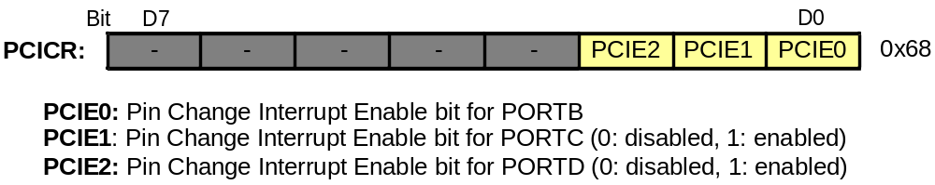
Pin Change Interrupt

Slide 27
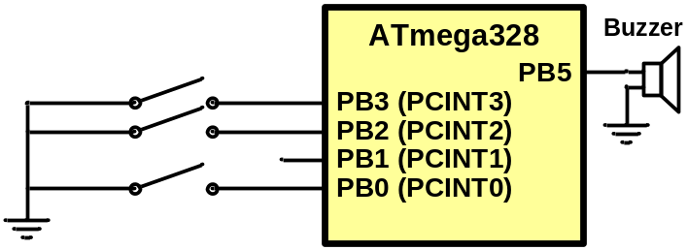
Pin Change Int. Sample Code
The PB0, PB2, and PB3 pins are connected to switches. Write a program that makes PORTB.5 high whenever any of the switches changes state.
1
2
3
4
5
6
7
8
9
10
11
12
13
14
15
.ORG 0 ;location for reset
JMP MAIN
.ORG 0x06 ;loc. for PCINT0
JMP PCINT0_ISR
MAIN: LDI R20,HIGH(RAMEND)
OUT SPH,R20
LDI R20,LOW(RAMEND)
OUT SPL,R20 SBI DDRB,5
CBI PORTB,5
;enable pull-up resistors
OUT PORTB,R20
;enable PB0, PB2, and PB3 PCINTs
LDI R20,0b00001101
STS PCMSK0,R20
161718
19
20
21
22
23
24
25
26
27
28
29
30
;enable PORTB change interrupt LDI R20,(1<<PCIE0)
STS PCICR,R20
SEI
HERE: JMP HERE
PCINT0_ISR:
SBI PORTB,5
RETI

Slide 28
Interrupt priority
Interrupt | Address (hex)
Reset | 0000
External Interrupt Request 0 | 0002
External Interrupt Request 1 | 0004
Pin Change Interrupt Request 0 | 0006
Pin Change Interrupt Request 1 | 0008
Pin Change Interrupt Request 2 | 000A
Watchdog Time-out Interrupt | 000C
Timer/Counter2 Compare Match A | 000E
Timer/Counter2 Compare Match B | 0010
Timer/Counter2 Overflow | 0012
Timer/Counter1 Capture Event | 0014
Timer/Counter1 Compare Match A | 0016
Timer/Counter1 Compare Match B | 0018
Timer/Counter1 Overflow | 001A
Timer/Counter0 Compare Match A | 001C
Timer/Counter0 Compare Match B | 001E
Timer/Counter0 Overflow | 0020
SPI Serial Transfer Complete | 0022
USART Rx Complete | 0024
USART Data Register Empty | 0026
USART Tx Complete | 0028
ADC Conversion Complete | 002A
EEPROM ready | 002C
Analog Comparator | 002E
Highest priority
Lowest priority

Slide 29
Interrupt inside an interrupt
The I flag is cleared when the AVR begins to execute an ISR. So, interrupts are disabled.
The I flag is set when RETI is executed.

Slide 30
Task switching and resource conflict
Does the following program work?
1
2
3
4
5
6
7
8
9
10
11
12
13
14
15
16
17
.ORG 0x0 ;location for reset
JMP MAIN
.ORG 0x1C ;Timer0 compare match
JMP T0_CM_ISR
;---------main program------------------------------
MAIN: LDI R20,HIGH(RAMEND)
OUT SPH,R20
LDI R20,LOW(RAMEND)
OUT SPL,R20 ;set up stack
LDI R20,159
OUT OCR0A,R20 LDI R20,(1<<WGM01)
OUT TCCR0A,R20
LDI R20,0x01
OUT TCCR0B,R20
LDI R20,(1<<OCIE0A)
STS TIMSK0,R20
18
19
20
21
22
23
24
25
26
27
28
29
30
SEI
LDI R20,0xFF
OUT DDRC,R20
OUT DDRD,R20
HERE: OUT PORTC,R20
INC R20
JMP HERE
;--------------------------ISR for Timer0
T0_CM_ISR:
IN R20,PIND
INC R20
OUT PORTD,R20
RETI

Slide 31
Solution 1: different registers
Use different registers for different tasks.
1
2
3
4
5
6
7
8
9
10
11
12
13
14
15
16
17
.ORG 0x0 ;location for reset
JMP MAIN
.ORG 0x1C ;Timer0 compare match
JMP T0_CM_ISR
;---------main program------------------------------
MAIN: LDI R20,HIGH(RAMEND)
OUT SPH,R20
LDI R20,LOW(RAMEND)
OUT SPL,R20 ;set up stack
LDI R20,159
OUT OCR0A,R20 LDI R20,(1<<WGM01)
OUT TCCR0A,R20
LDI R20,0x01
OUT TCCR0B,R20
LDI R20,(1<<OCIE0A)
STS TIMSK0,R20
18
19
20
21
22
23
24
25
26
27
28
29
30
31
32
SEI
LDI R20,0xFF
OUT DDRC,R20
OUT DDRD,R20
LDI R20, 0
HERE: OUT PORTC,R20
INC R20
JMP HERE
;--------------------------ISR for Timer0
T0_CM_ISR:
IN R21,PIND
INC R21
OUT PORTD,R21
RETI

Slide 32
Solution 2: Context saving
Save the contents of registers on the stack before execution of each task, and reload the registers at the end of the task.
1
2
3
4
5
6
7
8
9
10
11
12
13
14
15
16
17
.ORG 0x0 ;location for reset
JMP MAIN
.ORG 0x1C ;Timer0 compare match
JMP T0_CM_ISR
;---------main program------------------------------
MAIN: LDI R20,HIGH(RAMEND)
OUT SPH,R20
LDI R20,LOW(RAMEND)
OUT SPL,R20 ;set up stack
LDI R20,159
OUT OCR0A,R20 LDI R20,(1<<WGM01)
OUT TCCR0A,R20
LDI R20,0x01
OUT TCCR0B,R20
LDI R20,(1<<OCIE0A)
STS TIMSK0,R20
18
19
20
21
22
23
24
25
26
27
28
29
30
31
32
33
34
SEI
LDI R20,0xFF
OUT DDRC,R20
OUT DDRD,R20
LDI R20, 0
HERE: OUT PORTC,R20
INC R20
JMP HERE
;--------------------------ISR for Timer0
T0_CM_ISR:
PUSH R20 ;save R20
IN R20,PIND
INC R20
OUT PORTD,R20
POP R20 ;restore R20
RETI

Slide 33
Saving SREG
We should save SREG, when we change flags in the ISR.
PUSH R20
IN R20,SREG
PUSH R20
...
POP R20
OUT SREG,R20
POP R20

