Slide 1
Week 12
SPIand I2C Communication.

Slide 2


















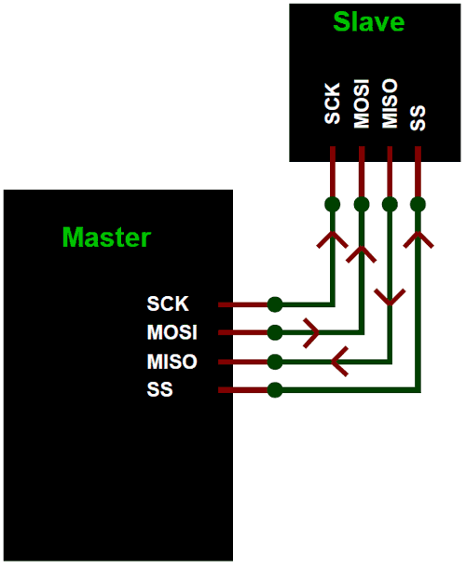












Slide 3































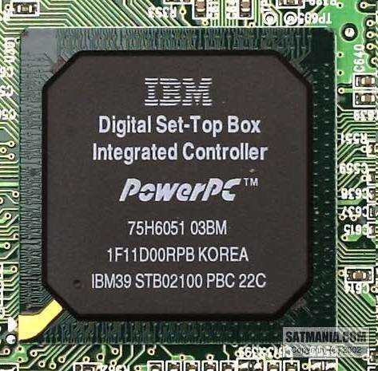
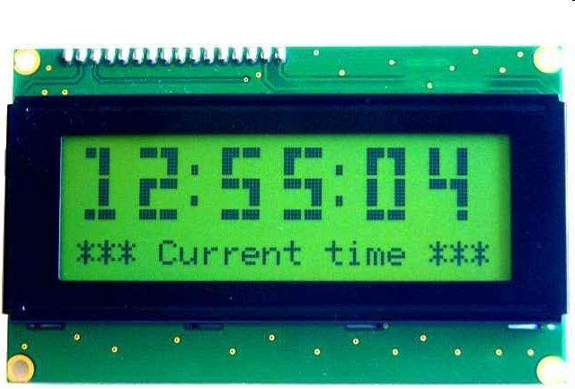

Slide 4


































Slide 5












































Slide 6















































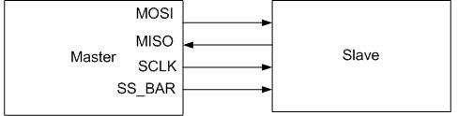

Slide 7





































































Slide 8











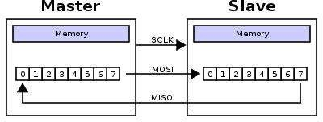









Slide 9






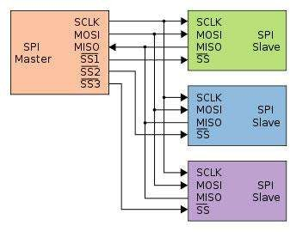
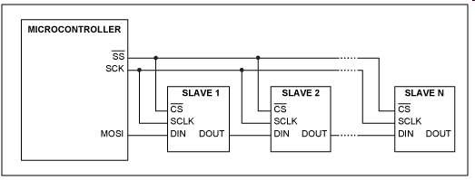








Slide 10






























































































Slide 11
























































Slide 12
































































Slide 13





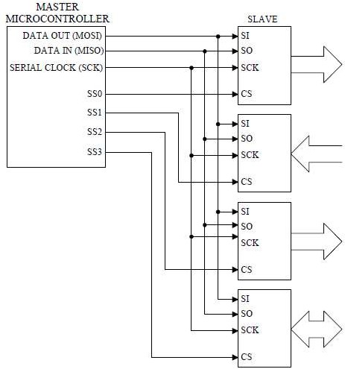






Slide 14

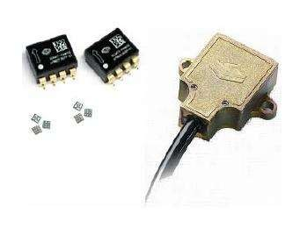

Slide 15
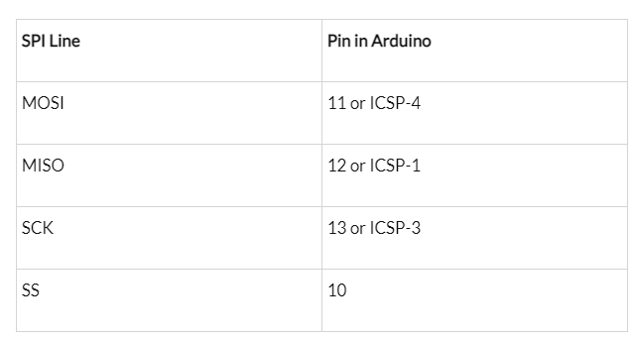
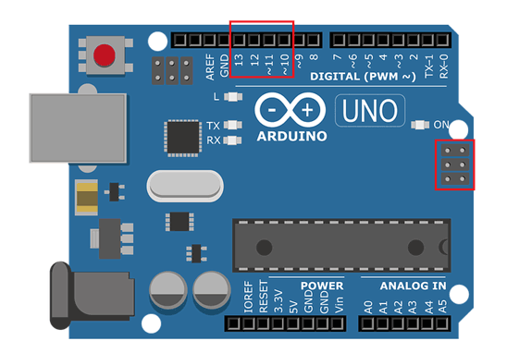
SPI Pins In Arduino

Slide 16
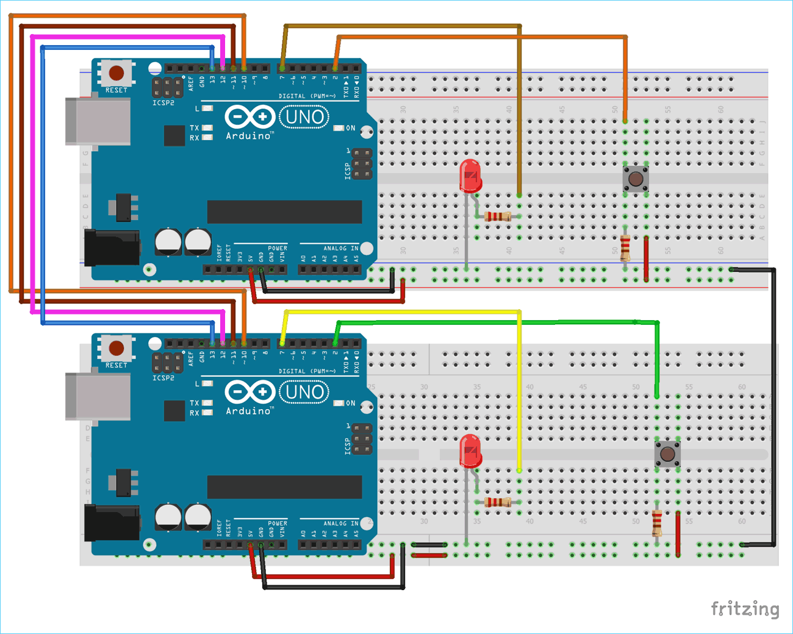
SPI Protocol Circuits

Slide 17
Multi-slave communication
17

Slide 18
SPI code for Master
//SPI MASTER (ARDUINO) //SPI COMMUNICATION BETWEEN TWO ARDUINO //CIRCUIT DIGEST
#include<SPI.h> //Library for SPI #define LED 7 #define ipbutton 2 int buttonvalue; int x; void setup (void)
{ Serial.begin(115200); //Starts Serial Communication at Baud Rate 115200 pinMode(ipbutton,INPUT); //Sets pin 2 as input pinMode(LED,OUTPUT); //Sets pin 7 as Output SPI.begin(); //Begins the SPI commnuication SPI.setClockDivider(SPI_CLOCK_DIV8); //Sets clock for SPI communication at 8 (16/8=2Mhz) digitalWrite(SS,HIGH); // Setting SlaveSelect as HIGH (So master doesnt connnect with slave) }
void loop(void) { byte Mastersend,Mastereceive;
buttonvalue = digitalRead(ipbutton); //Reads the status of the pin 2
if(buttonvalue == HIGH) //Logic for Setting x value (To be sent to slave) depending upon input from pin 2 { x = 1; } else { x = 0; } digitalWrite(SS, LOW); //Starts communication with Slave connected to master Mastersend = x; Mastereceive=SPI.transfer(Mastersend); //Send the mastersend value to slave also receives value from slave if(Mastereceive == 1) //Logic for setting the LED output depending upon value received from slave { digitalWrite(LED,HIGH); //Sets pin 7 HIGH Serial.println("Master LED ON"); } else { digitalWrite(LED,LOW); //Sets pin 7 LOW Serial.println("Master LED OFF"); } delay(1000); }

Slide 19
SPI code for Slave
Slave Arduino Code: //SPI SLAVE (ARDUINO) //SPI COMMUNICATION BETWEEN TWO ARDUINO //CIRCUIT DIGEST //Pramoth.T
#include<SPI.h> #define LEDpin 7 #define buttonpin 2 volatile boolean received; volatile byte Slavereceived,Slavesend; int buttonvalue; int x; void setup()
{ Serial.begin(115200); pinMode(buttonpin,INPUT); // Setting pin 2 as INPUT pinMode(LEDpin,OUTPUT); // Setting pin 7 as OUTPUT pinMode(MISO,OUTPUT); //Sets MISO as OUTPUT (Have to Send data to Master IN
SPCR |= _BV(SPE); //Turn on SPI in Slave Mode received = false;
SPI.attachInterrupt(); //Interuupt ON is set for SPI commnucation }
ISR (SPI_STC_vect) //Inerrrput routine function { Slavereceived = SPDR; // Value received from master if store in variable slavereceived received = true; //Sets received as True }
void loop() { if(received) //Logic to SET LED ON OR OFF depending upon the value recerived from master { if (Slavereceived==1) { digitalWrite(LEDpin,HIGH); //Sets pin 7 as HIGH LED ON Serial.println("Slave LED ON"); }else { digitalWrite(LEDpin,LOW); //Sets pin 7 as LOW LED OFF Serial.println("Slave LED OFF"); } buttonvalue = digitalRead(buttonpin); // Reads the status of the pin 2 if (buttonvalue == HIGH) //Logic to set the value of x to send to master { x=1; }else { x=0; } Slavesend=x; SPDR = Slavesend; //Sends the x value to master via SPDR delay(1000); } }

Slide 20
SPI pins in AVR
MOSI (Master Out Slave In)
MISO (Master In Slave Out)
SCK
SS
20

Slide 21
AVR registers
Control register:
SPCR (SPI Control Register)
Status Register:
SPSR (SPI Status Register)
Data Register:
SPDR (SPI Data Register)
21

Slide 22
SPSR (SPI Status Register)
SPIF (SPI Interrupt Flag)
A serial transfer is completed.
The SS pin is driven low in slave mode
WCOL (Write Collision)
SPI2X (Double SPI Speed)
22

Slide 23
SPCR
CPOL | CPHA | Data Read and Change Time | SPI Mode
0 | 0 | Read on rising edge, changed on a falling edge | 0
0 | 1 | Read on falling edge, changed on a rising edge | 1
1 | 0 | Read on falling edge, changed on a rising edge | 2
1 | 1 | Read on rising edge, changed on a falling edge | 3
SPIE (SPI Interrupt Enable)
SPE (SPI Enable)
DORD (Data Order)
MSTR (Master)
CPOL (Clock Polarity)
CPHA (Clock Phase)
SPR1, SPR0 :SPI Clock Rate
SPI2X | SPR1 | SPR0 | SCK Freq.
0 | 0 | 0 | Fosc/4
0 | 0 | 1 | Fosc/16
0 | 1 | 0 | Fosc/64
0 | 1 | 1 | Fosc/128
1 | 0 | 0 | Fosc/2 (not recommended)
1 | 0 | 1 | Fosc/8
1 | 1 | 0 | Fosc/32
1 | 1 | 1 | Fosc/64
23

Slide 24
SPCR

Slide 25
Program 1: Sending ‘G’ through SPI as a master
#include <avr/io.h>
#define MOSI 3
#define SCK 5
#define SS 2
int main (void)
{
DDRB = (1<<MOSI)|(1<<SCK)|(1<<SS); //MOSI and SCK are output
DDRD = 0xFF; //Port D is output
SPCR = (1<<SPE)|(1<<MSTR)|(1<<SPR0); //enable SPI as master
while(1) //do for ever
{
PORTB &= ~(1<<SS); //enable slave device
SPDR = 'G'; //start transmission
while(!(SPSR & (1<<SPIF))); //wait transfer finish
PORTD = SPDR; //move received data to PORTD
PORTB |= (1<<SS); //disable slave device
}
return 0;
}
25

Slide 26
Program 2: Sending ‘G’ through SPI as a slave
#include <avr/io.h>
#define MISO 4
int main (void)
{
DDRD = 0xFF; //Port D is output
DDRB = (1<<MISO); //MISO is output
SPCR = (1<<SPE); //enable SPI as slave
while(1)
{
SPDR = 'G';
while(!(SPSR &(1<<SPIF))); //wait for transfer finish
PORTD = SPDR; //move received data to PORTD
}
return 0;
}
26

Slide 27
Inter-Integrated Circuit (I2C)
Embedded Systems Design

Slide 28
I2C bus
Communication with the accelerometer
Read acceleration values and configure interrupts
Pros
Two wires bus that can connect multiple peripherals with the MCU
Cons
Overhead is significantly higher, and bus is slower

Slide 29
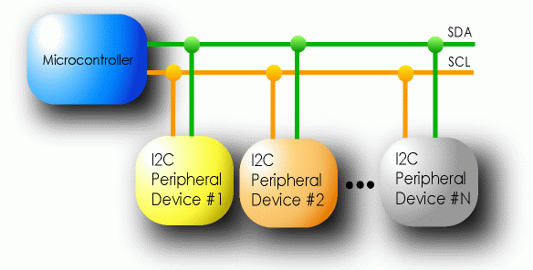
I2C Details
Two lines
Serial data line (SDA)
Serial clock line (SCL)
Only two wires for connecting multiple devices

Slide 30
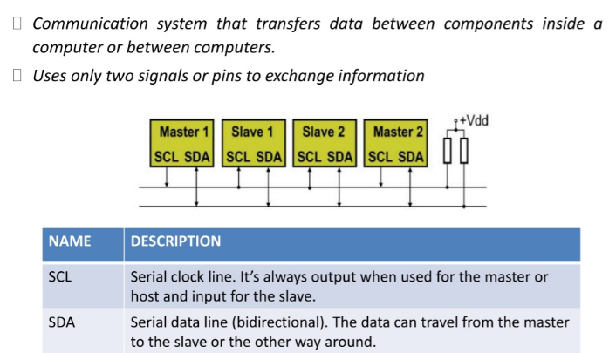
I2C Details

Slide 31
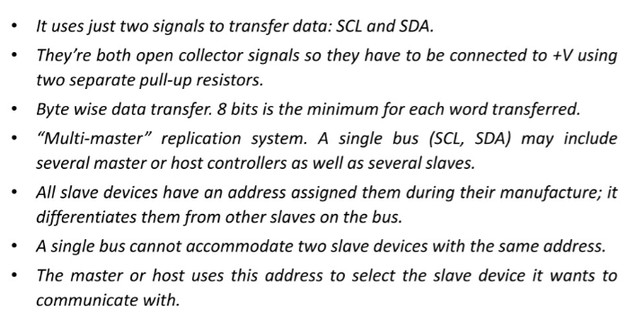
I2C Details

Slide 32
I2C Details
Each I2C device recognized by a unique address
Each I2C device can be either a transmitter or receiver
I2C devices can be masters or slaves for a data transfer
Master (usually a microcontroller): Initiates a data transfer on the bus, generates the clock signals to permit that transfer, and terminates the transfer
Slave: Any device addressed by the master at that time

Slide 33
How can any device transfer or receive on the same two wires?
Pull ups and high-impedance mode pins
Wires default to being “on”, any device can make a wire go “off”.
This is super clever. SPI and UART can’t do this, why?

Slide 34
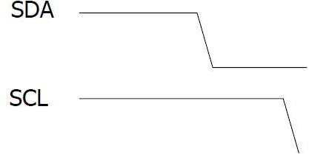























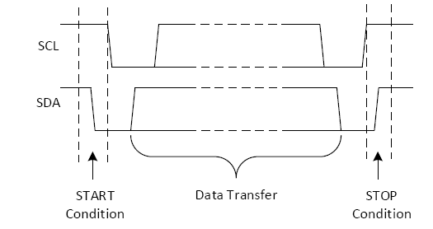
Start and Stop Condition

Slide 35
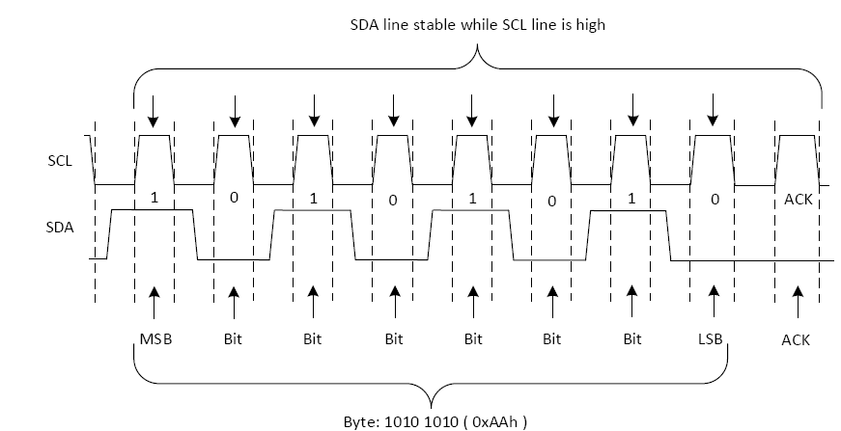
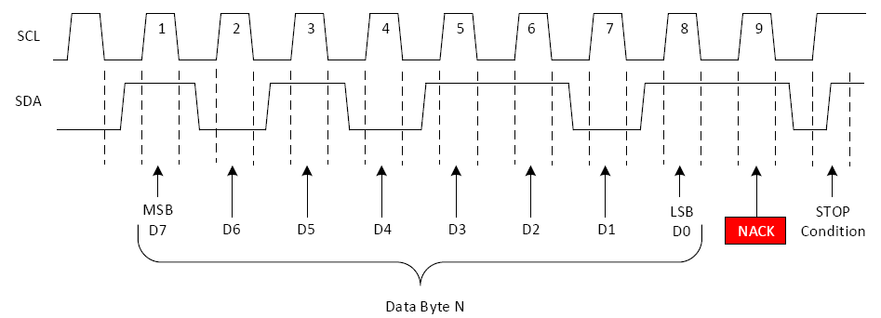
Acknowledge (ACK) and Not Acknowledge (NACK)
A transition of the data line while the clock line is high
is defined as either a start
or a stop condition.
Both start and stop conditions are generated by the bus master
The bus is considered busy after a start condition, until a stop condition occurs

Slide 36
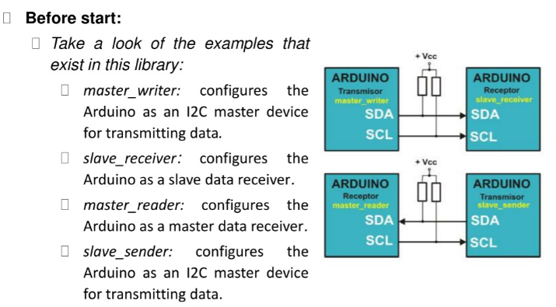
Bit Transfer on the I²C Bus

Slide 37
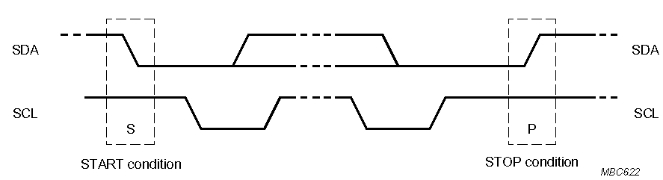
Start and Stop Conditions
A transition of the data line while the clock line is high is defined as either a start or a stop condition.
Both start and stop conditions are generated by the bus master
The bus is considered busy after a start condition, until a stop condition occurs
SDA
SDA
SCL
SCL
Start Condition
Stop Condition

Slide 38
I²C Addressing
Each node has a unique 7 (or 10) bit address
Peripherals often have fixed and programmable address portions
Addresses starting with 0000 or 1111 have special functions:-
0000000 Is a General Call Address
0000001 Is a Null (CBUS) Address

Slide 39
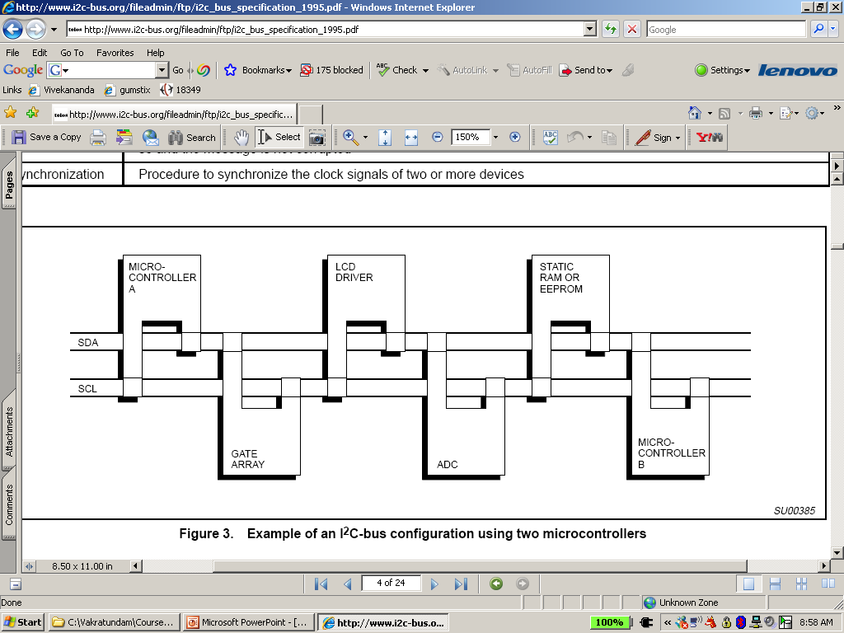
I2C-Connected System
Example I2C-connected system with two microcontrollers
(Source: I2C Specification, Philips)

