Slide 1
Week 13
Analog to Digital conversion
&
Pulse Width Modulation

Slide 2

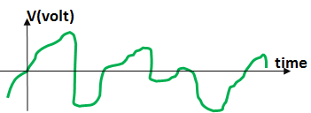
Analog vs. Digital Signals

Slide 3
What is an ADC?
Why we need ADC Interfacing?
An analog-to-digital converter (ADC, A/D or A2D) converts an analog signal to a digital signal, and a digital-to-analog converter (DAC, D/A or D2A) does the opposite.
An embedded system uses the ADC to collect information about the external world.
The input signal is usually an analog voltage, and the output is a binary number.

Slide 4
What is an ADC Interfacing?
Analog-to-Digital Converters (ADCs) are used to convert analog signals into digital representations that can be communicated and processed using digital logic.
A physical quantity which is analog in nature is converted to electrical signals using a device called transducers.
Transducers are also referred to as sensors.
Sensors produce an output that is voltage or current. Therefore, we need an ADC to translate the analog signals to digital numbers so that micro-controller can read and process them.

Slide 5
Why we need ADC Interfacing?
Such conversions are necessary because, while embedded systems deal with digital values, an embedded system’s surroundings typically involve many analog signals.
Analog refers to continuously-valued signal, such as temperature or speed represented by a voltage between 0 and 100, with infinite possible values in between.
Digital refers to discretely-valued signals, such as integers, and in computing systems, these signals are encoded in binary. By converting between analog and digital signals, we can use digital processors in an analog environment.

Slide 6
How many ADC bits are required
The capacity of an ADC to encode an analogue input is 2 raise to the power n, where n= no. of bits of ADC.
The resolution of a DAC or ADC is defined as Vmax/(2n-1), representing the number of volts between successive digital encodings.
Example:
An ADC with a resolution of 8 bits can encode an analog input to one in 256 different levels (2⁸ = 256). The values can represent the ranges from 0 to 255 (i.e. unsigned integer) or from −128 to 127 (i.e. signed integer), depending on the application.

Slide 7
ADC
ADC
$$\begin{aligned}\text{stepSize}=\frac{\text{Vref}}{\text{numofsteps}} \\ \text{output}=\left\lfloor \frac{\text{Vin}}{\text{stepSize}}\right\rfloor \end{aligned}$$
n
V_{in}
Output
(binary number)
Vref

Slide 8
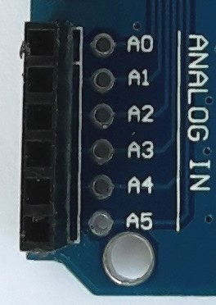
ADC in AVR

Slide 9
ADC in AVR

Slide 10
ADMUX
MUX0-MUX1: input select
ADLAR:
0: right adjust the result
1: left adjust the result
REFS1-REFS0: Vref selection

Slide 11
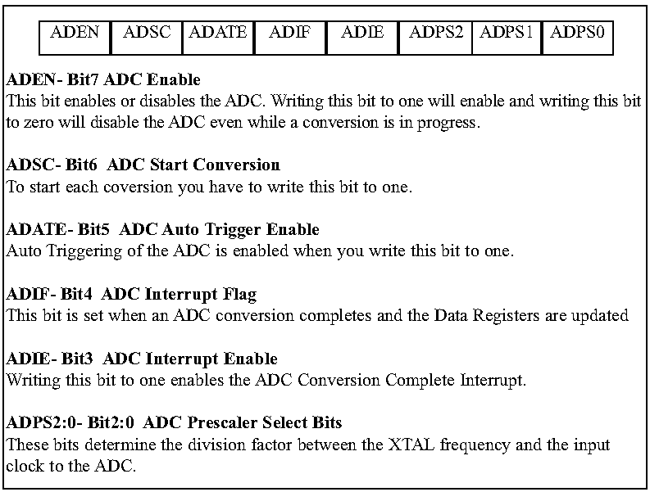
ADCSA

Slide 12
Steps in programming ADC
1. Make the pin for the selected ADC channel an input pin.
2. Turn on the ADC module
3. Select the conversion speed
4. Select voltage reference and ADC input channels.
5. Activate the start conversion bit by writing a one to the ADSC bit of ADCSRA.
6. Wait for the conversion to be completed by polling the ADIF bit in the ADCSRA register.
7. After the ADIF bit has gone HIGH, read the ADCL and ADCH registers to get the digital data output.
8. If you want to read the selected channel again, go back to step 5.
9. If you want to select another Vref source or input channel, go back to step 4.

Slide 13
Sensors
Sensor: Converts a physical signal (e.g. light, temperature, humidity, etc.) to an electrical signal (e.g. resistance, voltage, current, capacitance, etc)

Slide 14
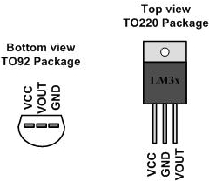
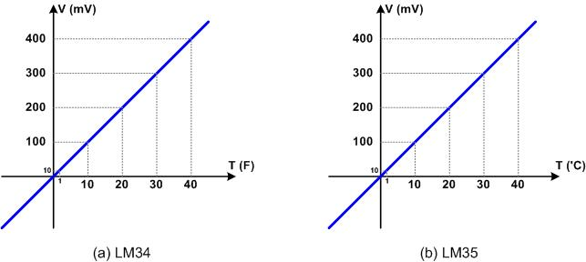
LM35 & LM34 (Temperature Sensors)
LM35 and LM34:
convert temp. to voltage
10mV for each degree

Slide 15
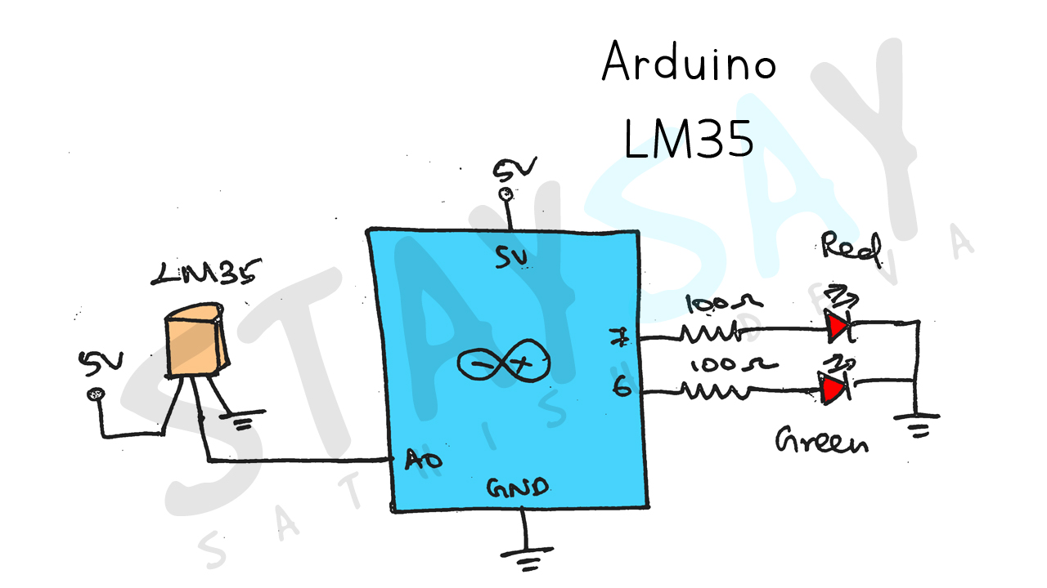
LM35 (Temperature Sensors)

Slide 16
Temperature Sensors
#define LM35 A0
#define RED 7
#define GREEN 6
float lm_value;
float tempc;
void setup() {
Serial.begin(9600);
pinMode(RED, OUTPUT);
pinMode(GREEN, OUTPUT);
}
void loop() {
lm_value = analogRead(LM35);
tempc = (lm_value * 500) / 1023;
Serial.println(tempc);//Temperature in Celcius
//Condition
if (tempc > 60) {
digitalWrite(RED, HIGH);
digitalWrite(GREEN, LOW);
}
else {
digitalWrite(GREEN, HIGH);
digitalWrite(RED, LOW);
}
delay(100);
}

Slide 17
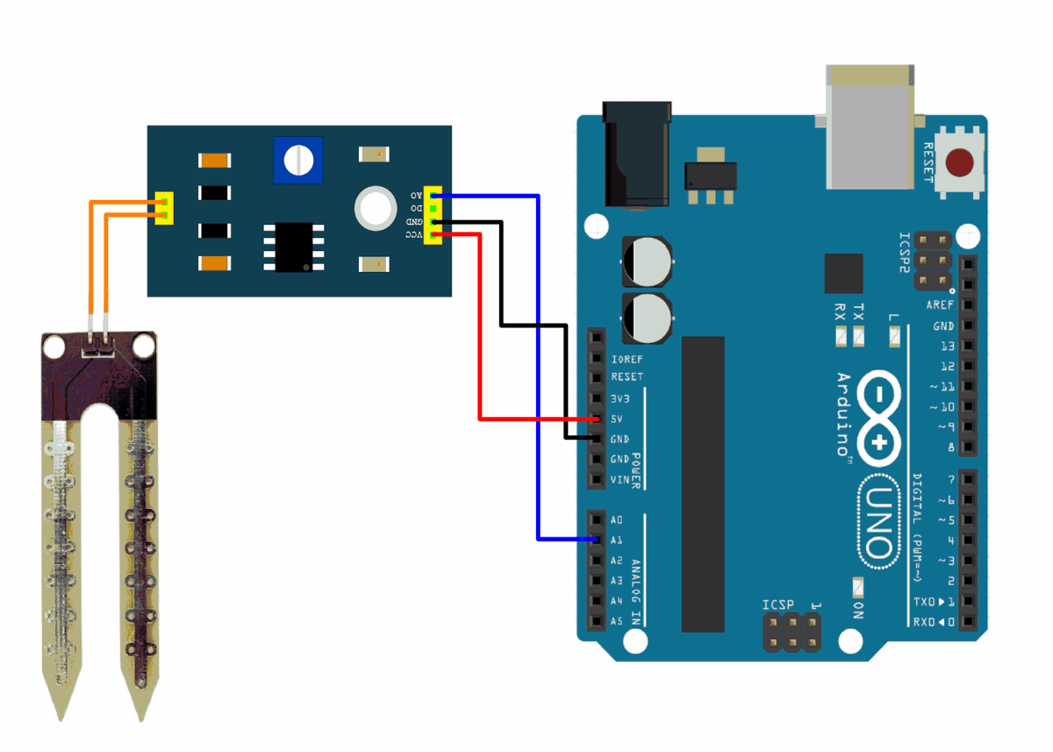
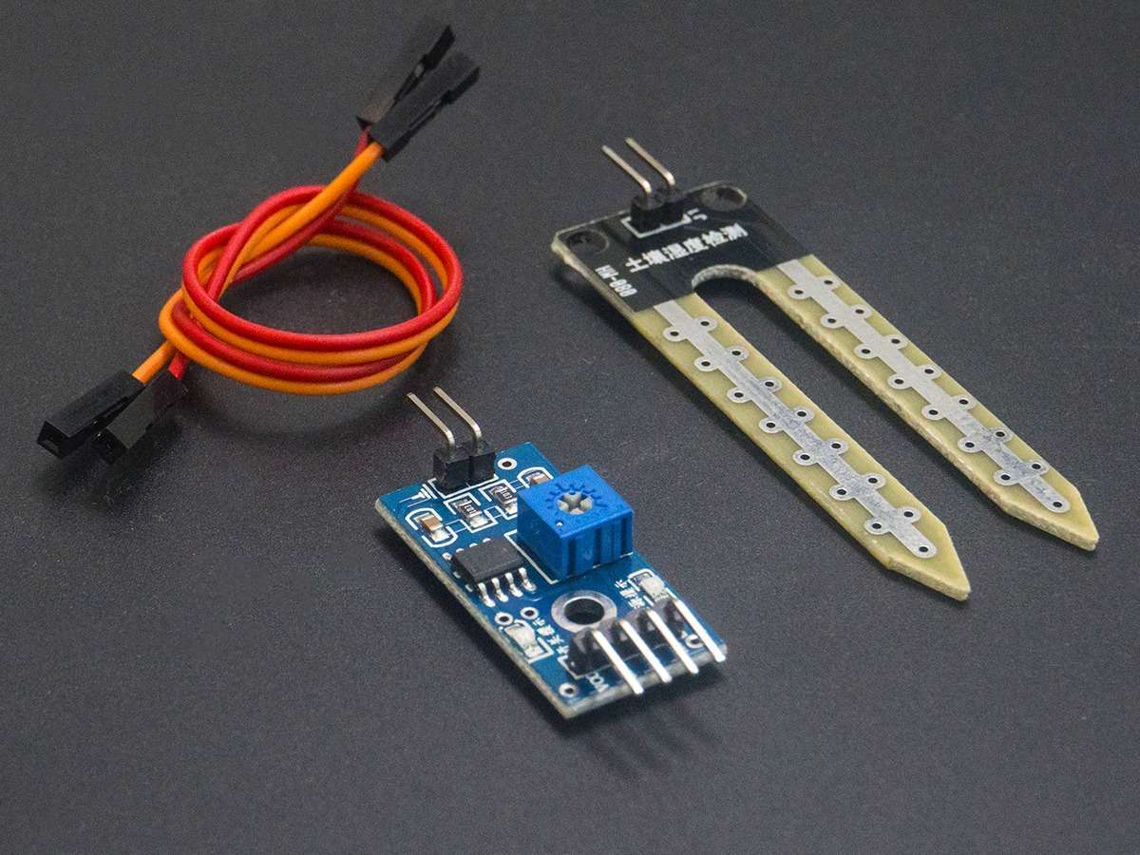
Soil Moisture
17

Slide 18
Soil Sensor Programming
const int sensor_pin = A1; /* Soil moisture sensor O/P pin */
void setup(){
Serial.begin(9600); /* Define baud rate for serial communication */
}
void loop(){
float moisture_percentage;
int sensor_analog;
sensor_analog = analogRead(sensor_pin);
moisture_percentage = ( 100 - ( (sensor_analog/1023.00) * 100 ) ); Serial.print("Moisture Percentage = ");
Serial.print(moisture_percentage);
Serial.print("%\n\n");
delay(1000);
}

Slide 19
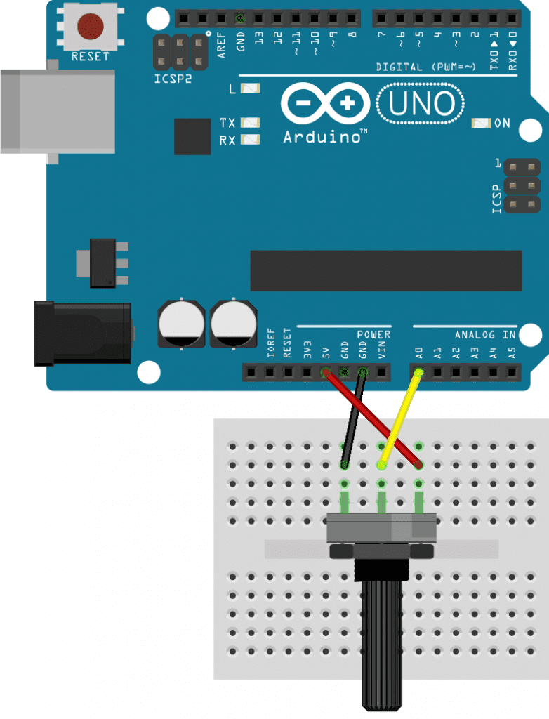
Voltage Level using Variable Resistor
void setup() {
Serial.begin(9600);
}
void loop() {
int rawValue = analogRead(A0);
Serial.println(rawValue);
delay(100);
}
19

Slide 20
Voltage Level using Variable Resistor
void setup() {
Serial.begin(9600);
}
void loop() {
int rawValue = analogRead(A0);
float voltage = rawValue * (5.0 / 1023.0);
Serial.print(voltage);
Serial.println(" Volts");
delay(100); }
rawValue=map(rawValue, sensorMin, sensorMax, 0, 255);
20

Slide 21
PWM

Slide 22
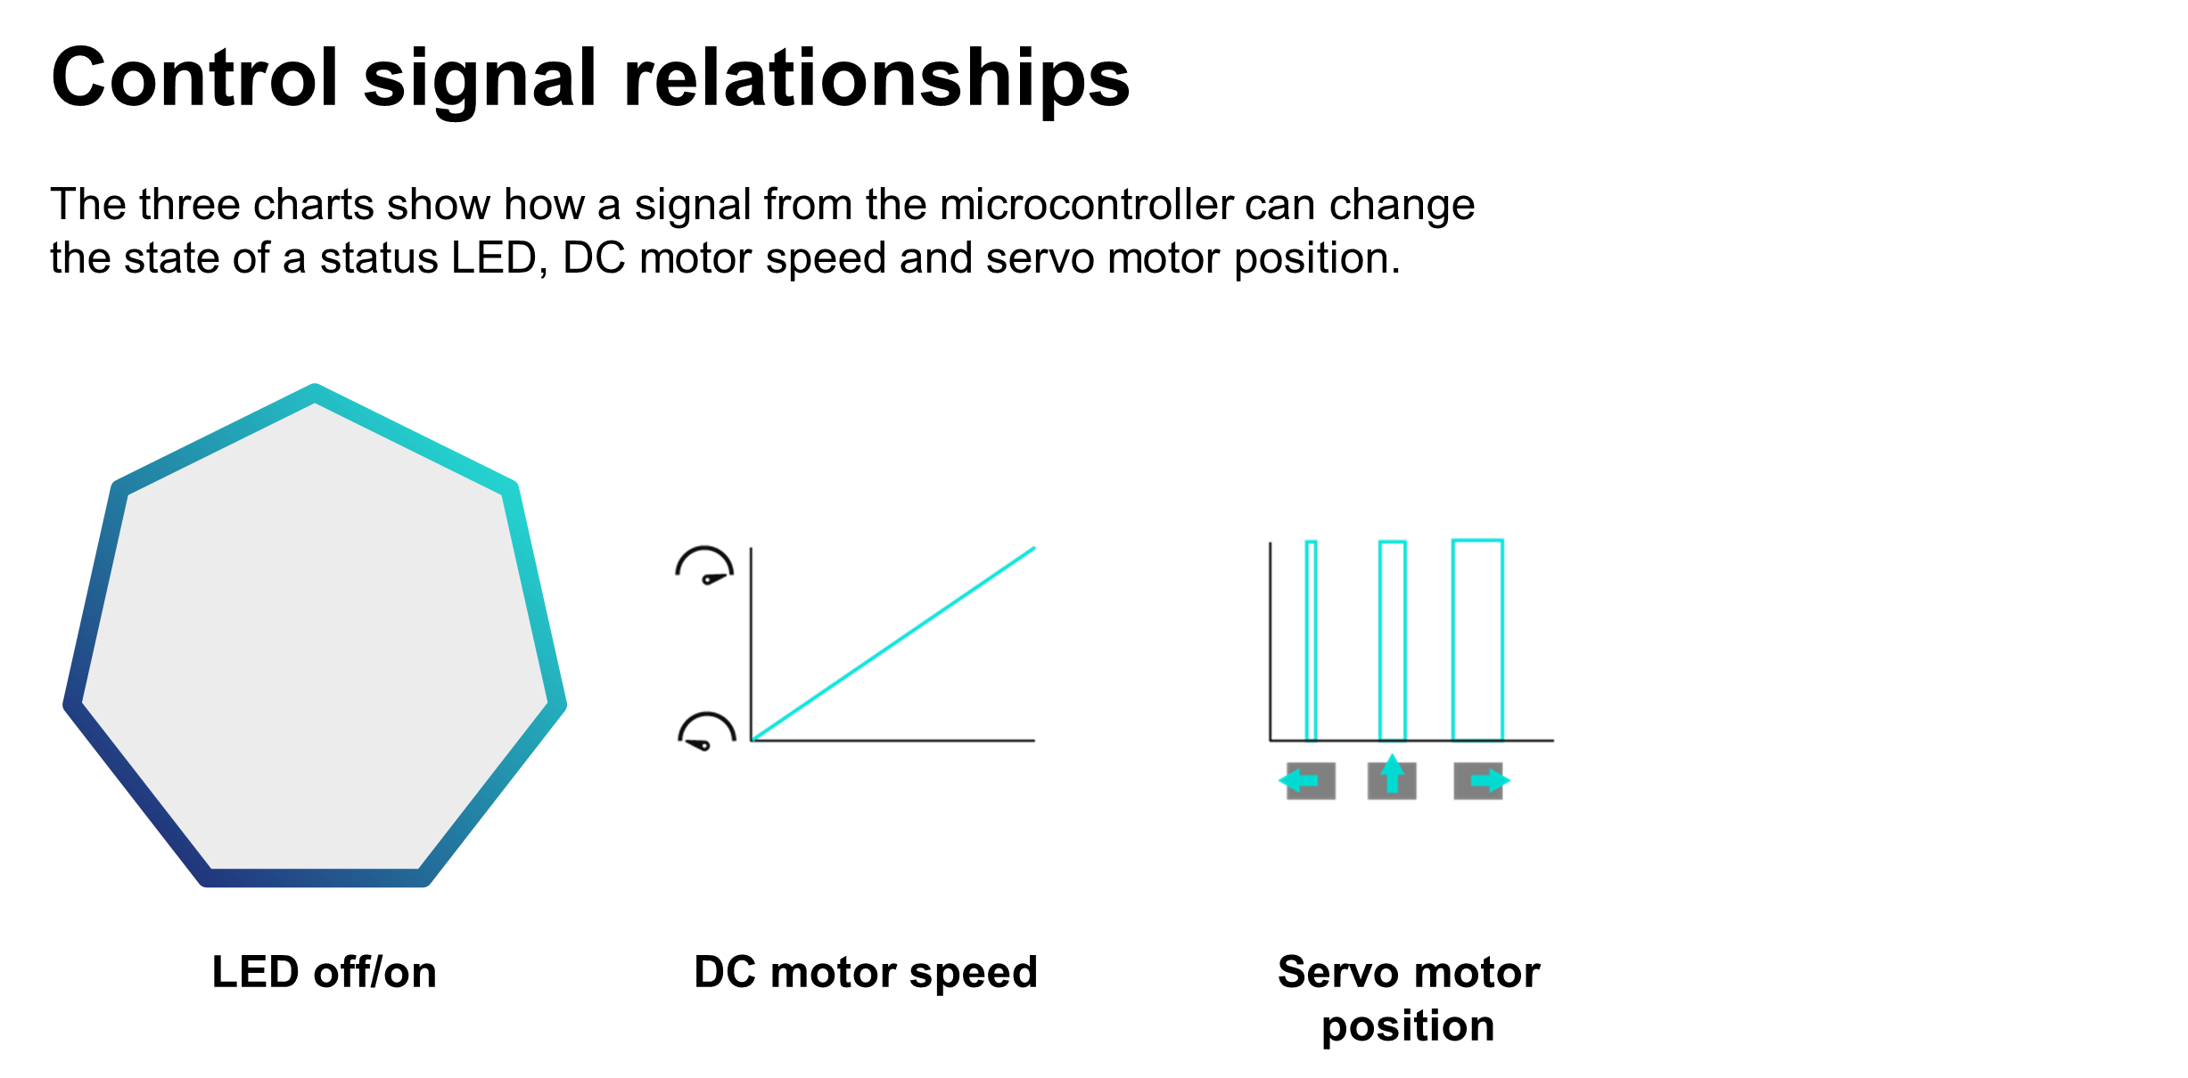
Control Signal Relationship

Slide 23
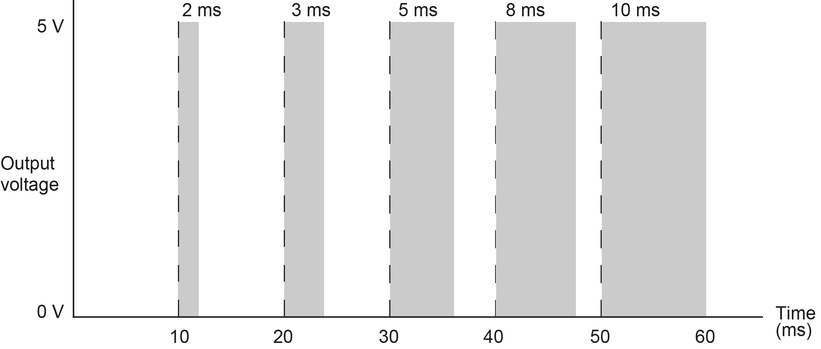
What is pulse width modulation?
Pulse width modulation (PWM) is a form of digital to analogue conversion (DAC).
PWM varies the time for which the output voltage is set high (the duty cycle) in a set frequency. Output devices like DC motors interpret this as the average voltage during each period. The bars in the diagram below show how the pulse widths in this signal vary. Each pulse is 10 ms apart, for example, a 1 ms pulse below would be a 10% duty cycle (1 ms/10 ms).
What is the frequency of this PWM signal?
Calculate the % duty cycle during each period, and the average voltage this produces each time.
What duty cycle would be needed to create the following average voltages? 1.2 V, 3.5 V, 4.8 V
This controller has 8-bit resolution (0 to 255). What is the resolution of the PWM output, in volts?

Slide 24
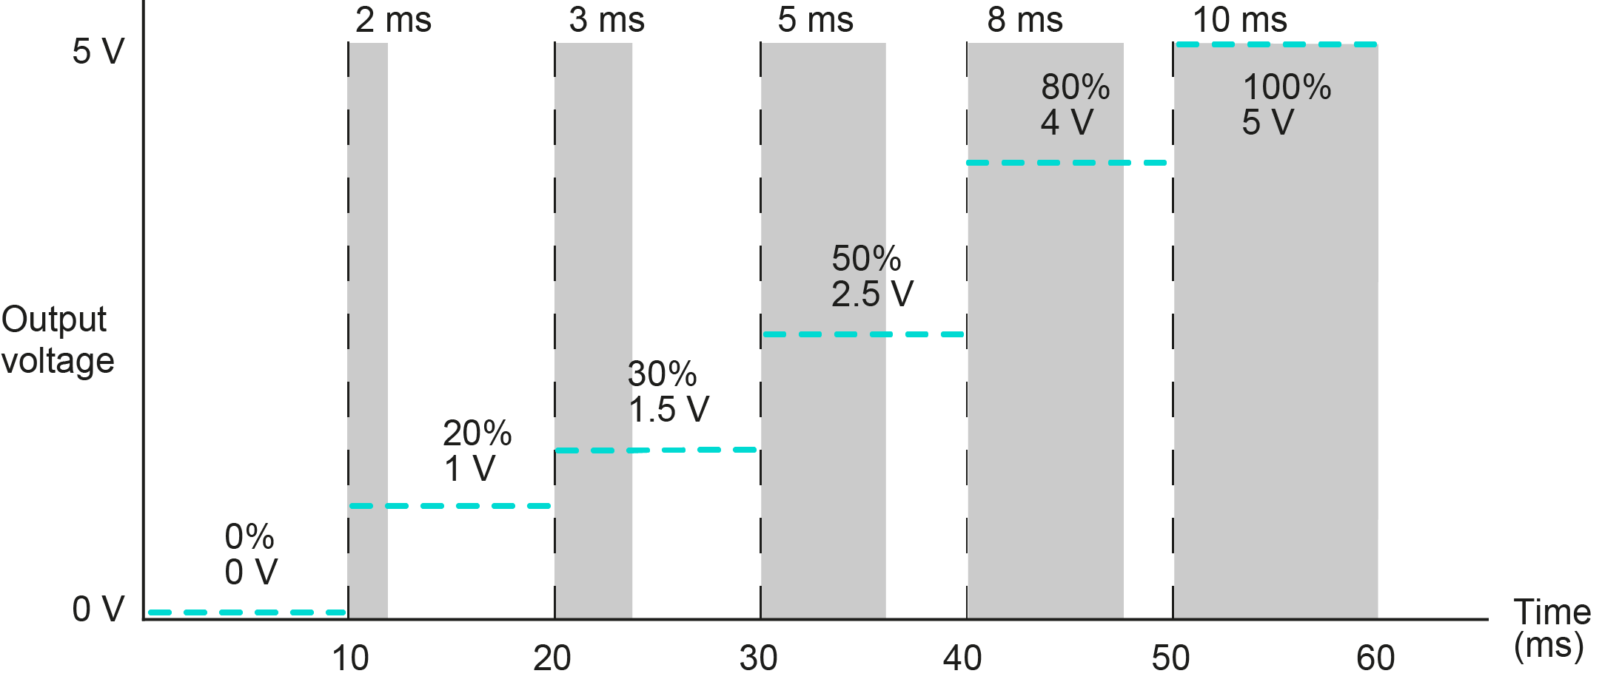
What is pulse width modulation?
What is happening if the duty cycle is set to zero or 100%?
More generally, what is happening if the duty cycle stays the same?
How could PWM control the speed of a motor?
The frequency of the PWM signal is 100 Hz (1/10 ms = 100)
Duty cycles:
1.2 V: 24%, or 2.4 ms (1.2 V/5 V x 100% = 24%)
3.5 V: 70%, or 7 ms
4.8 V: 96%, or 9.6 ms
The resolution of the PWM output is 5 Volts / 256 steps = 0.02 V to 2 decimal places.

Slide 25
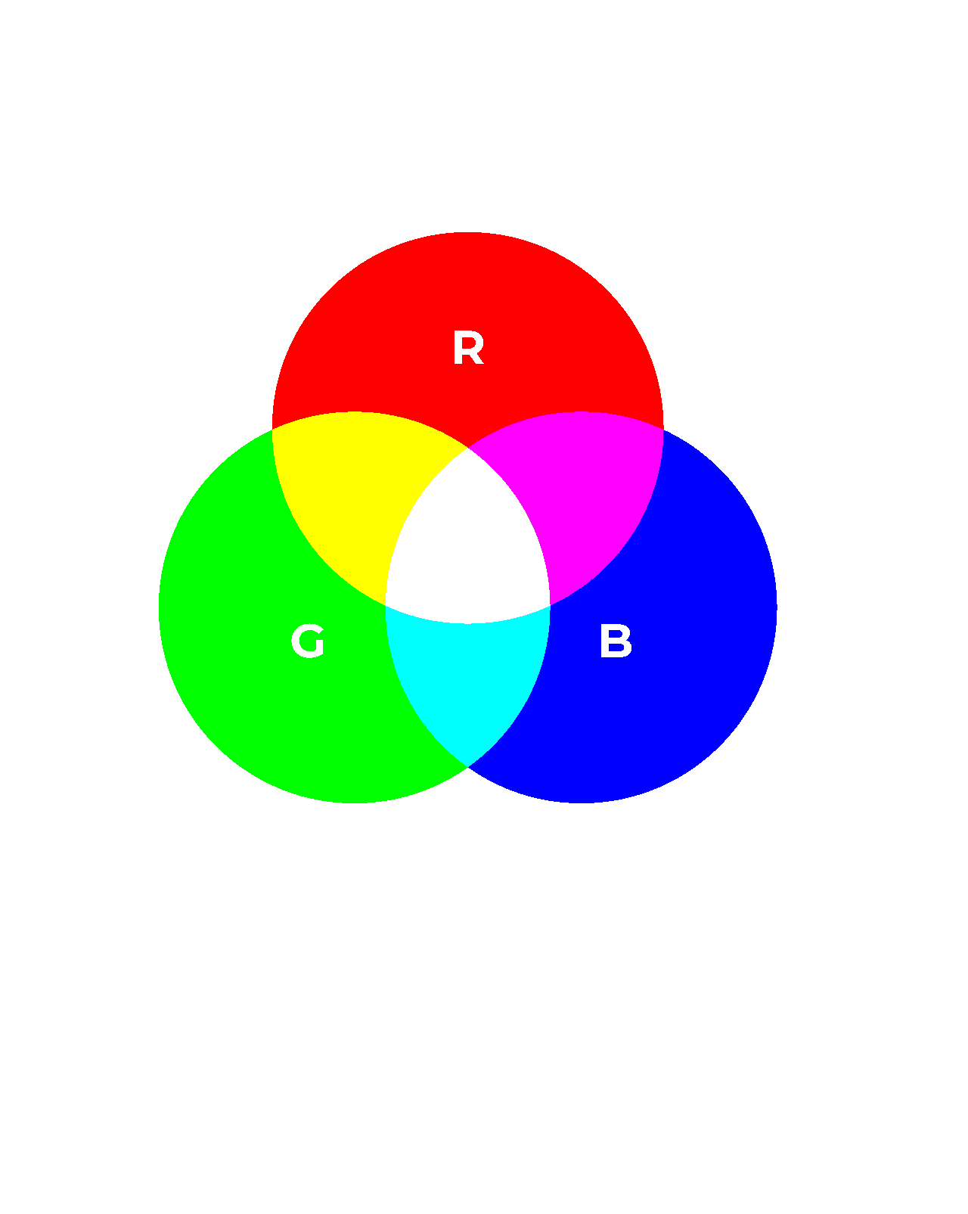

Applying pulse width modulation: RGB LEDs
A CNC machine status light can be red, amber or green.
A microcontroller changes the status of the red, green or blue emitters in an RGB LED.
Each emitter can be on, dimmed (50% duty cycle) or off.
First, think about what PWM signal to each emitter will create a red, yellow or green light. Then, consider whether you need to send a 50% duty cycle signal to the red or green emitter, while leaving the other on 100%, to change yellow to amber. Sketch on the activity sheet what PWM signals would make the light cycle through red, amber and green statuses.

Slide 26
Applying pulse width modulation: DC motors
The CNC tool head motor has an operating speed of 0 to 12,000 rpm.
The microcontroller will operate a higher power PWM circuit to control the motor speed.
This PWM circuit will operate at a frequency of 50 kHz.
Complete the table on the activity sheet to show the duty cycles for a range of tool head motor speeds.

Slide 27
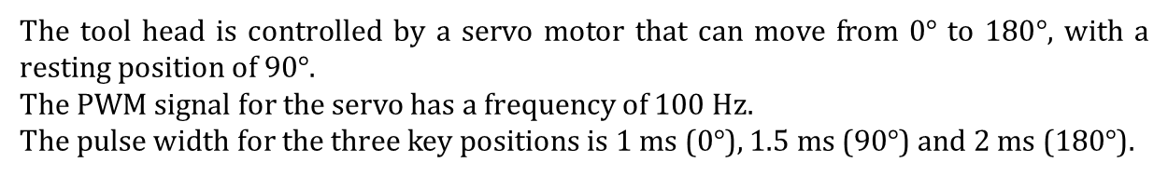
Applying pulse width modulation: servo motors
The tool head is controlled by a servo motor that can move from 0$°$ to 180$°$, with a resting position of 90$°$.
The PWM signal for the servo has a frequency of 100 Hz.
The pulse width for the three key positions is 1 ms (0$°$), 1.5 ms (90$°$) and 2 ms (180$°$).
Calculate the pulse width for the intermediate positions listed on the activity sheet.
If the microcontroller has an 8-bit (256 step) resolution, what is in principle the smallest increment by which the servo motor can rotate?

Slide 28
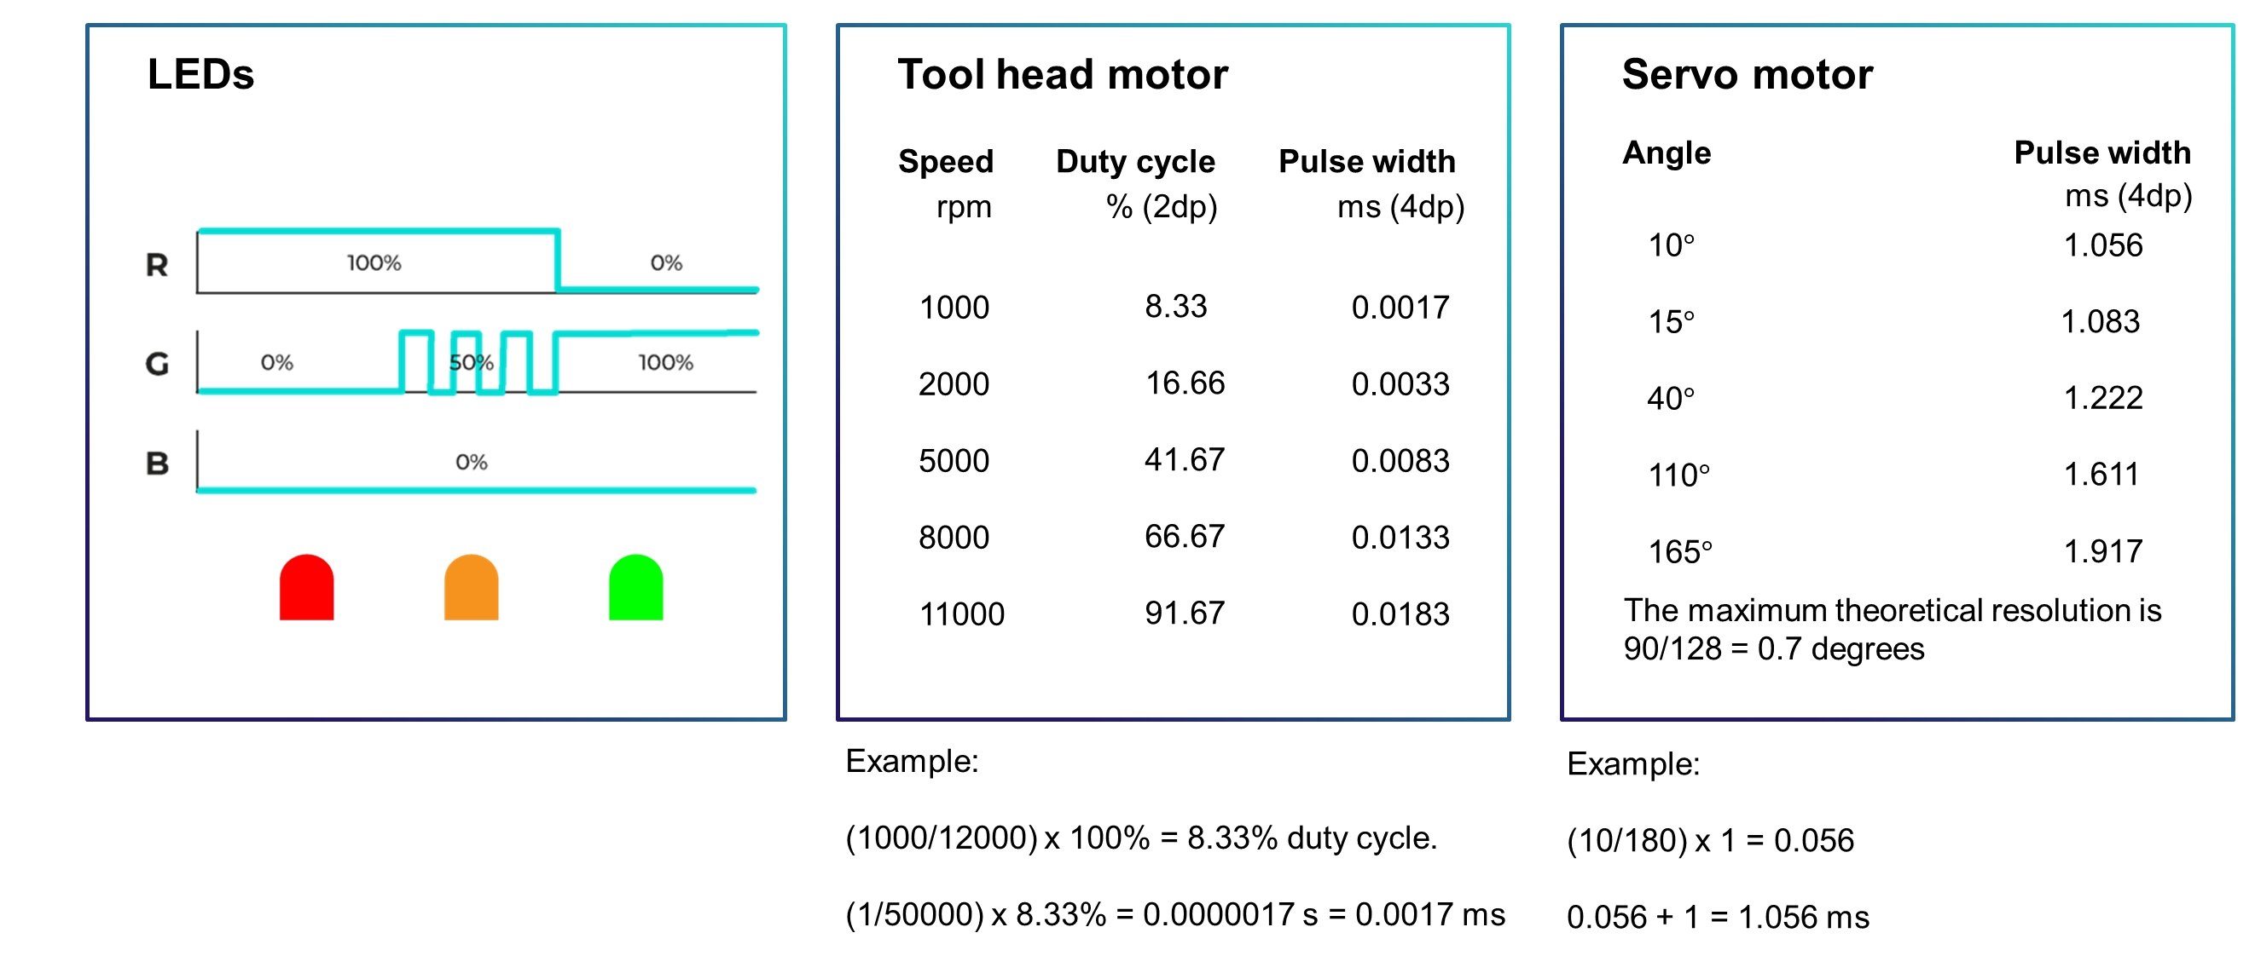

Slide 29
Pulse width modulation
Use Pulse Width Modulation (PWM) to approximate
Digital outputs are capable of 0V or 5V
Over a fraction (t_{on}) of a time period t_{cycle}, keep pin at 5V, the rest of the time, at 0V
Average voltage is proportional to t_{on}/t_{cycle}, called the ‘Duty Cycle’
Application
Identify how PWM can control a range of devices including LEDs, DC motors and servo motors.
Make calculations to generate the right PWM signal to obtain desired results.

Slide 30
Arduino analogWrite( )
analogWrite(pin, value);
0 ≤ value ≤ 255
0% duty cycle --> 0 V --> analogWrite(pin, 0);
100% duty cycle --> 5 V --> analogWrite(pin, 255);

Slide 31
Analog Output Example
const byte ledPin = 3; // red RGB LED on Experimenter
const byte FADE_MAX = 255; // max value for setting duty cycle
const byte FADE_INC = 5; // increment for changing duty cycle
void setup()
{
pinMode(ledPin, OUTPUT);
}
void loop()
{
int fadeValue; // PWM value
// fade in from min to max in increments of 5 points:
for(fadeValue = 0 ; fadeValue <= FADE_MAX; fadeValue +=FADE_INC)
{
analogWrite(ledPin, fadeValue); // sets the value (range from 0 to 255):
}
// fade out from max to min in increments of 5 points:
for(fadeValue = FADE_MAX; fadeValue >= 0; fadeValue -=FADE_INC)
{
analogWrite(ledPin, fadeValue); // sets the value (range from 0 to 255):
}
}
Fade the red LED in, then out
duty cycle is incremented then decremented
256 steps
0% to 100%

Slide 32
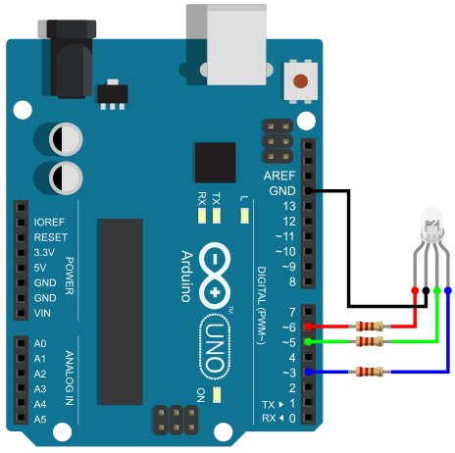
int redPin= 6;
int greenPin = 5;
int bluePin = 4;
void setup() {
pinMode(redPin, OUTPUT);
pinMode(greenPin, OUTPUT);
pinMode(bluePin, OUTPUT);
}
void loop() {
setColor(255, 0, 0); // Red Color
delay(1000);
setColor(0, 255, 0); // Green Color
delay(1000);
setColor(0, 0, 255); // Blue Color
delay(1000);
setColor(255, 255, 255); // White Color
delay(1000);
setColor(170, 0, 255); // Purple Color delay(1000); } void setColor(int redValue, int greenValue, int blueValue) { analogWrite(redPin, redValue);
analogWrite(greenPin, greenValue);
analogWrite(bluePin, blueValue); }

Slide 33
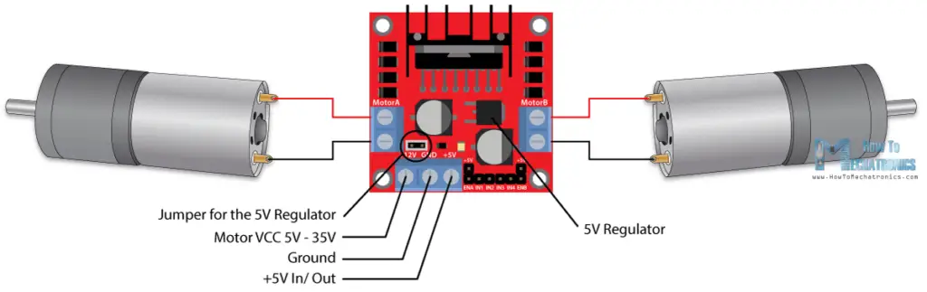
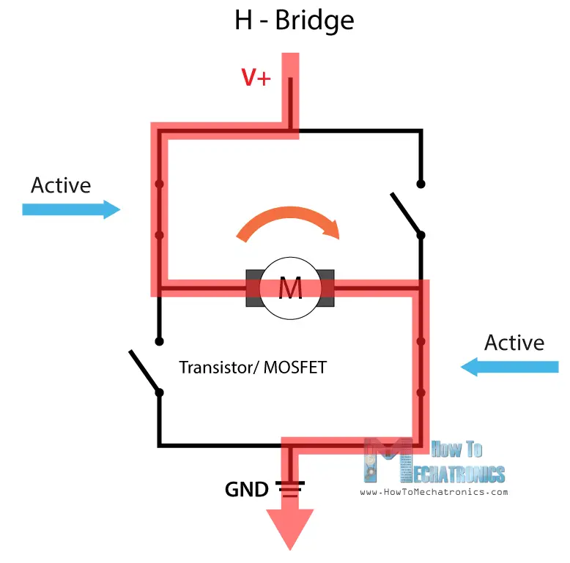
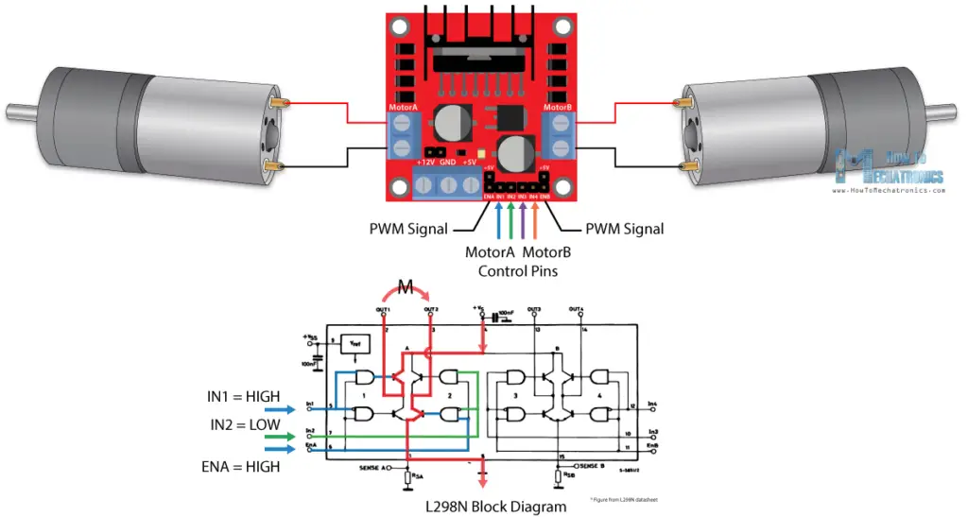
Robotics Car using DC Motor

Slide 34
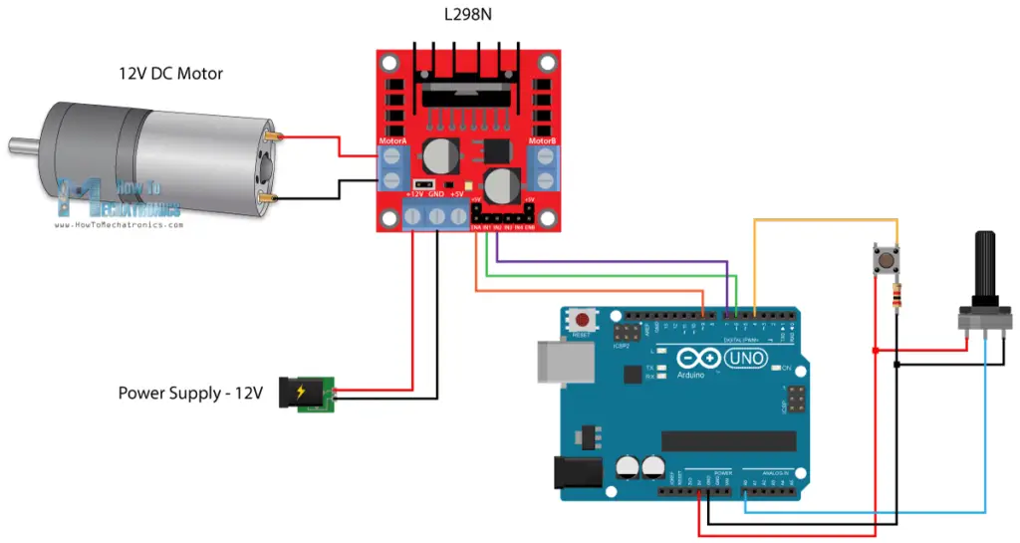
DC Motor speed Forward and Reverse direction

Slide 35
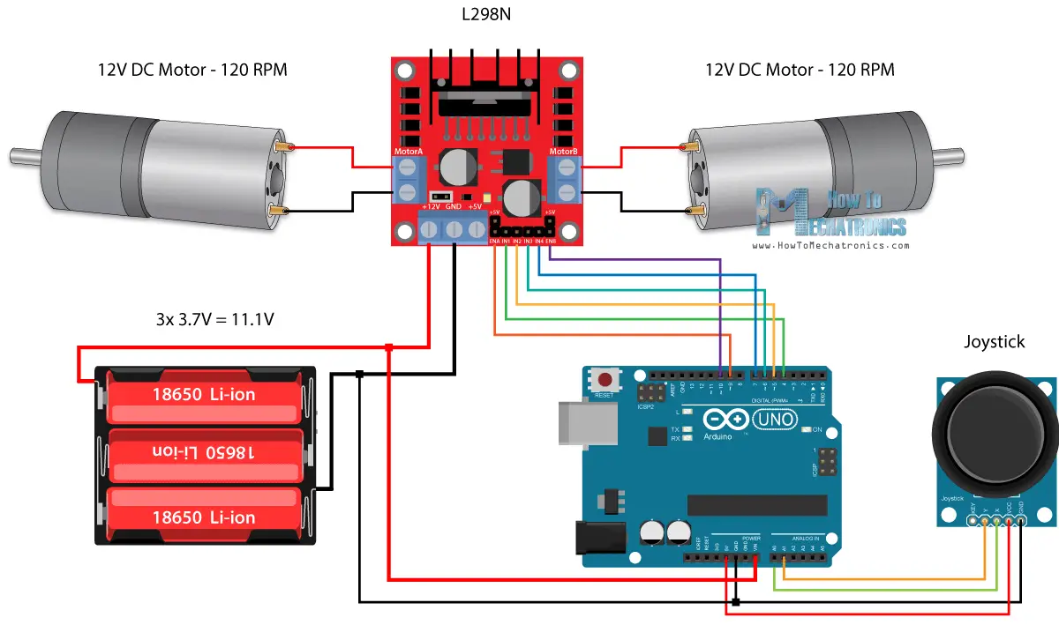
Car Moves using Joystick

Slide 36
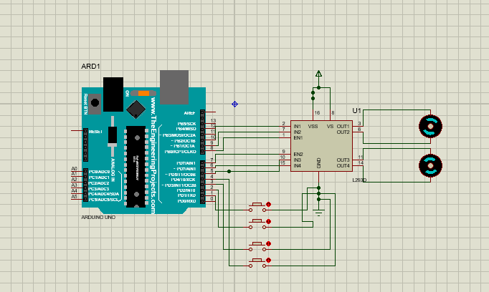

Slide 37
// Define motor control pins for left motor
int leftMotorIn1 = 10;
int leftMotorIn2 = 9;
int leftMotorEn = 8;
// Define motor control pins for right motor
int rightMotorIn1 = 6;
int rightMotorIn2 = 5;
int rightMotorEn = 7;
// Define button pins
int forwardButton = 1;
int reverseButton = 2;
int leftButton = 3;
int rightButton = 4;
void setup() {
// Set up left motor pins
pinMode(leftMotorIn1, OUTPUT);
pinMode(leftMotorIn2, OUTPUT);
pinMode(leftMotorEn, OUTPUT);
// Set up right motor pins
pinMode(rightMotorIn1, OUTPUT);
pinMode(rightMotorIn2, OUTPUT);
pinMode(rightMotorEn, OUTPUT);
// Set up button pins
pinMode(forwardButton, INPUT_PULLUP);
pinMode(reverseButton, INPUT_PULLUP);
pinMode(leftButton, INPUT_PULLUP);
pinMode(rightButton, INPUT_PULLUP);
}

Slide 38
void moveForward() {
digitalWrite(leftMotorEn, HIGH);
digitalWrite(leftMotorIn1, HIGH);
digitalWrite(leftMotorIn2, LOW);
digitalWrite(rightMotorEn, HIGH);
digitalWrite(rightMotorIn1, HIGH);
digitalWrite(rightMotorIn2, LOW);
}
void moveReverse() {
digitalWrite(leftMotorEn, HIGH);
digitalWrite(leftMotorIn1, LOW);
digitalWrite(leftMotorIn2, HIGH);
digitalWrite(rightMotorEn, HIGH);
digitalWrite(rightMotorIn1, LOW);
digitalWrite(rightMotorIn2, HIGH);
}
void turnLeft() {
digitalWrite(leftMotorEn, HIGH);
digitalWrite(leftMotorIn1, LOW);
digitalWrite(leftMotorIn2, HIGH);
digitalWrite(rightMotorEn, HIGH);
digitalWrite(rightMotorIn1, HIGH);
digitalWrite(rightMotorIn2, LOW);
}
void turnRight() {
digitalWrite(leftMotorEn, HIGH);
digitalWrite(leftMotorIn1, HIGH);
digitalWrite(leftMotorIn2, LOW);
digitalWrite(rightMotorEn, HIGH);
digitalWrite(rightMotorIn1, LOW);
digitalWrite(rightMotorIn2, HIGH);
}
void stopMotors() {
digitalWrite(leftMotorEn, LOW);
digitalWrite(rightMotorEn, LOW);
}

Slide 39
void loop() {
// Check the status of each button
if (digitalRead(forwardButton) == LOW) {
moveForward();
} else if (digitalRead(reverseButton) == LOW) {
moveReverse();
} else if (digitalRead(leftButton) == LOW) {
turnLeft();
} else if (digitalRead(rightButton) == LOW) {
turnRight();
} else {
stopMotors();
}
}

Slide 40
Timer0 Review
TCCR0A
TCCR0B
OCR0A
TCNT0
OCR0B
TOV0
=
=
OCF0A
OCF0B
40

Slide 41
Timer Mode (WGM)
WGM02 WGM01 WGM00 Comment
0 0 0 Normal
0 0 1 Phase correct PWM
0 1 0 CTC (Clear Timer on Compare Match)
0 1 1 Fast PWM
1 0 0 Reserved
1 0 1 Phase correct PWM
1 1 0 Reserved
1 1 1 Fast PWM

Slide 42
Fast PWM mode
Similar to Normal mode but OCR0x are buffered.
0
TCNT0
TOV0:
1
0xFF
TOV
TOV
TOV
0
time
TCNT0
FF
TOV0
=
OCF0x
FE
OCR0x
2
1
TOV0
0
TOV0 = 1
OCR0x-BUF
42

Slide 43
Phase Correct PWM mode
Goes up and down like a yo-yo
When TCNT becomes zero, the TOV0 flag sets.
0
TCNT0
TOV0:
1
0xFF
0
TOV
time
FF
TCNT0
FE
TOV0
=
OCF0x
2
OCR0x
TCNT0=0xFF
1
0
TOV0 = 1
OCR0x-BUF
43

Slide 44
Compare Output Mode (COM)
COM0x1 | COM0x0 | Description
0 | 0 | Normal port operation, OC0 disconnected
0 | 1 | Toggle OC0 on compare match
1 | 0 | Clear OC0 on compare match
1 | 1 | Set OC0 on compare match
CTC or Normal (Non PWM)
COM0x1 | COM0x0 | Description
0 | 0 | Normal port operation, OC0 disconnected
0 | 1 | Reserved
1 | 0 | Clear OC0 on compare match, set OC0 at TOP.
1 | 1 | Set OC0 on compare match, clear OC0 at TOP.
Fast PWM
COM0x1 | COM0x0 | Description
0 | 0 | Normal port operation, OC0 disconnected
0 | 1 | Reserved
1 | 0 | Clear OC0 on compare match when up-counting. Set OC0 on compare match when down-counting.
1 | 1 | Set OC0 on compare match when up-counting. Clear OC0 on compare match when down-counting.
Phase Correct PWM
44

Slide 45
Fast PWM Calculations
Fast PWM
Duty cycle = changeable (0% to 100%)
Frequency = selectable between limited choices
TCNT0
TCNT0
0xFF
0xFF
OCR0x
OCR0x
0
0
OC0x
OC0x
COM=2
COM=2
COM=2
OC0x
OC0x
COM=3
COM=3
COM=3
f_{clk}
F_{OC0}=
N(256)
45

Slide 46
Assuming XTAL = 16 MHz, make the following pulse duty cycle = 75% and frequency = 62.500KHz
f_{clk}
16MHz
16MHz
F_{OC0}=
62.500KHz=
N =
=1
N(256)
N(256)
62.500K*256
75/100 = (OCR0x+1)/256 ➔ OCR0x+1 = 192 ➔ OCR0x = 191
DDRD |= (1<<6); //PD6 as output
OCR0A = 191;
TCCR0A = (1<<COM0A1)|(1<<WGM01)|(1<<WGM00);
TCCR0B = 0x01; //N = 1 (no prescaler)
SBI DDRD, 6
LDI R20,191
OUT OCR0A,R20
LDI R20, (1<<COM0A1)|(1<<WGM01)|(1<<WGM00)
OUT TCCR0A,R20
LDI R20,0x01
OUT TCCR0B,R20
46

