Slide 1
Week 14
STM 32

Slide 2
Microcontroller
Self-contained processor on a chip
Desktop processors require an army of other parts
Extremely low cost – pennies to a few dollars
8-bit,16-bit, 32-bit are typical sizes
Most common 8-bit – 8051 (designed in 1980), used in mice, keyboards, etc.
Most common 32-bit – ARM Cortex-M[0-4]
Typically have common I/O devices built-in

Slide 3

Arm processor families
Cortex-A series (Application)
High performance processors capable of full Operating System (OS) support
Applications include smartphones, digital TV, smart books
Cortex-R series (Real-time)
High performance and reliability for real-time applications;
Applications include automotive braking system, powertrains
Cortex-M series (Microcontroller)
Cost-sensitive solutions for deterministic microcontroller applications
Applications include microcontrollers, smart sensors
SecurCore series
High security applications
Earlier classic processors including Arm7, Arm9, Arm11 families
Cortex-A73 Cortex-A72 Cortex-A57 Cortex-A53 Cortex-A35 Cortex-A32
Cortex-A17 Cortex-A15 Cortex-A9 Cortex-A8 Cortex-A7 Cortex-A5
Cortex-A
Cortex-R8 Cortex-R7 Cortex-R5 Cortex-R4
Cortex-R
Cortex-M23, M33 Cortex-M7 Cortex-M4 Cortex-M3 Cortex-M0, M0+
Cortex-M
SC000 SC300
SecurCore
Arm11 Arm9 Arm7
Classic
Notes:
Presenter
2019-02-01 07:57:17
--------------------------------------------
Arm’s processor families range from the A-series, which are optimized for rich operating systems, the R-series, which are optimized for hard real-time applications and high performance, the M-series, which is optimized for discrete processing and microcontroller, and the SecurCore, which is optimized for security applications. Arm Cortex-A processors are at the heart of the most powerful and compelling technology products. They are deployed in mobile devices, networking infrastructure, home and consumer devices, automotive in-vehicle infotainment and driver automation systems, and embedded designs.
Arm Cortex-R real-time processors offer high-performance computing solutions for embedded systems where reliability, high availability, fault tolerance and/or deterministic real-time responses are needed. Cortex-R processors are used in products that must always meet exacting performance requirements and timing deadlines.
The Arm Cortex-M processor family is a range of scalable, energy efficient, and easy to use processors that meet the needs of tomorrow’s smart and connected embedded applications. The processors are supported by the world’s number one embedded ecosystem, and have already been shipped in many billions of devices.
The Arm SecurCore processor family provides powerful 32-bit secure solutions based upon industry leading Arm architecture. By enhancing highly successful Arm processors with security features, SecurCore gives smart card and secure IC developers easy access to the benefits of Arm 32-bit technology such as small die size, energy efficiency, low cost, excellent code density and outstanding performance. Arm Classic processors include the Arm11, Arm9 and Arm7 processor families. These processors are still widely licensed around the globe, providing cost-effective solutions for many of today's applications.

Slide 4
Arm processors vs. Arm architectures
Arm architecture
Describes the details of instruction set, programmer’s model, exception model, and memory map
Documented in the Architecture Reference Manual
Arm processor
Developed using one of the Arm architectures
More implementation details, such as timing information
Documented in processor’s Technical Reference Manual
Armv7
Architecture Armv7-A
e.g. Cortex-A9
Armv7-R
e.g. Cortex-R4
Armv7-M
e.g. Cortex-M4
Armv4/v4T Architecture
Armv5/ v4E Architecture
Armv6 Architecture
Armv8
Architecture Armv8-A
e.g. Cortex- A53
Cortex-A57 Armv8-R
Armv8-M, e.g. Cortex-M23, M33
Arm v6-M
e.g. Cortex-M0, M1
e.g. Arm1136
e.g. Arm7TDMI
e.g. Arm9926EJ-S
Notes:
Presenter
2019-02-01 07:57:17
--------------------------------------------
While programming Arm systems, a distinction needs to be made between the Arm architecture and an Arm processor. Arm architecture describes the details related to programming including data types, instructions, registers, memory architecture etc. Companies that are licensing Arm architecture are using their own CPU design.
Arm architecture forms the basis for every Arm processor. Over time, the Arm architecture has evolved to include architectural features that meet the growing demand for new functionality, integrated security features, high performance and the needs of new and emerging markets. There are currently three Armv8 profiles: (1) the Armv8-A architecture profile for high performance markets such as mobile and enterprise, (2) the Armv8-R architecture profile for embedded applications in automotive and industrial control, and (3) the Armv8-M architecture profile for embedded and IoT applications. The Arm architecture supports implementations across a wide range of performance points, establishing it as the leading architecture in many market segments. The Arm architecture supports a very broad range of performance points, leading to very small implementations of Arm processors, and very efficient implementations of advanced designs using state of the art micro-architecture techniques. Implementation size, performance, and low power consumption are key attributes of the Arm architecture.

Slide 5

Arm Cortex-M series
Cortex-M series: Cortex-M0, M0+, M3, M4, M7, M22, M23
Low cost, low power, bit and byte operations, fast interrupt response
Energy-efficiency
Lower energy cost, longer battery life
Smaller code (Thumb mode instructions)
Lower silicon costs
Ease of use
Faster software development and reuse
Embedded applications
Smart metering, human interface devices, automotive and industrial control systems, white goods, consumer products and medical instrumentation
Notes:
Presenter
2019-02-01 07:57:18
--------------------------------------------
This course is about M-series-processors, optimized for low energy consumption and small codes, requiring less physical space and silicon for lower cost. These cores are optimized for mobile applications with independent power supply.
Arm offers Cortex-M0 and Cortex M0+ for applications requiring minimal cost, power, and area while Cortex-M3 and Cortex-M4 and Cortex-M7 are designed for applications requiring higher performance. Arm Cortex-M4 and Cortex-M7 integrate Digital Signal Processing (DSP) and accelerated floating point processing capability for fast and power-efficient algorithm processing of digital signal control applications.

Slide 6
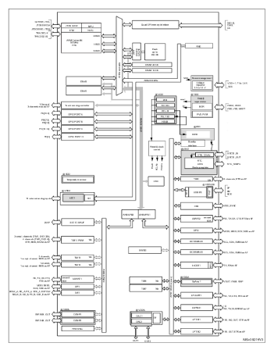
STM32 Family
STM32F0x – Cortex-M0 based, very low power, up to 40Mhz
F1, L1, F2 – Cortex-M3 based (L1 is low power, up to 72Mhz
F3 – Cortex-M4 based, 72 Mhz, floating point unit
F4 - Cortex-M4 based 250MHz, floating point unit
L4 – Cortex-M4 based, extremely low power, 80Mhz

Slide 7
STM32 Microcontroller
The STM32 is MCUs built on Arm® Cortex™M processor core. The
STM32 microcontrollers can
cover Arm® Cortex™ M0, M0+, M3, M4 and
M7 cores. They can have few K bytes to few M bytes of onchip Flash
memory for code. Their on-chip SRAM can vary depending on the chip.
They all have a large
number of on-chip peripherals. See Figure 2-1. In this
book, we focus on STM32F446 chips. The STM32F4xx
is based on CortexM4
while STM32F0 uses Cortex-M0+.

Slide 8
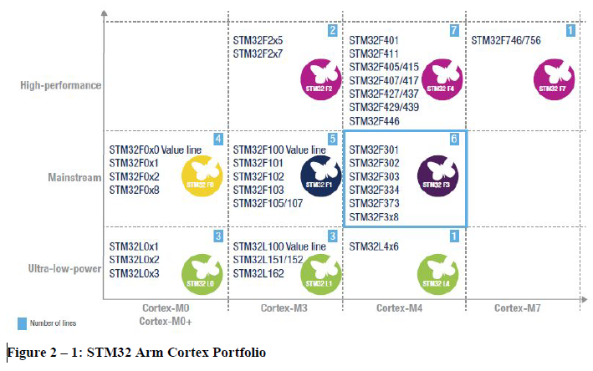
STM32 Family

Slide 9
STM32L432
Core Processor is Cortex-M4
Huge number of communication interfaces
USB
Serial Audio
2x I2C
3x USART
ADC (analog to digital converter)
2x DAC (digital to analog converter)
Extreme low power mode

Slide 10
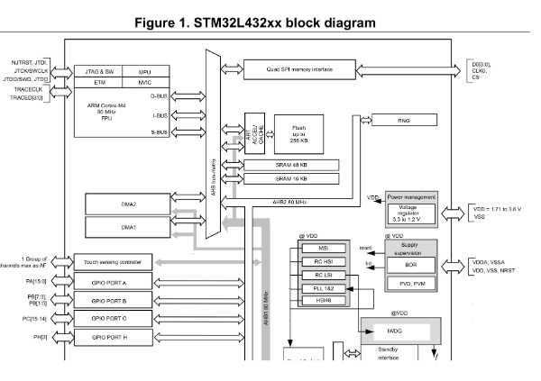
STM32L432xx

Slide 11
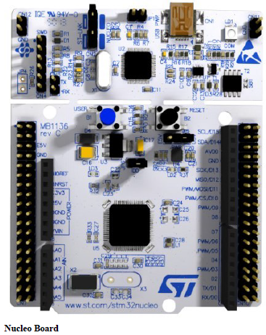
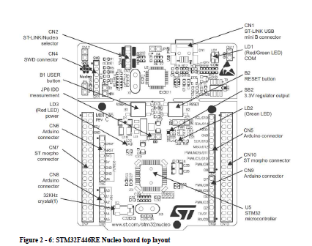
Nucleo board

Slide 12
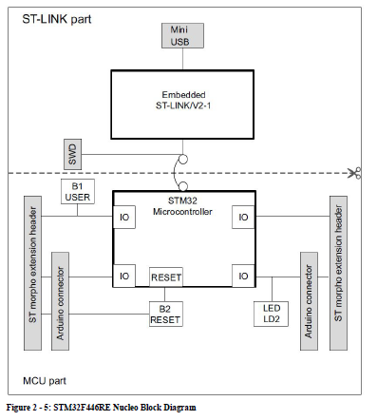
Nucleo board Block Diagram

Slide 13
STM32F4xx Memory Map
The Arm has 4GB (Giga bytes) of memory address space. It also uses memory mapped I/O, meaning the I/O peripheral registers are mapped into the 4GB memory space.
Flash 512KB 0x00000000-0x0007FFFF
SRAM 128KB 0x20000000-0x20001FFFF
I/O
All the peripherals 0x40000000-0x4xxxxxxx

Slide 14
I/o Port addresses
GPIO Port A: 0x4002 0000 - 0x4002 03FF
GPIO Port B: 0x4002 0400 - 0x4002 07FF
GPIO Port C: 0x4002 0800 - 0x4002 0BFF
GPIO Port D: 0x4002 0C00 - 0x4002 0FFF
GPIO Port E: 0x4002 1000 - 0x4002 13FF
GPIO Port F: 0x4002 1400 - 0x4002 17FF
GPIO Port G: 0x4002 1800 - 0x4002 1BFF
GPIO Port H: 0x4002 1C00 - 0x4002 1FFF
GPIO Port I: 0x4002 2000 - 0x4002 23FF

Slide 15
I/O Port Registers
Generally, every microcontroller has a minimum of two registers associated with each of I/O port.
They are Data Register and Direction Register. The Direction register is used to make the pin either input or output.
After the Direction register is properly configured, then we use the Data register to actually write to the pin or read data from the pin.
It is the Direction register (when configured as an output) that allows the information written to the Data register to be driven to the pins of the device.

Slide 16
GPIO port
The output register in STM Arm is called GPIO port output data register (GPIOx_ODR) in which x can be A, B, C and so on depending on the number of ports implemented in a given chip.
They are located at the offset address of 0x14 from the Base address of that port

Slide 17
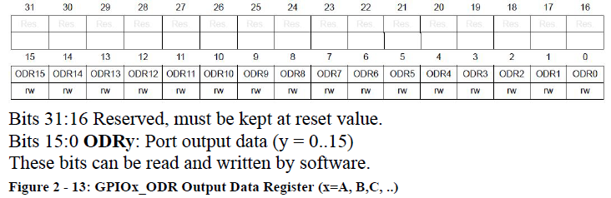
ODRy Register

Slide 18
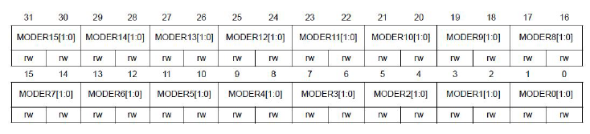
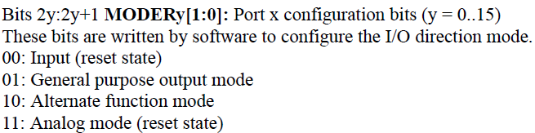
Direction Register
In STM Arm the direction register is part of the GPIOx_MODER which stands for GPIO Mode Register. For each GPIO pin, there are two corresponding bits in the MODER register.

Slide 19
Example
In a gives circuit board, an LED is connected to PA5. Find the value we need to write to the direction register.
Solution:
Since LEDs is an output, we need to write 0x0400 to the Mode register.
Notice the pins are designated as PA15-PA0.
The binary and hex numbers are as follow:
0000 0100 0000 0000 = 0x0400.

Slide 20
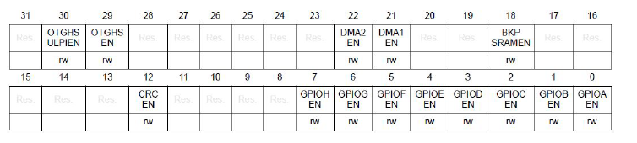
The Clock Enable of the Peripheral Registers
By default, the GPIO modules of the STM32 Arm microcontrollers have the clock disabled coming out of power-on reset. So the programmers have to enable the clock to a given I/O port or peripheral before using it.
This is done with a group of registers belonging to RCC (Reset and Clock Control) registers.
For the STM32F446 chips, the GPIO clock enable is controlled by lower bits of RCC_AHB1ENR (AHB1 Enable Register) register

Slide 21
The Clock Enable of the Peripheral Registers
Bit 7 GPIOHEN: IO port H clock enable This bit is set and cleared by software.
0: IO port H clock disabled
1: IO port H clock enabled
Bit 6 GPIOGEN: IO port G clock enable This bit is set and cleared bysoftware.
0: IO port G clock disabled
1: IO port G clock enabled
Bit 5 GPIOFEN: IO port F clock enable This bit is set and cleared by software.
0: IO port F clock disabled
1: IO port F clock enabled
Bit 0 GPIOAEN: IO port A clock enable This bit is set and cleared by software.
0: IO port A clock disabled
1: IO port A clock enabled

Slide 22
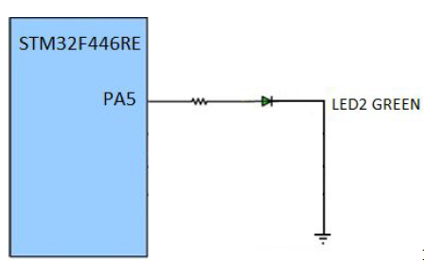
LED connection
Toggling LED in Software
To toggle the user LD2 (green) of the Nucleo board, the following steps
must be followed.
1) Set the Mode register bits for PA5 as output,
2) write HIGH to PA5 in data OUT register,
3) call a delay function,
4) write LOW to PA5 in data OUT register,
5) call a delay function,
6) repeat steps 2 to 5.

Slide 23
Toggling an LED in C
/* p2_1.c Toggle Green LED (LD2) on STM32F446RE Nucleo64 board at 1 Hz *
* This program toggles LD2 for 0.5 second ON and 0.5 second OFF * by writing 0 or 1 to bit 5 of the Port A Output Data Register.
* The green LED (LD2) is connected to PA5.
* The LED is high active (a '1' turns on the LED).* The default system clock is running at 16 MHz.
* This program was tested with Keil uVision v5.24a with DFP v2.11.0 */
#include "stm32f4xx.h"
void delayMs(int n);
int main(void) {
RCC->AHB1ENR |= 1; /* enable GPIOA clock */
GPIOA->MODER &= ~0x00000C00; /* clear pin mode */
GPIOA->MODER |=0x00000400; /* set pin to output mode */
while(1)
{
GPIOA->ODR |= 0x00000020; /* turn on LED */
delayMs(500);
GPIOA->ODR &= ~0x00000020; /* turn off LED */
delayMs(500);
} }
/* 16 MHz SYSCLK */
void delayMs(int n)
{
int i;
for (; n > 0; n--)
for (i = 0; i < 3195; i++) ;
}

Slide 24
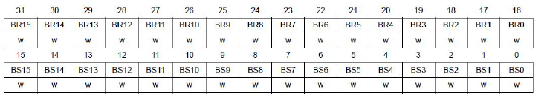
Bit Set/Reset Register
The STM32 Family GPIO ports have an additional register that make turning a pin (or more) on
and off easier.
This register allows the program to set or reset a bit or bits of the register by a single write instruction. See the GPIOx_BSRR (GPIO bit set/reset register).
Writing to the register only affects the pin(s) that the corresponding bit(s) in the value written is (are) ‘1’. This makes it easier to turn on or off a single pin or a few pins without affecting the other pins.
The lower 16 bits (D15-D0) of GPIOx_BSRR register turns on (set) a bit and the upper 16 bits (D31-D16) turns off (reset)

Slide 25
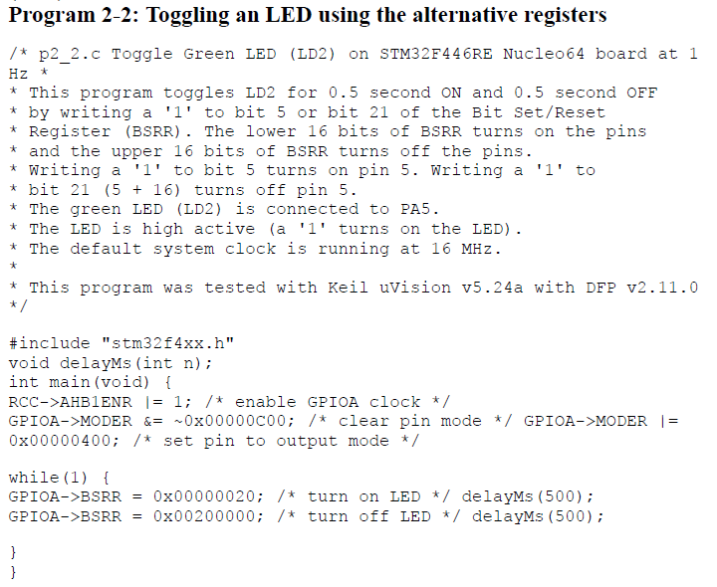

Slide 26
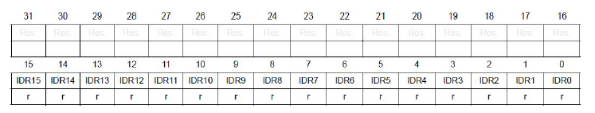
Input Data
Reading the GPIOx_IDR (GPIO input data) register will return the status of the port pins. If the pin is high, it returns a ‘1’ and if the pin is low, it returns a ‘0’.
Bits 31:16 Reserved, must be kept at reset value.
Bits 15:0 IDRy: Port input data (y = 0..15)
These bits are read-only and can be accessed in word mode only. They contain the input value of the corresponding I/O port

Slide 27
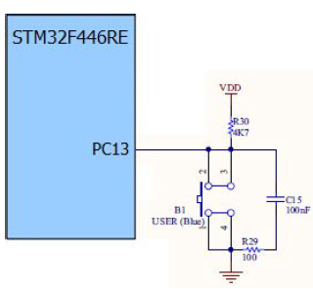
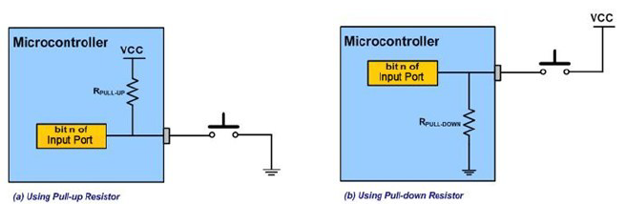
Reading a switch in STM Arm

Slide 28
I/O Port registers in STM Arm
Each of the GPIO ports has four 32-bit memory-mapped control registers (GPIOx_MODER, GPIOx_OTYPER, GPIOx_OSPEEDR, GPIOx_PUPDR) to configure up to 16 I/Os. The GPIOx_MODER register is used to select the I/O mode (input, output, AF, analog).
The GPIOx_OTYPER and GPIOx_OSPEEDR registers are used to select the output type (push-pull or open-drain) and speed. The GPIOx_PUPDR register is used to select the pull-up/pull-down whatever the I/O direction.

Slide 29
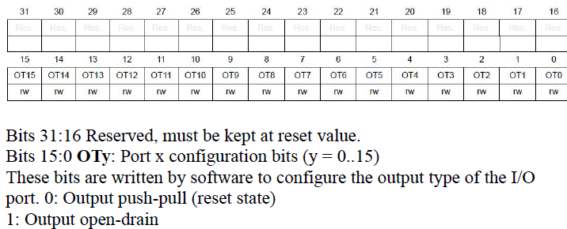
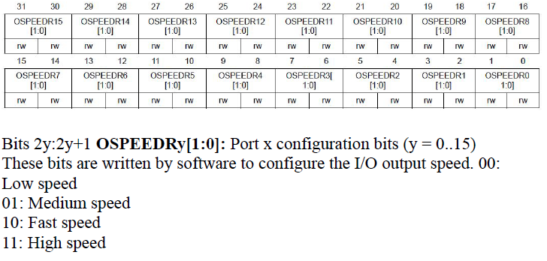
Oty and OSPEEDRy registers

Slide 30
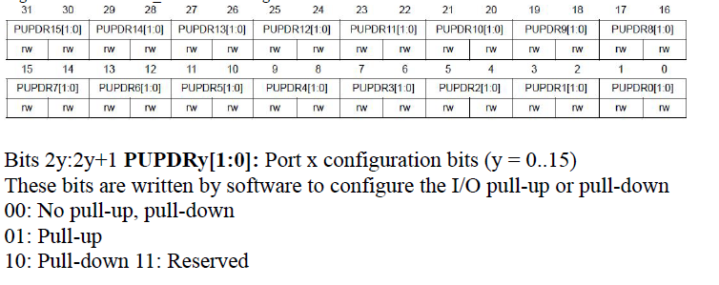
PUPDRy Register

Slide 31
Example
Write the statements to configure Port A0 as an input pin with pull-up
resistor.
Solution:
GPIOA->MODER &= ~0x00000003;
/* clear pin mode bits to input mode
for PA0 */
GPIOA->PUPDR &= ~0x00000003;
/* clear pull-up/pull-down bits for PA0
*/
GPIOA->PUPDR |= 0x00000001;
/* set pull-up for PA0 */

Slide 32
Step to read the switch
To read a switch and display it on an LED, the following steps must be
taken.
1) Make pin PA5 as output in MODER register for the LD2,
2) configure PC13 as input,
3) read switch from PC13,
4) if PC13 is high, set PA5 high to turn on the LED,
5) else clear PA5 low to turn off the LED
6) Repeat steps 3 to 5.

Slide 33
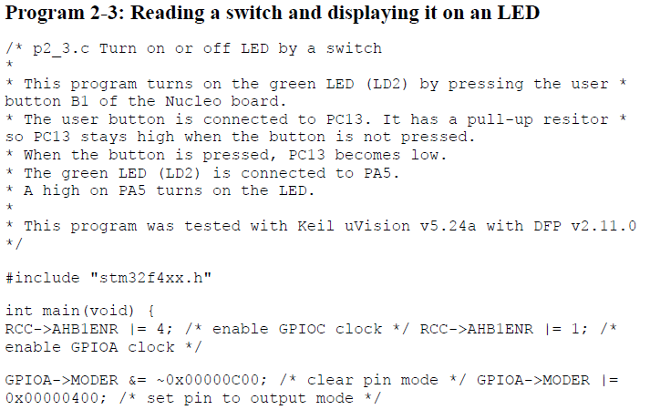
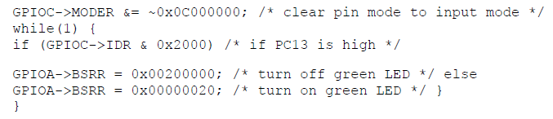

Slide 34
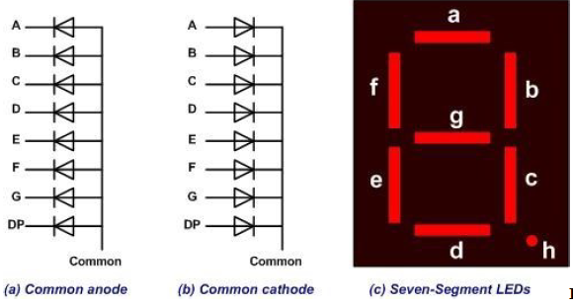
Seven-segment LED interfacing and programming
A popular numeric display is a seven-segment LED. The 7-seg LED can have a common anode or a common cathode.
The seven segments of LED are designated as a, b, c, d, e, f, and g

Slide 35
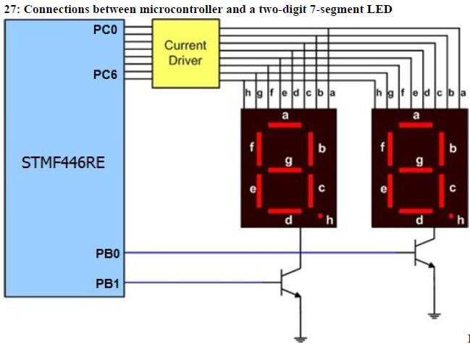

Slide 36
Step to display on 7 Segment
The two digits are turned on alternatively. For example, if we want to display number 75 on the 7-seg LED, the following steps should be used:
1) Configure Port C as output port to drive the segments,
2) Configure PortB0-1 as output port to select the digits,
3) Write the pattern of numeral 7 from Table 2-7 to Port C,
4) Turn on the select pin to HIGH to activate the tens digit,
5) Delay for some time,
6) Write the pattern of numeral 5 from Table 2-7 to Port C,
7) Turn on the select pin to HIGH to activate the ones digit,
8) Delay for some time,
9) Repeat from step 3 to 8.

Slide 37
