Slide 1
Week 15
STM 32 Serial Communication

Slide 2
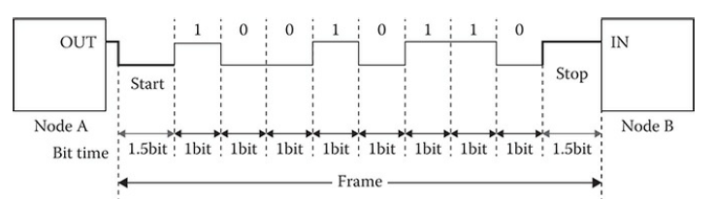
UARTS
Block diagram showing two UARTs connected, where Node A is transmitting to Node B.
The digital pulse train between the nodes is composed of one start bit,eight data bits, and one stop bit.
These bits all together are considered to be a
single frame.
The receiving node must detect the start bit in order to determine when the frame starts.

Slide 3
UARTS
The receiving node also has been configured to accept a predetermined number of data bits and whether or not there will be one or two stop bits.
UARTs can be set to send seven or eight data bits as well as one or two stop bits.
There is also a provision for sending an additional parity bit, which aids in detecting transmission error

Slide 4
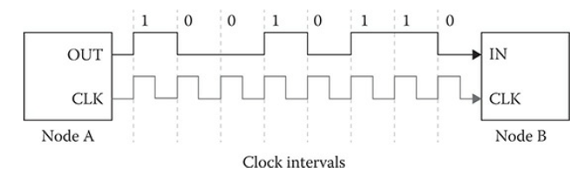
USART
The USART is a variant of the UART because an additional clock line can be used between nodes, as shown in Figure.
There is no need for start and stop bits to be used when two USART nodes are interconnected, as shown in Figure
The data bits are clearly synchronized to the clock pulses, which shortens the frame length and improves channel communication efficiency.

Slide 5
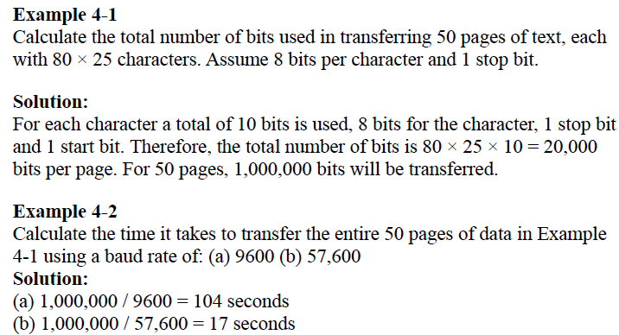

Slide 6
Register Name Register Function
USART_SR
USART_DR
USART_BRR
USART_CR1
USART_CR2
USART_CR3
Status Register
Data Register
Baud Rate Register, Control Register 1, Control Register 2, Control Register 3

Slide 7
Assume the clock source of 16 MHz is fed to USART Baud rate generator with oversampling rate of 16. Find the values for the USART_BRR register for baud rates of (a) 9,600, (b) 19,200, (c) 57,600, and (d)
115,200.
Solution:
USARTDIV = Fck / 16 x Baud
(a) 16MHz / 16 x 9,600 = 104.166. Now, 104 = 0x68 for upper 12-bits. For fraction part, 0.166 x 16 = 2.656 and we use 3 for the lower 4 bits. Therefore BRR = 0x0683
(b) 16MHz / 16 x 19,200 = 52.08. Now, 52 = 0x034 for upper 12-bits. For fraction part, 0.08 x 16 = 1.28 and we use 1 for lower 4-bits. Therefore BRR = 0x0341

Slide 8
(c) 16MHz / 16 x 57,600 = 17.36. Now, 17 = 0x011 for upper 12-bits. For fraction part, 0.36 x 16 = 5.76 and we use 6 for lower 4 bits. Therefore BRR = 0x0116
(d) 16MHz / 16 x 115,200 = 8.68. Now, 08 = 0x008 for upper 12-bits. For fraction part, 0.68 x 16 = 10.88 and we use 11 = 0xB for lower 4-bits.
Therefore BRR = 0x008B.
USART_BRR Register values for the different baud rate using oversampling of 16 with 16 MHz Clock frequency.

Slide 9
Program to sends the characters "YES" from the serial port at 9600 buadrate.

