Slide 1
Week 16
STM 32 Timer

Slide 2
What is a “timer”?
A TIMER is a circuit that enables the software to have the “knowledge of time”
It is basically a global variable (timer counter) that increments (or decrements) on the basis of a programmable clock source
The global variable (timer counter) can be read or written by the software
A timer can generate interrupts
A timer can be used by a slave circuit:
to generate particular periodic signals
to measure the period or pulse of input signals

Slide 3
Basics of timers
The hardware of TIMER is composed by three basic programmable parts:
The clock source, the circuit that generates the clock tick for the timer
The time base, the circuit that derive the time granularity from the clock source and contains the timer counter variable
The slave circuits, that provide additional functions (pulse measure, signal generation, etc.) by exploiting the timer variable

Slide 4
The Timers of the STM32 MCUs
STM32 MCUs offer up to 11 different timer/counters with the following features:
Clock selection (internal, external, other) 16/32-bit counter resolution Programmable prescaler
Four independent channels configurable as: Input Capture
Output Compare PWM Mode
One-pulse Output
Interrupt generation on the basis of the various events that can occur

Slide 5
The Software interface of Timers
Each timer has several special function registers
All of them are accessible by means of global variables called TIMx, where x is the number of the timer (TIM1, TIM2, ...)
The type of these variables is TIM TypeDef *,
i.e. pointers to a structure whose field are the SFR of the timer

Slide 6
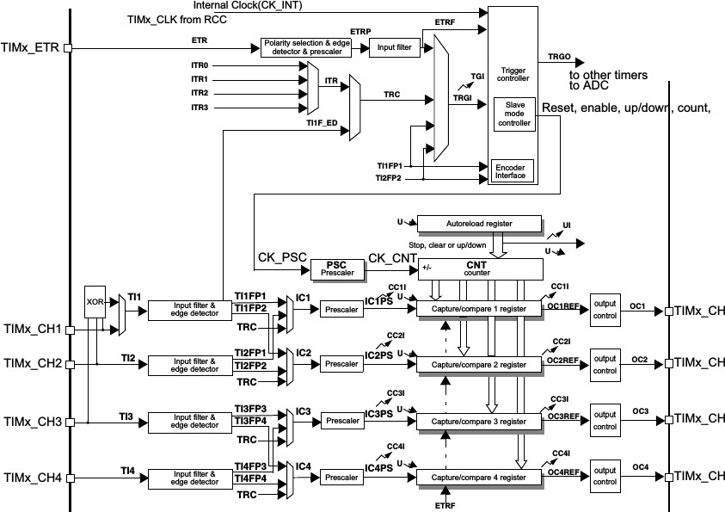
Block Schematics of the Timers

Slide 7
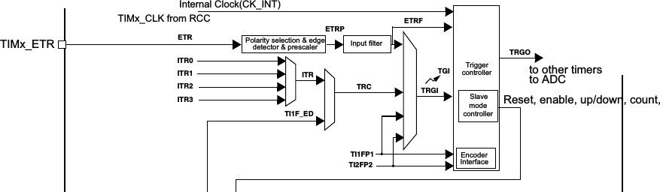
Timer Clock Source
Clock source can be:
Internal (System Peripheral Clock, default setting) External (External Pin)
External in QEI mode (Quadrature-encoder interface)
Several Gate/Trigger inputs can be configured in order to start/stop the clock on the basis of events

Slide 8
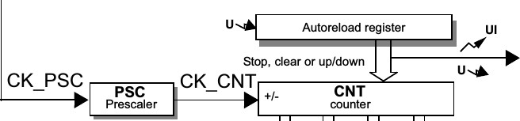
Time-Base Part
Counting is handled in the time-base by the following registers: TIMx->PSC: the prescaler register, it directly specified the division factor
TIMx->CNT: the counter register, it holds the counter value and increments (or decrements) according to the input clock
TIMx->ARR: the auto-reload register, CNT counts from 0 to ARR, then
CNT is set to 0 again
When CNT is reloaded an update event is generated (the “U” in figure), that can trigger interrupt generation

Slide 9
stm32 unict lib Functions for Timers
Note: Timer functions of stm32 unict lib currently support timers from TIM2 to TIM5 (but TIM5 is also used by the display)
Initialize a TIMER:
void TIM init(TIM TypeDef * timer);
Configure the timebase:
void TIM config timebase(TIM TypeDef * timer,
uint16 t prescaler, uint16 t autoreload);
Start a timer:
void TIM on(TIM TypeDef * timer);
Stop a timer:
void TIM off(TIM TypeDef * timer);

Slide 10
stm32 unict lib Functions for Timers
Read the counter:
int16 t TIM get(TIM TypeDef * timer);
Write the counter:
void TIM set(TIM TypeDef * timer, int16 t value);
Check if an update event occurred:
int TIM update check(TIM TypeDef * timer);
Clears the update event notification:
void TIM update clear(TIM TypeDef * timer);

Slide 11
Example: let’s flash a LED at 500 ms
Default clock source CK PSC is at 84 MHz (about 19 ns) We must derive a period of 500 ms
We could use a division factor of 84000 in order to have a clock count signal (CK CNT) at 1 ms, but the PSC register has only 16 bits...
Let’s used instead a division factor of 8400 in order to have a clock count signal (CK CNT) at 0.1 ms
So we must have 5000 counts in order to have a period of 500 ms

Slide 12
Example: let’s flash a LED at 500 ms
Let’s configure the timebase with prescaler=8400 and
autoreload=5000
Then poll the “update event”
When it occurs, toggle the led and clear the event

Slide 13
First Example: flashing using timer
,
#include "stm32_unict_lib.h"
int main()
{
// LED at PC3 GPIO_init(GPIOC);
GPIO_config_output(GPIOC, 3);
// init the timer TIM init(TIM2);
// Configure the timebase
// Counter clock set to 0.1 ms
TIM config timebase(TIM2, 8400, 5000);
TIM set(TIM2, 0); // resets the counter TIM on(TIM2); // starts the timer
// infinite loop for (;;) {
// check the update event
if (TIM update check(TIM2)) {
GPIO_toggle(GPIOC, 3);
// clear the update event TIM update clear(TIM2);
}
}
}
z r

Slide 14
Second Example: flashing controlled by button
,
#include "stm32_unict_lib.h"
int main()
{
int last_key_state, flashing = 0;
// LED at PC3 GPIO_init(GPIOC);
GPIO_config_output(GPIOC, 3);
// pushbutton X (PB10) GPIO_init(GPIOB);
GPIO_config_input(GPIOB, 10);
TIM_init(TIM2); // init the timer
// Configure the timebase, counter clock set to 0.1 ms TIM_config_timebase(TIM2, 8400, 5000);
TIM_set(TIM2, 0); // resets the counter
TIM_on(TIM2); // starts the timer
last_key_state = GPIO_read(GPIOB, 10); for (;;) {
int current_key_state = GPIO_read(GPIOB, 10);
if (last_key_state == 1 && current_key_state == 0) flashing = !flashing; last_key_state = current_key_state;
if (TIM_update_check(TIM2)) {
if (flashing) GPIO_toggle(GPIOC, 3); else GPIO_write(GPIOC,3, 0); TIM_update_clear(TIM2);
}
}
}
z r

