Slide 1

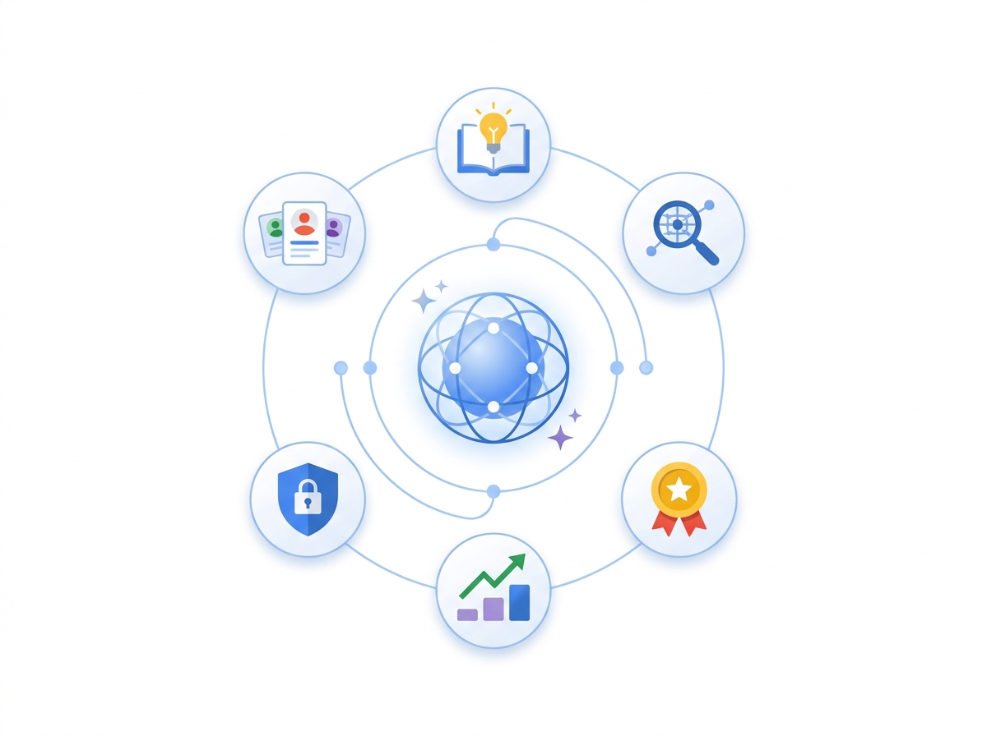





AMIT'S KEYNOTE (20–25 MIN) · GEMINI ENTERPRISE + CROSS-DOMAIN CXO
Future of Humans & Agents: CHRO & CXO Edition
Recent Gemini Enterprise breakthroughs meet real-world agentic workflows across HR, Finance, Public Sector & Operations — zero passive portals, named human authority.
Gemini Updates: MCP Tools, Agent2Agent (A2A) Mesh & Memory Bank
Cross-Domain Value: HR · Finance (CFO) · Public Sector · Operations
Workshop Bridge: No-Code Studio + Connectors + Custom MCP (PeopleStrong)
Mumbai · Nov 18, 2026 · 200+ Enterprise Chief Human Resources Officers (CHROs)
01 / 16
Notes:
Opening (20-25 min Keynote): Bridge Session 1's AI Workshop (No-Code + Enterprise Connectors + Custom MCP PeopleStrong) and Session 2's Human x AI vision into a cross-domain executive blueprint.

Slide 2






01 · GEMINI ENTERPRISE RECENT UPDATES & PROGRESS
What's New in Gemini Enterprise: Open Standards & Zero-Code Speed
Moving from isolated chat assistants to governed multi-agent collaboration across every enterprise system
Open Standards (MCP & A2A)
No-Code Agent Designer
Smart Model Tiering
Memory Bank & Armor
Standardized tool access & cross-vendor agent handoffs
HR & Finance teams compose workflow helpers in hours
Gemini Flash (<1s scale) + Gemini Pro (deep reasoning)
Persistent context + inline Model Armor & DLP guard
50+ Managed MCP Servers
Custom MCP (PeopleStrong)
Agent2Agent (A2A) Mesh
130+ Enterprise Connectors
Pre-built governed access to BigQuery, Storage & Workspace data.
Today's workshop pattern: secure two-way HRIS, ERP & custom API actions.
Agents across HR, Finance & CRM discover each other and delegate tasks.
Unified grounding across Workday, SAP, ServiceNow & SharePoint.
Deep Research & Canvas
Apigee MCP Governance
Persistent Memory Bank
Group-Scoped Publishing
Multi-step synthesis for board packs, policy reviews & workforce plans.
Curated, role-scoped tool bundles prevent noisy API overload.
Recalls org context, regional rules & prior approvals safely.
Deploy No-Code helpers across departments via Google Identity groups.
02 / 16
Notes:
Walk executives through Gemini Enterprise's recent progress: MCP for standardized data/tool connectivity, A2A for cross-vendor agent collaboration, Apigee for MCP governance, Memory Bank for persistent enterprise context, and No-Code Agent Designer.

Slide 3

02 · THE ZERO-UI ENTERPRISE SHIFT
Passive Portals End Here: Welcome to the Zero-UI Workplace
Why employees, finance analysts, and citizens reject another portal — AI must work inside daily tools
Goal-Driven Over Form-Driven
Employees stop clicking across HRIS, payroll, and leave tabs — they state a goal once in plain language.
Seamless Across Legacy Systems
Work flows quietly across recruiting, calendars, IT provisioning, and payroll without replacing existing HR tools.
Meet People Where They Work
24/7 natural conversations inside web, mobile, WhatsApp, and regional Indian languages.
Behavioral Shift: 800% year-over-year rise in conversational queries — your workforce already brings consumer expectations to HR.
03 / 16
Notes:
Draw from everyday life: just as consumers now delegate multi-step research and bookings to conversational assistants, employees will no longer tolerate five portals to change tax declarations or book interviews.

Slide 4

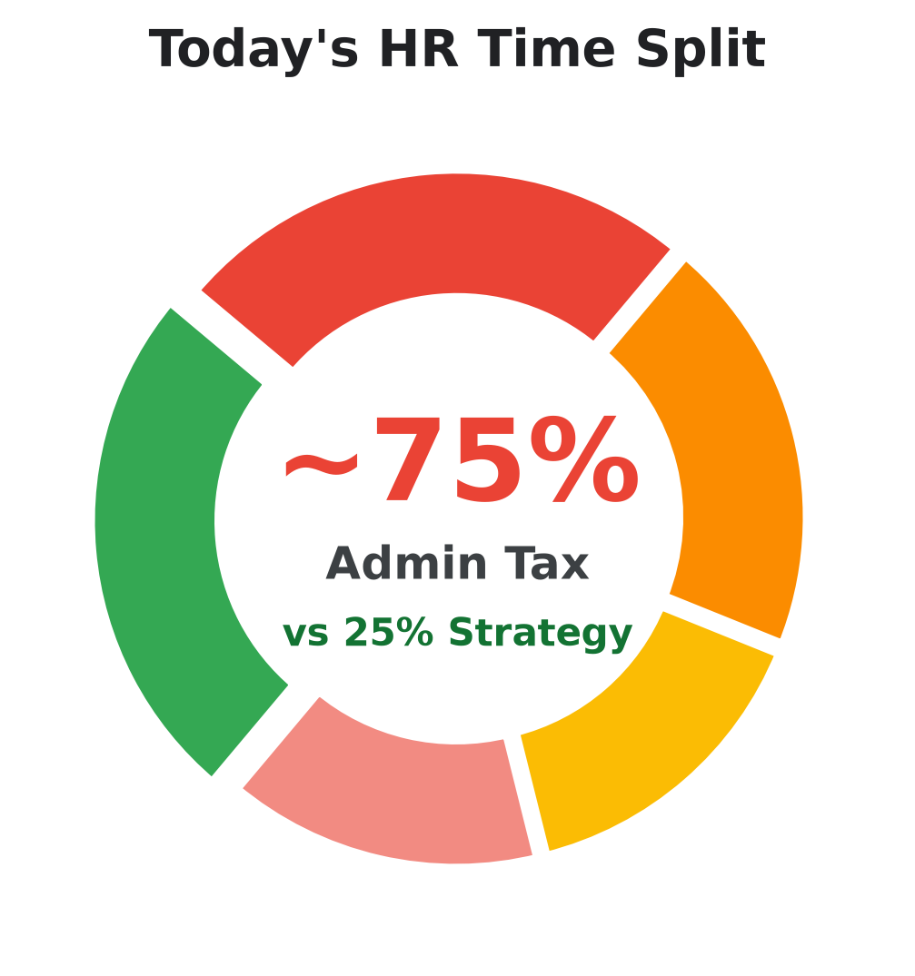
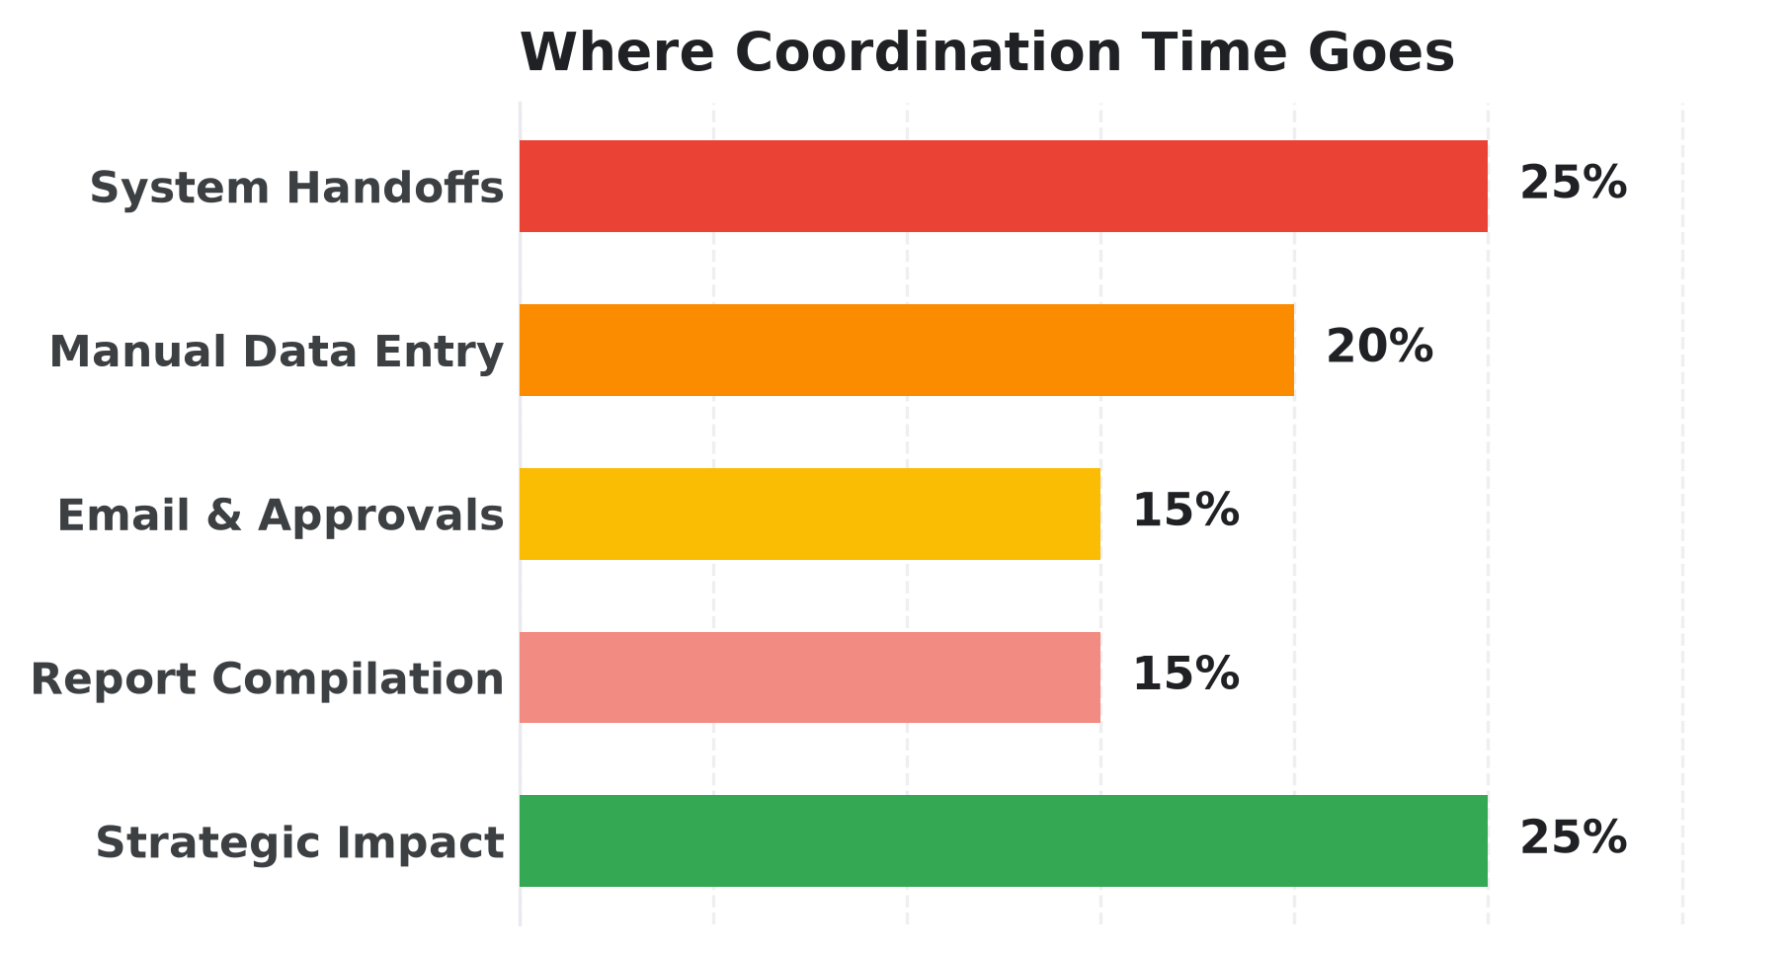
03 · THE ENTERPRISE COORDINATION PARADOX
The Enterprise Paradox: ~75% Coordination Tax vs. ~25% Strategy
Across HR, Finance, Public Sector & Ops, skilled professionals lose three-quarters of every week to manual handoffs
~75% ADMIN TAX
• 25% — Coordinating across HR, IT & hiring systems
• 20% — Manual data entry & spreadsheet validation
~25% STRATEGY
• 10% — Coaching & advising business leaders
• 8% — Strategic workforce & skills planning
Keynote Thesis: Agentic AI eliminates the ~75% administrative coordination tax — flipping HR from ticket handler to enterprise talent strategist.
04 / 16
Notes:
This benchmark resonates in every CHRO boardroom: HR does not suffer from a lack of strategic ambition — it suffers from an operating model that taxes 75% of human bandwidth on chasing forms and approvals.
Full Time-Allocation Details:
- Admin Tax: 25% — Coordinating across HR, IT & hiring systems; 20% — Manual data entry & spreadsheet validation; 15% — Chasing email approvals & follow-ups; 15% — Compiling quarterly slides & spreadsheets
- Strategic Value: 10% — Coaching & advising business leaders; 8% — Strategic workforce & skills planning; 7% — Culture, inclusion & employee experience

Slide 5



04 · FUTURE OF HUMANS & AGENTS (HUMAN × AI)
Future of Humans & Agents: Silicon Runs Routine, Leaders Own Judgment
AI absorbs scheduling, triage, and status chasing so people leaders double down on empathy and judgment
Decouple Growth From Admin Headcount
Handle 5x seasonal hiring surges and 50,000+ employee requests without burning out HR teams.
Elevate Empathy & Coaching
Return hours every day to leadership coaching, hard career conversations, and workplace belonging.
Humans Lead Every High-Stakes Call
AI prepares verified shortlists and salary options — people decide who is hired, promoted, or rewarded.
"When software handles forms and follow-ups, HR reclaims the Human Premium — trust, empathy, and strategic judgment."
05 / 16
Notes:
Turn AI anxiety into executive confidence: routine coordination drops to near zero while human judgment, ethical oversight, and high-trust coaching become your highest-value differentiator.

Slide 6


05 · CROSS-DOMAIN CXO USE CASES (BEYOND HR)
One Agentic Mesh Across 4 Domains: HR · Finance · Public Sector · Ops
Not limited to HR — the exact same Gemini Enterprise + MCP + HITL pattern scales across every CXO office
HR & CHRO · PEOPLESTRONG + CUSTOM MCP
40–50% Faster
FINANCE & CFO · SAP / ORACLE + BIGQUERY
Days -> Hours
Day-1 Onboarding & Blind Screening
Autonomous Close & Variance Intelligence
SCREENING & ONBOARDING
MONTH-END CLOSE
Systems: PeopleStrong · Workday · ServiceNow · Calendar
Systems: SAP S/4HANA · BigQuery · Sheets · Workspace
PII-masked skill shortlists, <1 hr panel scheduling, and automated Day-1 laptop, badge & 90-day buddy plans.
Continuous sub-ledger reconciliation, invoice anomaly detection, and CFO-approved board variance narratives.
PUBLIC SECTOR · CITIZEN & PERMIT SERVICES
24/7 Regional
OPERATIONS & COO · SUPPLY CHAIN TOWER
60–75% Deflect
Multilingual Grievance & Permit Concierge
Supply Disruption & Service Resolution
CITIZEN ACCESS
EXCEPTION TRIAGE
Systems: Citizen Portal · Sovereign Storage · Case CRM
Systems: ERP · Warehouse Mgmt · CRM · Supplier Portals
Voice/chat intake in regional languages, automatic case routing, and India DPDP-compliant citizen consent logs.
Detects shipment delays early, simulates alternate routing options, and escalates approved supplier recovery plans.
06 / 16
Notes:
Keynote Pivot Slide: Show CXOs in the room that while PeopleStrong Xponential highlights HR, the exact same Gemini Enterprise + Enterprise Connector + Custom MCP + A2A architecture solves CFO close, Public Sector citizen services, and COO supply chain disruptions.

Slide 7




06 · CHRO PILLARS & 25 BUSINESS FUNCTIONS
Six HR Pillars & Core Functions: Where Business Value Unlocks
Every operational HR function mapped cleanly from Requisition to Workforce Strategy — zero tech jargon
OFFICE OF THE CHRO · 6 PILLARS · 25 BUSINESS FUNCTIONS ACROSS HIRE-TO-RETIRE
01 · REQUISITION & SCREENING
02 · CANDIDATE HIRING
03 · ONBOARDING
Requisition & Screening
Candidate Hiring
Personalized Onboarding
40%–50% Less Screening
4 Days -> <1 Hr Scheduling
100% Day-1 Ready
Skills Extraction
Job Description Authoring
Panel Scheduling
Interview Readiness
Process Automation
New Hire Buddy
Application Processing
Fair Resume Screening
Feedback Aggregation
Offer Management
1-30-60-90 Journey
Day-1 Access Setup
04 · CONTINUOUS LEARNING & DEV
05 · PEOPLE OPS
06 · HR STRATEGY & REWARDS
Continuous Learning & Mobility
People Ops & Service
HR Strategy & Rewards
50 Pages -> 3 Min Reels
~70% Instant Deflection
<1–2% Unexplained Pay Gap
Personalized Training
Micro-Reel Creation
Employee Service Tickets
HR Policy Approvals
Compensation Analysis
Pay Benchmarking
Skill & Roleplay Drills
Career Pathing
Appraisal Synthesis
Burnout Case Triage
Workforce Composition
Hiring Projections
07 / 16
Notes:
Directly preserves the 6 HR Function Pillars and all 25 core business functions from Slide 17 — structured so CHROs immediately see which business KPI improves in every sub-function.

Slide 8

07 · HR VALUE UNLOCK (ATTRACT & HIRE)
Cut Agency Sourcing Tax & Shrink Interview Loops From 4 Days to <1 Hour
How Talent Acquisition captures Tier-2 and Tier-3 hubs without adding recruiting headcount
TALENT ACQUISITION PAYOFF: Reduce external recruiter spend, boost organic regional applications & stop losing finalists to scheduling delays
PILLAR 01 · REQUISITION & SCREENING
40%–50%
PILLAR 02 · CANDIDATE HIRING & SELECTION
4d -> <1h
Micro-Market Talent Magnet & Skill-First Triage
Zero-Touch Panel Scheduling & Calibrated Selection
LESS SCREENING EFFORT
INTERVIEW TURNAROUND
TODAY'S FRICTION
TODAY'S FRICTION
Over-reliance on external staffing agencies inflates sourcing costs while jargon-heavy JDs and 300+ CVs stall shortlists.
Exchanging dozens of emails across time zones takes ~4 days per round; noisy interviewer notes delay offers.
AI SOLUTION
AI SOLUTION
Localized outreach across Tier-2/3 hubs, skill-based role templates in minutes, 24/7 Candidate Q&A, and blind skill triage.
Autonomous calendar negotiation across candidate & panel, role rubrics, objective scorecard synthesis, and band-checked offers.
BUSINESS OUTCOME
BUSINESS OUTCOME
Lower agency dependency, broader diverse reach, and faster quality shortlists.
Minimal candidate drop-off, fair interview calibration, and faster close rates.
08 / 16
Notes:
Connects Requisition & Screening plus Candidate Hiring directly to revenue protection: winning scarce talent days before competitors even confirm interview slots.

Slide 9
08 · CROSS-DOMAIN VALUE: CFO FINANCE & PUBLIC SECTOR
Beyond HR: Autonomous Finance Close & 24/7 Citizen Service Delivery
Same governed Gemini Enterprise foundation — zero black-box decisions, full human audit trail
CROSS-DOMAIN REUSE: One governed MCP + A2A backbone powers Finance (CFO) and Public Sector agencies cleanly
FINANCE / CFO · RECORD-TO-REPORT
Days -> Hrs
PUBLIC SECTOR · CITIZEN GRIEVANCE & PERMITS
24/7 Voice
Autonomous Month-End Close & Cash Forecasting
Multilingual Citizen Triage & Case Resolution
RECONCILIATION CYCLE
REGIONAL DIALECTS
TODAY'S FRICTION
TODAY'S FRICTION
Finance teams manually chase inter-company mismatches, vendor invoices & spreadsheet sign-offs every close cycle.
Citizens face fragmented forms and language barriers while case officers drown in duplicate status inquiries.
AI SOLUTION
AI SOLUTION
Enterprise connectors pull ERP & bank feeds into BigQuery; Gemini Pro explains variances with clause-level citations.
Multilingual Gemini intake verifies eligibility via sovereign MCP connectors and drafts officer case briefs.
BUSINESS OUTCOME
BUSINESS OUTCOME
Faster board reporting, zero unlogged journal edits, and proactive working-capital foresight.
Instant citizen clarity, sovereign data residency, and faster resolution SLAs with officer sign-off.
09 / 16
Notes:
Compare Finance (CFO) and Public Sector side-by-side using the same Today's Friction -> AI Solution -> Business Outcome structure.

Slide 10

09 · LIVE WORKSHOP BRIDGE (NO-CODE + CONNECTORS + CUSTOM MCP)
From Workshop Demo to Enterprise Collaboration: 1 End-to-End Flow
How Session 1's No-Code Agent + Enterprise Connectors + Custom MCP (PeopleStrong) executes a real workflow
01
02
03
04
05
Plain Request
Enterprise Data
Custom MCP
A2A Handoff
Human Gate
Zero-UI
130+
2-Way
Multi-Agent
100% HITL
CHAT OR VOICE
CONNECTORS
PEOPLESTRONG API
HR + IT + FIN
NAMED SIGN-OFF
Manager or citizen triggers request inside Chat or Workspace.
Reads policies, ERP & BigQuery context with role permissions.
Executes live schema-checked reads & staged updates securely.
Coordinates IT tickets, calendar panels & budget checks.
Presents cited brief for one-click executive approval & audit.
10 / 16
Notes:
Connects directly to Session 1 (AI Workshop): shows how a No-Code agent collaborates across Enterprise Connectors and Custom MCP (PeopleStrong) to complete one end-to-end cross-domain workflow.

Slide 11
10 · AGENT PORTFOLIO MIND MAP (PART 1 OF 2)
Talent & Day-1 Mind Map: 3 Pillars · 7 Solutions · Personas Served
Every capability stays anchored to an HR Pillar and the exact People Personas it serves — zero isolated bots
01 · REQUISITION & SCREENING
Job Description Harmonizer
HR Studio
Talent Magnet
HR Studio
Blind Screening
Connected
Requisition & Screening
👤 Hiring Manager
👤 Talent Acquisition (TA) Partner
👤 Compensation & Job Architecture Lead
👤 Employer Brand Lead
👤 Talent Sourcing Specialist
👤 Prospective Candidate
👤 Technical Recruiter
👤 Hiring Panel Chair
👤 Compliance & Equal Opportunity Auditor
MIND MAP · PART 1 OF 2
Talent & Day-1 Pillars
02 · CANDIDATE HIRING
Interview Scheduler
HR Studio
Interview & Offer Coach
Connected
Pillars 01–03 · 7 Agents
Candidate Hiring
👤 Recruiting Coordinator
👤 Interview Panelist
👤 Hiring Manager
👤 Talent Acquisition (TA) Lead
👤 Compensation Partner
👤 Hiring Executive
SOLUTION TYPE
03 · ONBOARDING
Onboarding Buddy
HR Studio
Day-1 Provisioning
Connected
HR Team Studio
Personalized Onboarding
👤 New Joiner
👤 Onboarding Manager
👤 Assigned Peer Buddy
👤 HR Operations Specialist
👤 IT Service Desk
👤 Facilities & Security Lead
Cross-System Sync
11 / 16
Notes:
Show briefly on stage: Pillars 01–03 map cleanly to 7 specialized solutions and their exact personas — Recruiting Leads, Hiring Managers, Interview Panels, Candidates, and New Hires.
Executive Q&A Agent Contracts:
- Job Description Harmonizer (No-Code): Trigger: Hiring Manager enters rough bullet points for a new opening | Reads: Corporate Competency Matrix (Drive), Grade & Compensation Band Table | Writes: Draft Requisition in Google Docs, Ready-to-Post Template for Applicant Tracking System (ATS) | Human Gate: Hiring Manager and Talent Acquisition Partner review salary band and click Post in the ATS.
- Talent Magnet (Low-Code): Trigger: Recruiting Lead launches hiring in an emerging city or answers candidate questions | Reads: Public University & Labor Signals, Verified Careers & Benefits Repository | Writes: Localized Social / Short-Video Campaign Drafts, Careers Site Candidate Concierge Chat | Human Gate: Employer Brand Lead approves every external campaign script before social publishing.
- Blind Screening (High-Code): Trigger: Talent Acquisition Partner uploads incoming resume batch for an open requisition | Reads: PeopleStrong / Workday ATS Resume Queue, BigQuery Role Skill Rubrics | Writes: Recruiter Human-in-the-Loop (HITL) Review Queue, Fairness Audit Log in BigQuery | Human Gate: Zero autonomous rejections: Recruiter inspects borderline candidates and clicks Advance or Decline.
- Interview Scheduler (No-Code): Trigger: Recruiter marks candidates as shortlisted for multi-round interviews | Reads: Google Calendar Free/Busy Metadata, Interviewer Calibration Pool & Load Caps | Writes: Google Calendar & Google Meet Invites, Calibrated Interview Prep Emails to Panelists | Human Gate: Recruiter or candidate can reschedule or swap any proposed slot with one click.
- Interview & Offer Coach (High-Code): Trigger: Final interview panel submits all completed round scorecards | Reads: ATS Interview Scorecards, Restricted Compensation Equity Band Table | Writes: Compensation Partner & Hiring Manager Approval Queue | Human Gate: Strict Human Gate: No binding offer ever leaves the system without named Compensation & Hiring Manager sign-off.
- Onboarding Buddy (No-Code): Trigger: Candidate signs offer letter or New Joiner asks a Day 1–90 question | Reads: Role & Location Playbooks (Drive / OKF), Assigned Manager & Peer Buddy Directory | Writes: Personalized Joiner Chat Hub, Google Calendar Milestone Reminders | Human Gate: Escalates any personal, visa, or payroll anomaly directly to HR Operations Specialists.
- Day-1 Provisioning (High-Code): Trigger: Offer signed event fires (7–14 days before Day 1) or morning Day-1 readiness audit | Reads: PeopleStrong / Workday HCM (FastMCP), ServiceNow IT & Facilities Tickets (FastMCP) | Writes: Worker Record in HCM, ServiceNow Provisioning Tickets | Human Gate: Refuses unapproved elevated admin access requests; IT/Security approves exception tickets manually.

Slide 12
11 · AGENT PORTFOLIO MIND MAP (PART 2 OF 2)
Growth, Ops & Strategy Mind Map: 3 Pillars · 7 Solutions · Personas Served
Empowering Frontline Teams, Learning Leads, HR Business Partners, Total Rewards & the CHRO
04 · CONTINUOUS LEARNING & DEV
Micro-Learning Studio
HR Studio
Career Saathi
Connected
Continuous Learning & Mobility
👤 Learning & Development (L&D) Designer
👤 Compliance & Legal Officer
👤 Frontline Branch / Plant Associate
👤 Mid-Career Employee
👤 Frontline People Manager
👤 Talent Mobility Partner
MIND MAP · PART 2 OF 2
Growth, Ops & Strategy
05 · PEOPLE OPS
Policy Pilot
HR Studio
HR Concierge
Connected
Employee Pulse
Connected
Pillars 04–06 · 7 Agents
People Ops & Service
👤 All Employees
👤 Line Managers
👤 Regional HR Business Partner (HRBP)
👤 Every Employee
👤 HR Operations Team
👤 Payroll & Benefits Administrator
👤 HR Business Partner (HRBP)
👤 Chief Wellbeing Officer
👤 Department Head
SOLUTION TYPE
06 · HR STRATEGY & REWARDS
Workforce Planner
Connected
Pay Equity & Rewards
Connected
HR Team Studio
HR Strategy & Rewards
👤 Chief Human Resources Officer (CHRO)
👤 VP HR Strategy & Workforce Planning
👤 Chief Financial Officer (CFO) Business Partner
👤 Total Rewards Director
👤 Compensation & Benefits Analyst
👤 Executive Calibration Committee
Cross-System Sync
12 / 16
Notes:
Complete the 14-agent portfolio in one glance: Career Saathi, Micro-Learning Reels, HR Concierge, Burnout Pulse, and Strategic Workforce & Total Rewards Equity.
Executive Q&A Agent Contracts:
- Micro-Learning Studio (No-Code): Trigger: Compliance or Learning & Development (L&D) uploads a new regulatory circular or SOP | Reads: Verified Compliance Circulars & Standard Operating Procedures (SOPs) | Writes: LMS Micro-Learning Modules & SCORM Packs, Frontline Mobile FAQ Library | Human Gate: Compliance & Legal Officer approves final scripts before publishing to frontline associates.
- Career Saathi (High-Code): Trigger: Employee explores next career step or launches a practice coaching session | Reads: Enterprise Skill Graph (Spanner / BigQuery), Open Internal Job Requisitions | Writes: Private Employee Learning Progress Memory Bank, Suggested Internal Mobility Matches | Human Gate: Psychological safety lock: practice simulations stay 100% private to the employee and are never fed into appraisals.
- Policy Pilot (No-Code): Trigger: Employee or Manager asks a leave, travel, expense, or statutory policy question | Reads: Verified OKF Policy Repository (Read-Only) | Writes: Read-Only Advisory Answer in Chat (Zero HRIS Writes) | Human Gate: Never invents exceptions or waives policy; directs edge-case exception requests to Regional HRBP.
- HR Concierge (High-Code): Trigger: Employee requests a live HR transaction (leave, tax form, payroll ticket) in Chat or Portal | Reads: PeopleStrong / Workday HCM (FastMCP), Regional Holiday & Payroll Tables | Writes: HCM Leave / Request Transaction (After Click), ServiceNow HR Specialist Escalation Ticket | Human Gate: Two-step confirmation required before every system write; sensitive disputes go straight to an HR specialist.
- Employee Pulse (High-Code): Trigger: Scheduled weekly wellbeing scan or Quarterly Engagement Survey ingestion | Reads: Anonymized Pulse Survey Vault (BigQuery), Aggregated HR Support Categories | Writes: HR Business Partner Early-Care Briefings | Human Gate: Hard architectural ban on individual tracking, chat snooping, or punitive scoring; HRBP decides supportive outreach.
- Workforce Planner (High-Code): Trigger: Quarterly board prep or CHRO/CFO scenario planning request | Reads: BigQuery Workforce & Cost Warehouse, Career Saathi Skill Yield | Writes: CHRO & CFO Executive Scenario Briefs, Headcount Planning Dashboard | Human Gate: Assumptions and hiring budget envelopes stay transparent and require CHRO + CFO joint approval.
- Pay Equity & Rewards (High-Code): Trigger: Mid-year equity audit or Annual Compensation & Performance Calibration cycle | Reads: Restricted BigQuery Compensation Vault (Cloud DLP Masked), Peer & Manager Appraisals | Writes: Executive Calibration Committee Approval Portal (Draft Only) | Human Gate: Mandatory Human-in-the-Loop executive sign-off before any compensation, bonus, or promotion record changes.

Slide 13
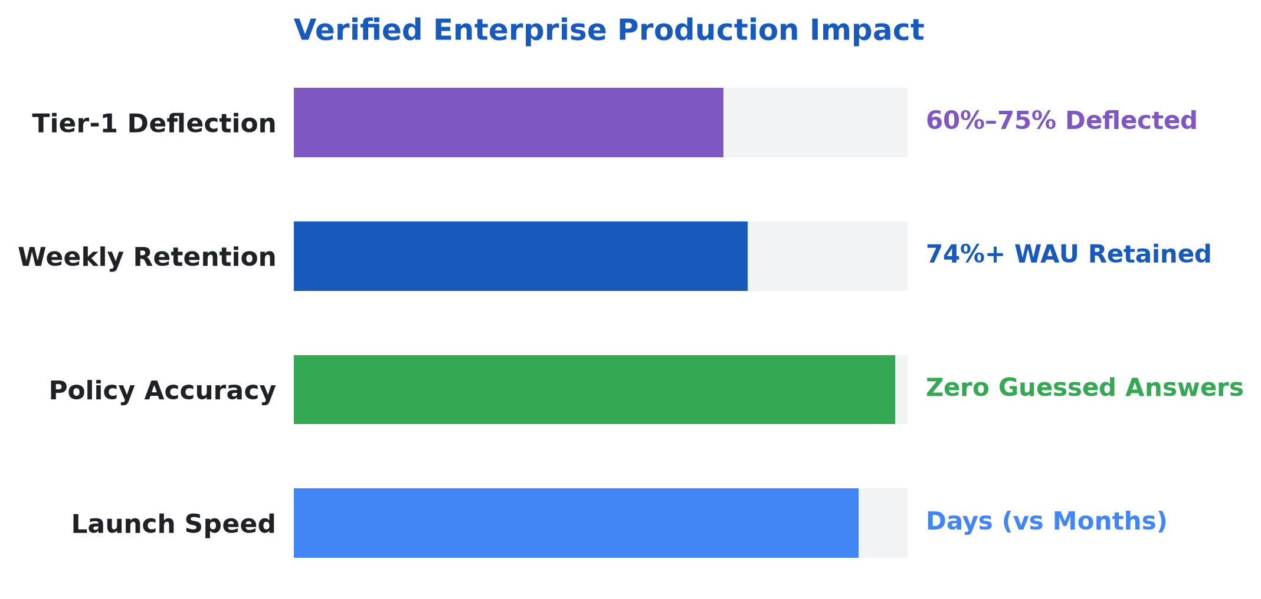
12 · ENTERPRISE PRODUCTION PROOF
Production Benchmark Today: 400+ Live Agents · 74%+ Retention
Anonymized production learnings from deploying grounded Human Resources micro-agents in a large Indian diversified enterprise.
400+
74%+
4 Live
Zero
Enterprise Agents Built Across Functions
Weekly Active User Retention
No-Code HR Production Assistants
Silently Guessed Policy Answers
Policy Pilot
JD Harmonizer
Answers leave & policy questions from verified circulars.
Unifies hiring drafts into unbiased, skill-first roles.
Onboarding Navigator
FAQ Generator
Guides Day-1 readiness tasks and policy checklists.
Turns 50-page circulars into instant searchable answers.
13 / 16
Notes:
Ground the vision in reality: over 400 production agents live across an Indian enterprise with 74%+ ongoing monthly retention and 30% faster leadership decisions.
Learnings:
- Right-Size Agent Granularity: Focused micro-agents per HR task outperform broad monolithic chatbots in accuracy and maintainability.
- Model Tiering for Latency & Cost: Route fast Tier-1 policy lookups through Gemini Flash while reserving Gemini Pro reasoning for multi-step synthesis and calibration.
- Enterprise Network & Proxy Bridging: Secure connectors and Model Context Protocol (MCP) bridges handle corporate proxies and on-premise HR databases cleanly.

Slide 14
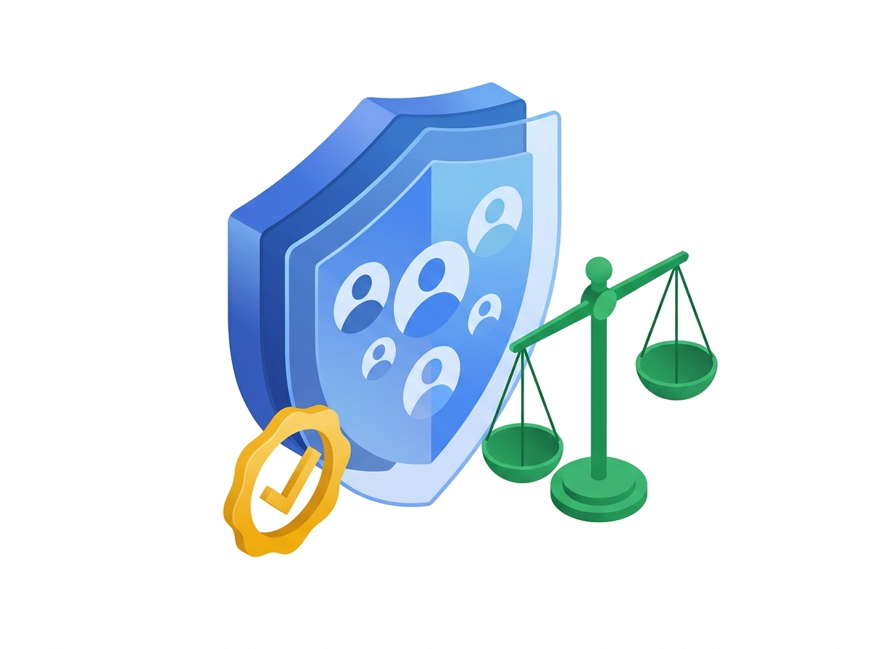
13 · TRUST, FAIRNESS & INDIA DPDP COMPLIANCE
Why CHROs, CFOs & Public Leaders Trust This System by Design
Bias safeguards, employee privacy, regional consent, and named human sign-off embedded into every workflow
Skill-First Blind Evaluation
India DPDP Act Aligned
Candidate names, age, gender, and home pins are automatically hidden during early shortlisting with ongoing fairness checks.
Purpose-bound employee consent records, Indian data residency, and automatic deletion when retention windows close.
Privacy-Safe Well-Being Pulse
Human Final Authority Always
Burnout alerts aggregate strictly at team sizes of 10 or more so HR supports teams early without exposing individuals.
Every offer letter, compensation adjustment, promotion, and disciplinary record requires an explicit human sign-off.
14 / 16
Notes:
Reassure Legal, Risk, and CHROs in plain business terms: fairness, privacy, and human accountability come first — never black-box automated people decisions.

Slide 15
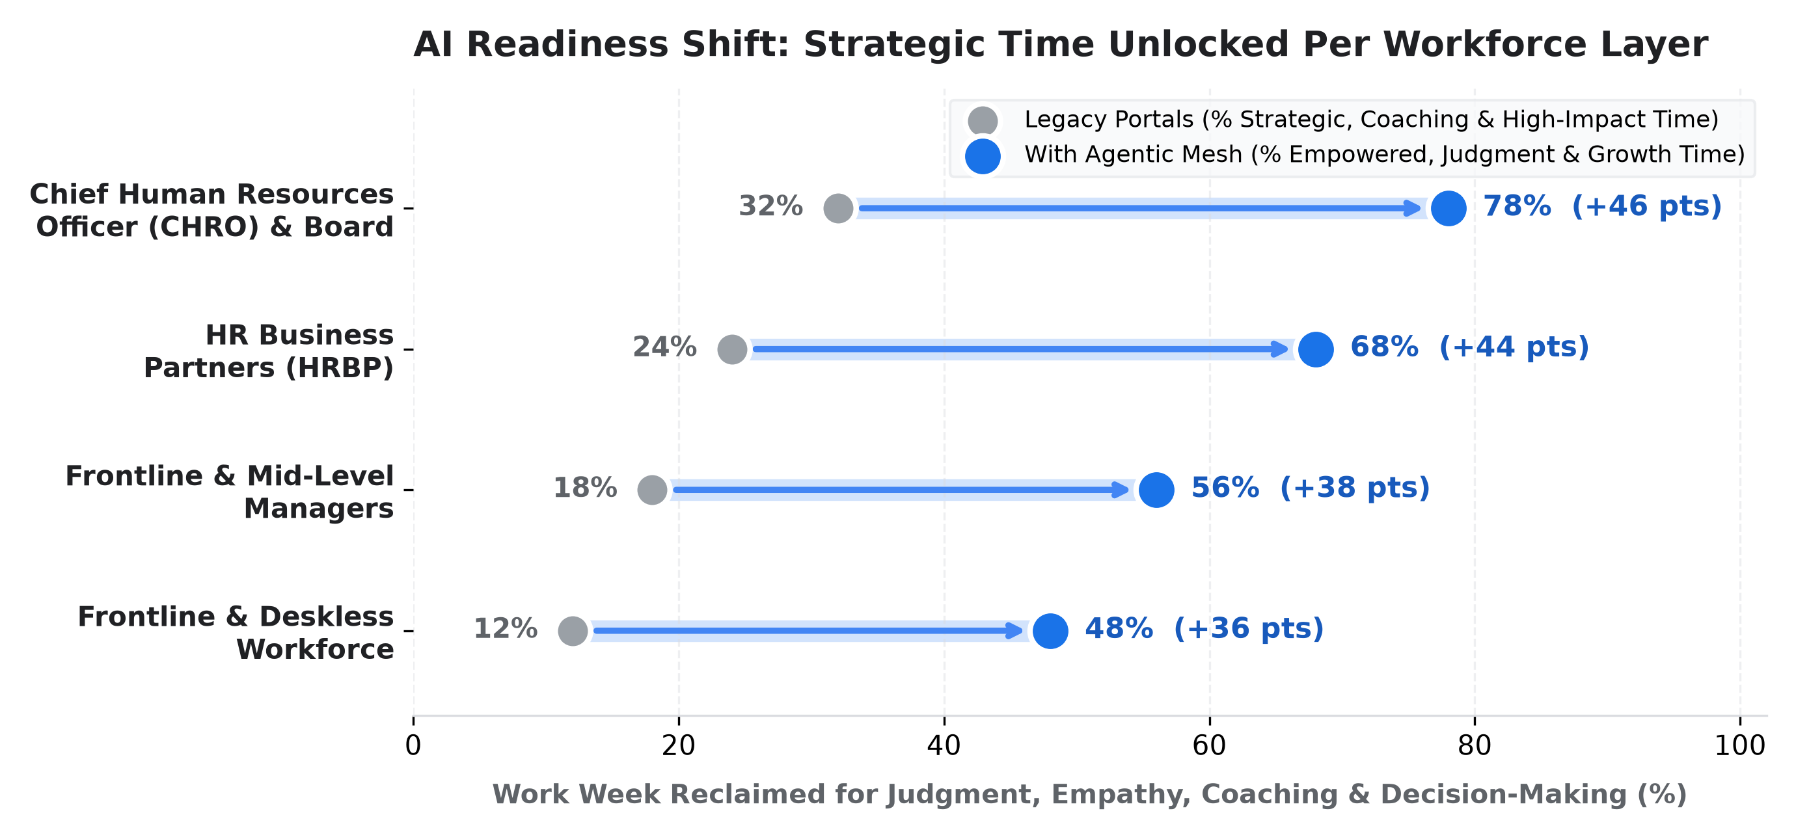
14 · ORGANIZATIONAL AI READINESS
No Workforce Left Behind: Unlocking Strategic Time at Every Tier
How ambient support lifts strategic capacity across CHROs, HRBPs, People Managers & Frontline Associates
Chief Human Resources Officer (CHRO)
32% -> 78% Strategic
Scenarios skills, attrition & pay equity live instead of waiting weeks for spreadsheet packs.
HR Business Partner (HRBP)
24% -> 68% Coaching
Trades ticket escalations for talent calibration, leader coaching & proactive care.
People & Hiring Managers
18% -> 56% Mentoring
Eliminates panel scheduling ping-pong and speeds up structured hiring & growth reviews.
Frontline Associates
15% -> 48% Learning
Uses 3-minute regional Career Saathi reels & instant policy answers in daily work.
15 / 16
Notes:
Point to every row on the chart: transformation succeeds because it unlocks meaningful time at every tier of the organization, from the boardroom down to regional branches.

Slide 16
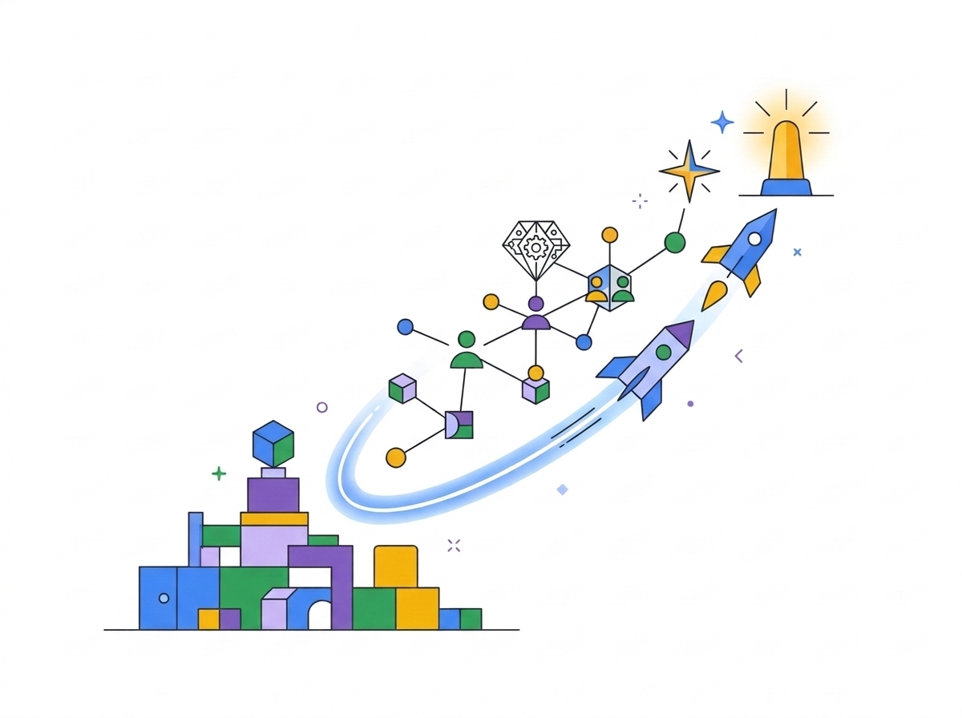
15 · FOUR ADOPTION PILLARS & 90-DAY CXO LAUNCH
Four Proven Adoption Pillars & Your 90-Day Launch Plan
What separates stalled pilots from enterprise-wide HR transformation — start cleanly on Monday morning
01 · Cross-Functional Governance
02 · Track Adoption Closely
Align HR, Legal & IT upfront on privacy, fairness & policy rules.
Spot usage gaps by region or cohort and tailor enablement early.
03 · Redesign Process First
04 · Invest in Upskilling
Simplify bloated approval chains before automating to multiply gains.
Deliver role-based hands-on fluency for HR teams & people managers.
01
Days 1–30 · Quick Win Pilot
Launch HR Policy Concierge & Day-1 Onboarding Buddy (~60% faster answers).
02
Days 31–60 · Frictionless Hiring
Activate Skill-First Blind Screening & <1 Hr Interview Scheduling.
03
Days 61–90 · Career Saathi & Clarity
Scale 3-Min Career Saathi reels, Burnout Pulse & CHRO Workforce Radar.
16 / 16
Notes:
Bring together the 4 Enterprise Adoption Pillars with a decisive 90-day Monday Morning sequence: start narrow with verified policies in 30 days, unlock hiring velocity at 60 days, and compound internal mobility by Day 90.

