Slide 1
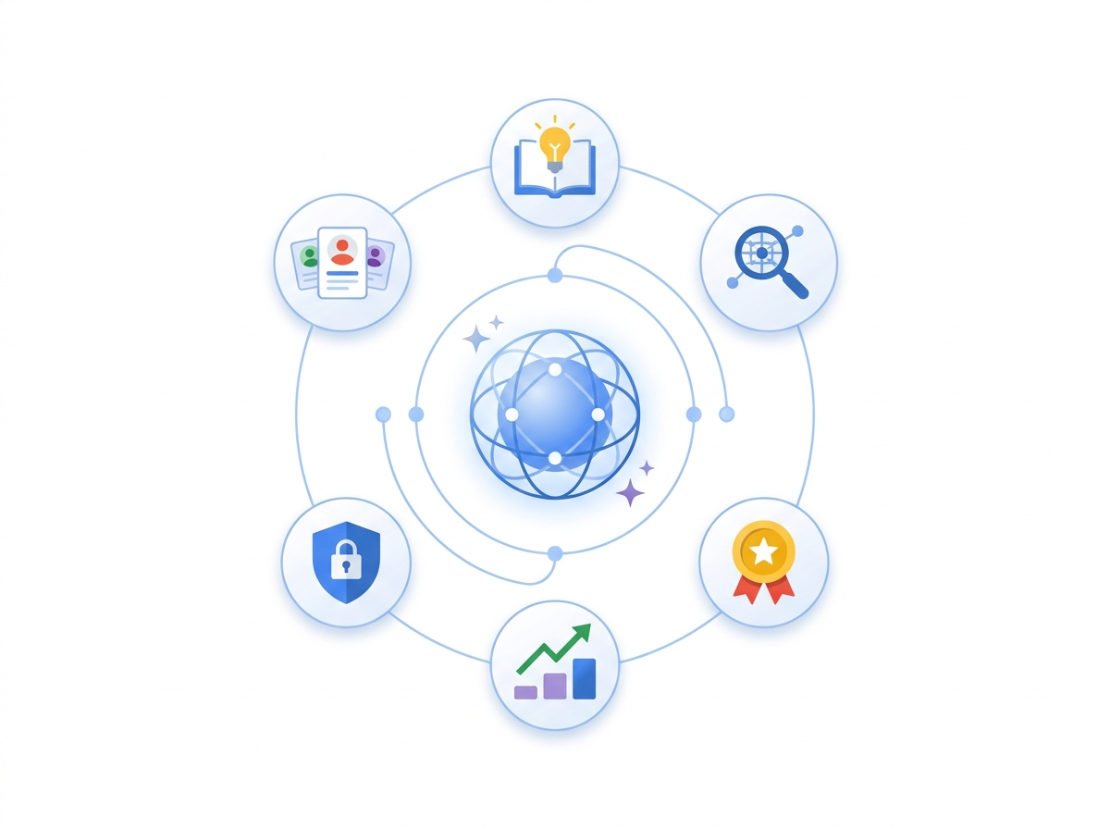



PEOPLESTRONG XPONENTIAL 2026 · EXECUTIVE KEYNOTE
Agentic for The People
Reshaping the Hire-to-Retire Operating Model with Gemini Enterprise
Audience: 200+ Chief Human Resources Officers
Thesis: Dissolve the ~75% HR Coordination Tax
Portfolio: 6 HR Pillars · 14 Process Agents
Mumbai · Nov 18, 2026 · 200+ Enterprise Chief Human Resources Officers (CHROs)
Notes:
Open by framing PeopleStrong Xponential as an operating model inflection point for every CHRO in the room, not another SaaS feature showcase.

Slide 2

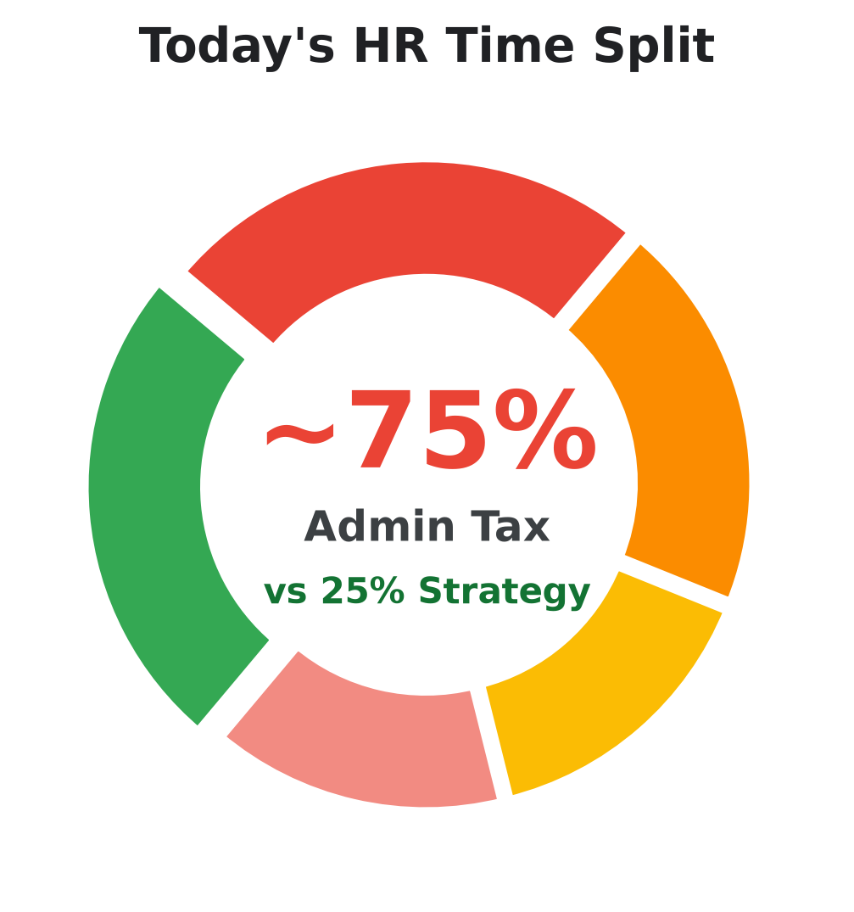
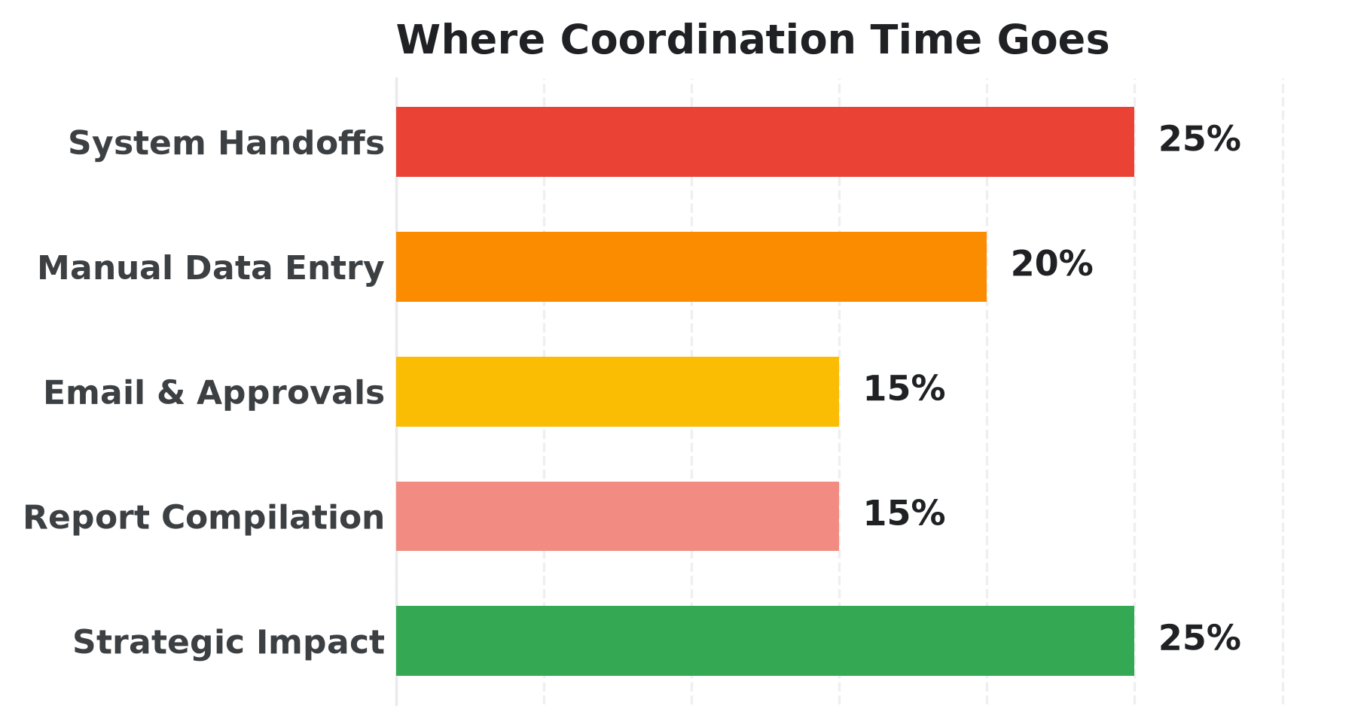

THE HR PARADOX (INDUSTRY BENCHMARK)
HR Exists to Be Strategic — Yet Runs Operational
Where HR capacity goes is an operating-model bottleneck, not a talent gap.
~75% ADMIN TAX
• 25% — Disconnected system handoffs
• 20% — Manual entry & tracking
~25% STRATEGY
• 10% — Leadership & manager coaching
• 8% — Workforce & succession strategy
Keynote Thesis: Agentic AI eliminates the ~75% administrative coordination tax — flipping HR from ticket handler to enterprise talent strategist.
Gemini Enterprise · Office of the Chief Human Resources Officer (CHRO) Transformation
02 / 20
Notes:
Pause on the 75/25 split: ask the CHROs how many hours their HRBPs spent stitching spreadsheets this week instead of coaching leaders.
Full Time-Allocation Details:
- Admin Tax: 25% — Disconnected system handoffs; 20% — Manual entry & tracking; 15% — Email & calendar ping-pong; 15% — Boardroom report prep
- Strategic Value: 10% — Leadership & manager coaching; 8% — Workforce & succession strategy; 7% — Culture, listening & retention

Slide 3
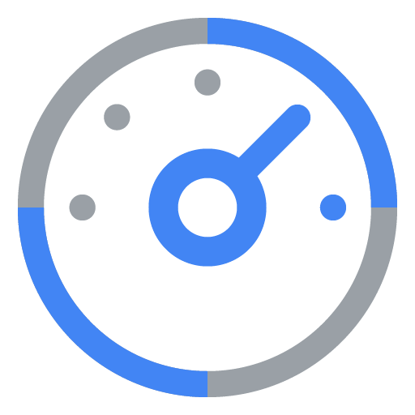
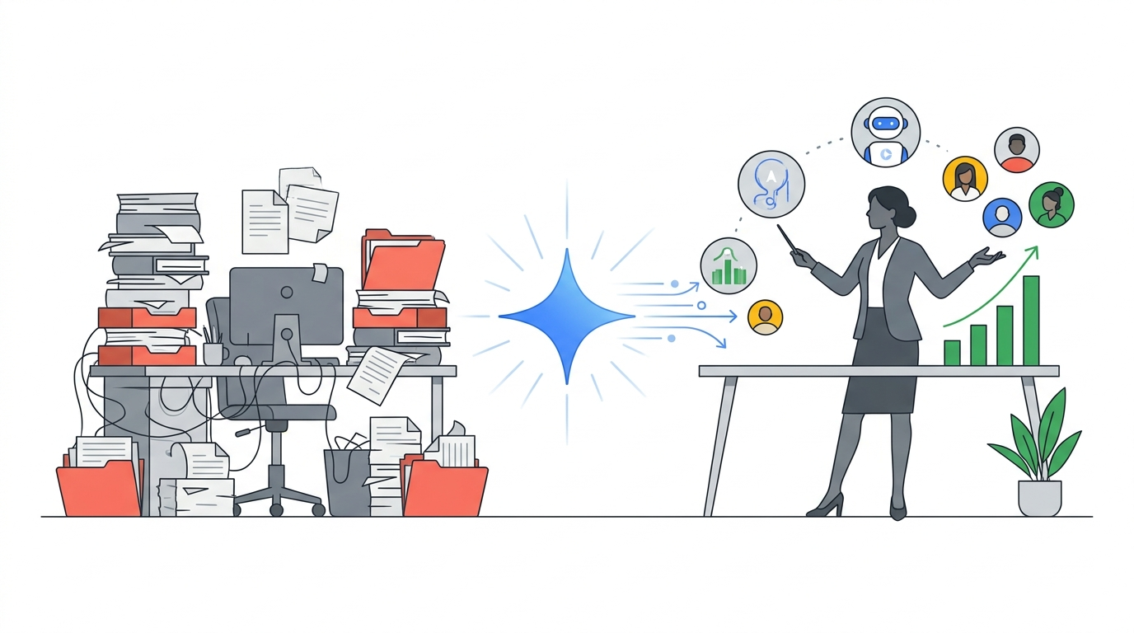

THE NEW WORKFORCE PARADIGM
The Future HR Team: Orchestrator, Not Just a Doer
Four Gemini Enterprise levers decouple talent impact from admin headcount.
SILOED DOER
STRATEGIC ORCHESTRATOR
1. Automate
2. Inform
Zero-Touch Workflows
Live Workforce Radar
Execute clean multi-system handoffs automatically.
Fuse internal skills with market benchmarks.
3. Personalize
4. Assist
Day-1 to Leadership
~70% Tier-1 Deflection
Tailor onboarding and Career Saathi journeys.
Cited answers first; human empathy always.
Gemini Enterprise acts as the bridge — never replacing human empathy.
Gemini Enterprise · Office of the Chief Human Resources Officer (CHRO) Transformation
03 / 20
Notes:
Highlight The Rise of the Human Premium: Empathy, Strategic Judgment, Ethical Oversight, and High-Trust Relationships rise in value when AI handles routine coordination.
Value Levers: 1. Automate: Execute clean multi-system handoffs automatically. | 2. Inform: Fuse internal skills with market benchmarks. | 3. Personalize: Tailor onboarding and Career Saathi journeys. | 4. Assist: Cited answers first; human empathy always.

Slide 4
PART 1 · THE CHRO ARCHITECTURE
6 HR Pillars. 14 Process Agents.
Organizing agents by business process — uniting No-Code studio speed with High-Code ADK precision.
01
02
03
04
05
06
Requisition
Hiring
Onboarding
Mobility
People Ops
Strategy
Gemini Enterprise · Office of the Chief Human Resources Officer (CHRO) Transformation
04 / 20
Notes:
Pause briefly before entering the architecture. Emphasize why we organize by HR process rather than isolated personas.

Slide 5





OFFICE OF THE CHRO · APQC 7.0 ALIGNED
Six Function Pillars Across Hire-to-Retire
6 No/Low-Code speedsters paired with 8 High-Code ADK + FastMCP orchestrators.
OFFICE OF THE CHRO · 6 PILLARS · 14 PROCESS AGENTS
01 · REQUISITION & SCREENING
02 · CANDIDATE HIRING
03 · ONBOARDING
Requisition & Screening
Candidate Hiring
Personalized Onboarding
40%–50% Faster
4 Days -> <1 Hr
>95% Day-7 Ready
3 Agents · No-Code + Low-Code + ADK
2 Agents · No-Code + High-Code ADK
2 Agents · No-Code + High-Code ADK
04 · CONTINUOUS LEARNING & DEV
05 · PEOPLE OPS
06 · HR STRATEGY & REWARDS
Continuous Learning & Mobility
People Ops & Service
HR Strategy & Rewards
3-Min Mastery
~70% Deflection
<1–2% Variance
2 Agents · No-Code + High-Code ADK
3 Agents · No-Code + High-Code ADK
2 Agents · High-Code ADK + BigQuery
Gemini Enterprise · Office of the Chief Human Resources Officer (CHRO) Transformation
05 / 20
Notes:
Walk through the exact Slide 17 architecture: 5 operational Hire-to-Retire pillars anchored on top of 1 cross-cutting HR Strategy & Total Rewards foundation.

Slide 6


PILLAR 01 · REQUISITION & SCREENING
Skill-First Hiring, Micro-Market Reach & Blind Screening
How do we attract hard-to-find Tier-2, Tier-3, and Global Capability Center (GCC) talent while screening hundreds of applications accurately and without bias?
1. Skill Brief
2. Harmonized JD
3. Talent Magnet
4. Blind Parse
5. Ranked Shortlist
Job Description Harmonizer
NO-CODE
Skill-first job descriptions in minutes.
BENCHMARK OUTCOME
40%–50% Faster
Talent Magnet & Micro-Market Agent
LOW-CODE
Reaches Tier-2/3 talent in regional languages.
Lower screening toil & agency spend
Solves: Jargon-heavy job specs and manual CV triage slow hiring.
Skills Extraction & Blind Screening
HIGH-CODE
PII-masked screening with Four-Fifths audit.
Gemini Enterprise · Office of the Chief Human Resources Officer (CHRO) Transformation
06 / 20
Notes:
Contrast the high cost of external agency sourcing tax with Talent Magnet and DPDP-masked Blind Screening.
Full Pillar Toil & Impact Details:
- Hiring managers write inconsistent, jargon-heavy Job Descriptions (JDs) that trigger delays and narrow diverse pipelines.
- Heavy reliance on external staffing agencies inflates cost-per-hire across emerging Indian and regional talent hubs.
- Recruiters spend 40%–50% of sourcing week manually skimming unstructured PDF resumes across inconsistent formats.
- Standardizes every requisition into inclusive, skill-mapped templates in minutes (No-Code Job Description Harmonizer).
- Targets Tier-2/Tier-3 and specialized hubs via hyper-local outreach and 24/7 Candidate Concierge (Talent Magnet).
- Screens candidates on verified skills with automated Personal Identifiable Information (PII) masking and Four-Fifths (80%) fairness telemetry.
Agents:
- Job Description Harmonizer (No-Code): Transforms raw hiring manager notes into bias-free, skill-calibrated Job Descriptions (JDs) aligned with enterprise grade bands. | Personas: Hiring Manager, Talent Acquisition (TA) Partner, Compensation & Job Architecture Lead
- Talent Magnet & Micro-Market Agent (Low-Code): Maps emerging Tier-2, Tier-3, and Global Capability Center (GCC) talent hubs, generates localized outreach campaigns, and powers 24/7 Candidate Concierge Q&A. | Personas: Employer Brand Lead, Talent Sourcing Specialist, Prospective Candidate
- Skills Extraction & Blind Screening (High-Code): Parses messy multi-format resumes into structured skills, masks demographic identifiers for DPDP compliance, and explains shortlist rankings transparently. | Personas: Technical Recruiter, Hiring Panel Chair, Compliance & Equal Opportunity Auditor

Slide 7
PILLAR 02 · CANDIDATE HIRING
Interview Scheduling: From 4 Days to Under 1 Hour
How do we eliminate multi-day panel scheduling ping-pong and fragmented interview notes so hiring teams close top candidates before competitors do?
1. Calendar Sync
2. Slot Lock
3. Rubric Prep
4. Feedback Loop
5. Band Offer
Zero-Touch Interview Orchestrator
NO-CODE
4-day calendar ping-pong cut under 1 hour.
BENCHMARK OUTCOME
4 Days -> <1 Hr
Zero-touch panel interview scheduling
Interview Rubric & Offer Decision
HIGH-CODE
Solves: Calendar ping-pong and unstructured notes lose top talent.
Synthesizes scorecards & flags band drift.
Gemini Enterprise · Office of the Chief Human Resources Officer (CHRO) Transformation
07 / 20
Notes:
Zero-Touch Interview Orchestrator solves the #1 candidate drop-off driver; ADK Rubric Agent eliminates subjective debrief delays.
Full Pillar Toil & Impact Details:
- Recruiting coordinators exchange dozens of emails negotiating panel calendars across global time zones and business priorities.
- Panelists enter interviews without calibrated rubrics or ask overlapping questions, producing noisy hiring signals.
- Offer drafting stalls waiting for cross-checks against internal compensation bands and sign-off chains.
- Negotiates candidate and multi-interviewer calendars autonomously while dispatching rubric prep packs (No-Code/Connector).
- Synthesizes multi-interviewer scorecards into calibrated consensus summaries with conflict highlighting (ADK Agent).
- Generates band-compliant offer packages routed through mandatory Human-in-the-Loop (HITL) compensation approval.
Agents:
- Zero-Touch Interview Orchestrator (No-Code): Eliminates manual calendar tag by negotiating candidate slots, matching qualified panel backups, booking Meet links, and sending structured prep kits. | Personas: Recruiting Coordinator, Interview Panelist, Hiring Manager, Candidate
- Interview Rubric & Offer Decision (High-Code): Synthesizes interview panel scorecards into neutral evidence summaries, flags divergent signals, and drafts compensation-band-compliant offer letters. | Personas: Talent Acquisition (TA) Lead, Compensation Partner, Hiring Executive

Slide 8

PILLAR 03 · PERSONALIZED ONBOARDING
Day-One Delight & Cross-System FastMCP Provisioning
How do we guarantee every new joiner receives working credentials, hardware, local buddy support, and a tailored 90-day roadmap from Day 1?
1. Offer Signed
2. Parallel MCP
3. Day-1 Hub
4. Local Buddy
5. 90-Day Pulse
Onboarding Navigator & Virtual Buddy
NO-CODE
Personalized 1/30/60/90 guides per location.
BENCHMARK OUTCOME
>95% Day-7 Ready
15%–25% faster time to productivity
Zero-Touch Provisioning Agent
HIGH-CODE
Solves: Manual email handoffs stall laptops, badges, and onboarding.
Zero Day-1 blockers across HCM & ITSM.
Gemini Enterprise · Office of the Chief Human Resources Officer (CHRO) Transformation
08 / 20
Notes:
Show both the warm human UX (Day-One Buddy Hub) and the gritty enterprise plumbing (HCM + ServiceNow FastMCP).
Full Pillar Toil & Impact Details:
- Signed offers trigger brittle manual emails across HR Operations, IT Service Desk, Security, and Branch Facilities.
- New joiners lose productive weeks hunting down local branch protocols, benefits elections, and team directories.
- One-size-fits-all Day-1 slide decks fail frontline retail, engineering, and regional cohorts equally.
- Provides every new hire an interactive 1/30/60/90-day Virtual Buddy Hub grounded in site & role guides (No-Code Onboarding Navigator).
- Orchestrates atomic cross-system writebacks via FastMCP: creating worker profiles, ServiceNow laptop/access tickets, and compliance enrollments.
- Tracks pre-boarding blockers proactively before Day 1 so teams focus on warm human welcome.
Agents:
- Onboarding Navigator & Virtual Buddy (No-Code): Generates role- and location-specific 1/30/60/90-day onboarding plans and acts as a 24/7 multilingual Virtual Buddy across policy and branch queries. | Personas: New Joiner, Onboarding Manager, Assigned Peer Buddy
- Zero-Touch Provisioning Agent (High-Code): Orchestrates parallel backend provisioning upon contract signature — syncing HCM worker profiles, ServiceNow hardware/software tickets, and security badges. | Personas: HR Operations Specialist, IT Service Desk, Facilities & Security Lead

Slide 9
PILLAR 04 · CONTINUOUS LEARNING & MOBILITY
Career Saathi & 3-Minute Regulatory Learning Reels
When Gen Z talent stays an average of 1.1 years because they don't see growth pathways, how do we make internal reskilling and compliance engaging and visible?
1. Skill Baseline
2. 3-Min Reels
3. Voice Role-Play
4. Mastery Check
5. Career Match
Regulatory Learning & FAQ Studio
NO-CODE
Turns 50-page compliance PDFs into 3-min reels.
BENCHMARK OUTCOME
3-Min Mastery
Guided mobility curbs early-career churn
Career Saathi (Mobility & Coach)
HIGH-CODE
Solves: Dense PDF training and opaque growth drive 1-in-3 exits.
Internal career paths & multilingual coaching.
Gemini Enterprise · Office of the Chief Human Resources Officer (CHRO) Transformation
09 / 20
Notes:
Cite Randstad 2025: 1.1-year Gen Z tenure is growth-hunting, not disloyalty. Career Saathi makes growth visible.
Full Pillar Toil & Impact Details:
- 1 in 3 early-career employees plan a job switch within 12 months when internal mobility pathways remain opaque (Randstad 2025 benchmark).
- Frontline associates and busy specialists skim or ignore long regulatory compliance manuals.
- Employees lack safe, realistic practice environments to rehearse tough customer negotiations or managerial coaching.
- Converts regulatory circulars and SOPs into 3-minute regional-language micro-reels and searchable FAQs (No-Code Learning Studio).
- Maps individual skills against future roles (e.g., Retail Relationship Manager → Phygital Branch Manager) via Career Saathi.
- Runs live regional-language conversational customer & coaching simulations with gamified mastery checkpoints.
Agents:
- Regulatory Learning & FAQ Studio (No-Code): Converts dense compliance circulars, Prevention of Sexual Harassment (POSH) mandates, and product SOPs into 3-minute regional-language learning reels and searchable FAQs. | Personas: Learning & Development (L&D) Designer, Compliance & Legal Officer, Frontline Branch / Plant Associate
- Career Saathi (Mobility & Coach) (High-Code): Maps an employee's live skills against target internal roles and coaches them through realistic, multilingual high-stakes workplace simulations. | Personas: Mid-Career Employee, Frontline People Manager, Talent Mobility Partner

Slide 10
PILLAR 05 · PEOPLE OPS & SERVICE DELIVERY
Make Ops Meet People: 70% Deflection & Early Care
How do we deflect ~70% of repetitive policy, payroll, tax, and leave tickets without compromising strict compliance or missing quiet employee burnout signals?
1. Unified Intake
2. Policy Gate
3. Live MCP Action
4. Privacy Pulse
5. Human Care
HR Policy Pilot (OKF & Search)
NO-CODE
100% cited policy answers, zero guessing.
BENCHMARK OUTCOME
~70% Deflection
Zero-Touch HR Concierge
HIGH-CODE
Executes routine leave & HRSD tickets fast.
Zero guessed answers + proactive care
Solves: Repeated policy tickets bury HRBPs before burnout shows.
Employee Pulse & Burnout Shield
HIGH-CODE
Early team burnout radar with N>=10 privacy.
Gemini Enterprise · Office of the Chief Human Resources Officer (CHRO) Transformation
10 / 20
Notes:
Zero-Touch HR Concierge frees specialists for complex 30% human cases while k-anonymity protects Pulse privacy under India DPDP.
Full Pillar Toil & Impact Details:
- HR teams answer thousands of identical leave balance, expense cap, tax form, and benefits questions every month.
- Generic bots hallucinate prohibited policy exceptions, creating legal and audit exposure.
- Managers only discover attrition risk during exit interviews after institutional knowledge is already walking out.
- Delivers zero-guessing policy answers grounded in Open Knowledge Format (OKF) & handbook clauses (No-Code Policy Pilot).
- Executes live transactional self-service across HCM and ITSM via FastMCP (leave booking, tax downloads, ticket routing), escalating the complex 30% with full summary.
- Analyzes anonymized pulse & support trends under India DPDP consent controls to trigger supportive Human Resources Business Partner (HRBP) check-ins.
Agents:
- HR Policy Pilot (OKF & Search) (No-Code): Answers nuanced leave, expense, business-courtesy, and statutory policy questions strictly from verified handbooks with exact section citations and trap-rule refusal. | Personas: All Employees, Line Managers, Regional HR Business Partner (HRBP)
- Zero-Touch HR Concierge (High-Code): Executes routine employee requests end-to-end inside chat — checking leave balances, applying PTO, fetching Form-16/tax slips, and routing complex 30% cases to HR Specialists. | Personas: Every Employee, HR Operations Team, Payroll & Benefits Administrator
- Employee Pulse & Burnout Shield (High-Code): Fuses anonymized pulse surveys, anonymized helpdesk category spikes, and exit-theme telemetry into early burnout risk signals for supportive HRBP outreach. | Personas: HR Business Partner (HRBP), Chief Wellbeing Officer, Department Head

Slide 11

PILLAR 06 · HR STRATEGY & TOTAL REWARDS
Continuous Workforce Planning & <1%–2% Pay Equity
How does the CHRO reclaim time from stitching 40 spreadsheets per quarter to model future skills, headcount scenarios, and <1% unexplained pay equity variance?
1. Census Fusion
2. Market Radar
3. Scenario Twin
4. Pay Equity
5. Executive Sign-Off
Strategic Workforce Intelligence
HIGH-CODE
Live CHRO & CFO headcount scenario modeling.
BENCHMARK OUTCOME
<1–2% Variance
Weeks -> minutes planning & pay equity
Total Rewards & Calibration Agent
HIGH-CODE
Solves: 40 manual spreadsheets delay CHRO workforce decisions.
Continuous pay-equity audit under HITL lock.
Gemini Enterprise · Office of the Chief Human Resources Officer (CHRO) Transformation
11 / 20
Notes:
Connect Strategic Workforce Intelligence and Total Rewards Equity back to dissolving the 75% CHRO spreadsheet tax.
Full Pillar Toil & Impact Details:
- Boardroom headcount, attrition, and hiring-projection decks take weeks to reconcile manually across finance and business units.
- Annual compensation and promotion calibrations miss mid-year pay compression and unexplained equity drift.
- Multi-rater performance appraisals overwhelm managers during calibration cycles, burying actionable coaching insights.
- Synthesizes internal workforce composition, exit drivers, and external industry labor benchmarks in minutes (Strategic Workforce Agent).
- Runs continuous regression pay-equity audits and unbiased multi-rater appraisal aggregation with strict Cloud DLP & Human-in-the-Loop (HITL) approval gates.
- Directly unlocks the 75% → 25% HR Paradox inversion so HR partners CEOs and CFOs on enterprise growth.
Agents:
- Strategic Workforce Intelligence (High-Code): Unifies internal headcount, attrition projections, and external talent market trends to model hiring budgets, span-of-control shifts, and AI productivity uplift. | Personas: Chief Human Resources Officer (CHRO), VP HR Strategy & Workforce Planning, Chief Financial Officer (CFO) Business Partner
- Total Rewards & Calibration Agent (High-Code): Detects unexplained compensation gaps across comparable cohorts continuously, models merit/bonus budgets, and synthesizes unbiased multi-rater performance appraisals. | Personas: Total Rewards Director, Compensation & Benefits Analyst, Executive Calibration Committee

Slide 12
PART 2 · FLAGSHIP WORKFLOWS IN ACTION
Four Signature Agents Across the Lifecycle
How connected orchestrators eliminate delays while enforcing India DPDP privacy and human oversight.
01
02
03
04
Blind Screening
Day-1 FastMCP
Career Saathi
Pulse Shield
Gemini Enterprise · Office of the Chief Human Resources Officer (CHRO) Transformation
12 / 20
Notes:
Transition into the 4 deepest flagship stories: fair screening, Day-1 provisioning across HRIS/ITSM, Career Saathi mobility, and privacy-locked burnout prevention.

Slide 13



FLAGSHIP #1 · RESPONSIBLE AI HIRING
Blind Screening with Cloud DLP & Four-Fifths Fairness
Requisition & Screening · Fairness Screening · High-Code
BEFORE
AFTER
300+ unmasked CVs reviewed manually.
40%–50% faster masked skill shortlists.
1. AGENT ORCHESTRATOR
2. KEY CAPABILITIES
3. CONNECTED SYSTEMS
ADK Screening Coordinator
Cloud DLP Masker
PeopleStrong / Workday
For: Technical Recruiter
Fairness Impact Audit
Recruiter Approval
INDIA DPDP & HITL LOCK:
Deterministic PII masking + mandatory human shortlist sign-off.
Gemini Enterprise · Office of the Chief Human Resources Officer (CHRO) Transformation
13 / 20
Notes:
CHROs demand explainability and legal safety: highlight zero autonomous rejection and full DPDP redaction before LLM scoring.
Full Problem: High-volume requisitions overwhelm recruiters with 300+ inconsistent CVs while unconscious name/college bias and Personal Identifiable Information (PII) exposure risk DPDP and fairness violations.
Outcome: -40%–50% Manual Review Time · Four-Fifths Fairness Audit (300+ unredacted PDFs reviewed manually → PII-masked evidence ranking)
MCP Tools: CloudDLPRedactPII (Deterministic Pre-Screen Strip), SkillGraphMatcher (Weighted Rubric Evaluator), AdverseImpactMonitor (Four-Fifths 80% Telemetry)
Guardrail: Deterministic Cloud DLP pre-processing, India DPDP purpose-limitation tagging, and mandatory human shortlist approval.
Demo Prompt: "Parse the 184 applications on Req #IND-2041 (Cloud Platform Engineer), redact all names, gender, addresses, and college names via Cloud DLP, score strictly against Python/Kubernetes/FinOps rubrics, and return the top 15 explainable profiles."

Slide 14
FLAGSHIP #2 · DAY-1 VELOCITY VIA FASTMCP
Zero-Touch Provisioning Across HCM & ServiceNow
Personalized Onboarding · Parallel Provisioning · High-Code
BEFORE
AFTER
Manual email handoffs delay Day-1 setup.
>95% Day-1 hardware & access readiness.
1. AGENT ORCHESTRATOR
2. KEY CAPABILITIES
3. CONNECTED SYSTEMS
ADK Provisioning Hub
HCM Worker Sync
PeopleStrong / Workday
For: HR Operations Specialist
ITSM Laptop & IAM
ServiceNow ITSM
INDIA DPDP & HITL LOCK:
Pre-offer state-lock prevents premature IT provisioning.
Gemini Enterprise · Office of the Chief Human Resources Officer (CHRO) Transformation
14 / 20
Notes:
Highlight zero silent partial failures — when a laptop or badge ticket stalls, IT & HR Ops know 72 hours before Day 1.
Full Problem: Hiring teams close great talent only for new joiners to spend Day 1 to Day 4 locked out of laptops, repositories, and payroll portals due to broken inter-system handoffs.
Outcome: -15%–25% Time-to-Productivity · Zero Day-1 Blockers (Manual email handoffs across 5 IT/HR tools → Atomic MCP orchestration)
MCP Tools: create_worker_profile (HCM FastMCP), provision_equipment_and_access (ServiceNow FastMCP), verify_day1_readiness_sla (Cross-System Health Check)
Guardrail: Strict gatekeeper invariant: enforces role-least-privilege IAM templates and refuses unapproved elevated admin access requests.
Demo Prompt: "Run Day-1 readiness orchestration for the 12 new engineers starting Monday in Hyderabad: verify HCM worker IDs, confirm MacBook/VMware ticket states in ServiceNow, and flag any unfulfilled badge dependencies."

Slide 15
FLAGSHIP #3 · RETENTION & MULTILINGUAL GROWTH
Career Saathi: Guided Internal Mobility & Role-Play
Continuous Learning & Mobility · Career Mobility · High-Code
BEFORE
AFTER
Opaque ladders push early-career exits.
Guided internal role match & practice.
1. AGENT ORCHESTRATOR
2. KEY CAPABILITIES
3. CONNECTED SYSTEMS
Career Saathi ADK Coach
Skill-Gap Mapper
Enterprise LMS
For: Mid-Career Employee
Voice Role-Play Sim
Talent Marketplace
INDIA DPDP & HITL LOCK:
Practice simulations stay strictly off performance ratings.
Gemini Enterprise · Office of the Chief Human Resources Officer (CHRO) Transformation
15 / 20
Notes:
Show how a 3-minute regional-language simulation builds confidence faster than 50-page static PDFs.
Full Problem: High-potential associates (such as Gen Z retail branch staff) quit at ~1.1 years because they cannot see how to reach roles like Phygital Branch Manager or lack safe practice for tough client conversations.
Outcome: Transforms 1.1-Yr Churn into Internal Mobility (Opaque promotion ladders → Guided skill mapping & live scenario coaching)
MCP Tools: SkillGapGraphMapper (Current vs. Target Role Diff), RegionalRolePlaySimulator (Demanding HNI / SME Client Persona), InternalJobMatchRecommender (Mobility Feed Sync)
Guardrail: Psychological safety boundary: practice simulations remain private developmental coaching data, never auto-fed into disciplinary scoring.
Demo Prompt: "Evaluate my 2 years as Retail Relationship Manager against the Phygital Branch Manager competency profile, show my top 3 skill gaps, and launch a 3-minute Hindi-English simulation negotiating an SME working-capital line with a skeptical factory owner."

Slide 16
FLAGSHIP #4 · ETHICAL PEOPLE INTELLIGENCE
Early Burnout Prevention with K-Anonymity (N>=10) Lock
People Ops & Service Delivery · Wellbeing & Pulse · High-Code
BEFORE
AFTER
Burnout surfaces only at exit interviews.
Cohort-level retention care weeks earlier.
1. AGENT ORCHESTRATOR
2. KEY CAPABILITIES
3. CONNECTED SYSTEMS
Pulse Analytics Core
K-Anonymity Lock
Aggregated Pulse
For: HR Business Partner (HRBP)
Theme Synthesizer
HRBP Care Portal
INDIA DPDP & HITL LOCK:
Strict K-anonymity (N>=10) blocks individual scoring.
Gemini Enterprise · Office of the Chief Human Resources Officer (CHRO) Transformation
16 / 20
Notes:
Reassure CHROs: Pulse senses structural overload at cohort level without employee keystroke spying.
Full Problem: Critical teams experience silent overload months before resignation letters arrive, leaving HR reacting in post-exit interviews when talent is already lost.
Outcome: Early Burnout Detection · Proactive Retention Care (Surprise resignations in exit interviews → Early supportive wellbeing check-ins)
MCP Tools: kAnonymousCohortAggregator (Min-N=10 Privacy Gate), BurnoutClusterDetector (Survey + Workload Spikes), WellbeingCheckInRecommender (Non-Punitive Action Playbook)
Guardrail: Hard privacy prohibition on individual scoring, message surveillance, or disciplinary triggers; strictly cohort-level supportive insights.
Demo Prompt: "Analyze Q3 anonymized engagement verbatims and HR ticket spikes across Customer Support hubs (cohorts >= 15 employees) to highlight top structural stressors and recommended manager support interventions."

Slide 17
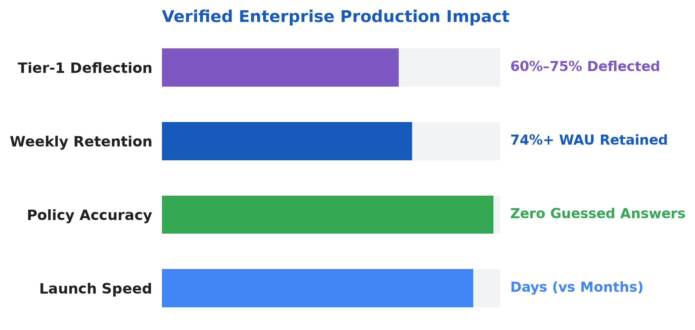
INDIA ENTERPRISE PROOF · LIVE IN PRODUCTION
Indian Conglomerate Benchmark: 400+ Agents & 74%+ Retention
Anonymized production learnings from deploying grounded Human Resources micro-agents in a large Indian diversified enterprise.
400+
74%+
4 Live
Zero
Enterprise Agents Built Across Functions
Weekly Active User Retention
No-Code HR Production Assistants
Silently Guessed Policy Answers
Policy Pilot
JD Harmonizer
Answers leave & policy questions from verified circulars.
Unifies hiring drafts into unbiased, skill-first roles.
Onboarding Navigator
FAQ Generator
Guides Day-1 readiness tasks and policy checklists.
Turns 50-page circulars into instant searchable answers.
Gemini Enterprise · Office of the Chief Human Resources Officer (CHRO) Transformation
17 / 20
Notes:
Share practical enterprise lessons without disclosing customer identity: small focused micro-agents beat monolithic mega-prompts, and model tiering (Flash vs Pro) controls latency and cost.
Learnings:
- Right-Size Agent Granularity: Focused micro-agents per HR task outperform broad monolithic chatbots in accuracy and maintainability.
- Model Tiering for Latency & Cost: Route fast Tier-1 policy lookups through Gemini Flash while reserving Gemini Pro reasoning for multi-step synthesis and calibration.
- Enterprise Network & Proxy Bridging: Secure connectors and Model Context Protocol (MCP) bridges handle corporate proxies and on-premise HR databases cleanly.

Slide 18


PLATFORM ARCHITECTURE · TRUST BY DESIGN
Gemini Enterprise Stack & Open Knowledge Format
6 No/Low-Code speedsters + 8 ADK orchestrators protected by Model Armor & Cloud DLP.
1. THE TASKFORCE (HR Experiences)
14 Process Agents + PeopleStrong / Workday / ServiceNow
TRUST & INDIA
DPDP SHIELD
2. THE WORKBENCH (Dual Build Tier)
6 No/Low-Code Studio Agents + 8 Code-First ADK Agents
Model Armor Guard
3. THE CONTEXT (Enterprise Memory)
Cloud DLP Redaction
Open Knowledge Format (OKF) + Vertex AI RAG + FastMCP
Consent Ledger
4. THE BRAINS (Model Tiering)
Least Privilege IAM
Gemini Flash (Sub-Second FAQ) + Gemini Pro (Deep Reasoning)
Gemini Enterprise · Office of the Chief Human Resources Officer (CHRO) Transformation
18 / 20
Notes:
Explain how HR owns the Workbench: policy Q&A starts No-Code with OKF strict citations; multi-system writes scale via ADK + FastMCP.

Slide 19
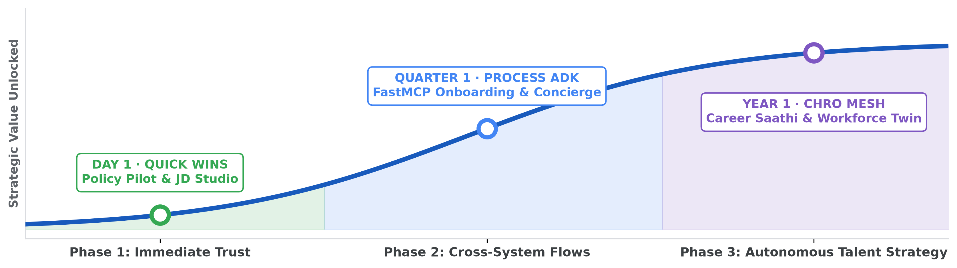
HOW LEADING CHROS SUCCEED
3-Horizon Value Curve & 4 Adoption Pillars
Ship Day-1 No-Code quick wins while building multi-system ADK orchestration.
PILLAR #01
PILLAR #02
PILLAR #03
PILLAR #04
Establish an AI SWAT Team
Monitor Adoption & Deflection
Redesign Processes — Don't Pave Cowpaths
Invest in Tiered AI Upskilling
HR, Legal, InfoSec & IT governance council.
Track weekly retention and Tier-1 accuracy.
Fix broken loops before automating steps.
Train HRBPs across Practitioner & ADK tiers.
Gemini Enterprise · Office of the Chief Human Resources Officer (CHRO) Transformation
19 / 20
Notes:
Walk across Day 1 -> Early Weeks -> Ongoing, anchored by AI SWAT governance, adoption tracking, process redesign, and tiered upskilling.
Value Curve Stages:
- 01 · Day 1 (No-Code Quick Wins): Immediate Value in Gemini Enterprise (Launch No-Code Policy Pilot, FAQ Generator, and Job Description Harmonizer directly in Gemini Enterprise.; Connect verified HR handbooks, Google Workspace, and policy drives with strict source citations.; Generate micro-learning scripts and bilingual employee communications immediately.)
- 02 · Early Weeks (Grounded Connectors): Custom Grounded Agents & Governance (Integrate ATS and Google Calendar / Meet connectors for Zero-Touch Interview Orchestration.; Deploy Open Knowledge Format (OKF) + Vertex AI Search retrieval with Model Armor guardrails.; Launch Day-One Onboarding Navigator and Talent Magnet outreach campaigns.)
- 03 · Ongoing (Multi-Agent Scale): Code-First Google ADK & MCP Orchestration (Coordinate cross-system writes across PeopleStrong, Workday, and ServiceNow via FastMCP tools.; Operate Career Saathi multilingual voice simulations, Blind Screening, and Employee Pulse early warnings.; Run continuous Strategic Workforce & Total Rewards Equity analytics under Human-in-the-Loop (HITL) control.)

Slide 20
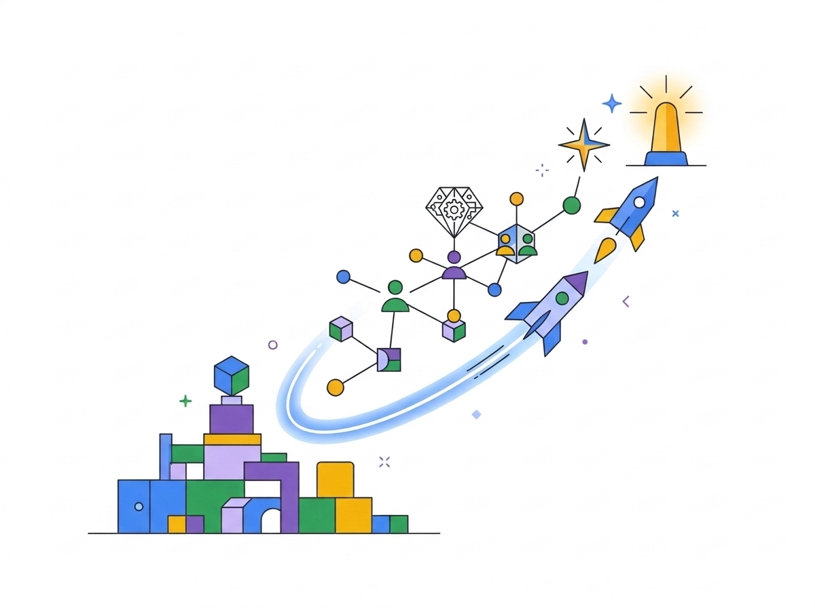
HANDS-ON BUILDER WORKSHOP & NEXT STEPS
Build Your First HR Agent Today — Scale Tomorrow
Join the Builder Lab and launch a 30-day CHRO Discovery Sprint.
01
Today's Builder Lab
Policy Agent: Vertex AI RAG vs. OKF + MCP
02
Week 1 Quick Wins
Ship No-Code Policy Pilot & Onboarding Guide
03
Quarter 1 Scale
Deploy ADK Concierge & Career Saathi Mobility
Notes:
Invite the 200+ CHROs and their builder teams to join the sidelines hands-on AI lab and pick one high-friction HR bottleneck per quarter.

