Slide 1

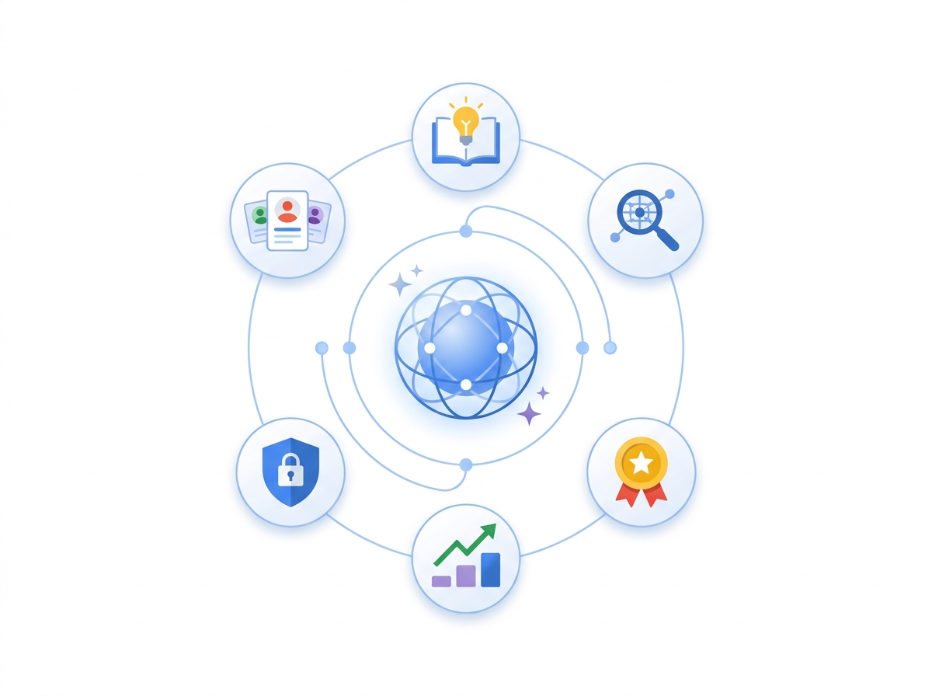





PEOPLESTRONG XPONENTIAL 2026 · CHIEF HUMAN RESOURCES OFFICER (CHRO) KEYNOTE
Agentic for The People
Reclaim the ~75% HR Coordination Tax and Put Human Leadership Back at the Center
Dissolve Multi-Portal Work: Employees get answers and finish HR tasks in plain language
6 HR Pillars & 25 Business Functions: From Tier-2/3 Hiring to Internal Career Mobility
Trust, Fairness & India DPDP Act Compliance: Privacy masking and human sign-off built in
Mumbai · Nov 18, 2026 · 200+ Enterprise Chief Human Resources Officers (CHROs)
01 / 16
Notes:
Open on the human promise for CHROs: this is not a technology showcase for IT — it is how HR stops acting as a ticket router and reclaims time for culture, coaching, and leadership growth.

Slide 2



01 · THE ZERO-UI WORKPLACE SHIFT
Passive Portals End Here: Welcome to the Zero-UI Workplace
Consumers stopped hunting across 10 blue links — now employees expect the exact same simplicity at work
Goal-Driven Over Form-Driven
Employees stop clicking across HRIS, payroll, and leave tabs — they state a goal once in plain language.
Seamless Across Legacy Systems
Work flows quietly across recruiting, calendars, IT provisioning, and payroll without replacing existing HR tools.
Meet People Where They Work
24/7 natural conversations inside web, mobile, WhatsApp, and regional Indian languages.
Behavioral Shift: 800% year-over-year rise in conversational queries — your workforce already brings consumer expectations to HR.
02 / 16
Notes:
Draw from everyday life: just as consumers now delegate multi-step research and bookings to conversational assistants, employees will no longer tolerate five portals to change tax declarations or book interviews.

Slide 3

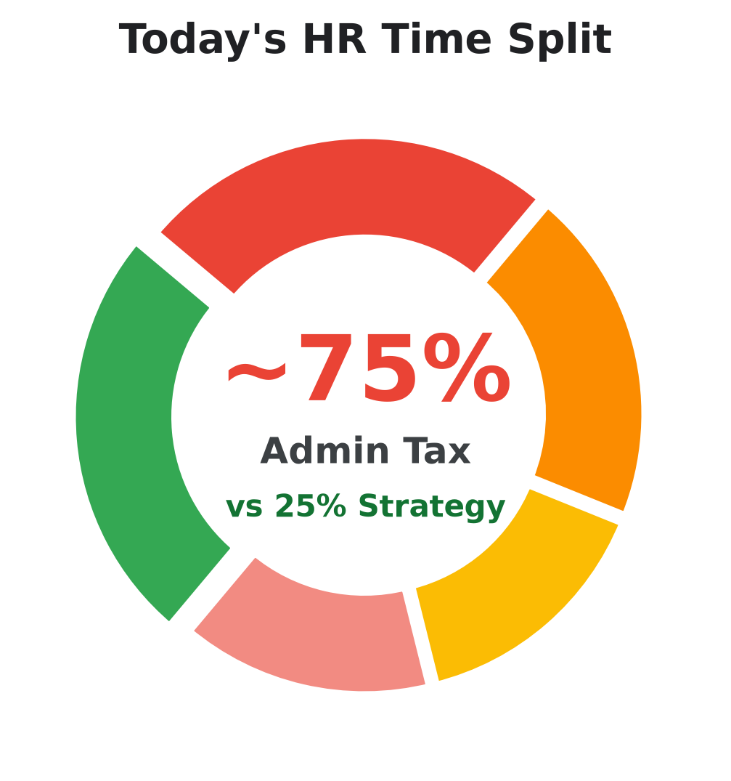
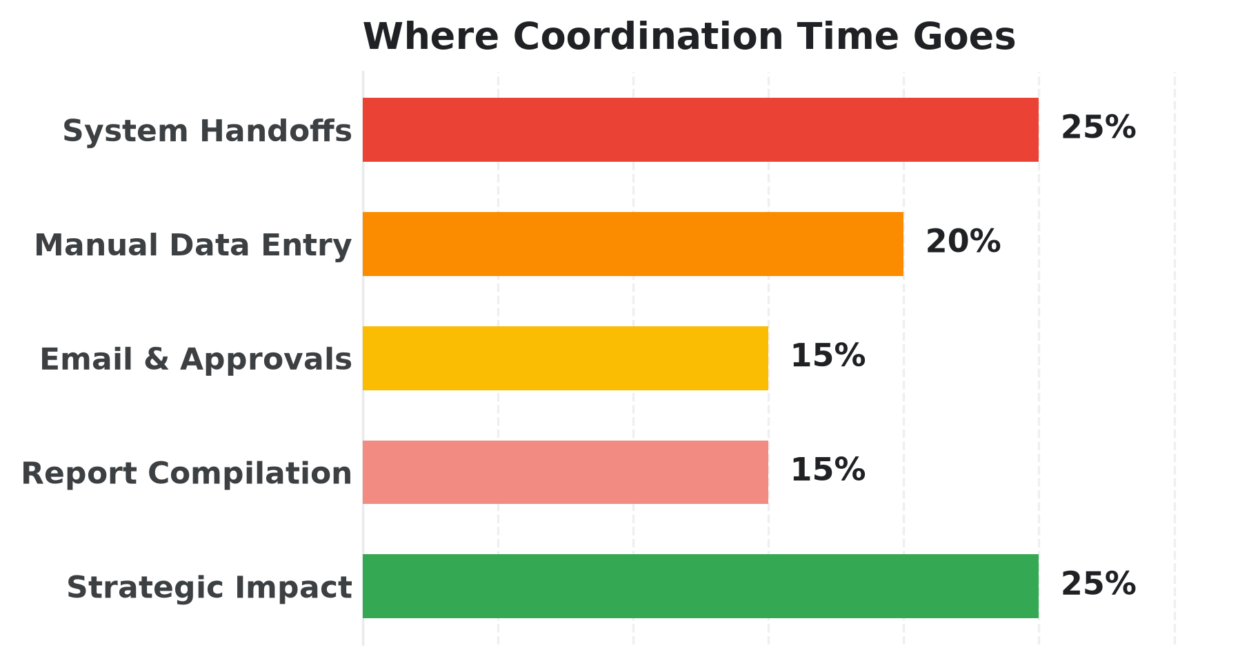
02 · THE HR PARADOX (INDUSTRY BENCHMARK)
The HR Paradox: ~75% Coordination Tax vs. ~25% Strategy
People teams exist to shape culture and talent — yet three-quarters of every week disappears into coordination plumbing
~75% ADMIN TAX
• 25% — Coordinating across HR, IT & hiring systems
• 20% — Manual data entry & spreadsheet validation
~25% STRATEGY
• 10% — Coaching & advising business leaders
• 8% — Strategic workforce & skills planning
Keynote Thesis: Agentic AI eliminates the ~75% administrative coordination tax — flipping HR from ticket handler to enterprise talent strategist.
03 / 16
Notes:
This benchmark resonates in every CHRO boardroom: HR does not suffer from a lack of strategic ambition — it suffers from an operating model that taxes 75% of human bandwidth on chasing forms and approvals.
Full Time-Allocation Details:
- Admin Tax: 25% — Coordinating across HR, IT & hiring systems; 20% — Manual data entry & spreadsheet validation; 15% — Chasing email approvals & follow-ups; 15% — Compiling quarterly slides & spreadsheets
- Strategic Value: 10% — Coaching & advising business leaders; 8% — Strategic workforce & skills planning; 7% — Culture, inclusion & employee experience

Slide 4



03 · THE RISE OF THE HUMAN PREMIUM
The Rise of the Human Premium: Silicon Runs Routine, HR Leads People
AI absorbs scheduling, triage, and status chasing so people leaders double down on empathy and judgment
Decouple Growth From Admin Headcount
Handle 5x seasonal hiring surges and 50,000+ employee requests without burning out HR teams.
Elevate Empathy & Coaching
Return hours every day to leadership coaching, hard career conversations, and workplace belonging.
Humans Lead Every High-Stakes Call
AI prepares verified shortlists and salary options — people decide who is hired, promoted, or rewarded.
"When software handles forms and follow-ups, HR reclaims the Human Premium — trust, empathy, and strategic judgment."
04 / 16
Notes:
Turn AI anxiety into executive confidence: routine coordination drops to near zero while human judgment, ethical oversight, and high-trust coaching become your highest-value differentiator.

Slide 5





04 · HIRE-TO-RETIRE TRANSFORMATION
Automate · Inform · Personalize · Assist Across 8 Employee Touchpoints
Turning executive excitement into measurable daily productivity at every moment from candidate to alumni
1. Automate
2. Inform
3. Personalize
4. Assist
Eliminate manual routing & admin checklists
Deliver verified, cited answers in seconds
Tailor journeys by role, hub & language
24/7 guidance inside tools people already use
Candidate
Onboarding
New Associate
Learning & Growth
Instant role answers & scheduling save thousands of recruiter hours.
Guides new hires smoothly through Day-1 paperwork and tools.
Fast, local access to branch maps, IT setup & team buddies.
Role-specific micro-learning and internal career pathing.
Performance Mgmt
Health & Benefits
Internal Mobility
Offboarding
Objective goal tracking and calibrated review preparation.
Clear, empathetic answers on leave, claims & life events.
Matches hidden employee skills to open internal roles early.
Respectful exit handovers and structured retention insights.
05 / 16
Notes:
Synthesizes the Hire-to-Retire transformation model: 4 business action levers applied across the exact 8 touchpoints every CHRO owns.

Slide 6
05 · THE 6 HR PILLARS & 25 BUSINESS FUNCTIONS
Six HR Pillars & Core Functions: Where Business Value Unlocks
Every operational HR function mapped cleanly from Requisition to Workforce Strategy — zero tech jargon
OFFICE OF THE CHRO · 6 PILLARS · 25 BUSINESS FUNCTIONS ACROSS HIRE-TO-RETIRE
01 · REQUISITION & SCREENING
02 · CANDIDATE HIRING
03 · ONBOARDING
Requisition & Screening
Candidate Hiring
Personalized Onboarding
40%–50% Less Screening
4 Days -> <1 Hr Scheduling
100% Day-1 Ready
Skills Extraction
Job Description Authoring
Panel Scheduling
Interview Readiness
Process Automation
New Hire Buddy
Application Processing
Fair Resume Screening
Feedback Aggregation
Offer Management
1-30-60-90 Journey
Day-1 Access Setup
04 · CONTINUOUS LEARNING & DEV
05 · PEOPLE OPS
06 · HR STRATEGY & REWARDS
Continuous Learning & Mobility
People Ops & Service
HR Strategy & Rewards
50 Pages -> 3 Min Reels
~70% Instant Deflection
<1–2% Unexplained Pay Gap
Personalized Training
Micro-Reel Creation
Employee Service Tickets
HR Policy Approvals
Compensation Analysis
Pay Benchmarking
Skill & Roleplay Drills
Career Pathing
Appraisal Synthesis
Burnout Case Triage
Workforce Composition
Hiring Projections
06 / 16
Notes:
Directly preserves the 6 HR Function Pillars and all 25 core business functions from Slide 17 — structured so CHROs immediately see which business KPI improves in every sub-function.

Slide 7
06 · PILLARS 01 & 02 · TALENT ACQUISITION VALUE
Cut Agency Sourcing Tax & Shrink Interview Loops From 4 Days to <1 Hour
How Talent Acquisition captures Tier-2 and Tier-3 hubs without adding recruiting headcount
TALENT ACQUISITION PAYOFF: Reduce external recruiter spend, boost organic regional applications & stop losing finalists to scheduling delays
PILLAR 01 · REQUISITION & SCREENING
40%–50%
PILLAR 02 · CANDIDATE HIRING & SELECTION
4d -> <1h
Micro-Market Talent Magnet & Skill-First Triage
Zero-Touch Panel Scheduling & Calibrated Selection
LESS SCREENING EFFORT
INTERVIEW TURNAROUND
TODAY'S FRICTION
TODAY'S FRICTION
Over-reliance on external staffing agencies inflates sourcing costs while jargon-heavy JDs and 300+ CVs stall shortlists.
Exchanging dozens of emails across time zones takes ~4 days per round; noisy interviewer notes delay offers.
AI SOLUTION
AI SOLUTION
Localized outreach across Tier-2/3 hubs, skill-based role templates in minutes, 24/7 Candidate Q&A, and blind skill triage.
Autonomous calendar negotiation across candidate & panel, role rubrics, objective scorecard synthesis, and band-checked offers.
BUSINESS OUTCOME
BUSINESS OUTCOME
Lower agency dependency, broader diverse reach, and faster quality shortlists.
Minimal candidate drop-off, fair interview calibration, and faster close rates.
07 / 16
Notes:
Connects Requisition & Screening plus Candidate Hiring directly to revenue protection: winning scarce talent days before competitors even confirm interview slots.

Slide 8
07 · PILLARS 03 & 04 · DAY-ONE DELIGHT & CAREER SAATHI
Turn Growth-Hunting Into Loyalty: Personalized Day-1 & 3-Minute Learning
Modern employees rarely quit over salary alone — they leave when Day-1 feels overwhelming and growth paths feel invisible
RANDSTAD WORKFORCE INSIGHT (2025): 1.1-yr average Gen Z tenure reflects growth-hunting, not disloyalty — 1 in 3 switch without clear development pathways
PILLAR 03 · PERSONALIZED ONBOARDING
100%
PILLAR 04 · CONTINUOUS LEARNING & MOBILITY
50p -> 3m
Day-One Experience Hub & Always-On Virtual Buddy
Career Saathi: 3-Minute Reels & Guided Internal Paths
DAY-1 TOOL & BUDDY READY
REGULATORY MICRO-LEARNING
TODAY'S FRICTION
TODAY'S FRICTION
New hires wait days for laptops, facility passes, and answers to local branch policies across disconnected onboarding portals.
50-page policy and regulatory manuals fail modern attention spans; internal talent exits because promotion criteria stay opaque.
AI SOLUTION
AI SOLUTION
Interactive 1-30-60-90 Day welcome plan, local facility map, instant Virtual Buddy Q&A, and pre-arrival IT & badge setup.
Converts dense rules into 3-minute regional-language reels, customer negotiation roleplay, and personalized internal career roadmaps.
BUSINESS OUTCOME
BUSINESS OUTCOME
Immediate Day-1 confidence, warmer cultural belonging, and weeks shaved off ramp time.
Daily habit compliance, ready frontline confidence, and higher internal leadership fills.
08 / 16
Notes:
Highlights two signature keynote crowd-pleasers: the Day-One Delight experience and Career Saathi transforming boring compliance docs into 3-minute regional habits.

Slide 9
08 · PILLARS 05 & 06 · PEOPLE OPS & LIVE CHRO STRATEGY
Resolve 70% of Routine HR Queries Instantly & Spot Burnout Early
Make Operations meet people where they work — while turning quarterly spreadsheet drills into live CHRO foresight
SERVICE & STRATEGY SHIFT: 70% routine tickets deflected instantly — freeing HRBPs for the 30% empathetic moments and strategic workforce planning
PILLAR 05 · PEOPLE OPS & SERVICE DELIVERY
~70%
PILLAR 06 · HR STRATEGY & TOTAL REWARDS
<1%–2%
Zero-Touch HR Concierge & Early Burnout Intervention
Live Workforce Planning & Pay Equity Assurance
INSTANT TICKET DEFLECTION
UNEXPLAINED PAY GAP TARGET
TODAY'S FRICTION
TODAY'S FRICTION
HR specialists spend hours answering leave, payroll, and tax tickets while employee stress signals only surface at exit interviews.
Compiling 40 spreadsheets delays boardroom hiring forecasts, external talent hotspot tracking, and fair pay-compression checks.
AI SOLUTION
AI SOLUTION
Resolves routine requests in under 30 seconds from verified policies and escalates complex 30% cases with empathy context and early pulse warnings.
Fuses internal skills, exit drivers, and external market trends into live headcount scenarios and regression-tested pay equity checks.
BUSINESS OUTCOME
BUSINESS OUTCOME
Happier employees on mobile & chat plus early, supportive retention outreach.
Weeks of reporting shrunk to minutes and proactive retention across critical hubs.
09 / 16
Notes:
Closes the 6-Pillar value walk by pairing everyday Employee Delight (~70% instant answers) with boardroom CHRO decision velocity.

Slide 10

09 · THE HUMAN STORY BEHIND ALL 6 PILLARS
One Employee Story: From Tier-3 Applicant to Phygital Branch Leader
How all 6 HR Pillars work invisibly behind one frontline retail associate over two years (anonymized benchmark)
01
02
03
04
05
Tier-3 Reach
Fast Hiring
Warm Day-1
Daily Mastery
Leader Leap
Regional
24/7 + <1h
90-Day
2-Min
2x Speed
YOUTUBE & REELS
WHATSAPP & SLOTS
VIRTUAL BUDDY HUB
SALES & COMPLIANCE
CAREER SAATHI
Discovers branch role in her regional language on social feeds with an inclusive, jargon-free description.
Clarifies role pay in plain chat, receives fair skill triage, and books her panel interview in minutes.
Walks into the branch with logins active, a branch map, and a custom 90-day onboarding buddy.
Practices real customer & compliance conversations in short bursts during branch downtime.
Maps skills, practices SME negotiation sims, and steps into Phygital Branch Leadership.
10 / 16
Notes:
Tell Radha's anonymized story from the deck: AI never appears as cold software — to her, it feels like an employer who discovered her talent, respected her time, and invested in her leadership.

Slide 11
10 · AGENT PORTFOLIO MIND MAP (PART 1 OF 2)
Talent & Day-1 Mind Map: 3 Pillars · 7 Solutions · Personas Served
Every capability stays anchored to an HR Pillar and the exact People Personas it serves — zero isolated bots
01 · REQUISITION & SCREENING
Job Description Harmonizer
HR Studio
Talent Magnet
HR Studio
Blind Screening
Connected
Requisition & Screening
👤 Hiring Manager
👤 Talent Acquisition (TA) Partner
👤 Compensation & Job Architecture Lead
👤 Employer Brand Lead
👤 Talent Sourcing Specialist
👤 Prospective Candidate
👤 Technical Recruiter
👤 Hiring Panel Chair
👤 Compliance & Equal Opportunity Auditor
MIND MAP · PART 1 OF 2
Talent & Day-1 Pillars
02 · CANDIDATE HIRING
Interview Scheduler
HR Studio
Interview & Offer Coach
Connected
Pillars 01–03 · 7 Agents
Candidate Hiring
👤 Recruiting Coordinator
👤 Interview Panelist
👤 Hiring Manager
👤 Talent Acquisition (TA) Lead
👤 Compensation Partner
👤 Hiring Executive
SOLUTION TYPE
03 · ONBOARDING
Onboarding Buddy
HR Studio
Day-1 Provisioning
Connected
HR Team Studio
Personalized Onboarding
👤 New Joiner
👤 Onboarding Manager
👤 Assigned Peer Buddy
👤 HR Operations Specialist
👤 IT Service Desk
👤 Facilities & Security Lead
Cross-System Sync
11 / 16
Notes:
Show briefly on stage: Pillars 01–03 map cleanly to 7 specialized solutions and their exact personas — Recruiting Leads, Hiring Managers, Interview Panels, Candidates, and New Hires.
Executive Q&A Agent Contracts:
- Job Description Harmonizer (No-Code): Trigger: Hiring Manager enters rough bullet points for a new opening | Reads: Corporate Competency Matrix (Drive), Grade & Compensation Band Table | Writes: Draft Requisition in Google Docs, Ready-to-Post Template for Applicant Tracking System (ATS) | Human Gate: Hiring Manager and Talent Acquisition Partner review salary band and click Post in the ATS.
- Talent Magnet (Low-Code): Trigger: Recruiting Lead launches hiring in an emerging city or answers candidate questions | Reads: Public University & Labor Signals, Verified Careers & Benefits Repository | Writes: Localized Social / Short-Video Campaign Drafts, Careers Site Candidate Concierge Chat | Human Gate: Employer Brand Lead approves every external campaign script before social publishing.
- Blind Screening (High-Code): Trigger: Talent Acquisition Partner uploads incoming resume batch for an open requisition | Reads: PeopleStrong / Workday ATS Resume Queue, BigQuery Role Skill Rubrics | Writes: Recruiter Human-in-the-Loop (HITL) Review Queue, Fairness Audit Log in BigQuery | Human Gate: Zero autonomous rejections: Recruiter inspects borderline candidates and clicks Advance or Decline.
- Interview Scheduler (No-Code): Trigger: Recruiter marks candidates as shortlisted for multi-round interviews | Reads: Google Calendar Free/Busy Metadata, Interviewer Calibration Pool & Load Caps | Writes: Google Calendar & Google Meet Invites, Calibrated Interview Prep Emails to Panelists | Human Gate: Recruiter or candidate can reschedule or swap any proposed slot with one click.
- Interview & Offer Coach (High-Code): Trigger: Final interview panel submits all completed round scorecards | Reads: ATS Interview Scorecards, Restricted Compensation Equity Band Table | Writes: Compensation Partner & Hiring Manager Approval Queue | Human Gate: Strict Human Gate: No binding offer ever leaves the system without named Compensation & Hiring Manager sign-off.
- Onboarding Buddy (No-Code): Trigger: Candidate signs offer letter or New Joiner asks a Day 1–90 question | Reads: Role & Location Playbooks (Drive / OKF), Assigned Manager & Peer Buddy Directory | Writes: Personalized Joiner Chat Hub, Google Calendar Milestone Reminders | Human Gate: Escalates any personal, visa, or payroll anomaly directly to HR Operations Specialists.
- Day-1 Provisioning (High-Code): Trigger: Offer signed event fires (7–14 days before Day 1) or morning Day-1 readiness audit | Reads: PeopleStrong / Workday HCM (FastMCP), ServiceNow IT & Facilities Tickets (FastMCP) | Writes: Worker Record in HCM, ServiceNow Provisioning Tickets | Human Gate: Refuses unapproved elevated admin access requests; IT/Security approves exception tickets manually.

Slide 12
11 · AGENT PORTFOLIO MIND MAP (PART 2 OF 2)
Growth, Ops & Strategy Mind Map: 3 Pillars · 7 Solutions · Personas Served
Empowering Frontline Teams, Learning Leads, HR Business Partners, Total Rewards & the CHRO
04 · CONTINUOUS LEARNING & DEV
Micro-Learning Studio
HR Studio
Career Saathi
Connected
Continuous Learning & Mobility
👤 Learning & Development (L&D) Designer
👤 Compliance & Legal Officer
👤 Frontline Branch / Plant Associate
👤 Mid-Career Employee
👤 Frontline People Manager
👤 Talent Mobility Partner
MIND MAP · PART 2 OF 2
Growth, Ops & Strategy
05 · PEOPLE OPS
Policy Pilot
HR Studio
HR Concierge
Connected
Employee Pulse
Connected
Pillars 04–06 · 7 Agents
People Ops & Service
👤 All Employees
👤 Line Managers
👤 Regional HR Business Partner (HRBP)
👤 Every Employee
👤 HR Operations Team
👤 Payroll & Benefits Administrator
👤 HR Business Partner (HRBP)
👤 Chief Wellbeing Officer
👤 Department Head
SOLUTION TYPE
06 · HR STRATEGY & REWARDS
Workforce Planner
Connected
Pay Equity & Rewards
Connected
HR Team Studio
HR Strategy & Rewards
👤 Chief Human Resources Officer (CHRO)
👤 VP HR Strategy & Workforce Planning
👤 Chief Financial Officer (CFO) Business Partner
👤 Total Rewards Director
👤 Compensation & Benefits Analyst
👤 Executive Calibration Committee
Cross-System Sync
12 / 16
Notes:
Complete the 14-agent portfolio in one glance: Career Saathi, Micro-Learning Reels, HR Concierge, Burnout Pulse, and Strategic Workforce & Total Rewards Equity.
Executive Q&A Agent Contracts:
- Micro-Learning Studio (No-Code): Trigger: Compliance or Learning & Development (L&D) uploads a new regulatory circular or SOP | Reads: Verified Compliance Circulars & Standard Operating Procedures (SOPs) | Writes: LMS Micro-Learning Modules & SCORM Packs, Frontline Mobile FAQ Library | Human Gate: Compliance & Legal Officer approves final scripts before publishing to frontline associates.
- Career Saathi (High-Code): Trigger: Employee explores next career step or launches a practice coaching session | Reads: Enterprise Skill Graph (Spanner / BigQuery), Open Internal Job Requisitions | Writes: Private Employee Learning Progress Memory Bank, Suggested Internal Mobility Matches | Human Gate: Psychological safety lock: practice simulations stay 100% private to the employee and are never fed into appraisals.
- Policy Pilot (No-Code): Trigger: Employee or Manager asks a leave, travel, expense, or statutory policy question | Reads: Verified OKF Policy Repository (Read-Only) | Writes: Read-Only Advisory Answer in Chat (Zero HRIS Writes) | Human Gate: Never invents exceptions or waives policy; directs edge-case exception requests to Regional HRBP.
- HR Concierge (High-Code): Trigger: Employee requests a live HR transaction (leave, tax form, payroll ticket) in Chat or Portal | Reads: PeopleStrong / Workday HCM (FastMCP), Regional Holiday & Payroll Tables | Writes: HCM Leave / Request Transaction (After Click), ServiceNow HR Specialist Escalation Ticket | Human Gate: Two-step confirmation required before every system write; sensitive disputes go straight to an HR specialist.
- Employee Pulse (High-Code): Trigger: Scheduled weekly wellbeing scan or Quarterly Engagement Survey ingestion | Reads: Anonymized Pulse Survey Vault (BigQuery), Aggregated HR Support Categories | Writes: HR Business Partner Early-Care Briefings | Human Gate: Hard architectural ban on individual tracking, chat snooping, or punitive scoring; HRBP decides supportive outreach.
- Workforce Planner (High-Code): Trigger: Quarterly board prep or CHRO/CFO scenario planning request | Reads: BigQuery Workforce & Cost Warehouse, Career Saathi Skill Yield | Writes: CHRO & CFO Executive Scenario Briefs, Headcount Planning Dashboard | Human Gate: Assumptions and hiring budget envelopes stay transparent and require CHRO + CFO joint approval.
- Pay Equity & Rewards (High-Code): Trigger: Mid-year equity audit or Annual Compensation & Performance Calibration cycle | Reads: Restricted BigQuery Compensation Vault (Cloud DLP Masked), Peer & Manager Appraisals | Writes: Executive Calibration Committee Approval Portal (Draft Only) | Human Gate: Mandatory Human-in-the-Loop executive sign-off before any compensation, bonus, or promotion record changes.

Slide 13



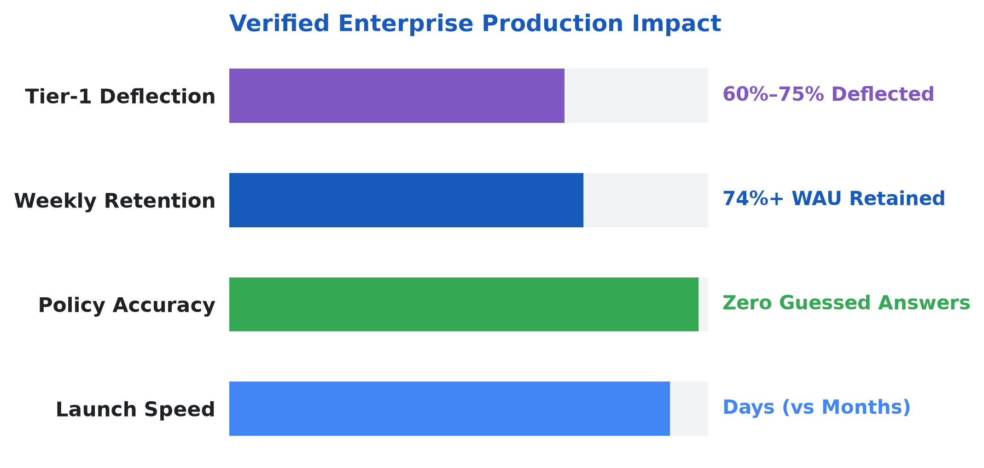
12 · INDIA PRODUCTION PROOF TODAY
Production Benchmark Today: 400+ Live Agents · 74%+ Retention
Anonymized production learnings from deploying grounded Human Resources micro-agents in a large Indian diversified enterprise.
400+
74%+
4 Live
Zero
Enterprise Agents Built Across Functions
Weekly Active User Retention
No-Code HR Production Assistants
Silently Guessed Policy Answers
Policy Pilot
JD Harmonizer
Answers leave & policy questions from verified circulars.
Unifies hiring drafts into unbiased, skill-first roles.
Onboarding Navigator
FAQ Generator
Guides Day-1 readiness tasks and policy checklists.
Turns 50-page circulars into instant searchable answers.
13 / 16
Notes:
Ground the vision in reality: over 400 production agents live across an Indian enterprise with 74%+ ongoing monthly retention and 30% faster leadership decisions.
Learnings:
- Right-Size Agent Granularity: Focused micro-agents per HR task outperform broad monolithic chatbots in accuracy and maintainability.
- Model Tiering for Latency & Cost: Route fast Tier-1 policy lookups through Gemini Flash while reserving Gemini Pro reasoning for multi-step synthesis and calibration.
- Enterprise Network & Proxy Bridging: Secure connectors and Model Context Protocol (MCP) bridges handle corporate proxies and on-premise HR databases cleanly.

Slide 14
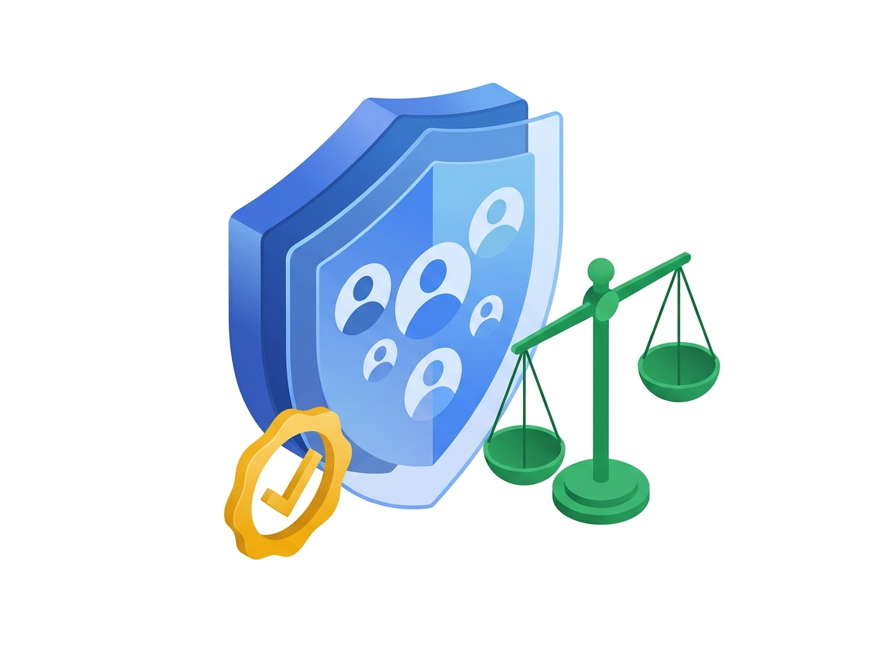
13 · TRUST, FAIRNESS & INDIA DPDP ACT COMPLIANCE
Why Chief Human Resources Officers Trust This System by Design
Bias safeguards, employee privacy, regional consent, and named human sign-off embedded into every workflow
Skill-First Blind Evaluation
India DPDP Act Aligned
Candidate names, age, gender, and home pins are automatically hidden during early shortlisting with ongoing fairness checks.
Purpose-bound employee consent records, Indian data residency, and automatic deletion when retention windows close.
Privacy-Safe Well-Being Pulse
Human Final Authority Always
Burnout alerts aggregate strictly at team sizes of 10 or more so HR supports teams early without exposing individuals.
Every offer letter, compensation adjustment, promotion, and disciplinary record requires an explicit human sign-off.
14 / 16
Notes:
Reassure Legal, Risk, and CHROs in plain business terms: fairness, privacy, and human accountability come first — never black-box automated people decisions.

Slide 15
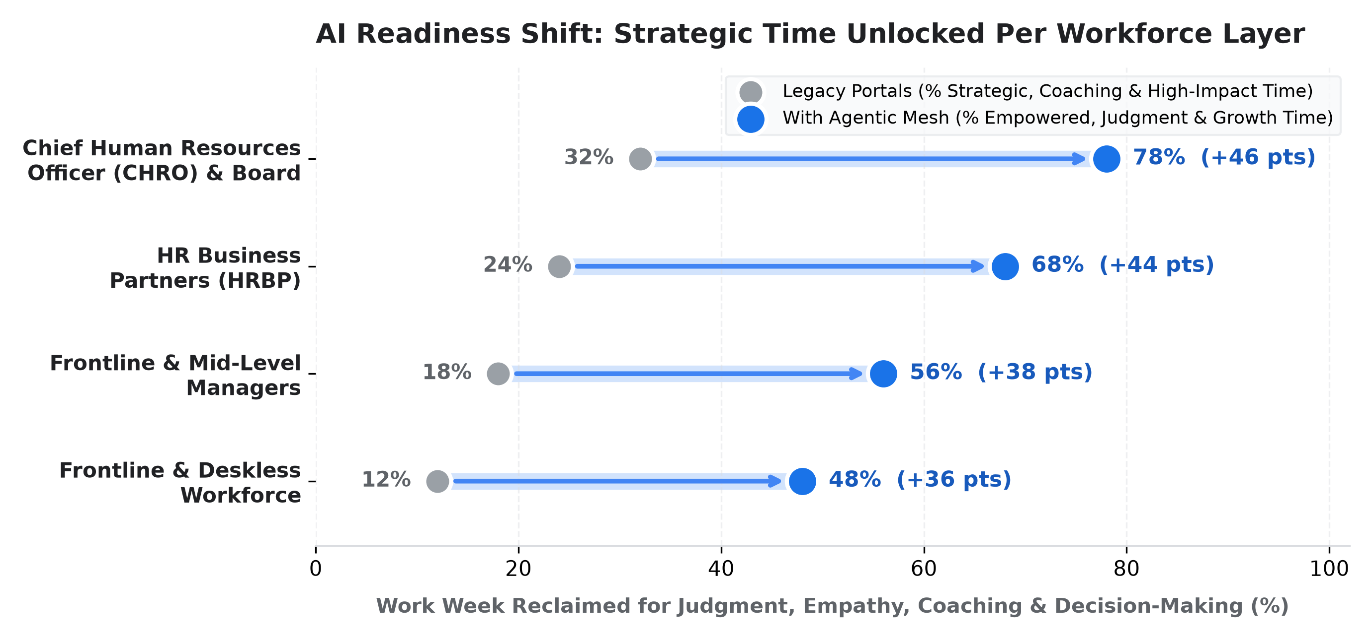
14 · ORGANIZATIONAL AI READINESS
No Workforce Left Behind: Unlocking Strategic Time at Every Tier
How ambient support lifts strategic capacity across CHROs, HRBPs, People Managers & Frontline Associates
Chief Human Resources Officer (CHRO)
32% -> 78% Strategic
Scenarios skills, attrition & pay equity live instead of waiting weeks for spreadsheet packs.
HR Business Partner (HRBP)
24% -> 68% Coaching
Trades ticket escalations for talent calibration, leader coaching & proactive care.
People & Hiring Managers
18% -> 56% Mentoring
Eliminates panel scheduling ping-pong and speeds up structured hiring & growth reviews.
Frontline Associates
15% -> 48% Learning
Uses 3-minute regional Career Saathi reels & instant policy answers in daily work.
15 / 16
Notes:
Point to every row on the chart: transformation succeeds because it unlocks meaningful time at every tier of the organization, from the boardroom down to regional branches.

Slide 16
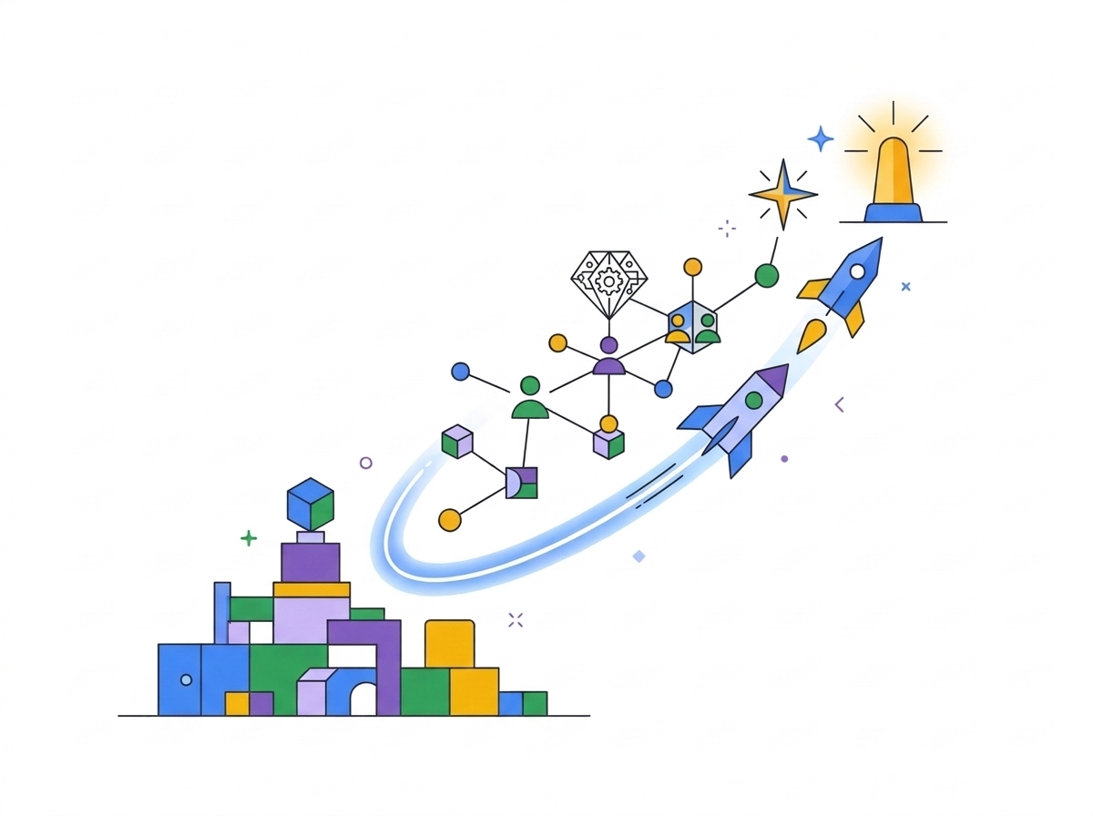
15 · FOUR ADOPTION PILLARS & MONDAY MORNING PLAYBOOK
Four Proven Adoption Pillars & Your 90-Day Launch Plan
What separates stalled pilots from enterprise-wide HR transformation — start cleanly on Monday morning
01 · Cross-Functional Governance
02 · Track Adoption Closely
Align HR, Legal & IT upfront on privacy, fairness & policy rules.
Spot usage gaps by region or cohort and tailor enablement early.
03 · Redesign Process First
04 · Invest in Upskilling
Simplify bloated approval chains before automating to multiply gains.
Deliver role-based hands-on fluency for HR teams & people managers.
01
Days 1–30 · Quick Win Pilot
Launch HR Policy Concierge & Day-1 Onboarding Buddy (~60% faster answers).
02
Days 31–60 · Frictionless Hiring
Activate Skill-First Blind Screening & <1 Hr Interview Scheduling.
03
Days 61–90 · Career Saathi & Clarity
Scale 3-Min Career Saathi reels, Burnout Pulse & CHRO Workforce Radar.
16 / 16
Notes:
Bring together the 4 Enterprise Adoption Pillars with a decisive 90-day Monday Morning sequence: start narrow with verified policies in 30 days, unlock hiring velocity at 60 days, and compound internal mobility by Day 90.

