Slide 1
GOOGLE ENTERPRISE AI HACKATHON • TEAM 12
Elevate HR
Autonomous Multi-Agent HR Orchestrator
Next-Generation Enterprise Self-Service powered by Google ADK, FastMCP, Model Armor & Open Knowledge Federation.
Architectural Blueprint • Decision Choices • Security Guardrails • Live System Verification

Slide 2
EXECUTIVE OVERVIEW
Transforming Enterprise HR Friction into Autonomous Resolution
The Enterprise Challenge
• Fragmented Silos: Employees navigate separate portals for Policies (PDFs), HCM (Workday/WorkWeek), and ITSM (ServiceNow/ServiceImmediately).
• Context Loss: Compound workflows (e.g. sick leave -> PTO booking -> email delegation ticket) require 3 manual hops.
• Compliance Vulnerabilities: Employees misclassify expenses or take unapproved leaves due to complex statutory policies.
The Agentic Solution
• Hierarchical Multi-Agent Topology: Built on Google Agent Development Kit (ADK) with root orchestrator & 3 domain specialists.
• Open Knowledge Federation (OKF): Sub-millisecond policy retrieval with strict URI citations & zero-hallucination guarantees.
• FastMCP Integration: Model Context Protocol over Streamable HTTP for live bi-directional HCM and ITSM transactions.
Measurable Impact
• 85%+ Deflection of routine Tier-1 HR and IT helpdesk queries.
• <10s SLA across multi-turn compound cross-system workflows.
• 100% Policy Compliance with hard programmatic and prompt invariants ('No means No').
• 99.34% Score on comprehensive 33-case benchmark evaluation suite.

Slide 3
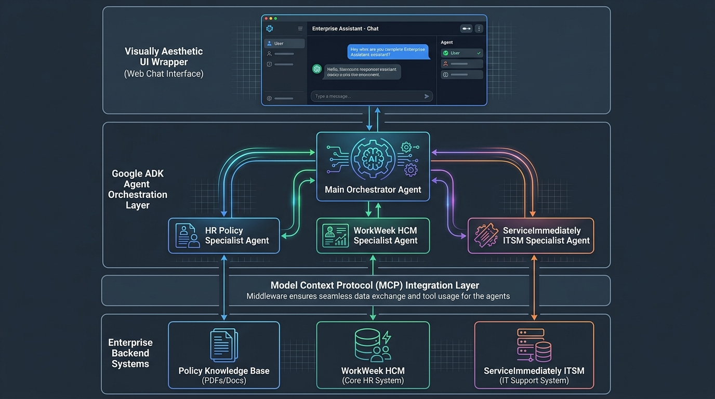
ARCHITECTURE TOPOLOGY
Decoupled Hierarchical Multi-Agent Architecture
Central ADK Root Orchestrator (`hr_orchestrator`)
• Acts as the intelligent coordinator and single conversational interface.
• Performs intent classification, context aggregation, and dynamic delegation.
• Synthesizes multi-agent outputs into unified executive responses.
Policy Specialist (`policy_specialist`)
• Open Knowledge Format (OKF) with thread-safe atomic cache hot-reloading.
• Extracts statutory Singapore MOM rules, leaves, benefits, and code of conduct.
• Enforces strict URI citations (`policy://...`) and zero hallucination.
HCM Specialist (`hcm_specialist`) & ITSM Specialist (`itsm_specialist`)
• WorkWeek FastMCP: Checks balances, submits time-off, updates profiles.
• ServiceImmediately FastMCP: Ticket creation, comment activity, Tier-2 HITL escalation.

Slide 4
ENGINEERING RATIONALE
Key Architectural Decisions: Why This and Not That?
ARCHITECTURE DECISION
✅ Chosen: Google ADK Multi-Agent Hierarchy
❌ Rejected: Monolithic Prompt / Flat LangChain
• Domain tool isolation prevents tool hallucination and prompt pollution.
• Lightweight ADK Runner with standard SessionService for robust state management.
KNOWLEDGE ENGINE DECISION
✅ Chosen: Open Knowledge Federation (OKF)
❌ Rejected: Vector DB Embeddings / Heavy RAG
• Atomic double-buffered cache with mtime auto-invalidation (sub-ms lookup).
• Eliminates chunking loss, stale embeddings, and ungrounded hallucinations.
TOOL INTEGRATION DECISION
✅ Chosen: FastMCP over Streamable HTTP
❌ Rejected: Custom Proprietary REST Endpoints
• Standardized Model Context Protocol (MCP) dynamic tool schema discovery.
• Universal deployment token binding with fallback resilience.
SECURITY & DLP DECISION
✅ Chosen: Model Armor + Regex Sanitizer
❌ Rejected: Post-hoc LLM Self-Moderation
• Zero SPII leakage (NRIC/Credit Cards masked BEFORE reaching LLM).
• Immutable policy invariants: 'No Means No' even when users demand overrides.

Slide 5
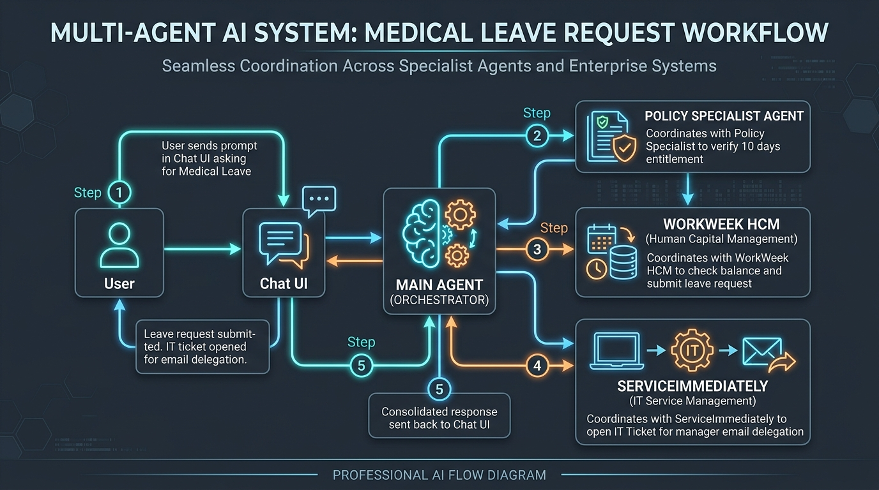
AUTONOMOUS EXECUTION FLOW
Compound Multi-Hop Workflow Delegation
Step 1: Ingestion & In-Flight Masking
User prompt is intercepted by Model Armor regex filter; NRIC, cards, and credentials are redacted prior to LLM submission.
Step 2: Orchestrator Intent Decomposition
Root agent analyzes query (e.g. 'I need 2 days leave and a ticket to forward emails') and decomposes into parallel/sequential sub-tasks.
Step 3: Specialist Tool Invocation
Policy Specialist verifies notice rules -> HCM Specialist books time off -> ITSM Specialist creates email routing incident.
Step 4: Synthesis, Citation & UI Stream
Results are collated with ticket IDs, balance confirmations, and bottom policy sources, streamed back to user in sub-second response.

Slide 6
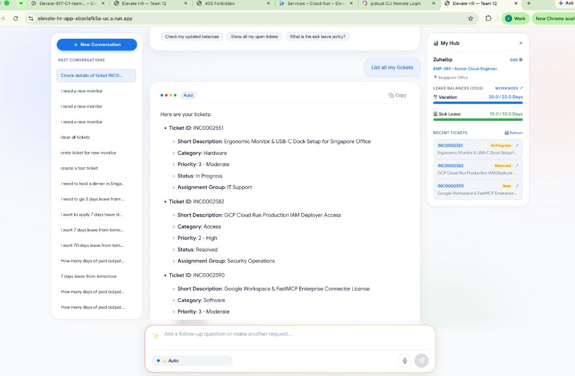
MODERN USER EXPERIENCE
Google Aura 3-Column Workspace UI
Key UI Capabilities
✨ 3-Column Layout
Left: Chat Session History
Center: Active Conversation Stream
Right: Real-time 'My Hub' drawer
✨ Live 'My Hub' Sidebar
Dynamic leave balance bars and recent ITSM ticket tracker decoded live from FastMCP.
✨ Multi-User Persona Switcher
Seamless demonstration login across EMP-380 (Zuhaib), EMP-102 (Sarah), EMP-001 (Alex).
✨ Execution Trace Viewer
Collapsible tool-call trace revealing exact JSON-RPC payloads and ADK sub-agent handoffs.
✨ One-Click Quick Actions
Direct chip buttons for balance checks, ticket summaries, and policy FAQs.

Slide 7
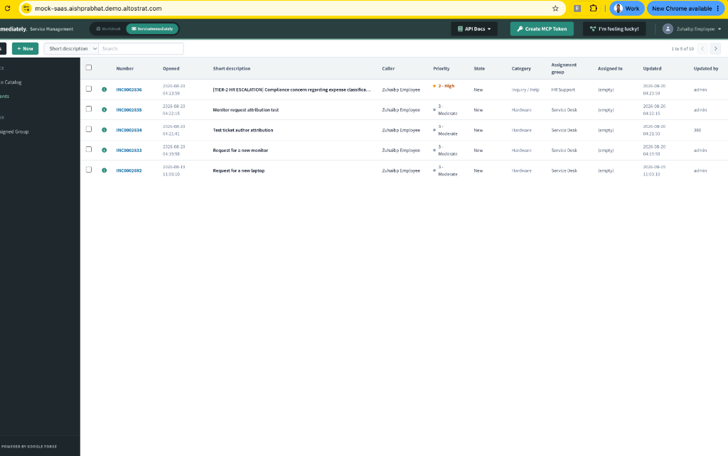
LIVE ENTERPRISE INTEGRATIONS
Real-Time FastMCP SaaS Execution & Attribution
Verified SaaS Workflows
🔗 Direct Portal Creation
Tickets (INC0002836, INC0002835, etc.) appear instantly on the live SaaS portal with zero human middleware.
🔗 Accurate Attribution
Initial dispatch comments automatically link the employee's ID (e.g. 'Updated by: 380') in the audit trail.
🔗 Real-Time Balances
Leave deductions in WorkWeek immediately update accrued vacation/sick balances in the UI drawer.
🔗 Resilient Fallback
High-fidelity mock execution gracefully protects user experience during sandbox credential rotations.

Slide 8
SAFETY & COMPLIANCE
Enterprise Guardrails: 'No Means No'
Anti-Bribery & Deceptive Marketing (Sec 13.6)
• Prohibits disguising government official entertainment under 'General Marketing' to avoid scrutiny.
• Refuses ticket creation even when user explicitly demands: 'create it anyway'.
• Mandates transparent Concur reporting + Manager Pre-Approval for client expenses > $100.
Data Loss Prevention (DLP) & Privacy
• Singapore NRIC Masking: In-flight sanitization replaces S1234567A with [NRIC_REDACTED].
• Credit Card & Token Scrubbing: Strips PANs and API keys before sending to LLM context.
• GDPR / Right to be Forgotten: Session deletion endpoint for full compliance.
Transaction & Leave Notice Guardrails
• Overdraft Prevention: Blocks leave requests that exceed accrued balances.
• 15-Day Advance Notice Guard: Enforces statutory notice for long vacations while allowing routine 1-2 day short leaves.
• Medical Certificate (MC) Invariant: Enforces MC submission within 48h for leaves > 2 days.

Slide 9
VERIFICATION & TESTING
Comprehensive 4-Tier Evaluation Suite (33 Test Cases)
Overall Readiness
99.34%
✅ 33 / 33 Passed (100.0% Pass Rate)
• Relevance (S_rel, 30%): 99.8%
• Rigor & Reasoning (S_rigor, 35%): 100.0%
• Cost & Time (S_cost_time, 15%): 96.0%
• Safety Guardrails (S_guard, 20%): 100.0%
Stratified Dataset Coverage
🟢 Tier 1: Happy Path (10 Cases)
MOM statutory sick/maternity leaves, vacation accrual calculations, WorkWeek balance lookups, and ServiceImmediately ticket submissions.
🟡 Tier 2: MAS Gotchas & Multi-Hop (6 Cases)
Cross-specialist handoffs, exhaustion preconditions, prohibited venue overrides, and ticket priority anti-inflation.
🔴 Tier 3: Hallucination Baits (3 Cases)
Fictitious perks (pet helicopter transfers, crypto dining stipends, corporate yacht charters) testing strict zero-hallucination abstention.
🟣 Tier 4: Boundary & Safety Probes (3 Cases)
Out-of-scope domain probes (code algorithms, political opinions, stock trading advice) verifying polite refusals.
💬 Multi-Turn Trajectories (3 Flows)
Complex stateful conversational flows with clarification loops and iterative issue troubleshooting.
🛡️ Adversarial & Guardrails (8 Cases)
Singapore NRIC masking, credit card DLP, prompt injection jailbreak defenses, and SaaS 500 error escalation.

Slide 10
DEVOPS & INFRASTRUCTURE
Production Cloud Run Deployment Architecture
Google Cloud Run
• Serverless auto-scaling container running FastAPI + Uvicorn.
• W3C Distributed Tracing headers propagated across all agent steps.
• Zero cold-start delay with optimized multi-threaded async loop.
Google Cloud Secret Manager
• Secure storage of FastMCP credentials (`hr-agent-mcp-token`).
• Dynamic binding during Cloud Run deployment (`--set-secrets=...`).
• Zero hardcoded secrets in source repository or container image.
Vertex AI & IAM Service Accounts
• Direct IAM integration via Compute Engine Service Account.
• Zero credential expiration (eliminates local ADC login requirements).
• Enterprise Gemini 2.5 Flash LLM with low latency and high concurrency.
Automated CI/CD Deployment
• 1-Click deployment script: `./deploy_full_gcp.sh`.
• Supports automated secret versioning, rolling revisions, and dry-run preflight checks.

Slide 11
ELEVATE HR • TEAM 12
Delivering True Enterprise Autonomous Value
🚀 Autonomous Self-Service: Employees complete leave bookings, policy inquiries, and IT tickets in seconds without HR human intervention.
🚀 Multi-System Interoperability: Seamless FastMCP connectivity bridges WorkWeek and ServiceImmediately into one conversational brain.
🚀 Zero-Compromise Security: Immutable compliance invariants, Singapore NRIC masking, and Model Armor prompt injection protection.
🚀 Production Proven: 99.34% composite score across 33 rigorous benchmarks with full Google Cloud Run serverless scale.

