Slide 1
SCAFFOLD
Knowledge-State-Driven Adaptive Scaffolding for Programming Labs
Helping students learn to code — not just submit code that runs.
Team
Member A — [Full name] (ML Engineer)
Member B — [Full name] (Systems Engineer)
Member C — [Full name] (Full-stack + Research)
Supervisor
[Supervisor full name], Department of Computer Science
Department
Computer Science, FAST NUCES
1
Notes:
Introduce the project name, the one-line problem, and the team. Emphasize: this targets the 'vibe coding' habit in programming labs, not a generic AI-tutor demo.

Slide 2
The problem: “vibe coding” in the lab
Who has the problem
Undergraduate students in lab-based programming courses (target: C++ Data Structures), and the instructors who must assess genuine skill development.
Current workflow
Paste the lab problem into ChatGPT / Copilot Chat
Copy the returned solution with minimal independent reasoning
Submit code that runs, but was never understood
Why it matters
Displaces the “productive struggle” known to drive durable skill acquisition
Invisible to instructors — a passing submission looks identical either way
Gaps in fundamentals surface later, in harder courses
Today's workflow
Lab problem statement
Pasted into AI chat
Solution copy-pasted
Submitted — runs, ungraded for understanding
No signal reaches the instructor about whether learning occurred.
Scaffold — FYP Proposal Defense
2
Notes:
Frame the problem concretely: who is affected, what they currently do, and why the existing workflow is invisible to instructors. This motivates the need for a system that can see and respond to the process, not just the final submission.

Slide 3
Where existing systems fall short
Dimension | CodeHelp (2023) | CodeAid (CHI'24) | ClassAid (CHI'26) | Scaffold (this project)
Per-student knowledge model | No | No | No | Yes — BKT / DKT
Intervention trigger | Student asks | Student asks | Instructor switches mode | Automatic (struggle detection)
Leakage prevention | Prompt guardrail | Pseudocode-only | Mode-based | Graduated policy + AST filter
Proactive support | No | No | Inactivity only | Yes — telemetry-driven
Cross-session profile | No | No | No | Yes — persists across labs
Real gap: no existing system automatically calibrates hint specificity to a live, per-student knowledge model.
Departmental FYP archive search finds no directly overlapping prior project (proposal Sec. 2.2).
Scaffold — FYP Proposal Defense
3
Notes:
Walk the table dimension by dimension. The key line to land: ClassAid is the closest system, and it still needs an instructor to manually switch modes. Nobody automates the calibration.

Slide 4
What the literature tells us
1
2
3
LLM tutoring
Knowledge tracing
Pedagogical alignment
Representative works
CodeHelp, CodeAid, STAP, ClassAid
What we learned
Prompt guardrails reduce leakage, but no system holds a knowledge model.
Representative works
Code-DKT, DPKT, pyBKT
What we learned
Predicts mastery accurately — but only offline; never feeds a live system.
Representative works
TutorRL / PedagogicalRL, PEARL, SocraticLM
What we learned
RL/DPO can bake tutor behavior into weights — but only ever tried on math.
~70 papers reviewed (2015–2026) across CHI, SIGCSE, EDM, AIED, ACL, EACL, AAAI — full list in proposal Appendix A.
Scaffold — FYP Proposal Defense
4
Notes:
Three clusters of prior work, each contributing one piece of the puzzle, none combining them. This sets up the gap statement on the next slides.

Slide 5
Why this is not a course project
Dimension | Course-project level | Scaffold's actual requirement
Modeling | Call an LLM API with a system prompt | Implement and empirically compare BKT, DKT, and a novel telemetry-enriched DKT variant
Systems | Single-user CRUD web app | Real-time event pipeline for 40–60 concurrent students, <200ms capture latency
ML / NLP | Prompt engineering only | Structured prompt injecting a live knowledge-state vector, plus a DPO fine-tuning experiment
Evaluation | Manual demo to supervisor | IRB-approved, 3-condition, within-subjects controlled classroom study
Security | Basic auth, input validation | Graduated AST-similarity leakage detector + adversarial jailbreak classifier
Research question: does KT-conditioned, proactively triggered scaffolding beat reactive, student-model-blind assistance?
Scaffold — FYP Proposal Defense
5
Notes:
Use this table if the committee pushes back on complexity. Every row shows a course-project baseline versus what Scaffold actually requires, across five different dimensions of difficulty.

Slide 6
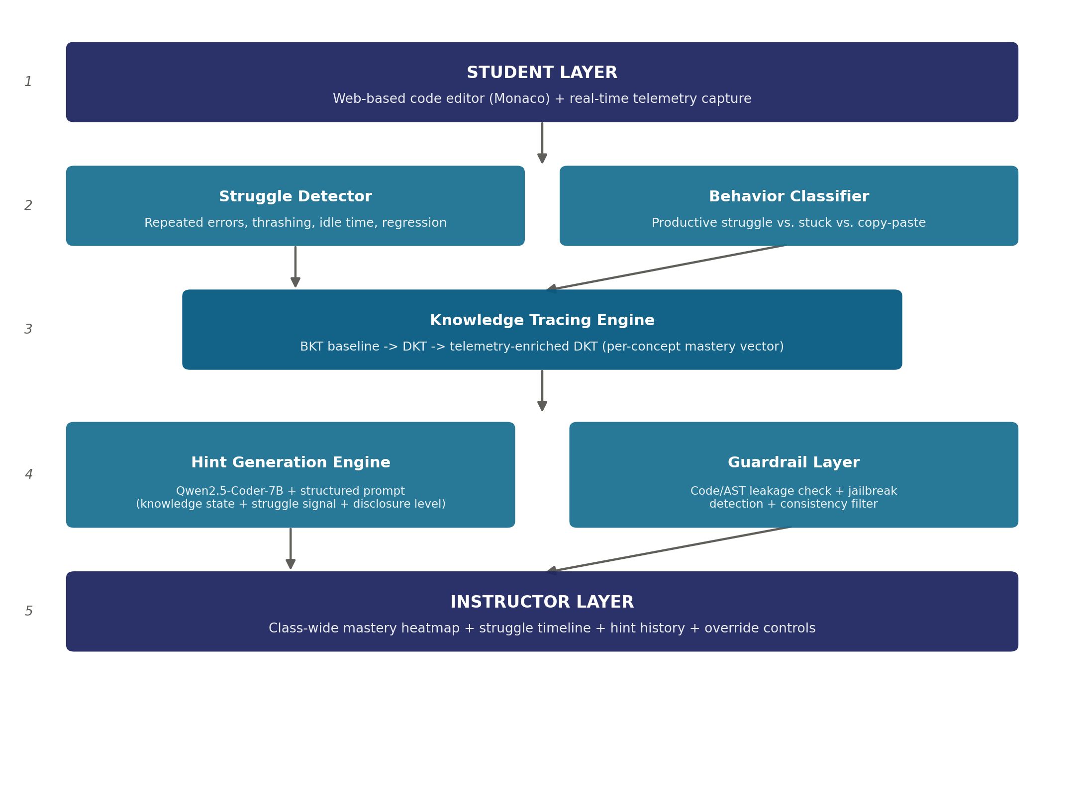
System architecture and contribution
Five-layer closed loop
Telemetry feeds struggle detection, which feeds a live knowledge-tracing model, which conditions LLM hint generation, filtered through a leakage guardrail, and surfaced to instructors.
Contribution statement
The first system closing the loop between real-time IDE telemetry, programming knowledge tracing, and knowledge-state-conditioned LLM hints, with a graduated leakage policy — evaluated through a controlled classroom study.
Secondary: the first application of preference-based pedagogical alignment (DPO) to code tutoring.
Scaffold — FYP Proposal Defense
6
Notes:
Walk the diagram bottom-to-top or top-to-bottom once, then land on the contribution box. This is the single slide a committee member would point to if asked 'what exactly are you building.'

Slide 7
What we can show today
Student IDE view
Instructor dashboard
Student profile
Architecture walkthrough
Editor, hint panel, live mastery sidebar
Class mastery heatmap, per-student drill-down
Per-lab mastery trend, recommendations
Animated data-flow across all 5 layers
Clickable, high-fidelity interface — every screen above uses mock data behind it. It demonstrates the experience, not yet the algorithms.
Technical spikes (feasibility evidence beyond the UI)
Spike | Task | Evidence | Effort
A — KT baseline | Fit BKT on CSEDM dataset | Documented AUC + mastery table | 4–6 hrs
B — Telemetry | Capture Monaco events live | Screen recording of live capture | ~2 days
C — End-to-end hint | Prompt + KT state → LLM → hint | Prompt + generated hint samples | ~1 day
Scaffold — FYP Proposal Defense
7
Notes:
Be explicit: the POC-lite is a UI shell only. The technical spikes are what actually prove feasibility. Recommend leading with Spike A during the defense since it is the lowest-effort, highest-signal evidence.

Slide 8
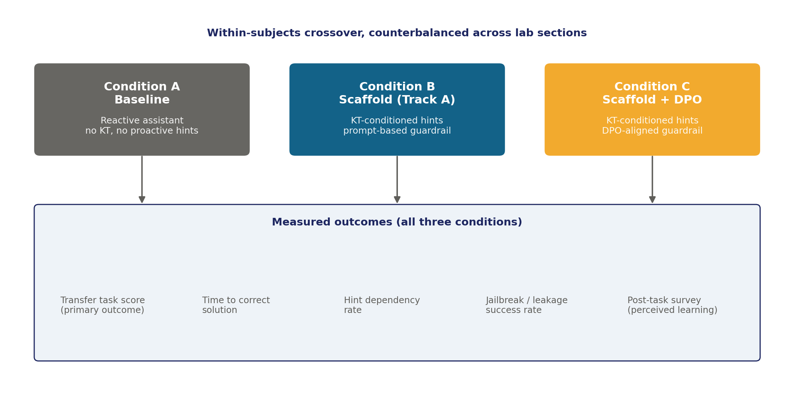
Measuring success, and what could go wrong
Top risks
Ethics approval delayed
Submit in Month 2, not Month 8; convenience-sample fallback
Qwen2.5-Coder-7B hint quality too low
Fall back to a commercial API for the study only
DPO experiment does not converge
Secondary only — Track A study stands alone as a complete thesis
Tool / API / GenAI boundary
Deployed system runs on the local RTX 3090 only. Commercial APIs (Claude/GPT-4) are used for development-time prototyping only — never in the live classroom study.
Scaffold — FYP Proposal Defense
8
Notes:
Cover the study design diagram first (three conditions, shared outcome measures), then pivot to the top three risks and the GenAI usage boundary, which the committee will specifically ask about.

Slide 9
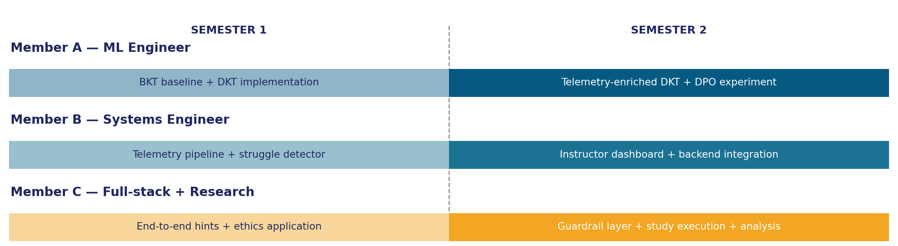
Who does what, and when
Member A — ML Engineer
Member B — Systems Engineer
Member C — Full-stack + Research
S1: BKT baseline, DKT implementation
S2: Telemetry-enriched DKT, DPO experiment
S1: Telemetry pipeline, struggle detector
S2: Instructor dashboard, backend integration
S1: End-to-end hints, ethics application
S2: Guardrail layer, study execution, analysis
Scaffold — FYP Proposal Defense
9
Notes:
Each member owns a vertical slice end-to-end across both semesters, so no one is blocked waiting on another's deliverable. Weekly stand-ups and bi-weekly supervisor check-ins keep the timeline honest; Months 5-6 and Month 10 carry deliberate slack.

Slide 10
DEI, ethics, and legal safeguards
D
Diversity, Equity & Inclusion
E
Ethical & Legal Compliance
Representation: external KT training data (CSEDM) may embed bias; performance will be checked across self-reported prior-exposure groups and disparities reported openly.
Accessibility: keyboard navigability tested; students may opt out of telemetry analysis while still receiving full assistance.
Informed consent + voluntary participation, no grade impact
Ethics/IRB approval sought Month 2, before any data collection
Data minimized, stored on university infrastructure only
KT mastery scores never shared with instructors for grading
Checked for demographic parity in KT predictions where data allows
No student data collection begins before written ethics approval is received.
Scaffold — FYP Proposal Defense
10
Notes:
Close on this slide with the bolded commitment at the bottom — it directly answers the most common objection committees raise about classroom AI studies: whether student data collection is properly safeguarded.

