Slide 1
IMA | PARSEHUB ASSIGNMENT
MUHAMMAD ZUHAIR SIDDIQUI | 19772

Slide 2
Background
In this project, we will be analyzing Pakistan Cricket Team’s performance throughout their entire history across all three formats, ODIs, Tests, and T20Is.
I have collected data from world’s leading cricket platform ESPNcricinfo through Parsehub data scrapper.
By using the scrapped data, we will see how Pakistan cricket team have performed over the years, their favorite venues, year by year trends, win to loss ratio, win percentage, and many other insights.

Slide 3
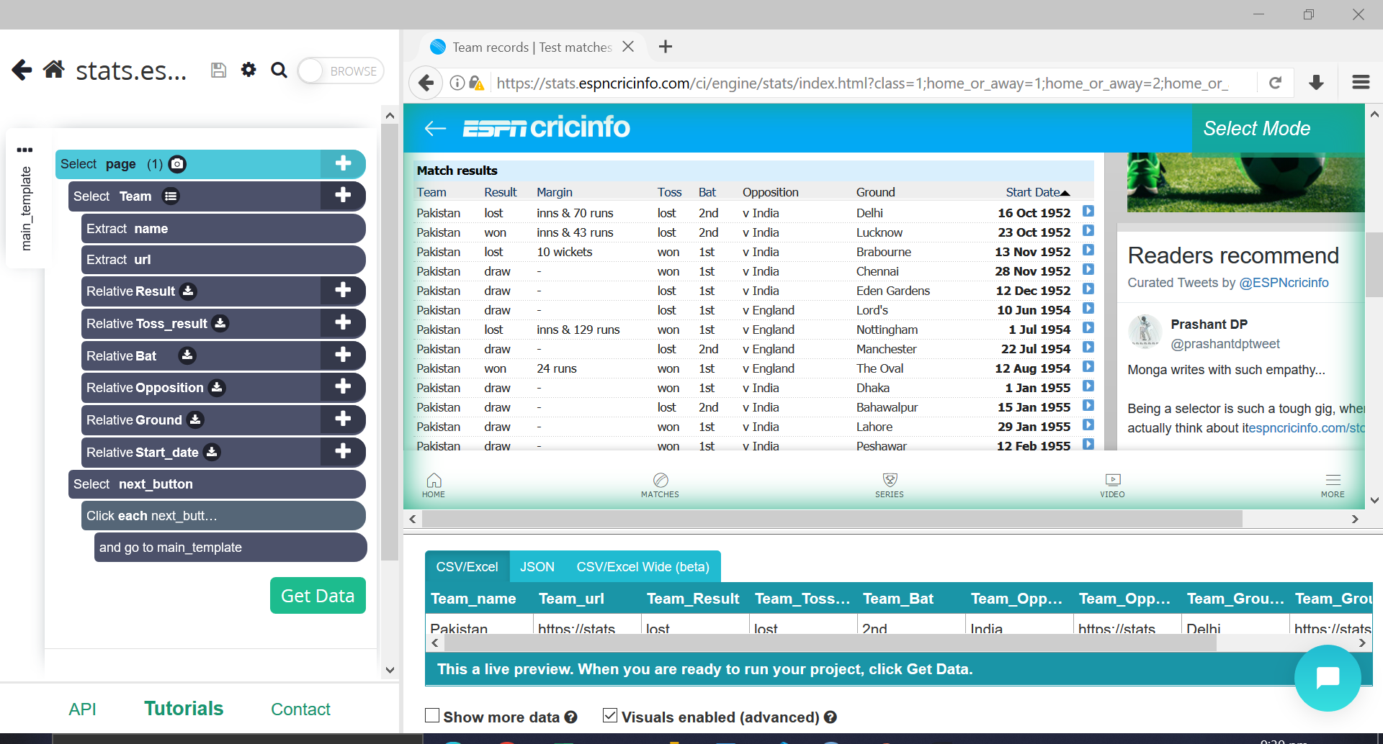
Data Scrapping with Parsehub

Slide 4
About Data
Data for each format (ODIs, Tests, and T20Is) were scrapped from separate parsehub projects.
Pagination was used to extract data from multiple pages.
There are 8 fields and 1607 rows in the dataset.

Slide 5
Data fields.
Team: this columns will contains only ‘Pakistan’ as we are analyzing only for Pakistan.
Match result: the end result of the particular match
Toss result: did Pakistan won the toss or not.
Bat_innings: in which innings did Pakistan bat, 1st or 2nd.
Opposition: which team did Pakistan play against.
Venue: ground in which the match was played.
Start_date: starting date of the match.
Format: Tests, Odis, or T20Is.

Slide 6
Analyzing performance of all formats collectively
Pakistan has played a total of 1607 international matches as of 8th December 2022
Out of these 1607 matches, Pakistan has won 775 games while losing 631 matches with 164 ending as draws, 12 tied, and 25 matches had no result.
Across its history, Pakistan have played 945 ODIs, 447 Test, and 215 T20Is.
Pakistan’s win-to-lose ratio is 1.23.
Pakistan have won more matches batting first than second, however the difference is marginal.
Pakistan have won its most matches in Sharjah (92) while Lahore being the second best (56), and Karachi third (55).
Pakistan has won its most matches against Sri Lanka 126 followed by West Indies, New Zealand, India, and Zimbabwe.
Pakistan’s least favorite opposition is Australia with 114 defeats against them.

Slide 7
Analyzing Pakistan Cricket in Tests
Out of 1607 international games, Pakistan have played 447 Test matches since 1950s.
Out of these 447 Tests, Pakistan have drawn 164, lost 137, and won 146.
Pakistan have played the most test matches against England, 87.
Pakistan have registered most wins in Test cricket against New Zealand than against any other team, with 25.
Pakistan have lost the most matches against Australia (34).
Pakistan have played the most test matches in Karachi (45) with Lahore being second (44).
Karachi is also the venue where Pakistan have won its most Test matches, 24.

Slide 8
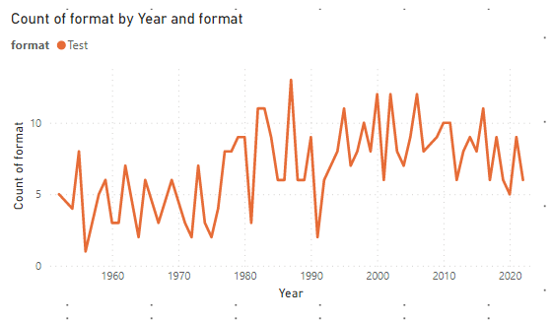
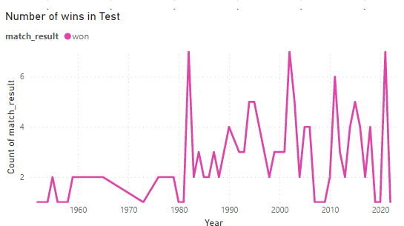
Analyzing Test cricket with visuals
Number of matches played every year. Number of wins every year

Slide 9
Analyzing Pakistan Cricket in ODIs
Pakistan have played 945 ODI matches.
Out of these 945 games, Pakistan have won 498 and have lost 418.
Win percentage of 52.7 while win-to-lose ratio of 1.19.
Pakistan have played its most ODI matches against Sri Lanka 155 while the most wins have come against the same opposition with 92 victories.
West Indies have defeated Pakistan the most, 71 times.
Pakistan have played most of its ODI matches in Sharjah and also have the most victories there, 83.
In ODI cricket, Pakistan have won more matches batting first (263) than chasing (235)

Slide 10
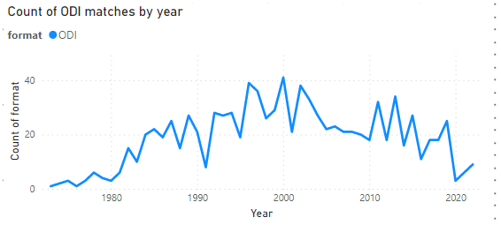
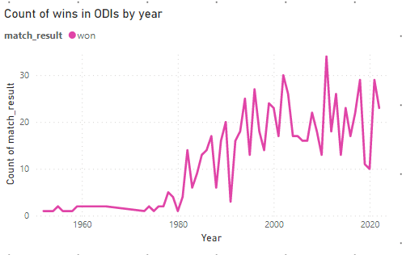
Analyzing ODI cricket with visuals
Count of ODI matches by year Count of ODI wins by year

Slide 11
Analyzing Pakistan cricket in T20Is
Pakistan have played 215 T20Is since the format’s inauguration.
Out of these 215 games, Pakistan have won 131 matches with 76 defeats.
A win% of 60.9 and a win-to-lose ratio of 1.72.
Pakistan have played the most number of T20 games against England and New Zealand with 29 games against each opponent.
Pakistan’s most victories have come against New Zealand (18).
England have defeated Pakistan the most number of times (18).
Pakistan have played a total of 32 T20I games in Dubai winning 17.
Pakistan have won 69 matches batting first while have won 62 chasing.

Slide 12
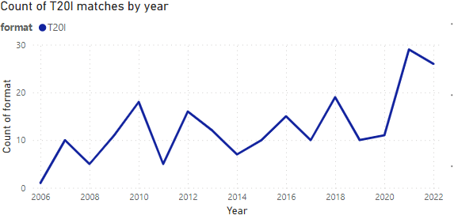

Count of T20I matches by year Count of T20I wins by year

Slide 13

More visuals
%win by year including all international matches

Slide 14


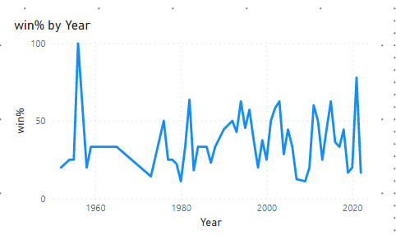
Win% by year in each format
ODIs T20Is Tests

Slide 15
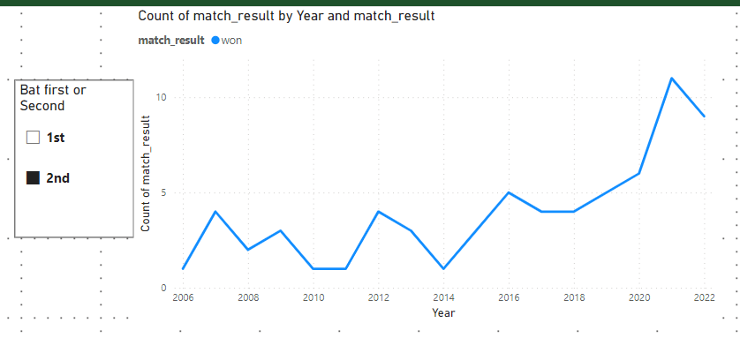
Conclusions
Pakistan’s favorite format as per the win percentage is T20 cricket.
As per the chart below, in T20I cricket, Pakistan have got better at chasing targets in last 8 years as the line chart shows an upward trend in number of wins per year when batting second.

