Slide 1
Machine Learning for Defects Root Cause Analysis
EXECUTIVE SUMMARY
In software development early prediction of defective software module is very important, as it can reduce the overall time, budget and increase the customer satisfaction by helping fulfilling customer requirements.
In order to achieve this ,it is essential to develop and implement various test cases which is a time consuming as well as tedious task.
The reliability and quality improvement of software systems by predicting fault-prone modules before the testing phase.
It focuses on pre-processing of data i.e. data cleaning, followed by dimensional reduction, which aims at reducing the noise and dimensions of the data sets.
Further, the system is trained to predict bugs efficiently at an earlier stage.
The main goal is to help RCA to concentrate their testing efforts to modules which have lesser bugs.

Slide 2
Background History
It is necessary to increase the quality of the product,
It is a challenging task for the companies to deliver reliable and a quality product.
A major task in developing a reliable and quality product is the identification of bugs.
These bugs degrade the overall reliability and quality of the software product, resulting in unreliable end-product and customer dissatisfaction.
The Software Development Lifecycle(SDLC) gives the various phases of software cycle and the order in which these phases are to be executed.
It comprises of the following stages:
1. Requirement gathering & analysis.
2. Design.
3. Implementation or coding.
4. Testing.
5. Deployment.
6. Maintenance.
According to IEEE standards, a 'bug' is an incorrect step, instruction or data in a program.
A software bug can be defined as a part of the code which would lead to an error, fault or may result in malfunctioning of the program. Despite proper planning, the occurrence of bug is inevitable.
There are various types of bugs which can be introduced in various phases of SDLC. For Example, in the requirement phase, if some requirements of the client are missed it will lead to development of incomplete product.
A bug in the design phase can lead to working of product in a way which was not intended.

Slide 3
Background History
As we proceed towards next phases of SDLC it becomes more and more harder to predict bugs in the software
It also becomes tough not to break existing functionality, when implementing new features.
Software Testing it the process which is done to find the quality of the product and its deviation from the desired outcome, which was identified during the Requirement gathering & Analysis phase
The main intention of testers during this process is to identify the bugs in the software.
Testing team can use the predicted defects to efficiently plan, manage and control test execution activities
The evolution of software engineering techniques has led to development of many bug prediction algorithms
These algorithms intend to find the bug-prone areas of the software.
Some algorithms make use of statistical methods, some use code metrics; some are based on feature extraction
Analysis of the results produced by these algorithms have proved that these algorithms are successful in reducing the tediousness of the job of testers
Machine learning metrics of accuracy, error rate, precision, time taken, memory used, have been used to find out the performance of these algorithms

Slide 4
Fact Finding Techniques Survey
Studies have found that, of the overall software development process 27% of the total time required for the development of project is consumed by testing.
Early prediction of bugs in software proves helpful to Software Testing & Quality Assurance (QA) team & it has been an area for continuous study for a long time
Software Defect prediction is very important in order to provide reliable and quality product
Over the past few years’ software fault prediction models have got a lot of attention from developers
Still there is need of fault prediction method which is robust, easy to implement and widely applicable
Bugs can be classified on the basis of their occurrence (frequency) and the severity of the bug
According to severity, bugs can be classified as catastrophic, major, minor, and those with no effect. It is vital to predict and remove the occurrence of major and catastrophic bugs at least
Defect analysis is of two types Classification and Prediction
It includes finding out defect classes and predicting future defect trends

Slide 5
Fact Finding Techniques Survey
The adapted steps of defects prediction process are
-Labeling
-Pre-Processing
-Creating Training Sets
-Prediction and assessment
Naive Bayes have been proposed
It is still one of the favorable methods for fault prediction
Naive Bayes algorithm has also got high performance with respect to fault prediction
It is found that various machine learning approaches such as Supervised Learning, Semi-supervised Learning, and Unsupervised Learning are being used for building fault prediction models
Among these, supervised learning approach is mostly used and is found to be more useful for predicting
Fault modules if sufficient amount of fault data is available

Slide 6
PROPOSED WORK
Defects prediction is needed to identify the different semantics and syntactical attributes analysis for identifying the error and bugs
Therefore, it is a classification and pattern analysis problem. Additionally, a lot of data is available in high dimension attributes which needs to be optimized by enhancing classification accuracy & resource consumption optimization in terms of space and time complexity
The goal here is to perform efficient bug prediction in model, so that the crucial task of testing will become easier
The approach will find applicability in ML model to make the task of testing easier and to get a better, reliable and less faulty end product. It will be helpful for both the testers and the end user
It will help testers to make better test cases better and help end user to get a better product
The initial expected that the major issues will be in
- Defects Dimensions ,when the defects data sets have huge dimensions, processing is improper and it becomes difficult to find it
- Noisy data, presence of noise in the relevant data makes the task of testing complex
- Cost , the cost of defect correct is marginally high after defect correction

Slide 7
PROPOSED WORK
In order to provide a solution to these problems, it is required to have better data sets
Using data cleaning techniques noisy data can be removed
The Model can be trained using Naïve Bayes can be performed
The Proposed model for defects prediction components
Input Training set , It is simple user interface that accepts the raw training data.
Pre-Processing: In this the training data is normalized & transformed to find more relevant attributes
Proposed Algorithm is the Naive Bayes Classifier technique is based on the so-called Bayesian theorem and is particularly suited when the dimensionality of the inputs is high
Despite its simplicity, Naive Bayes can often outperform more sophisticated classification methods
In the Bayesian analysis, this belief is known as the prior probability
After the study, it has been observed that early prediction of bugs leads to better resource planning, test planning and ultimately to a reliable and less faulty end product
Thus, the use of such kind of techniques will help the testers and will lead to development of a less faulty product
With the help of regression analysis approach, the occurrence of new faults and re-occurrence of existing faults will not take place
By training the neural network, the learning capacity of the system will be improved, which is a futuristic approach for bug prediction

Slide 8
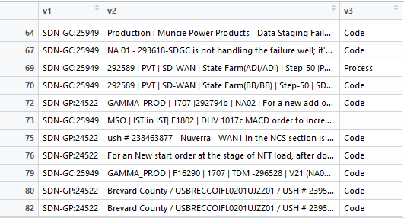
Sample Data of defects coding
Root cause App = v1,
Summary = v2,
ActualRC = v3

Slide 9
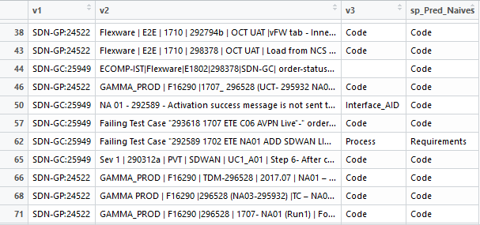
Actual test
Data
Prediction
Data

Slide 10

Conclusion
The prediction of defects leads to better resource planning, test planning and ultimately to a reliable and less faulty end product
Thus, the use of such kind of techniques will help the testers and will lead to development of a less faulty product
With the help of NB analysis approach, the occurrence of new faults and re-occurrence of existing faults will not take place
By training the data, the learning capacity of the system will be improved, which is a futuristic approach for defects prediction
Predicted
12 SDN-GP:24522 ,Code
1 SDN-CP:24291,NA
11 SDN-GC:25949,Code
1 SDN-GC:25949,Requirments

