Slide 1
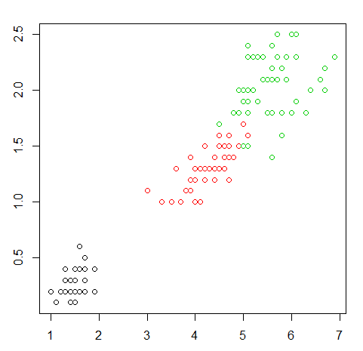
Preventable Outages & Operational Error
Problem: There is a cluster of Servers, whenever there is failure/anomaly in any of the server, how to minimize impacts
Solution : find patterns from available data as to when such anomalies can occur ,creating a SVMs support vector networks are supervised learning models with associated learning algorithms that analyze data used for classification and regression analysis
Benefits:
-Root cause error
-Minimize risk factors
-Preventing & correcting process
-Solving procedural problems
Sample Data:
Server name | Power | Temperature | Humidity | Location | Status
192.168.12.10 | 1 | 27 | 60 | 1 | Warn
192.168.15.13 | 1 | 22 | 60 | 2 | Normal
192.168.60.20 | 0 | 30 | 60 | 3 | Disconnect
ML SVM
ML SVM

