Slide 1

INFLUENZA MODEL using FPGA
Chaotic Epidemic Models

Slide 2
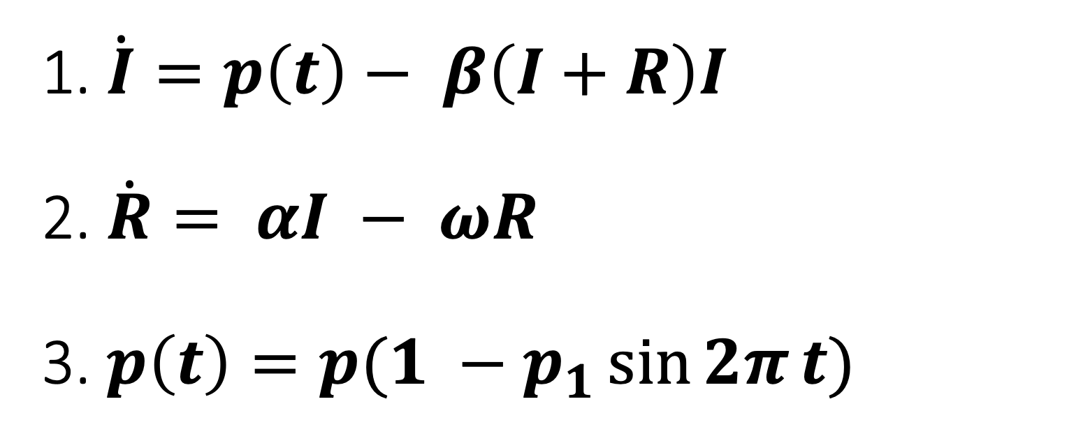
1. $\dot{I}=p\left(t\right)− β\left(I+R\right)I$ 2. $\dot{R}= αI − ωR$ 3. $p\left(t\right)=p(1 −p_{1}\sin{2π}t)$

Slide 3


1. $\dot{I}=p\left(t\right)− β\left(I+R\right)I$
$β$ = 0.1 and is a sensitive parameter
2. $\left(I+R\right)I$

Slide 4
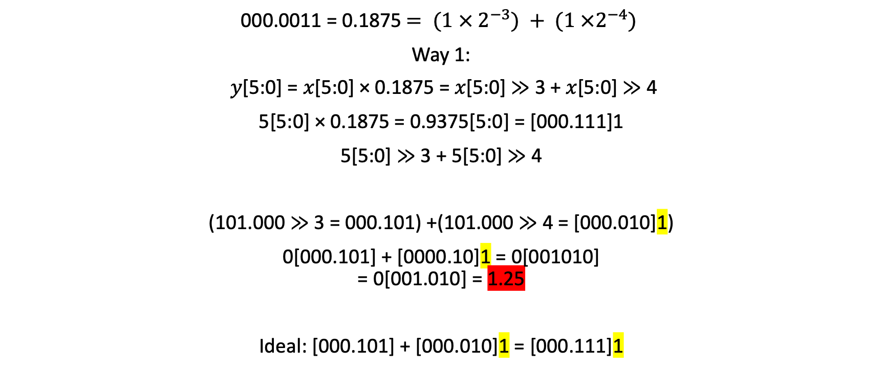
1. Multiply py 0.1 → take simple example → multiply py 0.1875
000.0011 = 0.1875 $= (1 × 2^{−3}) + (1 ×2^{−4})$
Way 1:
𝑦[5:0] = 𝑥[5:0] × 0.1875 = 𝑥[5:0] ≫ 3 + 𝑥[5:0] ≫ 4
5[5:0] × 0.1875 = 0.9375[5:0] = [000.111]1
5[5:0] ≫ 3 + 5[5:0] ≫ 4
(101.000 ≫ 3 = 000.101) +(101.000 ≫ 4 = [000.010]1)
0[000.101] + [0000.10]1 = 0[001010] = 0[001.010] = 1.25
Ideal: [000.101] + [000.010]1 = [000.111]1

Slide 5

1. Multiply py 0.1 → take simple example → multiply py 0.1875
000.0011 = 0.1875 $= (1 × 2^{−3}) + (1 ×2^{−4})$
Way 2:
0.1875 = 011.000 >> 4
011.000 = $(1 × 2^{1}) + (1 ×2^{0})$
𝑦[5:0] = 𝑥[5:0] × 0.1875 = ((𝑥[5:0] ≪ 1) + (𝑥[5:0])) ≫ 4
5[5:0] × 0.1875 = (5[5:0] ≪ 1 + 5[5:0]) ≫ 4
(101.000 ≪ 1 = 1[010.000]) + (101.000)
1[010000] + 0[101000] = 1[111000] = 1[111.000] >> 4 = [000.111]1 = 0.875

Slide 6
Multibly by 0.1
0.1 = 0.0,001,100,110,011,001,101
0.1 = 1100110011001101.0 >> 19
1100110011001101.0 = (1 × 2¹⁵) + (1 × 2¹⁴) + + (1 × 2¹¹) + (1 × 2¹⁰) + (1 × 2⁷) + (1 × 2⁶) + (1 × 2³) + (1 × 2²) + (1 × 2⁰) = 52429
𝑦[31:0] = 𝑥[31:0] × 0.1 = (𝑥[31:0] × 52429) >> 19

Slide 7
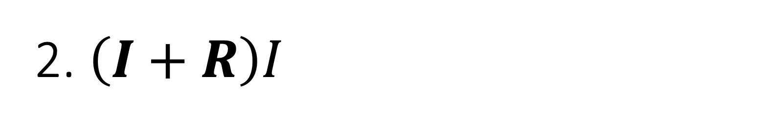
2. $\left(I+R\right)I$
Simple example:
Idealy:
010.001 (2.125) × 011.100 (3.5) = [111.011]1 (7.4375) → (7.375)
A𝑝𝑝𝑙𝑖𝑒𝑑:
010.001 × 011.100 = 00111[011.100] = 3.5
Shift left by size/2 to get the desimal in its right place
𝑥[5: 0] × 𝑦[5: 0] ≪ 3 = 00[111.011]100 = 7.375

Slide 8

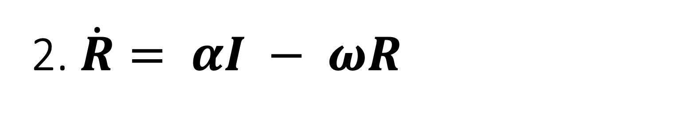
2. $\dot{R}= αI − ωR$
1. $ω=0.05$ and is not sensitive, assume to be 0.0625
2. $α=100$ and is not sensitive, assume to be 128
$$\dot{R}= I≪7 − R≫4$$

Slide 9

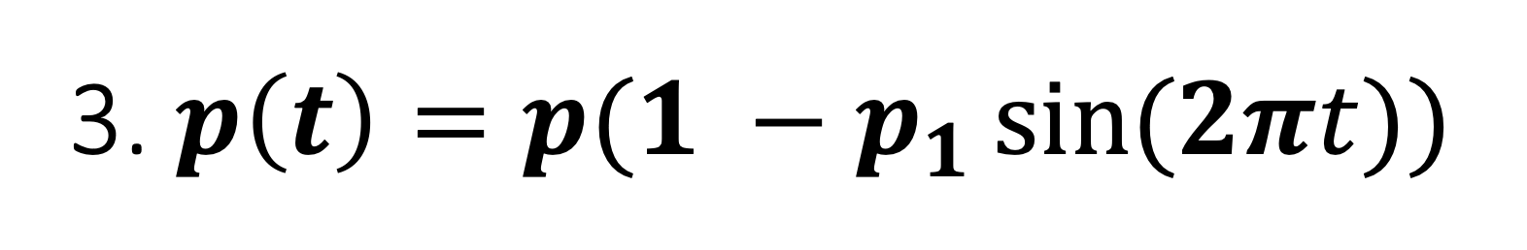
3. $p\left(t\right)=p(1 −p_{1}\sin{(2πt)})$
$p_{1}=0.2$ and is a sensitive parameter, we will do the same we did
with 0.1
2. $p$ = 1000 and is not sensitive, assume to be 1024.
3. $\sin{(2πt)}$

Slide 10
1. Multibly by 0.2
0.2 = 0.00,110,011,001,100,110,011
0.2 = 110011001100110011 >> 20
110011001100110011 = 209715 = (1 × 2¹⁷) + (1 × 2¹⁶) + (1 × 2¹³) + (1 × 2¹²) + (1 × 2⁹) + (1 × 2⁸) + (1 × 2⁵) + (1 × 2⁴) + (1 × 2¹) + (1 × 2⁰)
𝑦[31:0] = 𝑥[31:0] × 0.2 = (𝑥[31:0] × 209715) >> 20

Slide 11
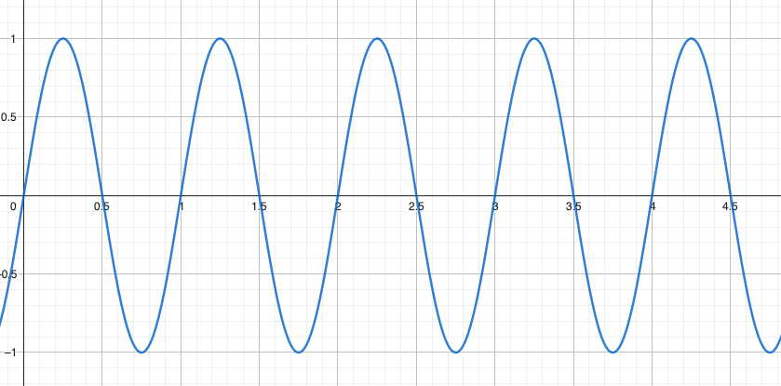

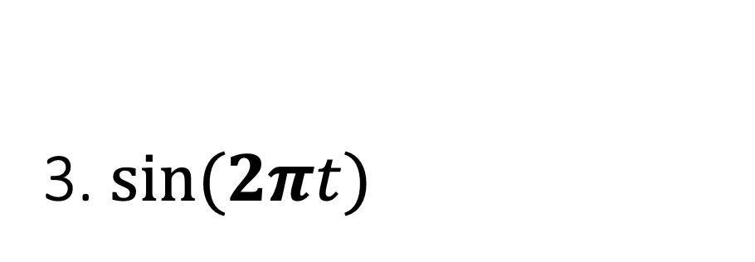
3. $\sin{(2πt)}$
$\sin{(2πt)}$ is always zero if we do an increment of one at every clk posedge.
So we are going to make some precision.
Add 0.0625 at every clk posedge
And so, every 16 clk we have one revolution
t[31:11]<=t[31:11]+1'b1;

Slide 12
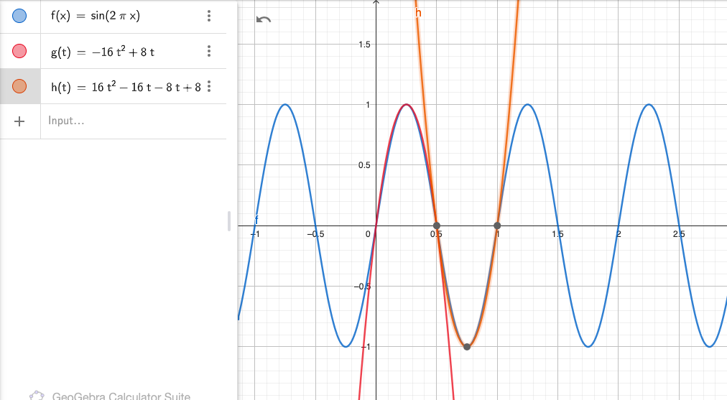

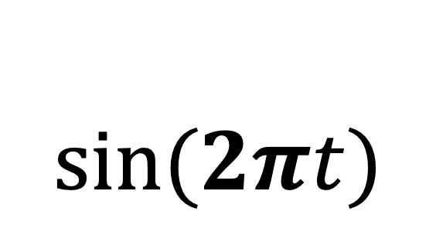
$$\sin{(2πt)}$$
When t [fraction_part] < 0.5
i.e., t[15:0] < 16'd32768
$\sin{(2πt)}$ = -16 $t^{2}+8t$
where t <= t [fraction_part]
2. When t [fraction_part] > 0.5
$$\sin\left(2πt\right)=16t^{2}−24t+8$$
Where t <= t [fraction_part]

Slide 13
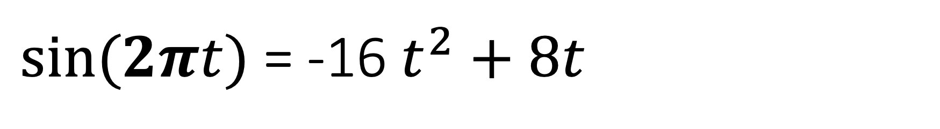
$\sin{(2πt)}$ = -16 $t^{2}+8t$
t[31:0] = {16’d0, t[15:0]}
y[31:0] = (t[31:0]*t[31:0] << 16)
Y[31:0] = y[31:0] << 4
Y[31:0] = t[31:0] << 3 – y[31:0]

Slide 14
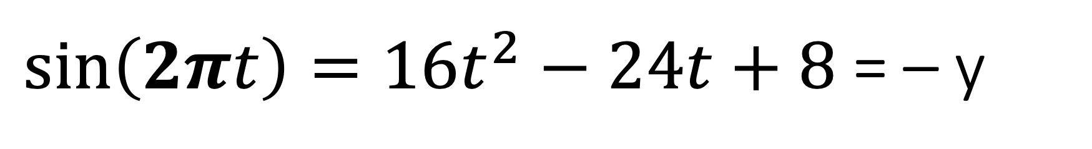
$\sin\left(2πt\right)=16t^{2}−24t+8$ = – y
t[31:0] = {16’d0, t[15:0]}
y[31:0] = (t[31:0]*t[31:0] << 16)
Y[31:0] = y[31:0] << 4
Y[31:0] = (t[31:0] << 4) + (t[31:0] << 3) – y[31:0]
Y[31:16] = y[31:16] – 4’d8
Sign = 1

Slide 15


$$p\left(t\right)=p(1 −p_{1}\sin{(2πt)})$$
If (sign is negative):
P(t) = $p(1 + p_{1} ∗ y[31:0])$
Else:
P(t) = $p(1 − p_{1} ∗ y[31:0])$

