Slide 1


Fourth order stable system generation with one value of K to yield a marginally stable.
Automatic control
SUBMITTED TO: DR. Zaer Abu Hammour

Slide 2
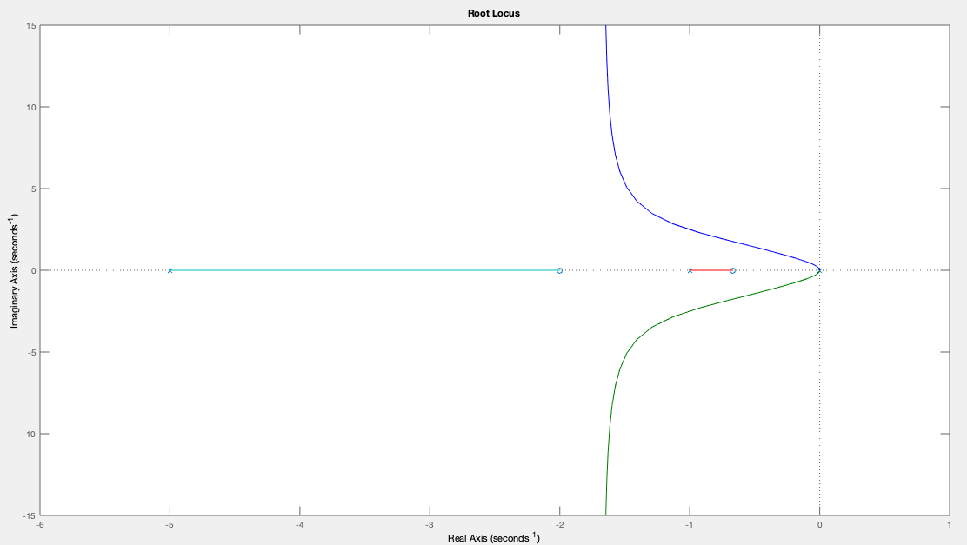
The desired system root locus
Repeated poles at origin

Slide 3
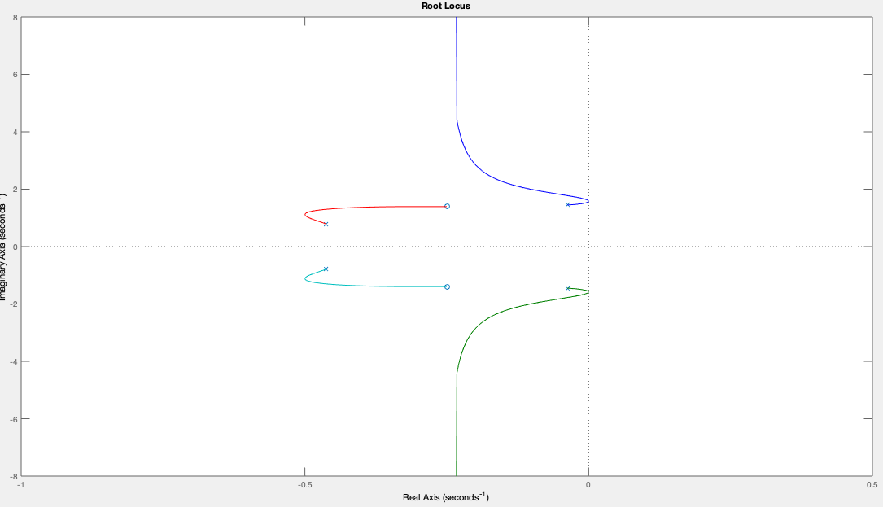
The desired system root locus
n-m=2

Slide 4
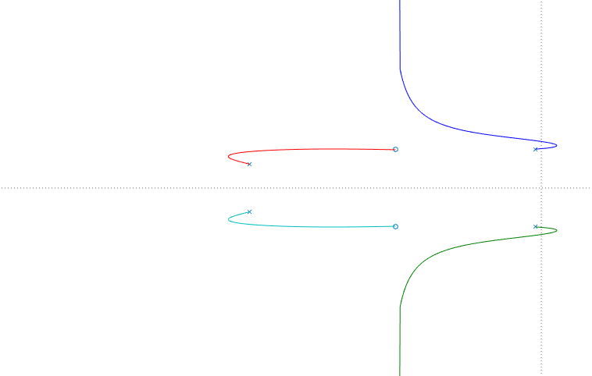
1. N-m=2 2. crossing jw-axis 3. Starting and ending at L.H.S in the general case

Slide 5
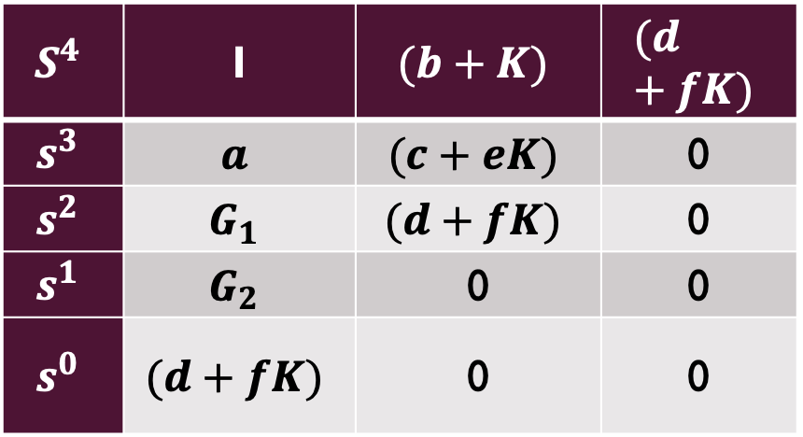

Routh stability
$$S^{4}$$ | 1 | $$(b+K)$$ | $$(d+fK)$$
$$s^{3}$$ | $$a$$ | $$(c+eK)$$ | 0
$$s^{2}$$ | $$G_{1}$$ | $$(d+fK)$$ | 0
$$s^{1}$$ | $$G_{2}$$ | 0 | 0
$$s^{0}$$ | $$(d+fK)$$ | 0 | 0
${Q(s)=s}^{4}+as^{3}+\left(b+K\right)s^{2}+\left(c+eK\right)s+\left(d+fK\right)$
G1 will depend on k with order of one G1= A+Bk
G2 will depend on k with order of two G2= $\frac{K^{2}−AK+C}{\text{A}\text{+}\text{Bk}}$
At the jw-axis, we will have symmetry, that will yield a row of zero.
to solve for k at that symmetry, we will have two values of k, k low and k high.

Slide 6
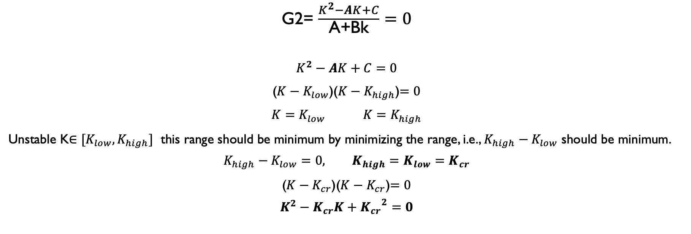
Row of zero
G2= $\frac{K^{2}−AK+C}{\text{A}\text{+}\text{Bk}}=0$
$$K^{2}−AK+C=0$$
($K−K_{low}$)($K−K_{high}$)$=0$
$K=K_{low}$ $K=K_{high}$
Unstable K$∈[K_{low},K_{high}]$ this range should be minimum by minimizing the range, i.e., $K_{high}−K_{low}$ should be minimum.
$$K_{high}−K_{low}=0, K_{high}=K_{low}=K_{cr}$$
($K−K_{cr}$)($K−K_{cr}$)$=0$
$$K^{2}−K_{cr}K+{K_{cr}}^{2}=0$$

Slide 7
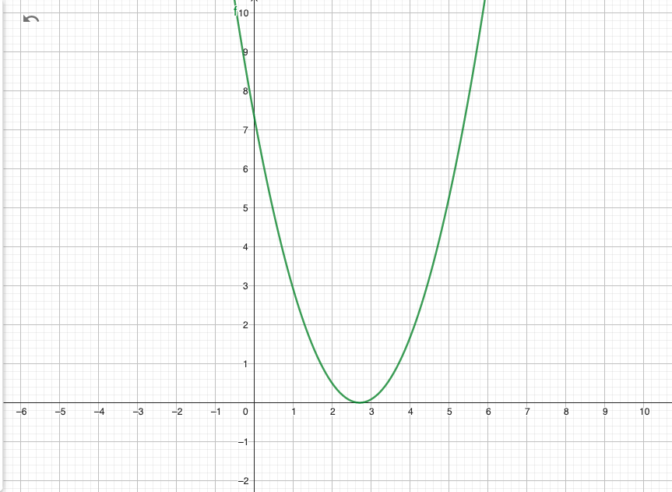

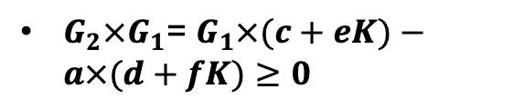



$$K^{2}−K_{cr}K+{K_{cr}}^{2}$$
$K^{2}−K_{cr}K+{K_{cr}}^{2}≥0$
$K^{2}−K_{cr}K+{K_{cr}}^{2}=G_{2}×G_{1}$
If $G_{1}$>0 → $G_{2}$>0
$G_{2}×G_{1}$= $G_{1}×(c+eK)−a×(d+fK)≥0$
$a×\left(d+fK\right)>0$

Slide 8


$$G_{2}×G_{1}=G_{1}×(c+eK)−a×(d+fK)≥0$$
$G_{1}×\left(c+eK\right)>0$
$G_{1}>0$
$G_{2}>0$
Recall: $K^{2}−K_{cr}K+{K_{cr}}^{2}≥0$ as condition
Check one value of K that make the condition true, means the condition is always fulfilled.

Slide 9
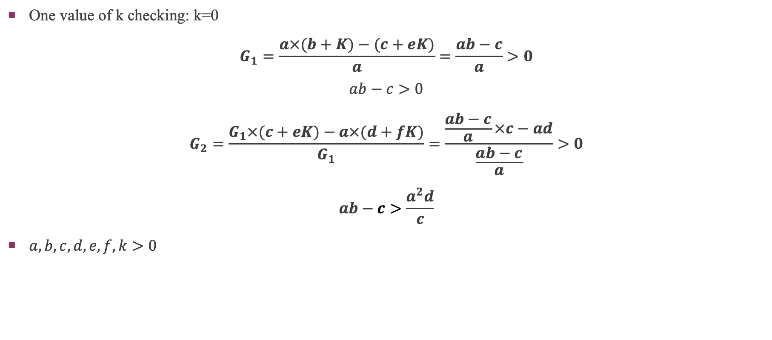
No sign change and necessary conditions:
One value of k checking: k=0
$$G_{1}=\frac{a×(b+K)−(c+eK)}{a}=\frac{ab−c}{a}>0$$
$$ab−c>0$$
$$G_{2}=\frac{G_{1}×(c+eK)−a×(d+fK)}{G_{1}}=\frac{\frac{ab−c}{a}×c−ad}{\frac{ab−c}{a}}>0$$
$$ab−c>\frac{a^{2}d}{c}$$
$a,b,c,d,e,f,k>0$

Slide 10

Row of zero
$$G_{1}×\left(c+eK\right)−a×\left(d+fK\right)=K^{2}−K_{cr}K+{K_{cr}}^{2}=0$$
$${K_{cr}}^{2}+(\frac{c+eb−2c\frac{e}{a}−af}{e−\frac{e^{2}}{a}})K_{cr}+(\frac{cb−ad−\frac{c^{2}}{a}}{e−\frac{e^{2}}{a}})=0$$
$$−K_{cr}=\frac{c+eb−2c\frac{e}{a}−af}{e−\frac{e^{2}}{a}}<0$$
$${K_{cr}}^{2}=\frac{cb−ad−\frac{c^{2}}{a}}{e−\frac{e^{2}}{a}}>0$$
$$\frac{cb−ad−\frac{c^{2}}{a}}{e−\frac{e^{2}}{a}}={(\frac{c+eb−2c\frac{e}{a}−af}{2(e−\frac{e^{2}}{a})})}^{2}$$

Slide 11

Set of equations 1/3
$$ab−c>\frac{a^{2}d}{c}, cb−ad−\frac{c^{2}}{a}>0$$
$$a,b,c,d,e,f,k>0$$
$$−K_{cr}=\frac{c+eb−2c\frac{e}{a}−af}{e−\frac{e^{2}}{a}}<0$$
$${K_{cr}}^{2}=\frac{cb−ad−\frac{c^{2}}{a}}{e−\frac{e^{2}}{a}}>0$$
$$\frac{cb−ad−\frac{c^{2}}{a}}{e−\frac{e^{2}}{a}}={(\frac{c+eb−2c\frac{e}{a}−af}{2(e−\frac{e^{2}}{a})})}^{2}$$

Slide 12

$$ab−c>\frac{a^{2}d}{c}, cb−ad−\frac{c^{2}}{a}>0$$
$${K_{cr}}^{2}=\frac{cb−ad−\frac{c^{2}}{a}}{e−\frac{e^{2}}{a}}>0$$
→ $e−\frac{e^{2}}{a}>0$
→$e\frac{e}{a}<e$
→ $e<a$

Slide 13

Set of equations 2/3
$$ab−c>\frac{a^{2}d}{c}$$
$$e<a$$
$$a,b,c,d,e,f,k>0$$
$$c+eb−2c\frac{e}{a}−af<0$$
$$\frac{cb−ad−\frac{c^{2}}{a}}{e−\frac{e^{2}}{a}}={(\frac{c+eb−2c\frac{e}{a}−af}{2(e−\frac{e^{2}}{a})})}^{2}$$

Slide 14
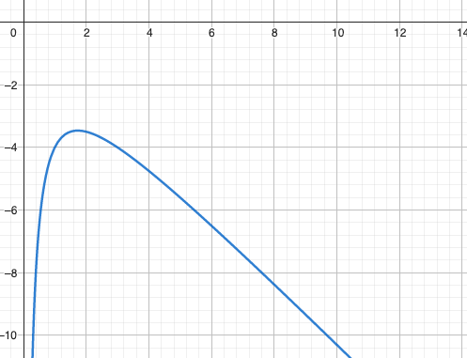
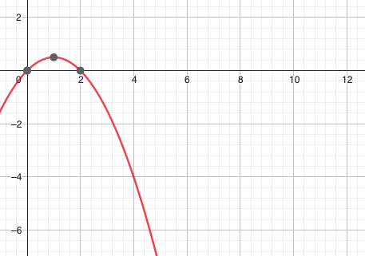
$$ab−c>\frac{a^{2}d}{c}$$
a | b | c | d
a=1 | Large b | C=1 | Small d

Slide 15
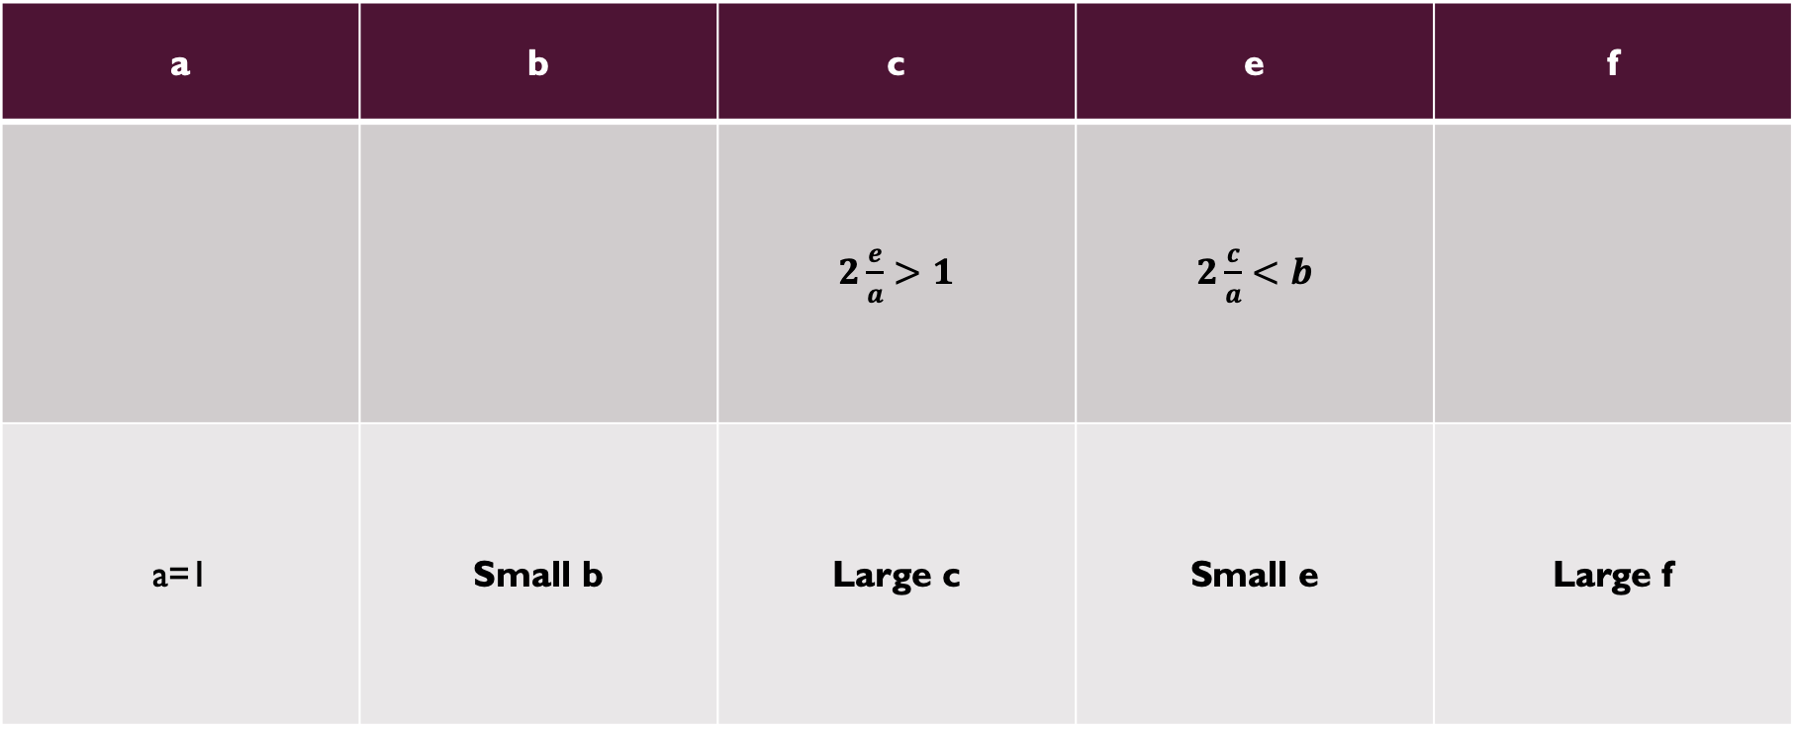
$$c+eb−2c\frac{e}{a}−af<0$$
a | b | c | e | f
 |  | $2\frac{e}{a}>1$ | $2\frac{c}{a}<b$
a=1 | Small b | Large c | Small e | Large f

Slide 16

Set of equations 3/3
$$a=1\text{, } c=2$$
$$\frac{e}{a}<1<2\frac{e}{a}$$
$$0.5<e<1$$
$2\frac{c}{a}<b$
$2c<b$
$c+eb<2ce+f$
$$b−2c<f−c$$
$$b−f<2, b>4, f>2$$
$b>\frac{d}{c}+c$ if $c>1$
$$d<4$$
$$\frac{cb−ad−\frac{c^{2}}{a}}{e−\frac{e^{2}}{a}}={(\frac{c+eb−2c\frac{e}{a}−af}{2(e−\frac{e^{2}}{a})})}^{2}$$

Slide 17
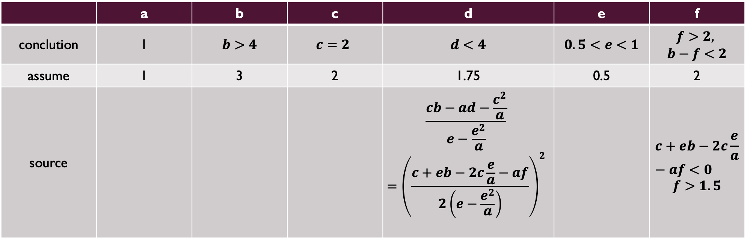
Results 1/2
 | a | b | c | d | e | f
conclution | 1 | $b>4$ | $$c=2$$ | $d<4$ | $0.5<e<1$ | $$f>2,$$ $b−f<2$
assume | 1 | 3 | 2 | 1.75 | 0.5 | 2
source |  |  |  | $$\frac{cb−ad−\frac{c^{2}}{a}}{e−\frac{e^{2}}{a}}$$ $$={\left(\frac{c+eb−2c\frac{e}{a}−af}{2\left(e−\frac{e^{2}}{a}\right)}\right)}^{2}$$ |  | $$c+eb−2c\frac{e}{a}−af<0$$ $f>1.5$

Slide 18
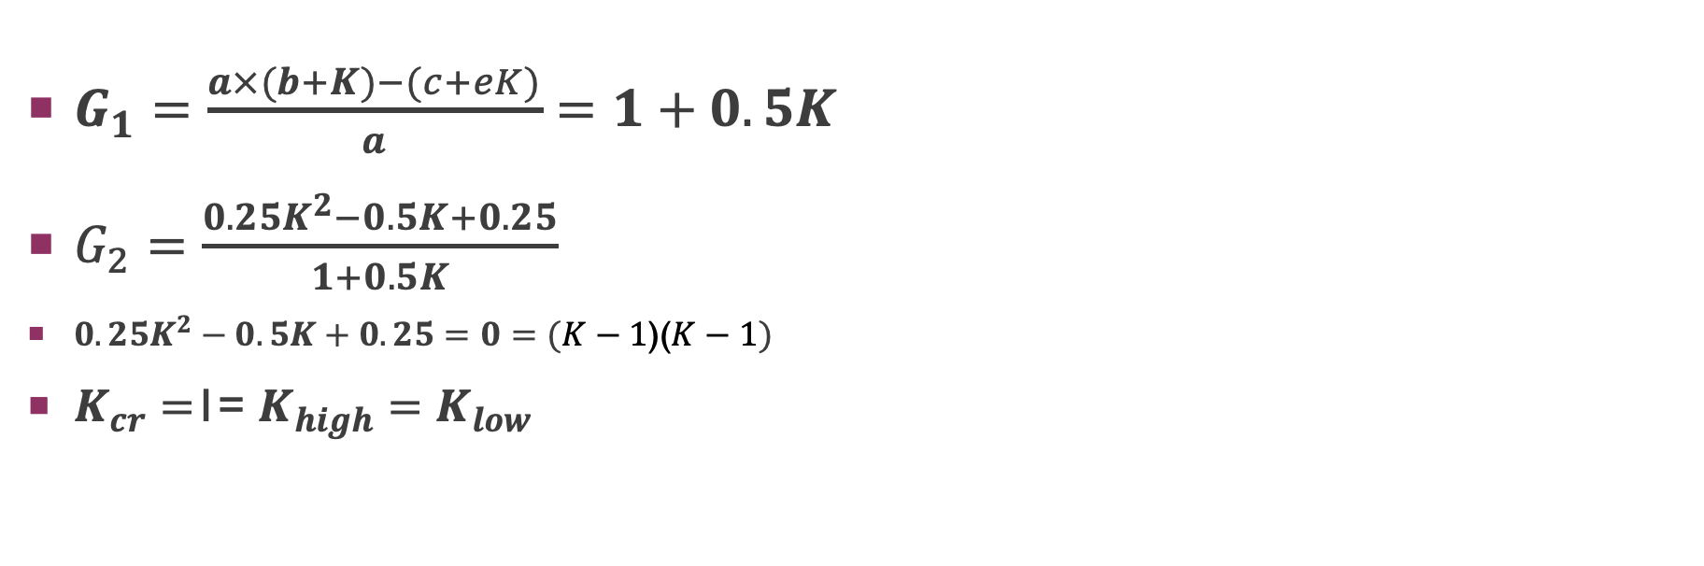
Results 2/2
$G_{1}=\frac{a×(b+K)−(c+eK)}{a}=1+0.5K$
$G_{2}=\frac{0.25K^{2}−0.5K+0.25}{1+0.5K}$
$0.25K^{2}−0.5K+0.25=0=(K−1\text{)(}K−1)$
$K_{cr}=$1= $K_{high}=K_{low}$

Slide 19

Solution:
$$Q(s)=1+K\frac{s^{2}+0.5s+2}{s^{4}+s^{3}+3s^{2}+2s+1.75}$$

Slide 20
Thanks for letting us explore our limits and know our abilities

