Slide 1

Chapter 4
Data Preprocessing
To make data more suitable for data mining.
To improve the data mining analysis with respect to time, cost and quality.

Slide 2
Why Data Preprocessing?
Data in the real world is dirty
  incomplete: missing attribute values, lack of certain attributes of interest, or containing only aggregate data
    e.g., occupation=“”
  noisy: containing errors or outliers
    e.g., Salary=“-10”
  inconsistent: containing discrepancies in codes or names
    e.g., Age=“42” Birthday=“03/07/1997”
    e.g., Was rating “1,2,3”, now rating “A, B, C”
    e.g., discrepancy between duplicate records

Slide 3
Why Is Data Preprocessing Important?
No quality data, no quality mining results!
  Quality decisions must be based on quality data
    e.g., duplicate or missing data may cause incorrect or even misleading statistics.
Data preparation, cleaning, and transformation comprises the majority of the work in a data mining application (90%).

Slide 4
Major Tasks in Data Preprocessing
(Fig 3.1)
Data cleaning
  Fill in missing values, smooth noisy data, identify or remove outliers and noisy data, and resolve inconsistencies
Data integration
  Integration of multiple databases, or files
Data transformation
  Normalization and aggregation
Data reduction
  Obtains reduced representation in volume but produces the same or similar analytical results
Data discretization (for numerical data)

Slide 5
Data Cleaning
Importance
  “Data cleaning is the number one problem in data warehousing”
Data cleaning tasks – this routine attempts to
  Fill in missing values
  Identify outliers and smooth out noisy data
  Correct inconsistent data
  Resolve redundancy caused by data integration

Slide 6
Missing Data
Data is not always available
  E.g., many tuples have no recorded values for several attributes, such as customer income in sales data
Missing data may be due to
  equipment malfunction
  inconsistent with other recorded data and thus deleted
  data not entered due to misunderstanding
  certain data may not be considered important at the time of entry
  not register history or changes of the data

Slide 7
How to Handle Missing Data?
Ignore the tuple
  Class label is missing (classification)
  Not effective method unless several attributes missing values
Fill in missing values manually: tedious (time consuming) + infeasible (large db)?
Fill in it automatically with
  a global constant : e.g., “unknown”, a new class?! (misunderstanding)

Slide 8
Cont’d
the attribute mean
  Average income of AllElectronics customer $28,000 (use this value to replace)
The attribute mean for all samples belonging to the same class as the given tuple
the most probable value
  determined with regression, inference-based such as Bayesian formula, decision tree. (most popular)

Slide 9
Noisy Data
Noise: random error or variance in a measured variable.
Incorrect attribute values may due to
  faulty data collection instruments
  data entry problems
  data transmission problems
  etc
Other data problems which requires data cleaning
  duplicate records, incomplete data, inconsistent data

Slide 10
How to Handle Noisy Data?
Binning method:
  first sort data and partition into (equi-depth) bins
  then one can smooth by bin means, smooth by bin median, smooth by bin boundaries, etc.
Clustering
  Similar values are organized into groups (clusters).
  Values that fall outside of clusters considered outliers.
Combined computer and human inspection
  detect suspicious values and check by human (e.g., deal with possible outliers)
Regression
  Data can be smoothed by fitting the data to a function such as with regression. (linear regression/multiple linear regression)

Slide 11
Binning Methods for Data Smoothing
Sorted data for price (in dollars): 4, 8, 15, 21, 21, 24, 25, 28, 34
Partition into (equi-depth) bins:
  Bin 1: 4, 8, 15
  Bin 2: 21, 21, 24
  Bin 3: 25, 28, 34
Smoothing by bin means:
  Bin 1: 9, 9, 9
  Bin 2: 22, 22, 22
  Bin 3: 29, 29, 29
Smoothing by bin boundaries:
  Bin 1: 4, 4, 15
  Bin 2: 21, 21, 24
  Bin 3: 25, 25, 34

Slide 12
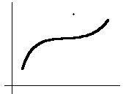
Outlier Removal
Data points inconsistent with the majority of data
Different outliers
  Valid: CEO’s salary,
  Noisy: One’s age = 200, widely deviated points
Removal methods
  Clustering
  Curve-fitting
  Hypothesis-testing with a given model

Slide 13
Data Integration
Data integration:
  combines data from multiple sources(data cubes, multiple db or flat files)
Issues during data integration
  Schema integration
    integrate metadata (about the data) from different sources
    Entity identification problem: identify real world entities from multiple data sources, e.g., A.cust-id ≡ B.cust-#(same entity?)
  Detecting and resolving data value conflicts
    for the same real world entity, attribute values from different sources are different, e.g., different scales, metric vs. British units
  Removing duplicates and redundant data
    An attribute can be derived from another table (annual revenue)
    Inconsistencies in attribute naming

Slide 14
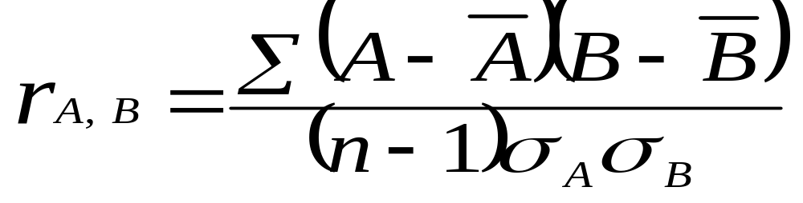
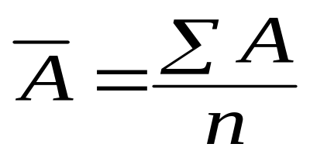
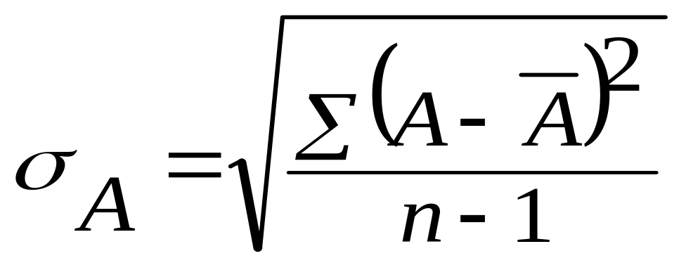
Correlation analysis
Can detect redundancies

Slide 15
Cont’d
> 0 , A and B positively correlated
  values of A increase as values of B increase
  The higher the value, the more each attribute implies the other
  High value indicate that A (or B) may be removed as a redundancy
= 0, A and B independent (no correlation)
< 0, A and B negatively correlated
  Values of one attribute increase as the values of the other attribute decrease (discourages each other)

Slide 16
Data Transformation
Smoothing: remove noise from data (binning, clustering, regression)
Normalization: scaled to fall within a small, specified range such as –1.0 to 1.0 or 0.0 to 1.0
Attribute/feature construction
  New attributes constructed / added from the given ones
Aggregation: summarization or aggregation operations apply to data
Generalization: concept hierarchy climbing
  Low level/ primitive/raw data are replace by higher level concepts

Slide 17
Data Transformation: Normalization
Useful for classification algorithms involving
  Neural networks
  Distance measurements (nearest neighbor)
Backpropagation algorithm (NN) – normalizing help in speed up the learning phase
Distance-based methods – normalization prevent attributes with initially large range (i.e. income) from outweighing attributes with initially smaller ranges (i.e. binary attribute)

Slide 18




Data Transformation: Normalization
min-max normalization
z-score normalization
normalization by decimal scaling
Where j is the smallest integer such that Max(| |)<1

Slide 19
Example:
Suppose that the minimum and maximum values for the attribute income are $12,000 and $98,000, respectively. We would like to map income to the range [0.0, 1.0].
Suppose that the mean and standard deviation of the values for the attribute income are $54,000 and $16,000, respectively.
Suppose that the recorded values of A range from –986 to 917.

Slide 20
Data Reduction Strategies
Data is too big to work with – may takes time, impractical or infeasible analysis
Data reduction techniques
  Obtain a reduced representation of the data set that is much smaller in volume but yet produce the same (or almost the same) analytical results
Data reduction strategies
  Data cube aggregation – apply aggregation operations (data cube)

Slide 21
Cont’d
  Dimensionality reduction—remove unimportant attributes
  Data compression – encoding mechanism used to reduce data size
  Numerosity reduction – data replaced or estimated by alternative, smaller data representation - parametric model (store model parameter instead of actual data), non-parametric (clustering sampling, histogram)
  Discretization and concept hierarchy generation – replaced by ranges or higher conceptual levels

Slide 22
Data Cube Aggregation
Store multidimensional aggregated information
Provide fast access to precomputed, summarized data – benefiting on-line analytical processing and data mining
Fig. 3.4 and 3.5

Slide 23
Dimensionality Reduction
Feature selection (i.e., attribute subset selection):
  Select a minimum set of attributes (features) that is sufficient for the data mining task.
  Best/worst attributes are determined using test of statistical significance – information gain (building decision tree for classification)
Heuristic methods (due to exponential # of choices – 2^{d}):
  step-wise forward selection
  step-wise backward elimination
  combining forward selection and backward elimination
  etc

Slide 24
Decision tree induction
Originally for classification
Internal node denotes a test on an attribute
Each branch corresponds to an outcome of the test
Leaf node denotes a class prediction
At each node – algorithm chooses the ‘best attribute to partition the data into individual classes
In attribute subset selection – it is constructed from given data

Slide 25
Data Compression
Compressed representation of the original data
Original data can be reconstructed from compressed data (without loss of info – lossless, approximate - lossy)
Two popular and effective of lossy method:
  Wavelet Transforms
  Principle Component Analysis (PCA)

Slide 26
Numerosity Reduction
Reduce the data volume by choosing alternative ‘smaller’ forms of data representation
Two type:
  Parametric – a model is used to estimate the data, only the data parameters is stored instead of actual data
    regression
    log-linear model
  Nonparametric –storing reduced representation of the data
    Histograms
    Clustering
    Sampling

Slide 27
Regression
Develop a model to predict the salary of college graduates with 10 years working experience
Potential sales of a new product given its price
Regression - used to approximate the given data
The data are modeled as a straight line.
A random variable Y (response variable), can be modeled as a linear function of another random variable, X (predictor variable), with the equation

Slide 28
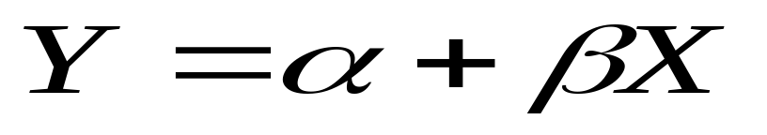
Cont’d
Y is assumed to be constant
α and β (regression coefficients) – Y-intercept and the slope line.
  Can be solved by the method of least squares. (minimizes the error between actual line separating data and the estimate of the line)

Slide 29
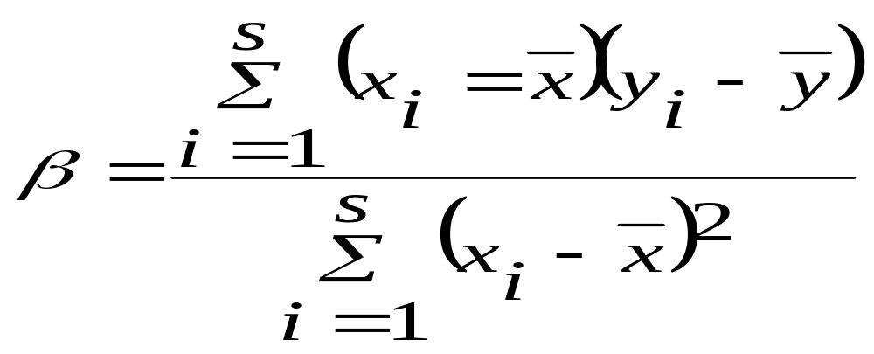
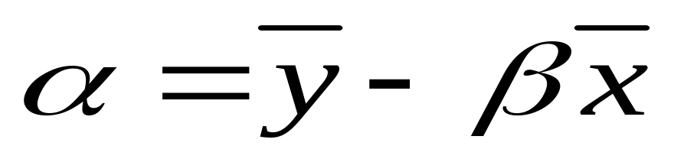
Cont’d

Slide 30
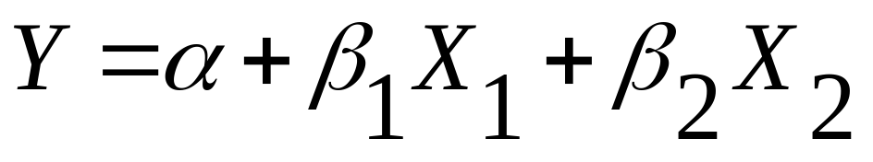
Multiple regression
Extension of linear regression
Involve more than one predictor variable
Response variable Y can be modeled as a linear function of a multidimensional feature vector.
Eg: multiple regression model based on 2 predictor variables X₁ and X₂

Slide 31
Histograms
A popular data reduction technique
Divide data into buckets and store average (sum) for each bucket
Use binning to approximate data distributions
Bucket – horizontal axis, height (area) of bucket – the average frequency of the values represented by the bucket
Bucket for single attribute-value/frequency pair – singleton buckets
Continuous ranges for the given attribute

Slide 32
Example
A list of prices of commonly sold items (rounded to the nearest dollar)
1,1,5,5,5,5,5,8,8,10,10,10,10,12, 14,14,14,15,15,15,15,15,15,18,18,18,18,18,18,18,18,18,20,20,20,20,20,20,20,21,21,21,21,25,25,25,25,25,28,28,30,30,30.
Refer Fig. 3.9

Slide 33
Cont’d
How are the bucket determined and the attribute values partitioned? (many rules)
Equiwidth, Fig. 3.10
Equidepth
V-Optimal – most accurate & practical
MaxDiff – most accurate & practical

Slide 34
Clustering
Partition data set into clusters, and one can store cluster representation only
Can be very effective if data is clustered but not if data is “smeared”/ spread
There are many choices of clustering definitions and clustering algorithms. We will discuss them later.

Slide 35
Sampling
Data reduction technique
  A large data set to be represented by much smaller random sample or subset.
4 types
  Simple random sampling without replacement (SRSWOR).
  Simple random sampling with replacement (SRSWR).
  Develop adaptive sampling methods such as cluster sample and stratified sample
  Refer Fig. 3.13 pg 131

Slide 36
Discretization and Concept Hierarchy
Discretization
  reduce the number of values for a given continuous attribute by dividing the range of the attribute into intervals. Interval labels can then be used to replace actual data values
Concept hierarchies
  reduce the data by collecting and replacing low level concepts (such as numeric values for the attribute age) by higher level concepts (such as young, middle-aged, or senior)

Slide 37
Discretization
Three types of attributes:
  Nominal — values from an unordered set
  Ordinal — values from an ordered set
  Continuous — real numbers
Discretization:
  divide the range of a continuous attribute into intervals because some data mining algorithms only accept categorical attributes.
Some techniques:
  Binning methods – equal-width, equal-frequency
  Histogram
  Entropy-based methods

Slide 38
Binning
Attribute values (for one attribute e.g., age):
  0, 4, 12, 16, 16, 18, 24, 26, 28
Equi-width binning – for bin width of e.g., 10:
  Bin 1: 0, 4 [-,10) bin
  Bin 2: 12, 16, 16, 18 [10,20) bin
  Bin 3: 24, 26, 28 [20,+) bin
  – denote negative infinity, + positive infinity
Equi-frequency binning – for bin density of e.g., 3:
  Bin 1: 0, 4, 12 [-, 14) bin
  Bin 2: 16, 16, 18 [14, 21) bin
  Bin 3: 24, 26, 28 [21,+] bin

Slide 39
Entropy-based discretization
Information-based measure – entropy
Recursively partition the values of a numeric attribute (hierarchical discretization)
Method: Given a set of tuples, S, basic method for entropy-based discretization of A (attribute) is as follows:

Slide 40
Cont’d
Each value of A can be considered a potential interval boundary or threshold T. For example, a value v of A can partition the samples in S into two subsets satisfying the condition A < v and A >= v – binary discretization
Given S, the threshold value selected if the one that maximizes the information gain resulting from subsequent partitioning.

Slide 41
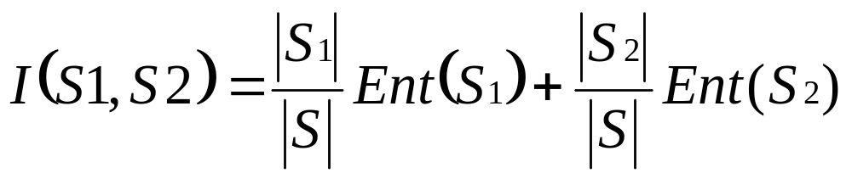
Information gain
S₁ and S₂ – the samples in S satisfying the condition A < T and A >=T

Slide 42
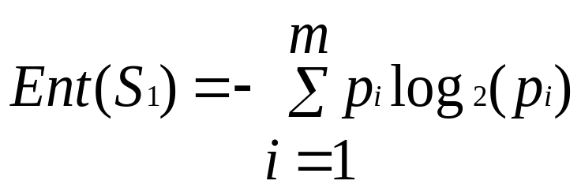
Entropy function
Ent for a given set is calculated based on the class distribution of the samples in the set. Eg, given m classes, the entropy of S₁ is
P_{i} – probability of class i in S₁, determined by dividing the number of samples of class i in S₁ by the total number of samples in S₁

Slide 43
Entropy-based (1)
Given attribute-value/class pairs:
  (0,P), (4,P), (12,P), (16,N), (16,N), (18,P), (24,N), (26,N), (28,N)
Entropy-based binning via binarization:
  Intuitively, find best split so that the bins are as pure as possible
  Formally characterized by maximal information gain.
Let S denote the above 9 pairs, p=4/9 be fraction of P pairs, and n=5/9 be fraction of N pairs.
Entropy(S) = - p log p - n log n.
  Smaller entropy – set is relatively pure; smallest is 0.
  Large entropy – set is mixed. Largest is 1.

Slide 44
Entropy-based (2)
Let v be a possible split. Then S is divided into two sets:
  S1: value <= v and S2: value > v
Information of the split:
  I(S1,S2) = (|S1|/|S|) Entropy(S1)+ (|S2|/|S|) Entropy(S2)
Goal: split with maximal information gain.
Possible splits: mid points b/w any two consecutive values.

Slide 45
Cont.
For v=14
I(S1,S2) = 0 + 6/9*Entropy(S2)
= 6/9 * 0.65
= 0.433
The best split is found after examining all possible splits.
Try for v 16, find I(S1,S2) ?
The process of determining a threshold value is recursively applied until the following stopping criteria
The above example no more splitting because S1&S@ contains purely class, i.e., all P and all N

Slide 46
Example 2: Table 1.3 Weather data

Slide 47
Summary
Data preparation is a big issue for data mining
Data preparation includes
  Data cleaning and data integration
  Data reduction and feature selection
  Discretization
Many methods have been proposed but still an active area of research

